Slide 1
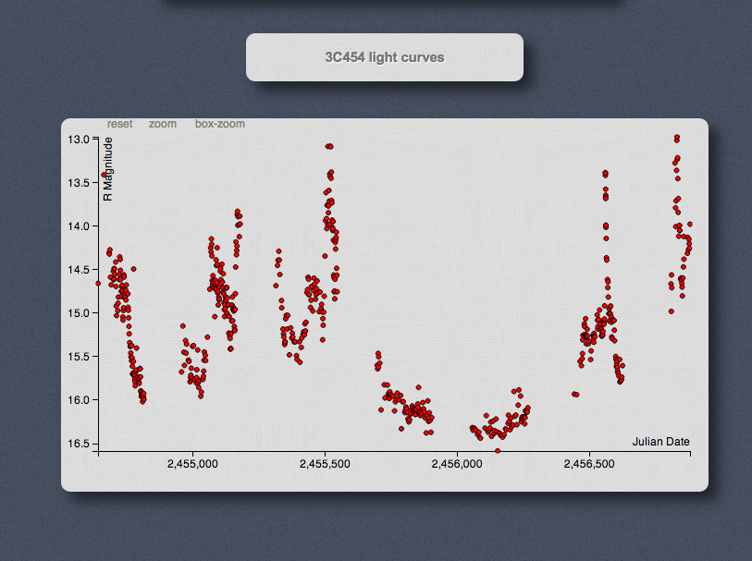
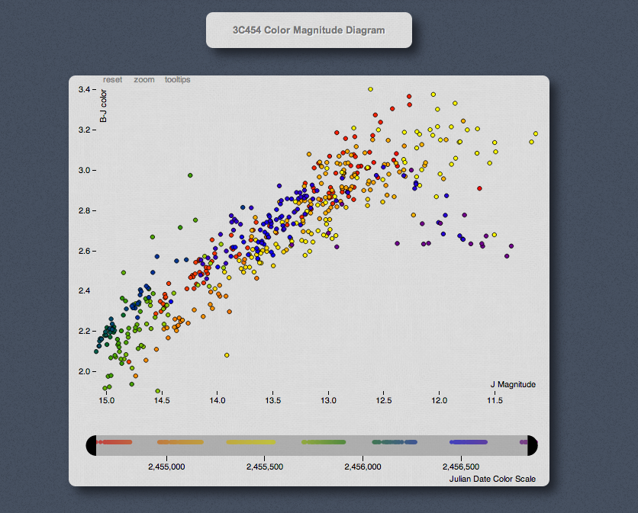
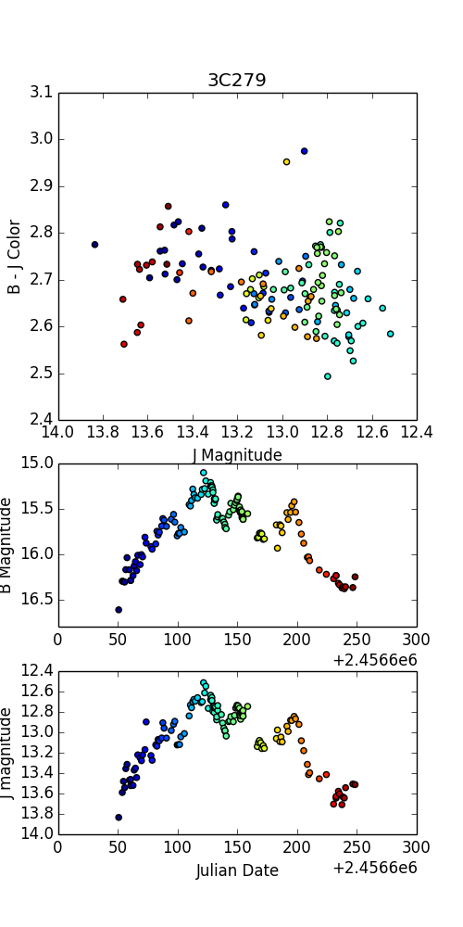
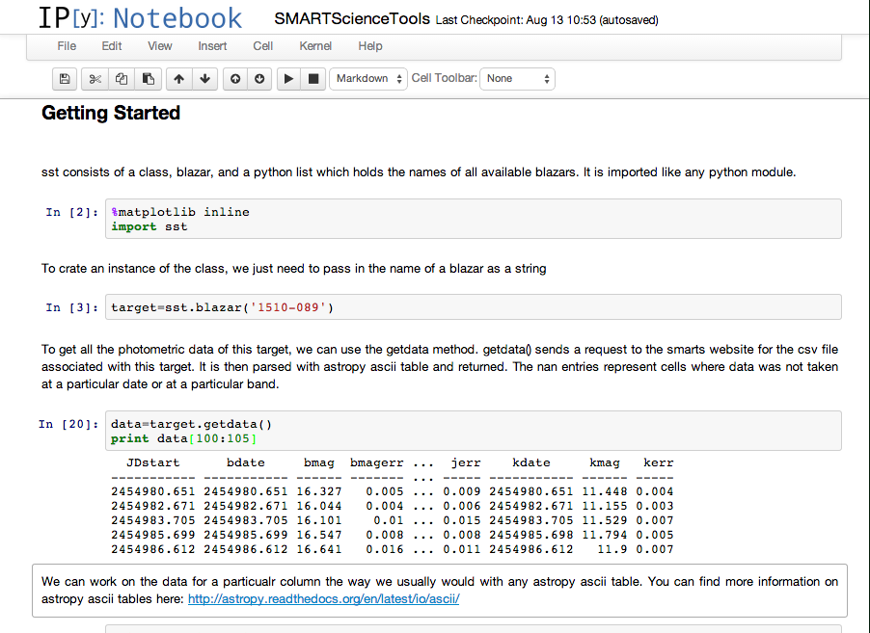
SMARTScience Tools: Interacting With Blazar Data Dynamically Imran Hasan, Charles Bailyn, Victoria Misenti, Jedidah Isler, Meg Urry, Paolo Coppi, Emily McPherson, Michelle Buxton Yale University
Motivation
On The Web
The Yale-SMARTS blazar group has used SMARTS telescopes and ANDICAM, located at CTIO, for over 6 years to gather optical-IR photometry of more than 70 Fermi-detected blazars. To enable public visualization and study of this data set, we developed SMARTScience Tools, which allows users to intuitively and easily dynamically interact with the data. SMARTScience Tools significantly improves the public’s ability to use the Yale-SMARTS data set, and can make multiwavelength studies of blazars more accessible, efficient, and community driven.
Science Objectives
Users are able to create customizable light curves and color magnitude diagrams. Specific bands can be selected to construct plots, which include features such as dynamic zooming, panning, and direct mouse interaction with individual points. Additionally, human- or machine-readable tables of the data can be printed directly for further independent study by the user. For further convenience, nearly all of these features can be used on mobile devices. Try it at bit.ly/SMARTScienceTools.
Yale-SMARTS data is showing a relation in the color-magnitude evolution over the course of optical-IR flares. Be sure to check out Jedidah Isler’s presentation for more. SMARTScience Tools will allow users to discover these kinds of relations in targets quickly and easily.
In Your Terminal
A small API written in Python allows users to get and work with the most up to date data. Using the API, users can query the Yale-SMARTS website directly for data, and parse it into an astropy ASCII table. The API also leverages matplotlib to create quick light curves and color magnitude diagrams. A tutorial in an ipython notebook is available here: bit.ly/SMARTScienceTutorial.
References
This work is made possible by software from d3.js, Github, matplotlib and astropy. The Yale-SMARTS Blazar program is funded by a grant from the Fermi Special Guest Investigator Program.

