Slide 1
STATUS UPDATE · JULY 2026
SRE Agent
Incident triage, root-cause analysis and reporting — in one conversation
ServiceNow + Azure DevOps + SharePoint + Docs
·
GitHub Copilot SDK
Notes:
Status update: the SRE Agent is demo-ready. One engine, two surfaces, built entirely inside our security constraints.

Slide 2
Incident Triage Today
One incident, four systems of record — and the engineer is the integration layer.
01
02
03
04
ServiceNow
Azure DevOps
SharePoint
Internal docs
Incidents, changes, SLA clocks
Work items and Git repositories
Incident documents and evidence
Runbooks, wikis, knowledge bases
Answering "what changed before INC0012345, and where did it break?" means tool-hopping — every time.
Notes:
Today an engineer investigating one incident hops across four systems and stitches the story together by hand. That is the time we are buying back.

Slide 3
One Conversational Interface
Engineers ask questions in plain language. The agent queries the systems, correlates the answer, and cites its sources.
you ›
what changed before INC0012345 and where in the code did it break?
Seconds instead of minutes of navigation — with every claim traceable to a record, commit or document.
2 change records in the window · CHG0044810 touched the same CI
Stack trace points to PaymentRouter.ts:214 — changed 3 days ago
→
Runs on each engineer's existing Copilot seat
→
Azure DevOps via az login / Entra — no PATs
Sources: ServiceNow CHG0044810 · commit 8f21c4e · runbook §4.2
→
No MCP servers — compliant by construction
Notes:
The agent sits on top of all four systems. Ask in plain language; it retrieves, correlates and answers with sources — in seconds.

Slide 4
Core Capabilities
Incident management
Work items
Search and summarise incidents, flag SLA-breach risk and stale tickets, correlate recent changes, daily operational summaries. Read-only.
Create bugs from incidents with priority mapping, clone and bulk-ingest work items. Every write gated by explicit human confirmation.
Knowledge & documents
Guided workflows
Semantic search over runbooks and wikis with cited sources; SharePoint incident documents readable in-line. Embeddings stay local.
/triage · /review · /postmortem · /handover — standard operating procedure as one command, consistent output every time.
24 model-callable tools — 21 read-only, 3 writes behind a human y/N gate.
Notes:
Four capability areas. Reads are free-form; the three write operations always require explicit human confirmation.

Slide 5
Code Analyser
FLAGSHIP
An isolated sub-agent that turns a stack trace into a suspect file:line — with evidence.
1
Detects code-shaped signals in the incident and offers analysis — never runs without consent
STRUCTURED REPORT
2
Checks out the repo at the deployed branch or tag — read-only, in-org HTTPS only
Suspects
file:line with rationale
Hypothesis
most likely failure mechanism
3
Chases every file, symbol and line from the error output; recent commits to suspect files are prime suspects
Evidence
code and commit facts
Fix area
where to start the change
4
Reports back — every claim grounded in actual repository content, with a stated confidence level
Confidence
with remaining uncertainty
Isolated by design: 5-tool allowlist, no write access, only the final report reaches the conversation.
Notes:
The flagship. A second, isolated AI session checks out the repo read-only, chases every lead from the stack trace, and returns a structured evidence-backed report. It never runs without consent.

Slide 6
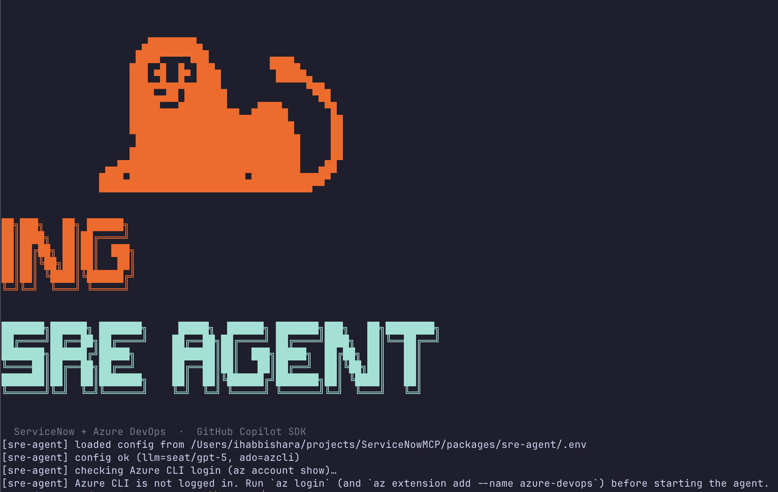
Two Delivery Surfaces, One Engine
Command-line chat
Terminal REPL; npm start scaffolds config and logs in; built-in doctor command diagnoses environment issues.
Web UI
Zero-install onboarding with browser device-flow login. Streaming chat, in-browser write confirmation, full settings editor.
Localhost-only, credentials never leave the machine — and no terminal skills required.
CLI — first-run self-service on Mac and Windows
Notes:
Same engine, two front doors. The CLI for terminal-native engineers; the Web UI removes the install barrier entirely — browser login, settings editor, localhost-only.

Slide 7
Security & Compliance Posture
No banned mechanisms
Least privilege
Data locality
No MCP servers, no PATs. Copilot seats and Entra (az login) sessions only.
21 of 24 tools read-only; writes behind human confirmation; sub-agent on a 5-tool allowlist.
Knowledge index and embeddings computed and stored on the engineer's machine.
Hardened repo access
Contained surface
Flexible LLM backend
In-org HTTPS only, read-only git, credential redaction — prompt-injected clone targets blocked.
Web UI binds to 127.0.0.1 only; domain-scoped crawler; secrets with restrictive permissions.
Corporate Copilot seat by default; BYO Azure OpenAI / Anthropic key or fully local models.
Notes:
Built inside the constraints from day one, not retrofitted. No banned mechanisms anywhere in the stack.

Slide 8
Engineering Maturity & Value
~657
100%
1
automated tests, CI-gated
of features peer-reviewed via PR
shared core — CLI and Web UI cannot drift
→
Triage in minutes instead of tool-hopping; root cause from stack trace to file:line
→
Consistent triage, review, postmortem and handover outputs across the team
→
Reuses existing Copilot seats — no new inference contract required
Notes:
Not a prototype: peer-reviewed monorepo, 657 CI-gated tests, shared core so the two surfaces cannot drift. Recap the value and close on cost — zero new inference contracts.

