Slide 1
Enterprise Integration Patterns
Solving integration problems using patterns Presented By : Ihab Ibrahim

Slide 2
Introduction
“There is no simple answer for enterprise integration.”
“If you can develop a single, stand-alone application that doesn’t need to collaborate with any other applications, you can avoid the whole integration issue entirely”
Gregor Hohpe .Enterprise Integration Patterns, 2004

Slide 3
Agenda
Integration Challenges
Application Integration Options
Integration types
Message-Oriented Middleware
Asynchronous Messaging
EIP:
Message
Message Translator
Channel
Endpoint
Filters
Router
Splitter / aggregator or Scatter-Gather
Wire tap
Control Bus - testing and Monitoring (Bonus)
Smart Proxy

Slide 4
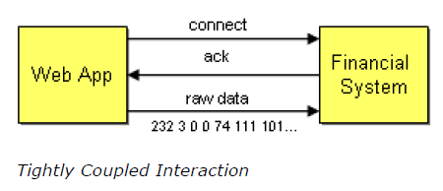
Integration Challenges
■Networks are unreliable
■Networks are slow
■Any two applications are different
■Changes to legacy systems are not possible in most cases
■Only a few standards for integration exist (XML, XSL, Web Services)
Notes:
Availability / timing / encoding / operating systems /

Slide 5
Application Integration Options
File transfer
Shared Database
Remote procedure invocation
Messaging
Notes:
There is no one integration approach that addresses all criteria equally well. Therefore, multiple approaches for integrating applications have evolved over time. The various approaches can be summed up in four main integration styles.

Slide 6
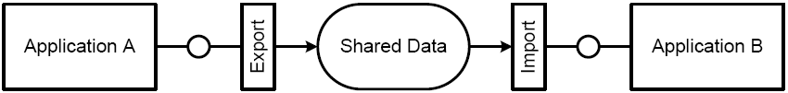
Application Integration Options
■ File transfer:
One application writes a file that another later reads. The applications need to agree on the filename and location, the format of the file, the timing of when it will be written and read, and who will delete the file.

Slide 7
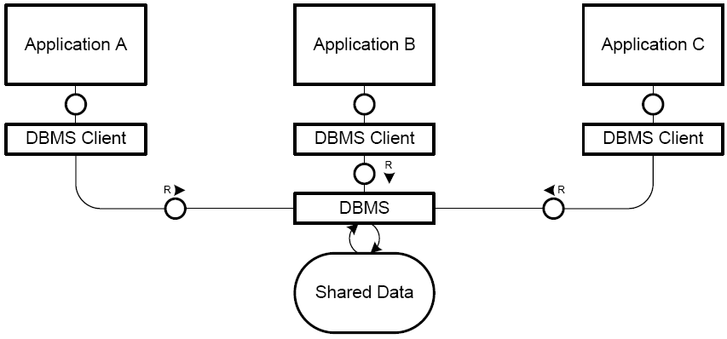
Application Integration Options
■ Shared database:
Multiple applications share the same database schema, located in a single physical database. Because there is no duplicate data storage, no data has to be transferred from one application to the other.

Slide 8
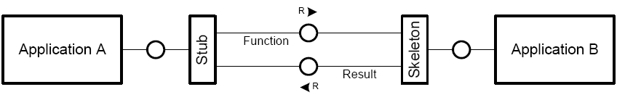
Application Integration Options
■ Remote procedure invocation:
One application exposes some of its functionality so that it can be accessed remotely by other applications as a remote procedure. The communication occurs real-time and synchronously.

Slide 9
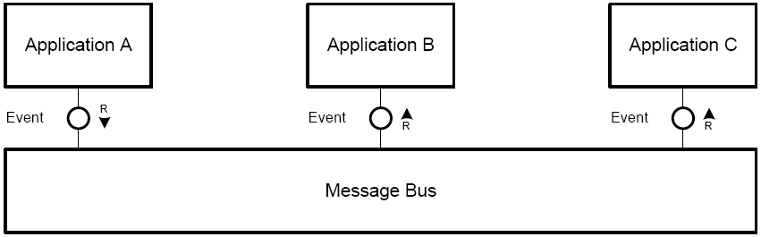
Application Integration Options
■ Messaging:
One applications publishes a message to a common message channel. Other applications can read the message from the channel at a later time. The applications must agree on a channel as well as the format of the message. The communication is asynchronous.

Slide 10
Integration types
Information portals
Data Replication
Shared Business Function
Business-to-Business
Service-Oriented Architecture
Distributed Business Process

Slide 11
Agenda
Integration Challenges
Application Integration Options
Integration types
Message-Oriented Middleware
Asynchronous Messaging
EIP:
Message
Message Translator
Channel
Endpoint
Filters
Router
Splitter / aggregator or Scatter-Gather
Wire tap
Control Bus - testing and Monitoring (Bonus)
Smart Proxy

Slide 12
Message-Oriented Middleware
Message-oriented architectures provide loose coupling and reliability
Data is exchanged in self- contained messages
Message-oriented middleware (MOM)
IBM WebSphere MQ
Microsoft MSMQ
Java Message Service (JMS) Implementations
Apache activemq
Jboss hornetq

Slide 13
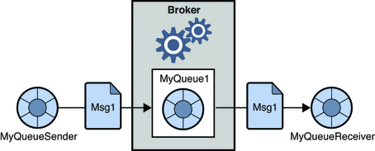
Message-Oriented Middleware Domain
Point-To-Point Messaging
Notes:
Acknowledge mode
Transaction
Poison messages

Slide 14
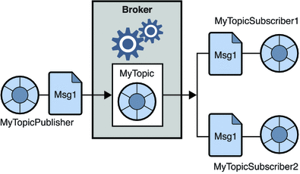
Message-Oriented Middleware Domain
Publish/Subscribe Messaging

Slide 15
Agenda
Integration Challenges
Application Integration Options
Integration types
Message-Oriented Middleware
Asynchronous Messaging
EIP:
Message
Message Translator
Channel
Endpoint
Filters
Router
Splitter / aggregator or Scatter-Gather
Wire tap
Control Bus - testing and Monitoring (Bonus)
Smart Proxy

Slide 16
Asynchronous Messaging
Complex programming model.
Sequence issues.
Synchronous scenarios.
Performance.
Limited platform support.
Vendor lock-in. (Messaging Bridge pattern.)
Notes:
Complex programming model. Asynchronous messaging requires developers to work with an event-driven programming model. Application logic can no longer be coded in a single method that invokes other methods, but the logic is not split up into a number of event handlers that respond to incoming messages. Such a system is more complex and harder to develop and debug.
Sequence issues. Message channels guarantee message delivery, but they do not guarantee when the message will be delivered. This can cause messages that are sent in sequence to get out of sequence. In situations where messages depend on each other special care has to be taken to re-establish the message sequence.
Synchronous scenarios. Not all applications can operate in a send and forget mode.
Performance. Messaging systems do add some overhead to communication. It takes effort to make data into a message and send it, and to receive a message and process it.
Limited platform support. Many proprietary messaging systems are not available on all platforms. Often times it is easier to FTP a file to another platform than accessing it via a messaging system.
Vendor lock-in. Many messaging system implementations rely on proprietary protocols. Even common messaging specifications such as JMS do not control the physical implementation of the solution. As a result, different messaging systems usually do not connect to one another. This can leave you with a whole new integration challenge: integrating multiple integration solutions! (Messaging Bridge pattern.)

Slide 17
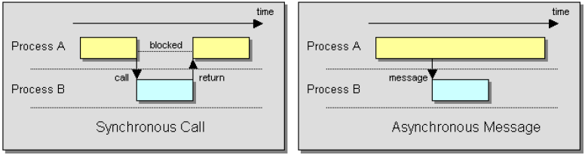
Thinking Asynchronous

Slide 18
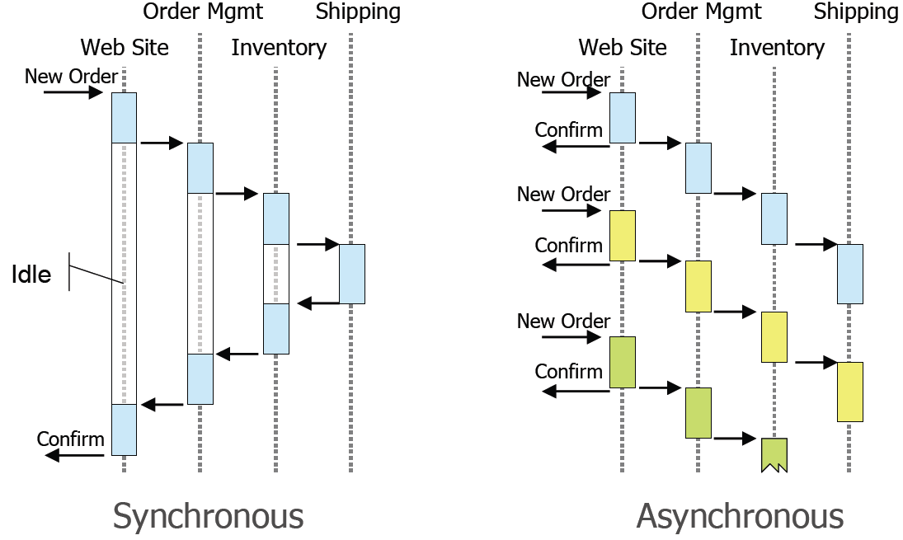
Thinking Asynchronous

Slide 19
Requirements : Receive order
Order management :
ABC Company are expanding and willing to receive orders from email, call center (legacy application closed source from unknown vendor ), modern web application, socket, web service, sFTP.
All the received orders should converted to the internal order xsd format which require some additional information (message enrichment )
All the received orders should be validated in accounting and inventory.
Validated in both accounting & inventory and grouped to valid orders and invalid orders.
All invalid orders logged to file and sent by email to stockholders at end of day
Move valid orders to billing and shipping.

Slide 20
Agenda
Integration Challenges
Application Integration Options
Integration types
Message-Oriented Middleware
Asynchronous Messaging
EIP:
Message
Message Translator
Channel
Endpoint
Filters
Router
Splitter / aggregator or Scatter-Gather
Wire tap
Control Bus - testing and Monitoring (Bonus)
Smart Proxy

Slide 21
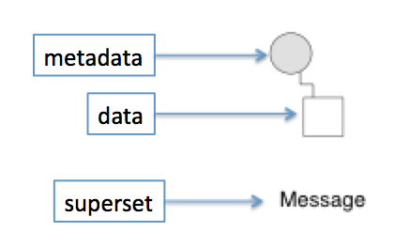
Message
A message is a discrete piece of data sent from one application to another
Messages typically contain headers (metadata) and a body (application payload)
Message Types:
Command Message
Document Message
Event Message
Request - Reply Message
Message Sequence
Message Expiration
Notes:
Message Types:
============
Command Message: to invoke procedure in another application
Document Message: to pass set of data to another application
Event Message: to notify another application with change in this application.
Request - Reply Message: the other application should send reply back.
Message Sequence: if data is large send more than message.
Message Expiration: The Message is only useful through amount of time

Slide 22
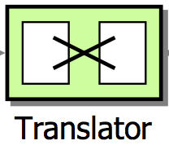
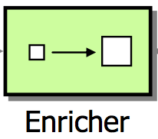
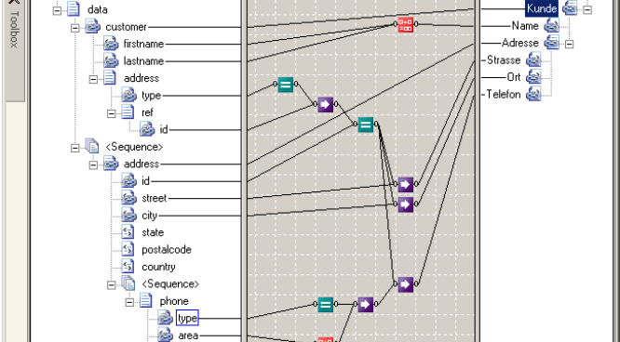
Message Translator
Apply XSL technology to convert from schema to another schema.

Slide 23
Channel
Channels are one-way
Which means communications are asynchronous
To model request/response use two channels

Slide 24
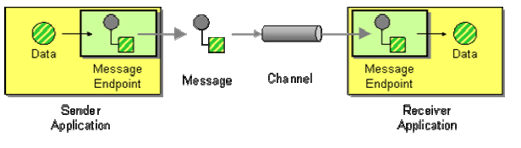
Endpoint
The piece of code that can send message to channel and receive message from channel.

Slide 25
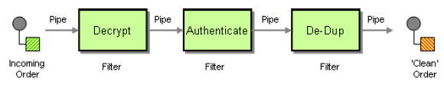
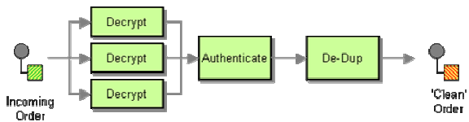
Filters
Divide a larger procession task into a sequence of smaller independent processing steps(Filters connected by pipes (channels))
Improve testability each component tested in separate / improve reusability.
Sequential : if the decryption step is slow the overall becomes very slow.
Parallel : multiple decryption steps work in parallel
Notes:
Filters connected with pipes ( channels between filters)
Divide a larger procession task into a sequence of smaller independent processing steps(Filters connected by pipes (channels))
Port : is the connection between filter & pipe.
Improve testability each component tested in separate / improve reusability.
Limitation: using many channels which required memory / CPU.

Slide 26
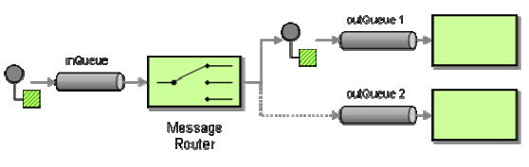
Router
Special types of filters which consumes messages and republish it again, to a different message channel, it differ from filters in a connection to many output channels.
If new routing rules between components added only routers change.
Similar to switch case in code
Router Types
Content based router
Context Based
Dynamic Router
Stateless Router
State full Router
Fixed Router
Notes:
Special types of filters which consumes messages and republish it again, to a different message channel, it differ from filters in a connection to many output channels.
If new routing rules between components added only routers change.
Dis-advantage,
-> may increase time if any processing needed on the message.
Huge systems with many components are hard to be traced /tested
Content based router : routing due to message content.
Context Based Router : routing due to environment variables.
Dynamic Router: configure itself due to control messages.
Stateless Router : take into account the existing message only when routing.
State full Router : consider the old message while routing like de duplicate
Fixed Router : fixed input and one output

Slide 27
Splitter / aggregator or Scatter-Gather
Send a message to a dynamic set of recipients, and return a single message that incorporates the responses

Slide 28
Wire tap
A wire tap is a simple Recipient List with two recipients. One channel is the tap that can be switched on or off (via Control Bus) when messages need to be inspected in a point to point channel.

Slide 29
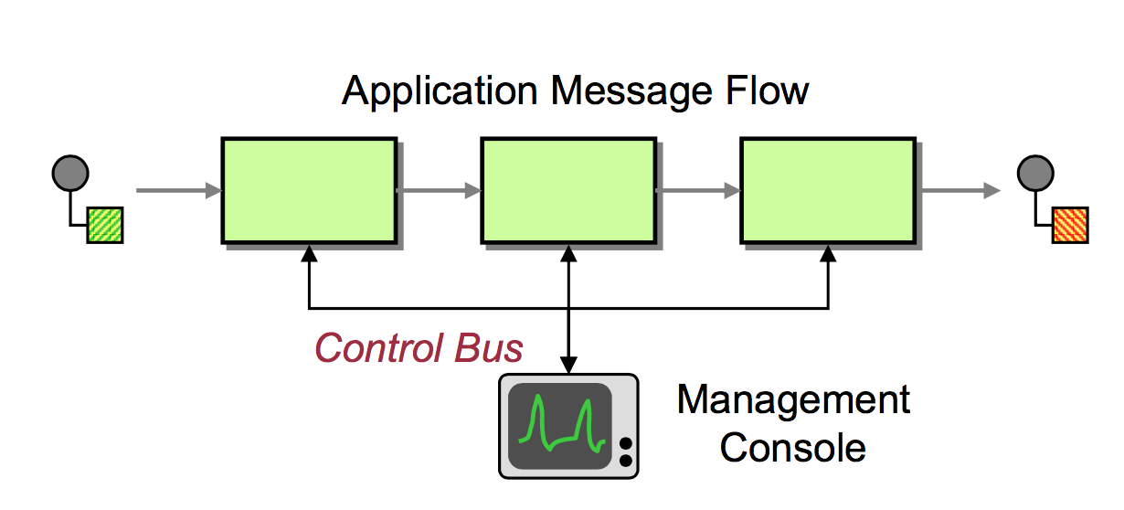
Control Bus - testing and Monitoring (Bonus)
Configuration
Heartbeat
Test messages
Exceptions / logging
Statistics / Quality-of-Service (QoS)
Live console

Slide 30
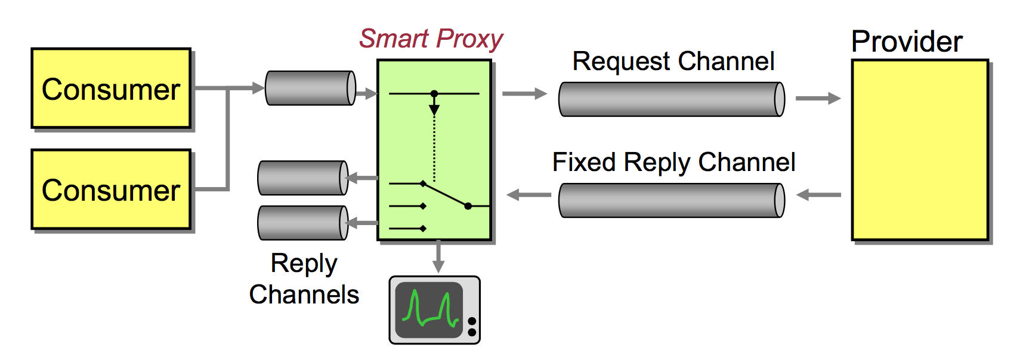
Smart Proxy
Intercepts reply messages and forwards them to correct channel
Allows analysis of request and reply messages

Slide 31
Requirements : Receive order
Order management :
ABC Company are expanding and willing to receive orders from email, call center (legacy application closed source from unknown vendor ), modern web application, socket, web service, sFTP.
All the received orders should converted to the internal order xsd format which require some additional information (message enrichment )
All the received orders should be validated in accounting and inventory.
Validated in both accounting & inventory and grouped to valid orders and invalid orders.
All invalid orders logged to file and sent by email to stockholders at end of day
Move valid orders to billing and shipping.

Slide 32
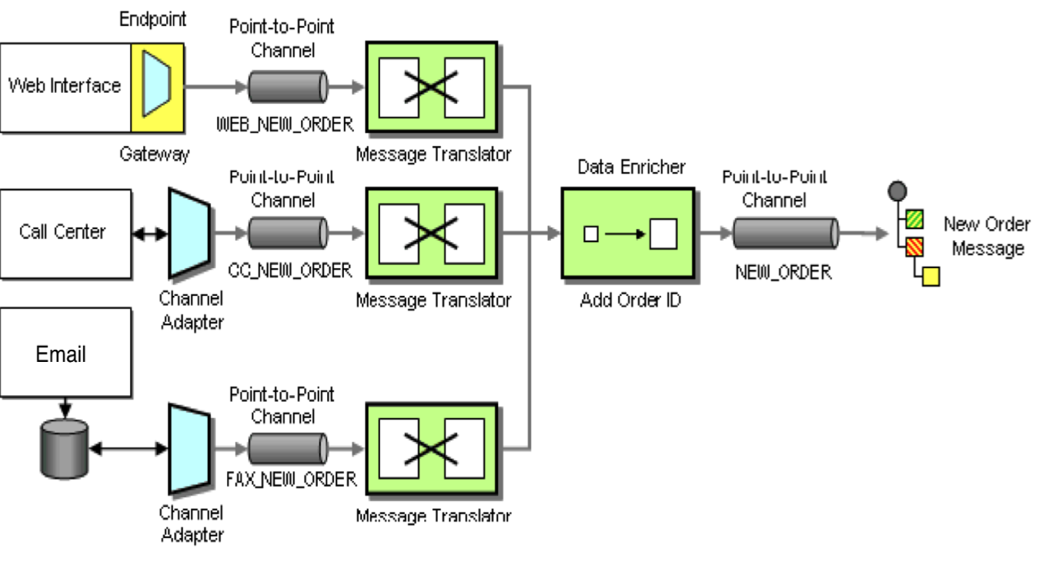
Receive orders

Slide 33
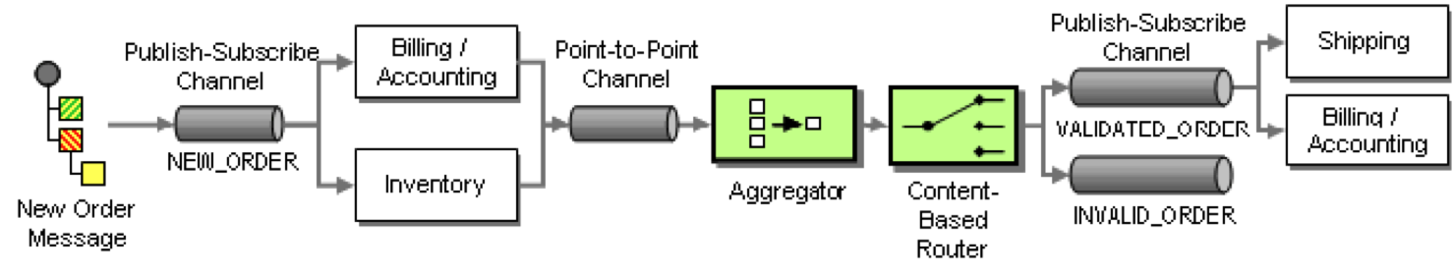
Process Orders

Slide 34
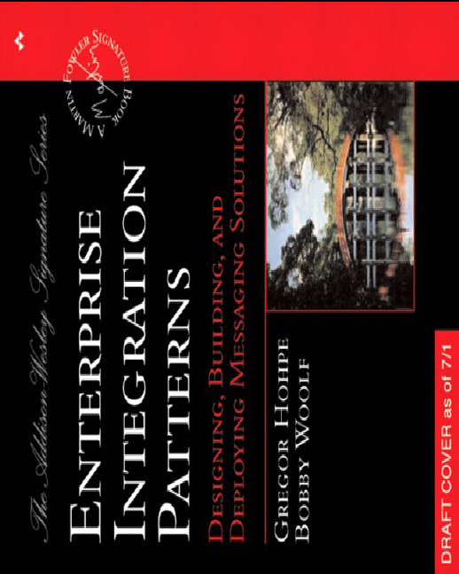
REF
https://docs.oracle.com/cd/E19316-01/820-6424/aerbg/index.html
http://www.enterpriseintegrationpatterns.com/index.html

Slide 35
Demo
Receive orders from file in folder
Receive orders from http inbound endpoint
Using spring integration – spring boot – maven -STS

Slide 36
Question & Thanks

