Slide 1
Openbravo POS Installation & User Guide
Ihab.yousif@gmail.com

Slide 2
Index
Installation prerequisite
Java sdk installation
Mysql db installation
Install pos
Configure the POS with mysql db
Add categories, sub-category and products
Add Categories and sub-category.
Add products to category.
Configure the POS to work in Restaurant mode.
Configure the POS to work in a food takeaway mode (Fast Food Mode)
How to work
Tables Booking
ticket operations(order)
Reports overview

Slide 3
Install JDK 1.6
Download jdk
Install the jdk on your windows operating system using the defalt instalation selects
2. Put the JAVA_HOME in the system variables
Right click on computer choose properties then the “advanced system settings“ choose the “advanced” tab then choose“environment variables” button, add new system variable,

Slide 4
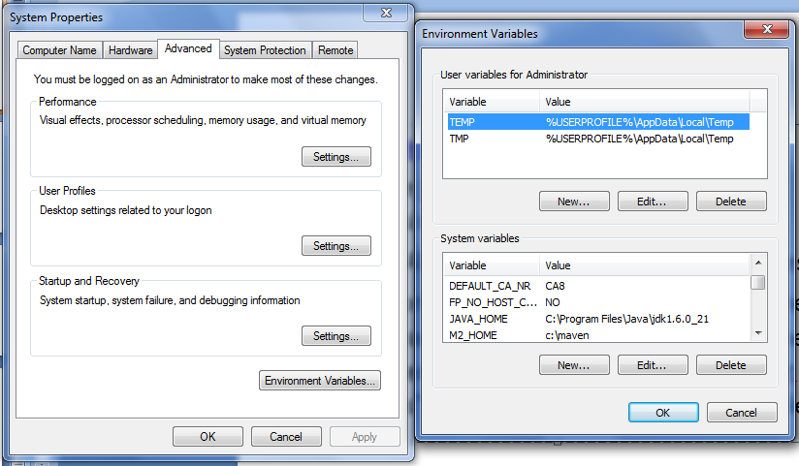
Install JDK 1.6

Slide 5
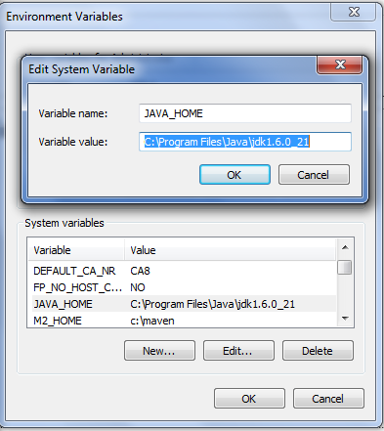
Install JDK 1.6
Choose add system variable and add “JAVA_HOME” with the physical location for the JDK as the image indicate

Slide 6
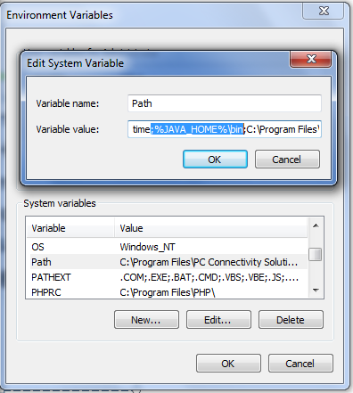
Install JDK 1.6
Also append the text “;%JAVA_HOME%\bin” to the end of the path environment variable as indicated in the image

Slide 7
Install Mysql DB
Download MySQL Community Server 5.1 »
Optional you can install MySQL Administrator and MySQL Query Browser MySQL GUI Tools Downloads.
After downloading the MySQL Community Server 5.1, extract and start the install and follow the default installation steps.

Slide 8
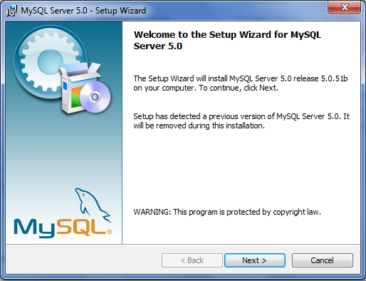
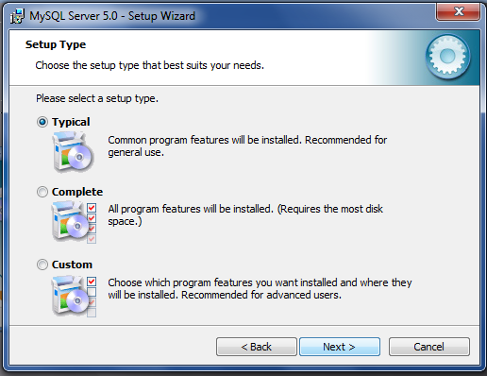
Install Mysql DB

Slide 9
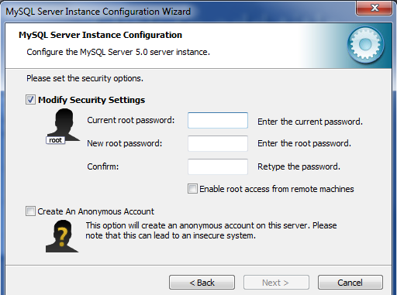
Install Mysql DB
Continue with the default options in the installation and enter the user name & password for the root(admin user)

Slide 10
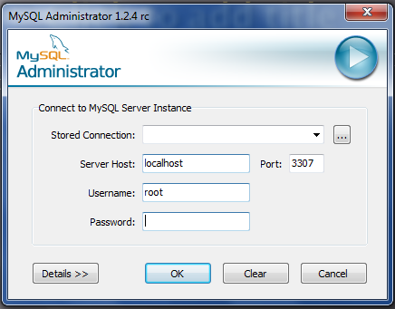
Install Mysql DB
After installing the mysql db server & mysql tools, open mysql adminstrator and login to your local instance using the root user.

Slide 11
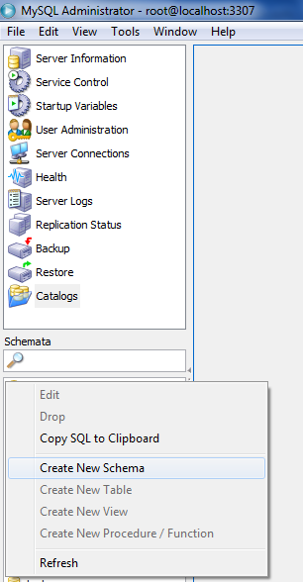
Install Mysql DB
Right click on the second left panel and create new schema named pos, to be used from the openbravo pos.

Slide 12
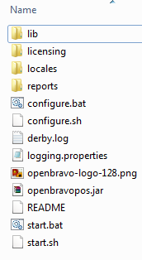
Install Openbravo
Download openbravo “openbravopos_2.30.2_bin.zip”
from the direct link
Direct Download
Or use the general link
General Download
And choose
openbravopos_2.30.2_bin.zip
From the displayedlist
Extract the compressed folder you will see the files as in the image

Slide 13
Configure the POS with mysql db
Download MySQL Connector/J, unzip the contents and place the “mysql-connector-java-5.1.17-bin.jar” it in the lib folder where Openbravo POS resides.

Slide 14
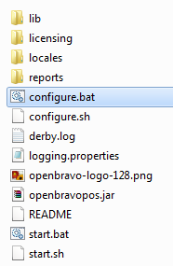
Configure the POS with mysql db
Open the “configure.bat”
Window and define the mysql connection information as following
- driver library : select the “mysql-connector-java-5.1.17-bin.jar” that you placed it inside the lib folder inside openbravo location before.

Slide 15
Configure the POS with mysql db
- Driver class : com.mysql.jdbc.Driver
URL : jdbc:mysql://localhost:3306/pos
URL general formate = jdbc:mysql://[db server host]:[mysql db port]/[db name]
- User = root (the pos db user name)
- Password = root (the pos db user password)
The next image indicate the db connecton properties

Slide 16
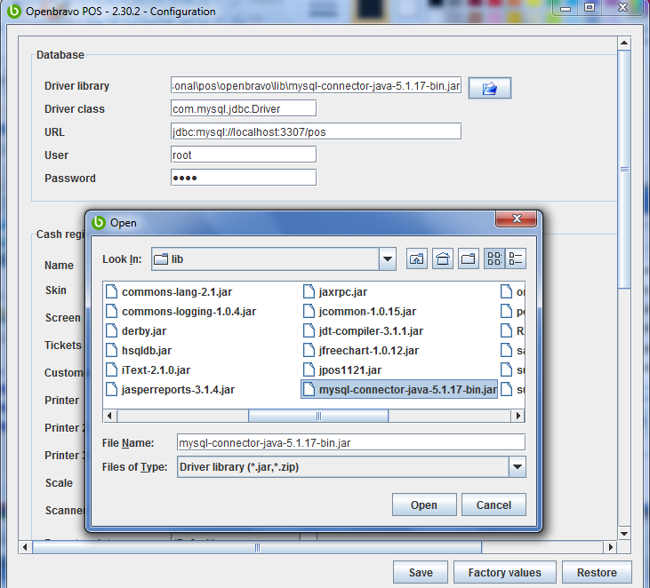

Slide 17
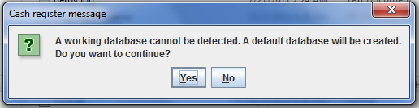
Configure the POS with mysql db
When start the openbravo from “start.bat” the screen in the below image appear, choose yes to install default db tables and default configurations values.

Slide 18
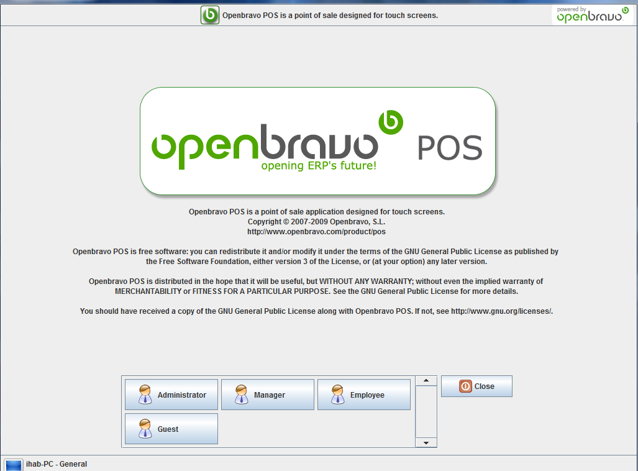
Configure the POS with mysql db
The main screen for the openbravo the buttons at the end of screen indicate the default users, you can change the default users password or delete as per your need.

Slide 19
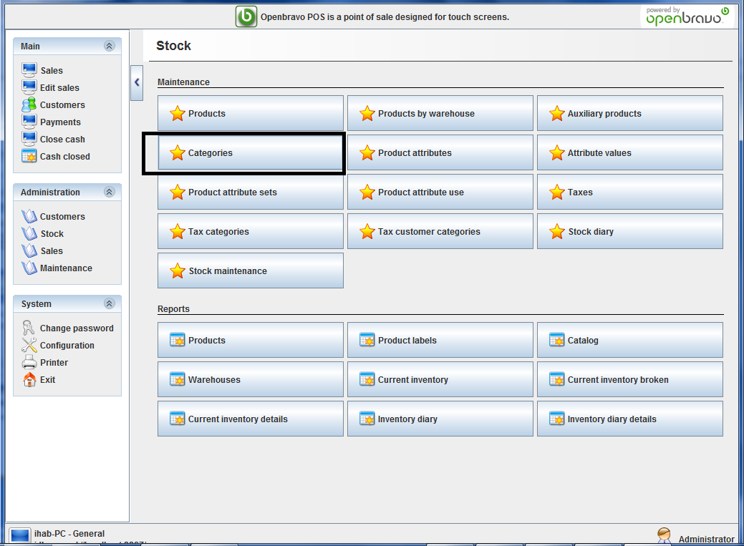
Add Categories and sub-category
Login as admin(click on the admin button)
Click on the “stock” then choose “Categories”

Slide 20



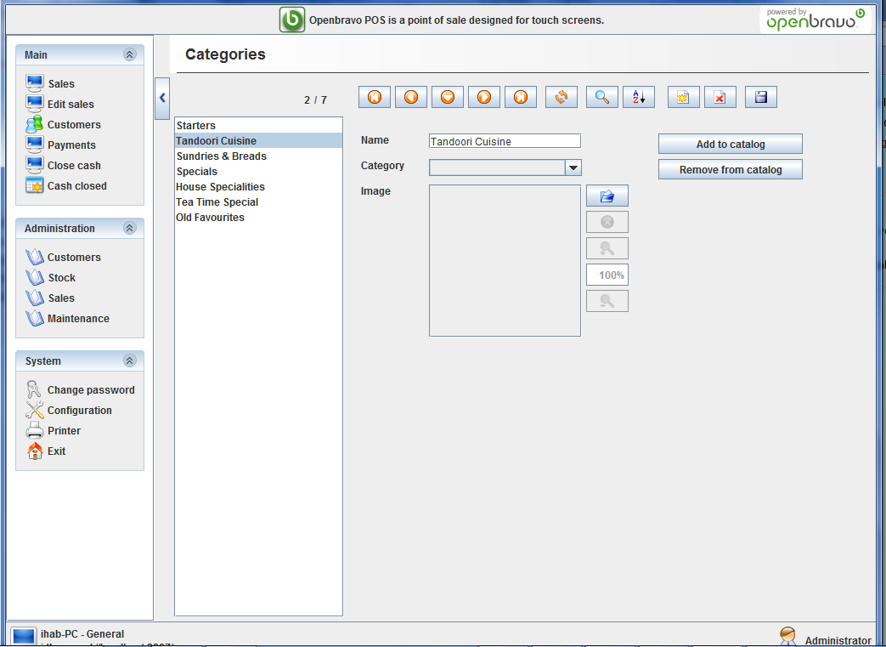
Add Categories and sub-category
You can add new (click on the new button first ) or select existing from the left menu to edit, then click on the save button , or remove category

Slide 21
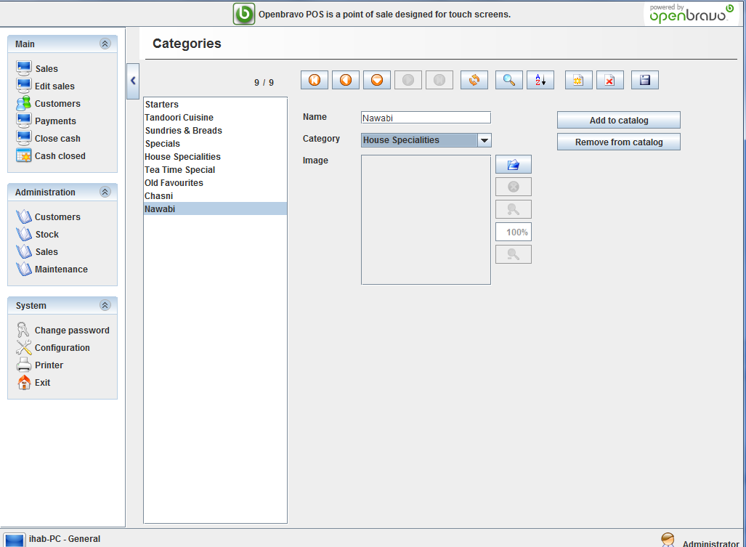
Add Categories and sub-category
To add sub category you must select the parent category as indicated in the below image

Slide 22
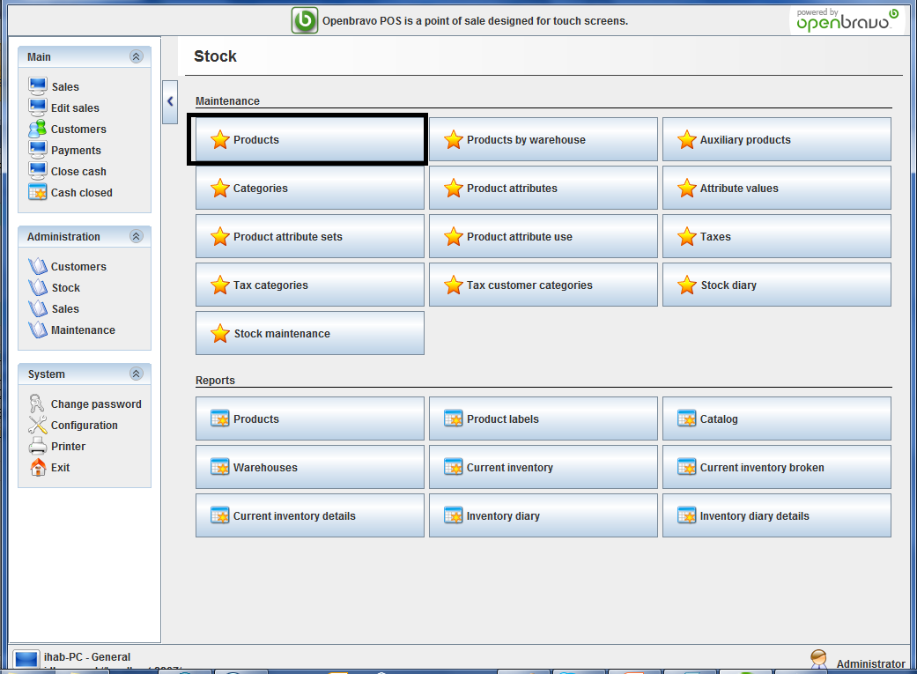
Add products to category
From the main window select stock then products.

Slide 23
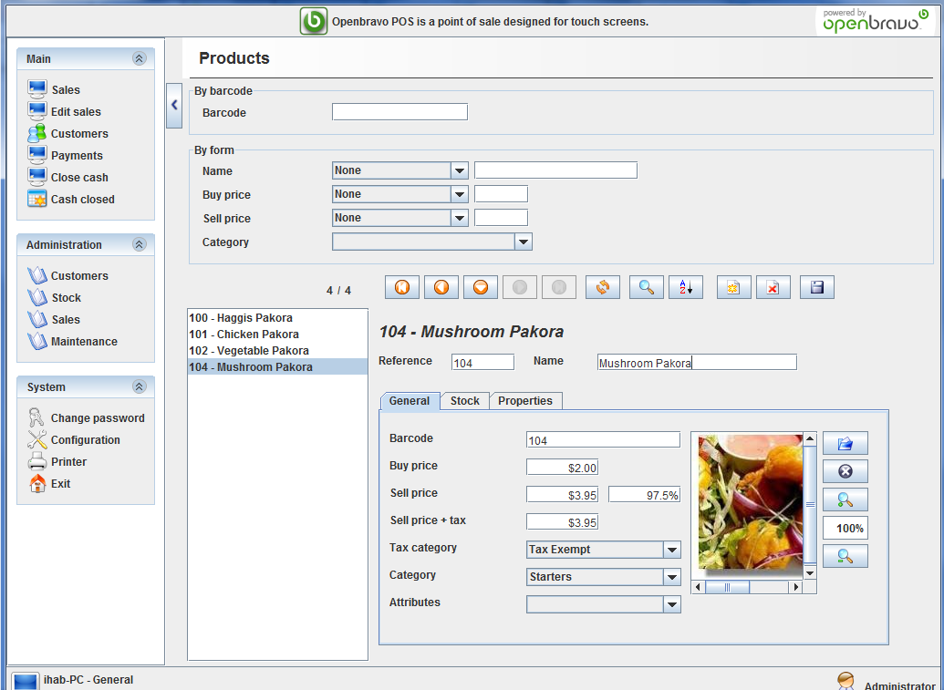
Add products to category
Complete all the mandatory fields name & buy – sell prices & image & category or sub-category & tax category.

Slide 24
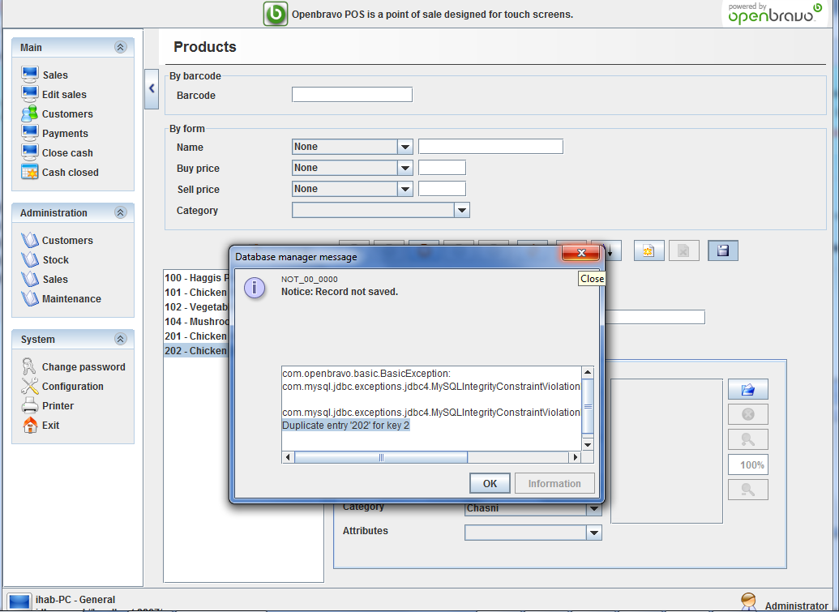
Add products to category
You will get the below error if you attempt to add duplicate ref , ref and barcode must be unique across all the products in all categories

Slide 25
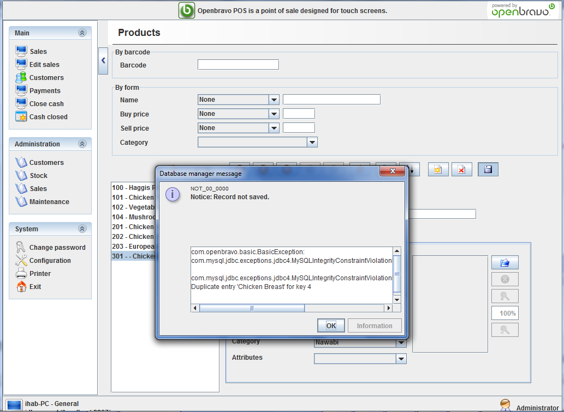
Add products to category
You will get the below error if you attempt to add duplicate product name , product name must be unique across all the products in all categories

Slide 26
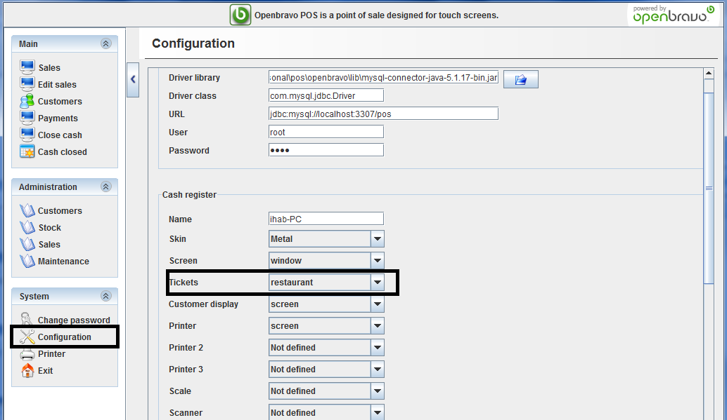
Configure the POS to work in Restaurant mode
To configure the POS to work in restaurant mode, choose configuration then change the tickets to restaurant as in the below image

Slide 27
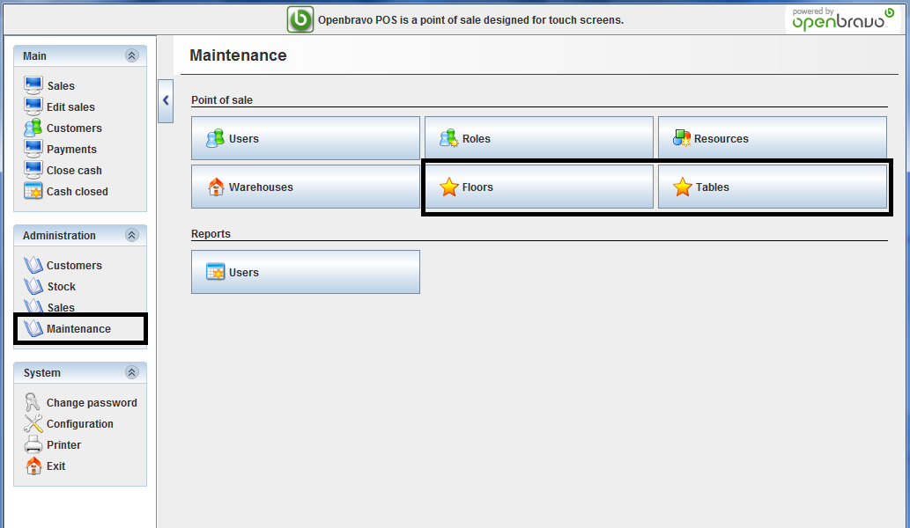
Configure the POS to work in Restaurant mode
Configure the number of restaurant flours and tables

Slide 28
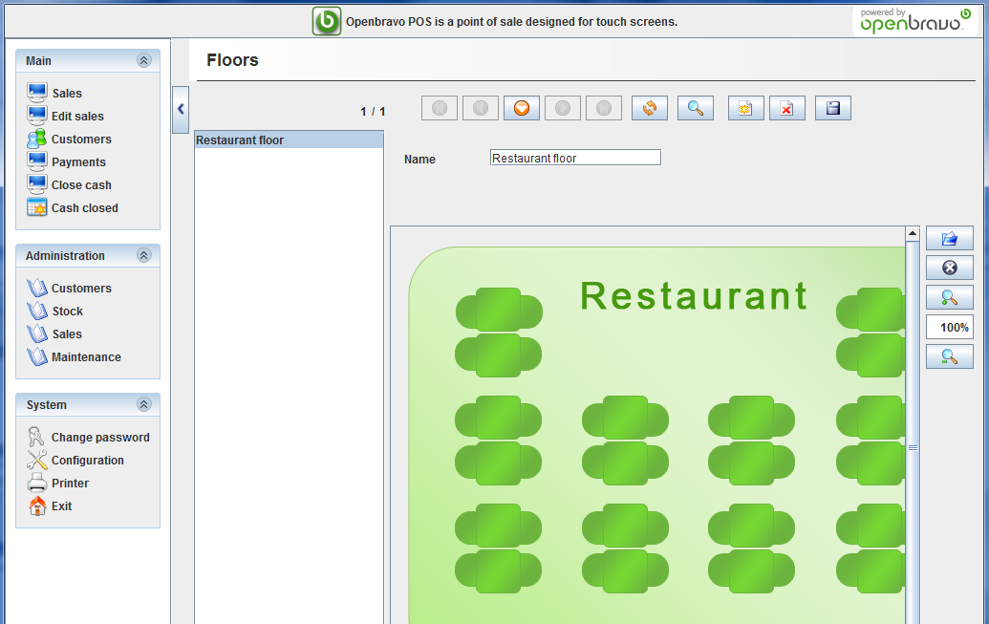
Configure the POS to work in Restaurant mode
Adding restaurant floor, from maintenance => floors, you can add all your restaurant floors, with an image indicate the tables locations for each floor.

Slide 29
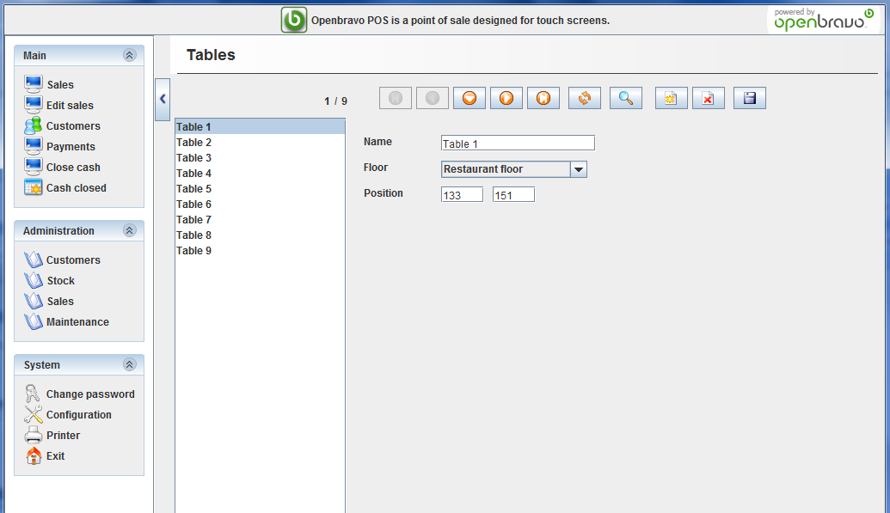
Configure the POS to work in Restaurant mode
Add the tables for each floor with the position attributes for the table on the floor image in pixel vertical and horizontal.

Slide 30
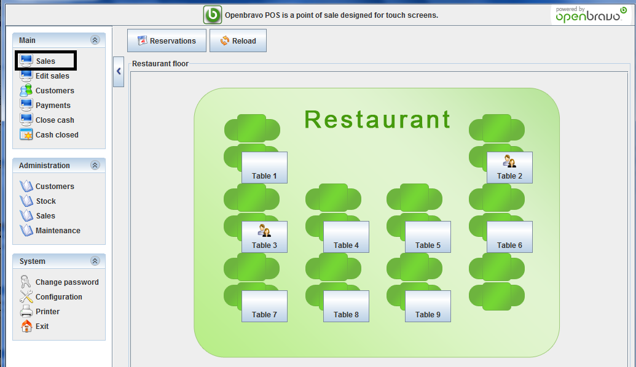
Configure the POS to work in Restaurant mode
When you open the sales page the preconfigured restaurant tables are displayed

Slide 31
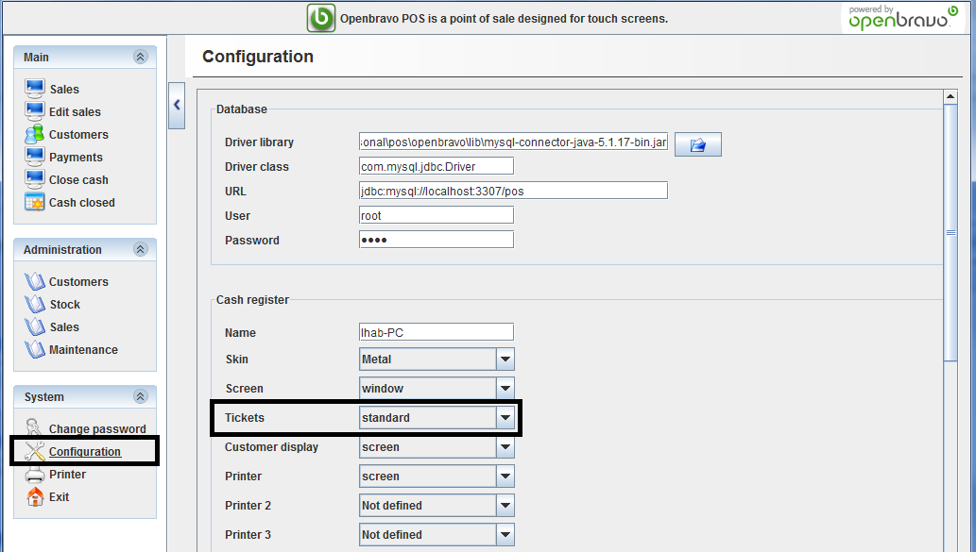
Configure the POS to work in a food takeaway mode
To configure the POS to work in restaurant mode, choose configuration then change the tickets to restaurant as in the below image

Slide 32
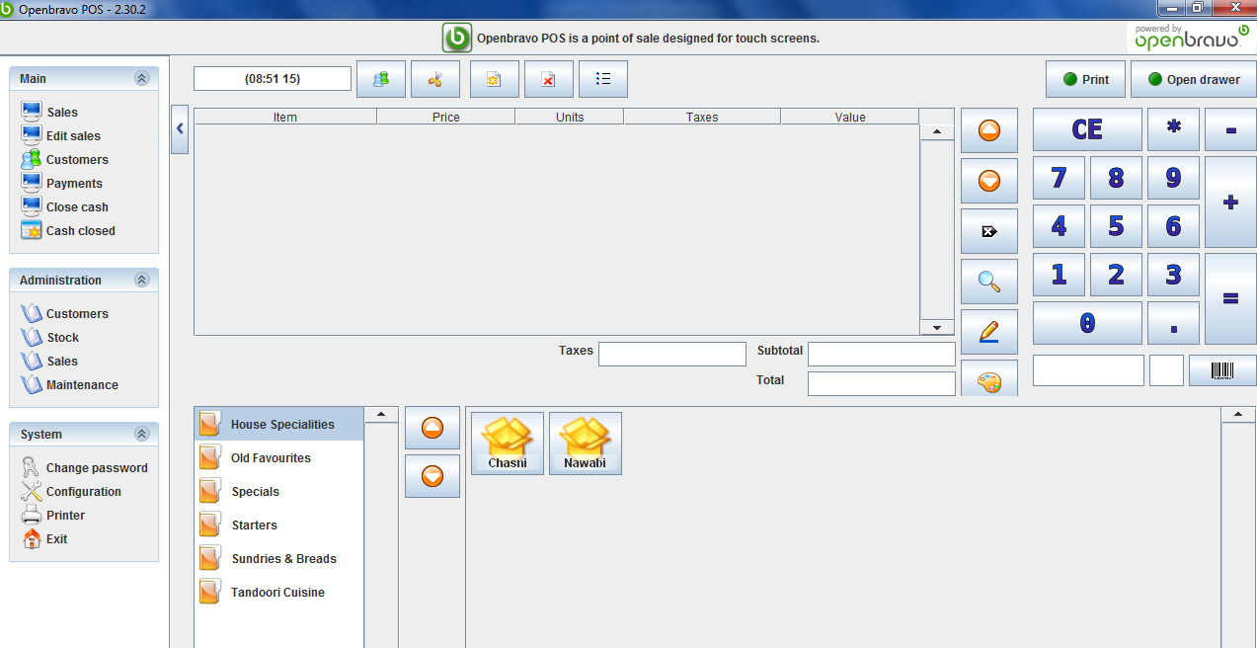
Configure the POS to work in a food takeaway mode
When open the sales, the below screen displayed, to select products from different categories.

Slide 33
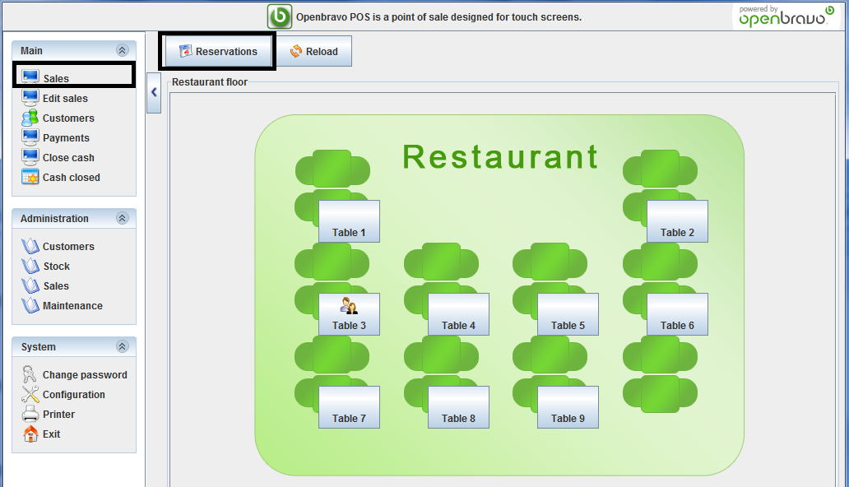
How to work - Tables Booking
From the sales screen select reservations as indicated in the below image

Slide 34
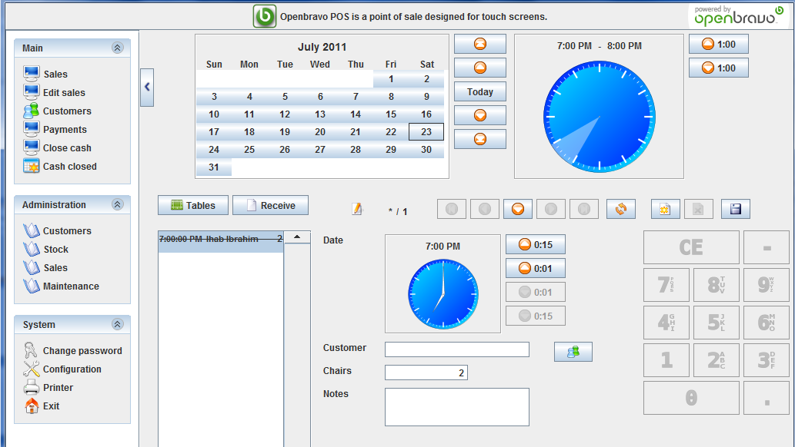
How to work - Tables Booking
Select the customer & reservation time & required number of chairs.

Slide 35
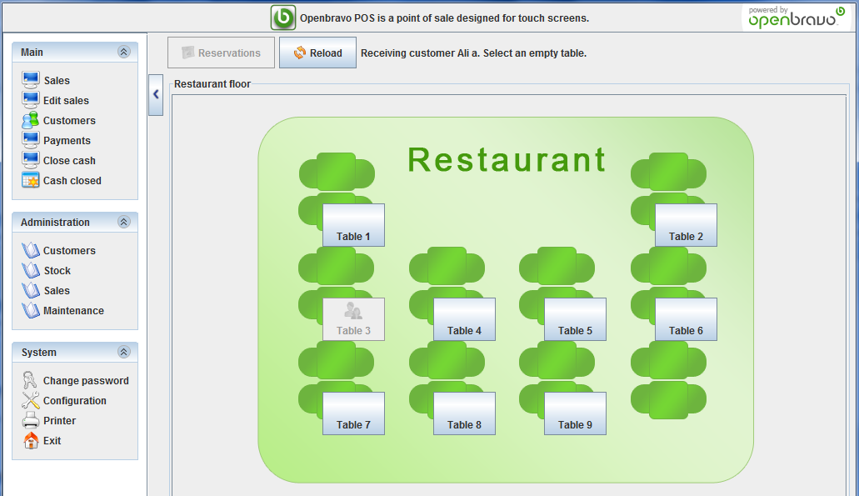
How to work - Tables Booking
When the customer arrives choose “Receive“ button from the reservation screen. This will open the restaurant tables view, disabling the already in use tables, once the table select it will open ticket for the orders.

Slide 36
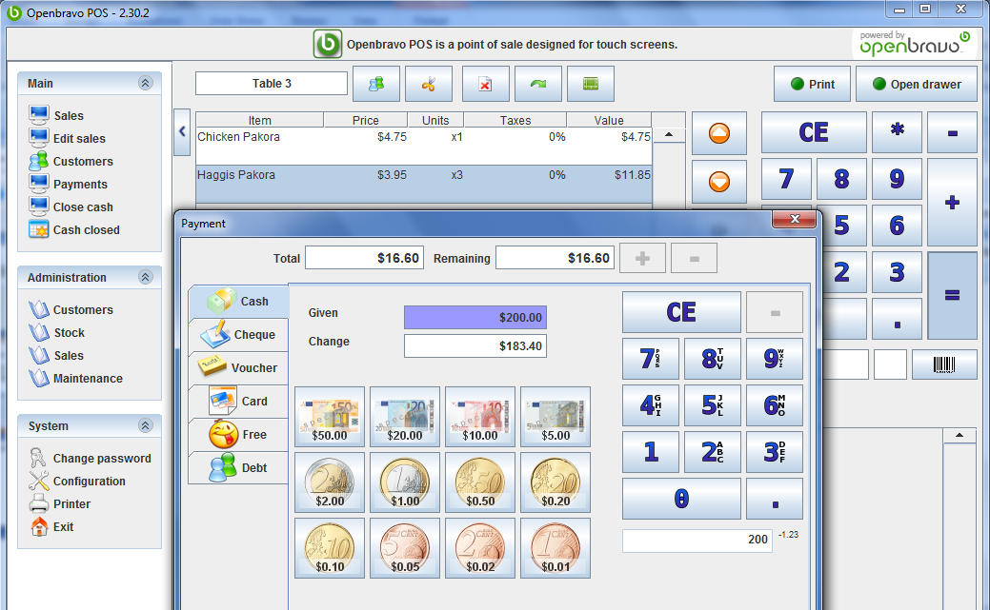
How to work - ticket operations(order)
In case of restaurant when you click on any table new ticket displayed, you can add any number of products, from multiple levels of categories, once you click on “=”, and write the paid amount the remaining amount displayed, when pressing ok the drawer open and the ticket printed

Slide 37
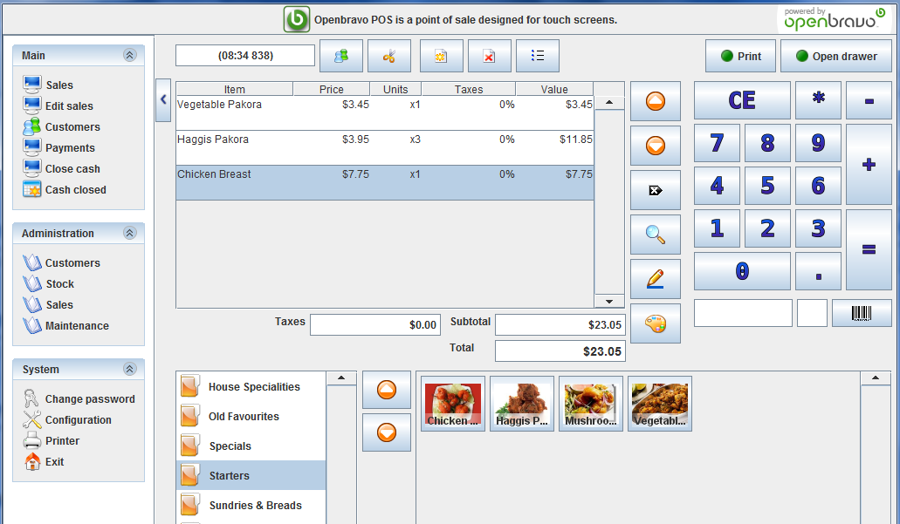
How to work - ticket operations(order)
Just select required products from the category & sub category to add all the required products

Slide 38
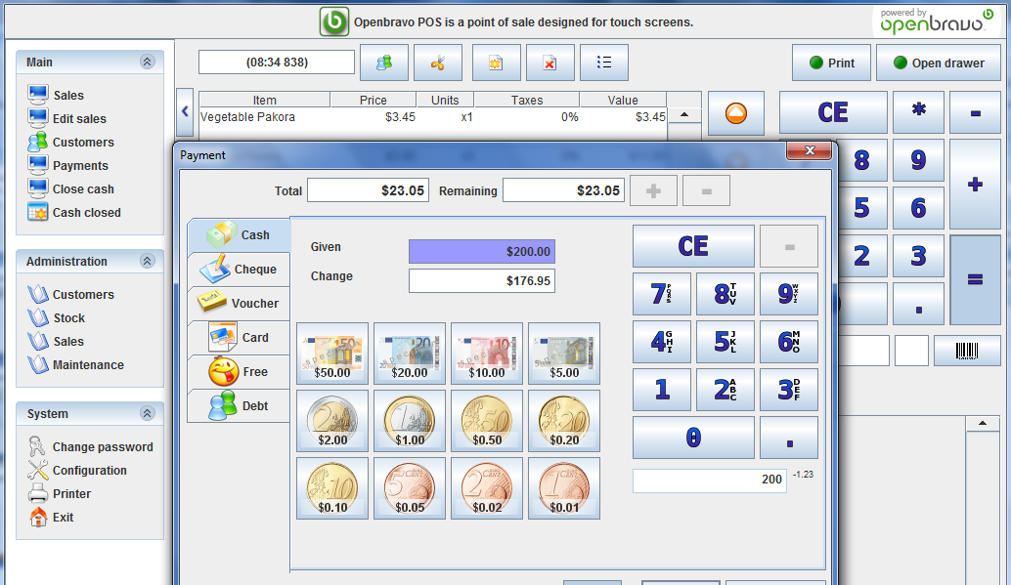
How to work - ticket operations(order)
Once click on equal and writ the paid amount the change are displayed, then press ok will open the drawer and print the ticket.

Slide 39
Reports
Openbravo contains competitive & useful reports, displayed below samples for the openbravo reporting framework.

Slide 40
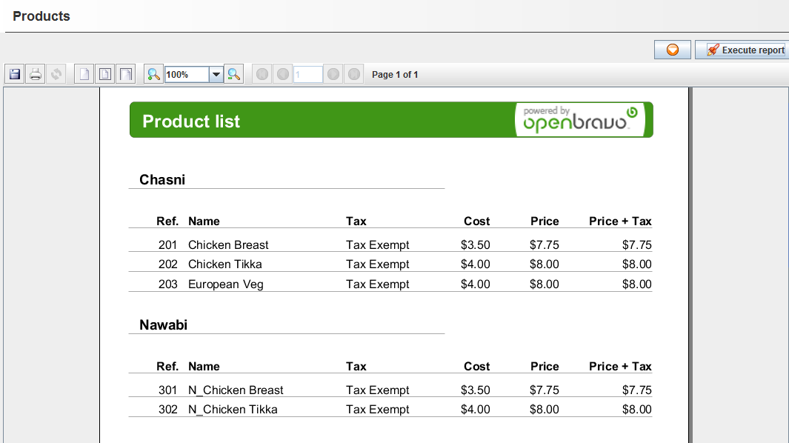
Reports
Reports report : display all reports grouped by category.

Slide 41
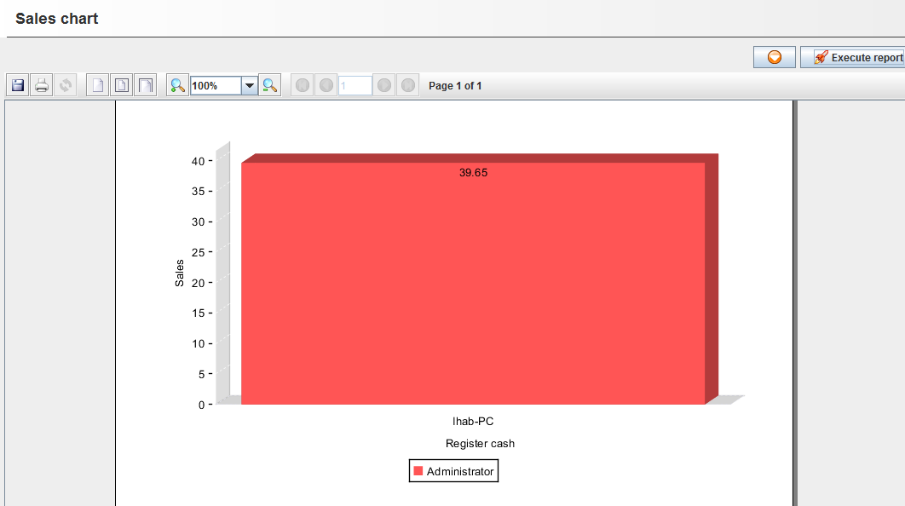
Reports
Draw the sales chart between given dates.

Slide 42
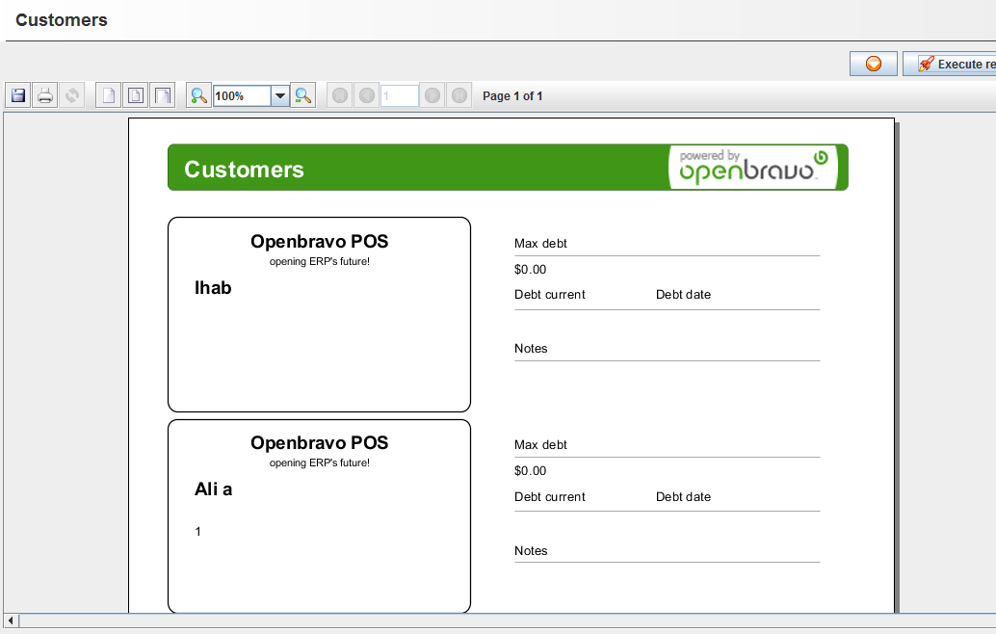
Reports
List for the customers informations

