Slide 1

Help make a breakthrough in ALS disease research!
PayPal offices
August 2015

Slide 2
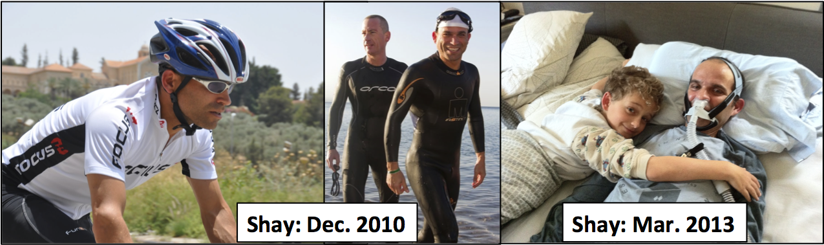
What is ALS?
(Amyotrophic Lateral Sclerosis, or Lou Gehrig’s Disease)
A neurodegenerative disease affecting specifically the cells that drive our muscles. 100% fatal, typically within 3-5 years.

Slide 3
What is the goal of this Datathon?
The goal of every team is to cluster ALS patients using their clinical data timed by 3 months, and to predict their condition after 9 months.
What is the data-set?
The data set includes 1800+ de-identified patient data records from completed clinical trials, over 2 million data points
Currently available information includes:
Demographics
Clinical information
Family history data
Functional measures
Vital signs
Lab data (blood chemistry, hematology, and urinalysis)

Slide 4
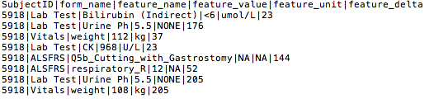
Data-sets
The Datathon training data is located in : https://github.com/ihadanny/p4l-als-challenge and based on PRO-ACT data sets.
It includes 3 files:
train_data.csv Training data – includes data for 3 month for 1800~ patients
train_slope.csv Slope gold standard – includes the dependent variable to be predicted in the Datathon
test_data.csv Test set – as same as the training set, will be accessible from 14:00

Slide 5
Predicted Variable – ALSFLS slope
A functional scale of functional deterioration
“every month, I lose something”
10 questions regarding everyday activity- speaking, respiration, climbing stairs, dressing oneself, writing, on a scale of 0-4, with 4 being normal, 0 being complete inability
A slow progressor will lose 0-3 points per year.
A fast progressor can lose 20.
 | Speech | Respira. | Saliv. | Swall. | Handwr | Cutting | Dress. | Turn. | Climb. | Walk. | Total
Visit 0 | 3 | 4 | 3 | 3 | 4 | 4 | 3 | 4 | 4 | 4 | 36
Month 1 | 3 | 4 | 3 | 3 | 4 | 4 | 3 | 4 | 4 | 4 | 36
Month 2 | 3 | 4 | 2 | 3 | 4 | 4 | 3 | 4 | 4 | 4 | 35
Month 3 | 3 | 4 | 2 | 3 | 4 | 4 | 3 | 4 | 4 | 3 | 34

Slide 6
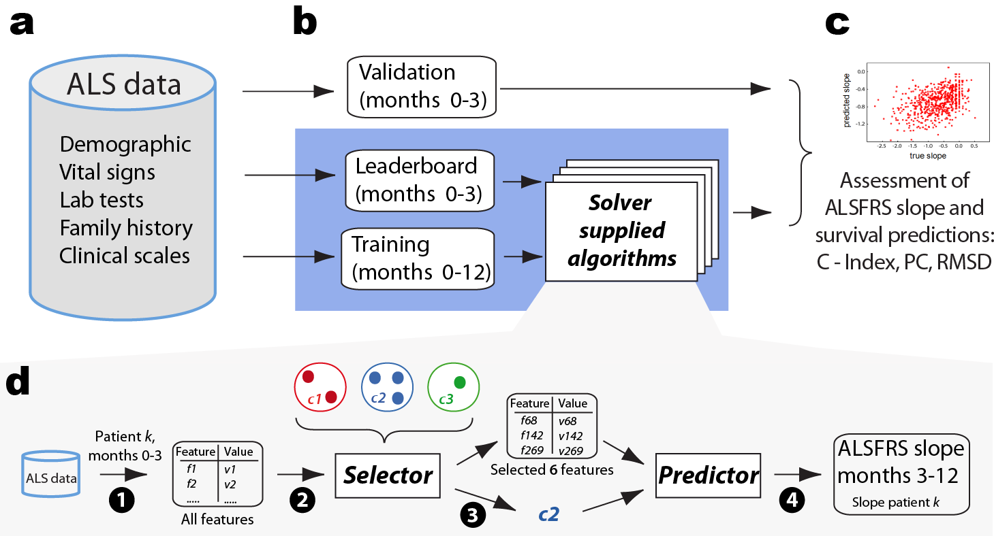
Process

Slide 7
Output
For every patient:
ALSFLS slope
Cluster id
Features chosen for this cluster
Final output (see test_prediction.csv) should be a record for every patient which includes:
Subject_id | ALSFLS slope | Cluster # | Features
12808|-0.440821256|33|bp_diastolic;height;respiratory_rate

Slide 8
Baseline Code provided
A working python prototype (reference implementation) pipeline
Vectorizer - vectorizer_beta.ipynb
Clusterer - Clusterer_beta.ipynb
Feature_selector - feature_selector_beta.ipynb
Predictor - predictor_beta.ipynb
Requires Ipython 3.0.0 (Jupyter notebook).
On windows install Anaconda
On unix `sudo pip install –I “ipython[notebook]”==3.0.0`

Slide 9
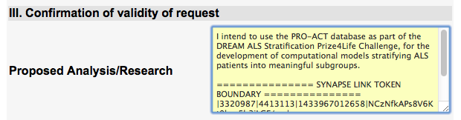
Registration to the challenge
Go to the challenge (http://dreamchallenges.org/challenges/ → click the first challenge), to section 3.1 and click register (it might ask you to create a synapse account first and then go back and register), it will send you a verification email, then when you verify ,You will get an email (email subject: PRO-ACT Data Access Request)- keep it!
Go to PRO-ACT https://www.ALSdatabase.org , fill the form
PUT THE TOKEN (marked in ==== ) in the proposed research (see pic). Submit! Another verification email and youre done!

Slide 10
Winners
Each team should provide the output mentioned below by 15:00.
The final score for each group will be calculated using:
Concordance index
Pearson Correlation
Root mean Square of Deviation (RMSD)
Full explanation on calculation can be found here:
https://www.synapse.org/Portal/filehandle?ownerId=syn2873386&ownerType=ENTITY&fileName=Concordance%20Index%20and%20Censoring%20Tables.pdf&preview=false&wikiId=234629
The winning team would get 100$ money to their PayPal’s accounts.

Slide 11
Questions?

