Slide 1
Motivation
NatIDQPSolver
Understanding how a solver
reaches the optimum
Implement the method. Make each iteration visible.
Irfan Hadzic / 20013 / Numerical Optimization
NatIDQPSolver
01
Notes:
15 seconds
Cilj projekta bio je implementirati solver za kvadratno programiranje i prikazati kako se kroz iteracije približava optimumu. Zato sam numerički algoritam povezao s interaktivnom vizualizacijom.
The motivation statement is original presentation wording, not an attributed quotation.

Slide 2
Problem formulation
Convex quadratic programming
minₓ ½ xᵀQx + cᵀx
Ax = b Gx ≤ h
Q = Qᵀ ⪰ 0
Quadratic objective with linear equality and inequality constraints
NatIDQPSolver
02
Notes:
20 seconds
Rješavam konveksni kvadratni problem s linearnim jednakostima i nejednakostima. Matrica Q je pozitivno semidefinitna. Solver koristi C++20 i natID za dense i sparse linearnu algebru.
Source: project proposal and src/InteriorPointSolver.cpp.

Slide 3
How it works
Mehrotra predictor–corrector method
Initialize
Assemble KKT
& factorize
Predictor
& corrector
Update
iterate
Check
convergence
Repeat until scaled KKT residuals ≤ ε
natID sparse LDLT: one factorization, two solves per iteration
Conceptual reference: cppipm (Y. Yan)
NatIDQPSolver
03
Notes:
30 seconds
Osnova je Mehrotra predictor–corrector algoritam. U svakoj iteraciji sastavljam i faktorizujem sparse KKT sistem. Istu faktorizaciju koristim za predictor i corrector, zatim ažuriram varijable i provjeravam residuale. cppipm sam koristio kao konceptualnu referencu.
For inequality-constrained problems; equality-only problems use a direct KKT solve.
References: Nocedal and Wright, Numerical Optimization, 2nd ed., Chapter 16. https://github.com/YimingYAN/cppipm
Implementation: src/InteriorPointSolver.cpp.

Slide 4
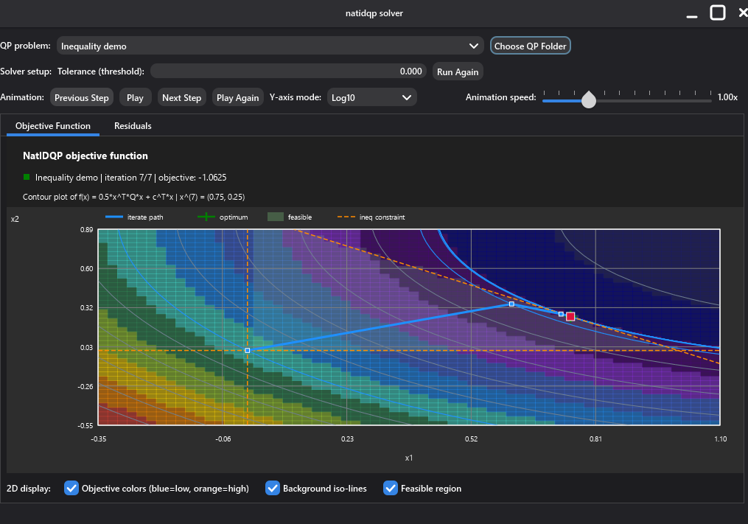
Project result
C++20 solver
using natID
Interactive objective
and residual plots
dTwin solution
comparison
Live demo
NatIDQPSolver
04
Notes:
25 seconds
Rezultat je C++20 solver s interaktivnim prikazom objective funkcije i residuala te poređenjem s dTwin rješenjem. Sada ću pokazati kako to izgleda na konkretnom problemu.
Demo, 2 minutes: 40 s objective animation and display toggles; 35 s residuals and dTwin comparison; 25 s tolerance and Run Again; 20 s select another problem. Keep 30 seconds in reserve for the four-minute slot.
Image: application screenshot supplied by Irfan Hadzic in this conversation.

