Slide 1

Program to filter VCFs
Institute of Genetics, University of Bern
Lab meeting 2.7.2018
Irene Häfliger
Updated April 1st 2019
Notes:
Please ask questions right away!
I tried to build the presentation in a way that I thought it makes sense but that may not make sense to all of us.
Don‘t worry to take notes, I will put the presentation on the G work space.

Slide 2
General
Name: filterVariants
Usage: to filter VCFs
Available on vetsrv06
programmed in bash scripting
What is new?
Can select regions in the genome
Can select specific genes
Several cases with several possible genotypes
→ Tip: if you don't need any of these stick with Etiennes v11 program!!

Slide 3
Algorithm
Possible causative variants
VCF
Select regions
Variant filtering
Genotype filtering
Genes
Chromosomes
Regions
Impact
Quality
Genotypes of cases
Genotypes of controls
Exclude animals
Notes:
Step 1 and Step 2 are rather fast (AND speed up step 3!!)
However step 3 slows the program down incredibly

Slide 4
Prerequisites
Access to vetsrv06
Parameterfile
Input for the program
VCF
The vcf needs a header line with labIDs

Slide 5
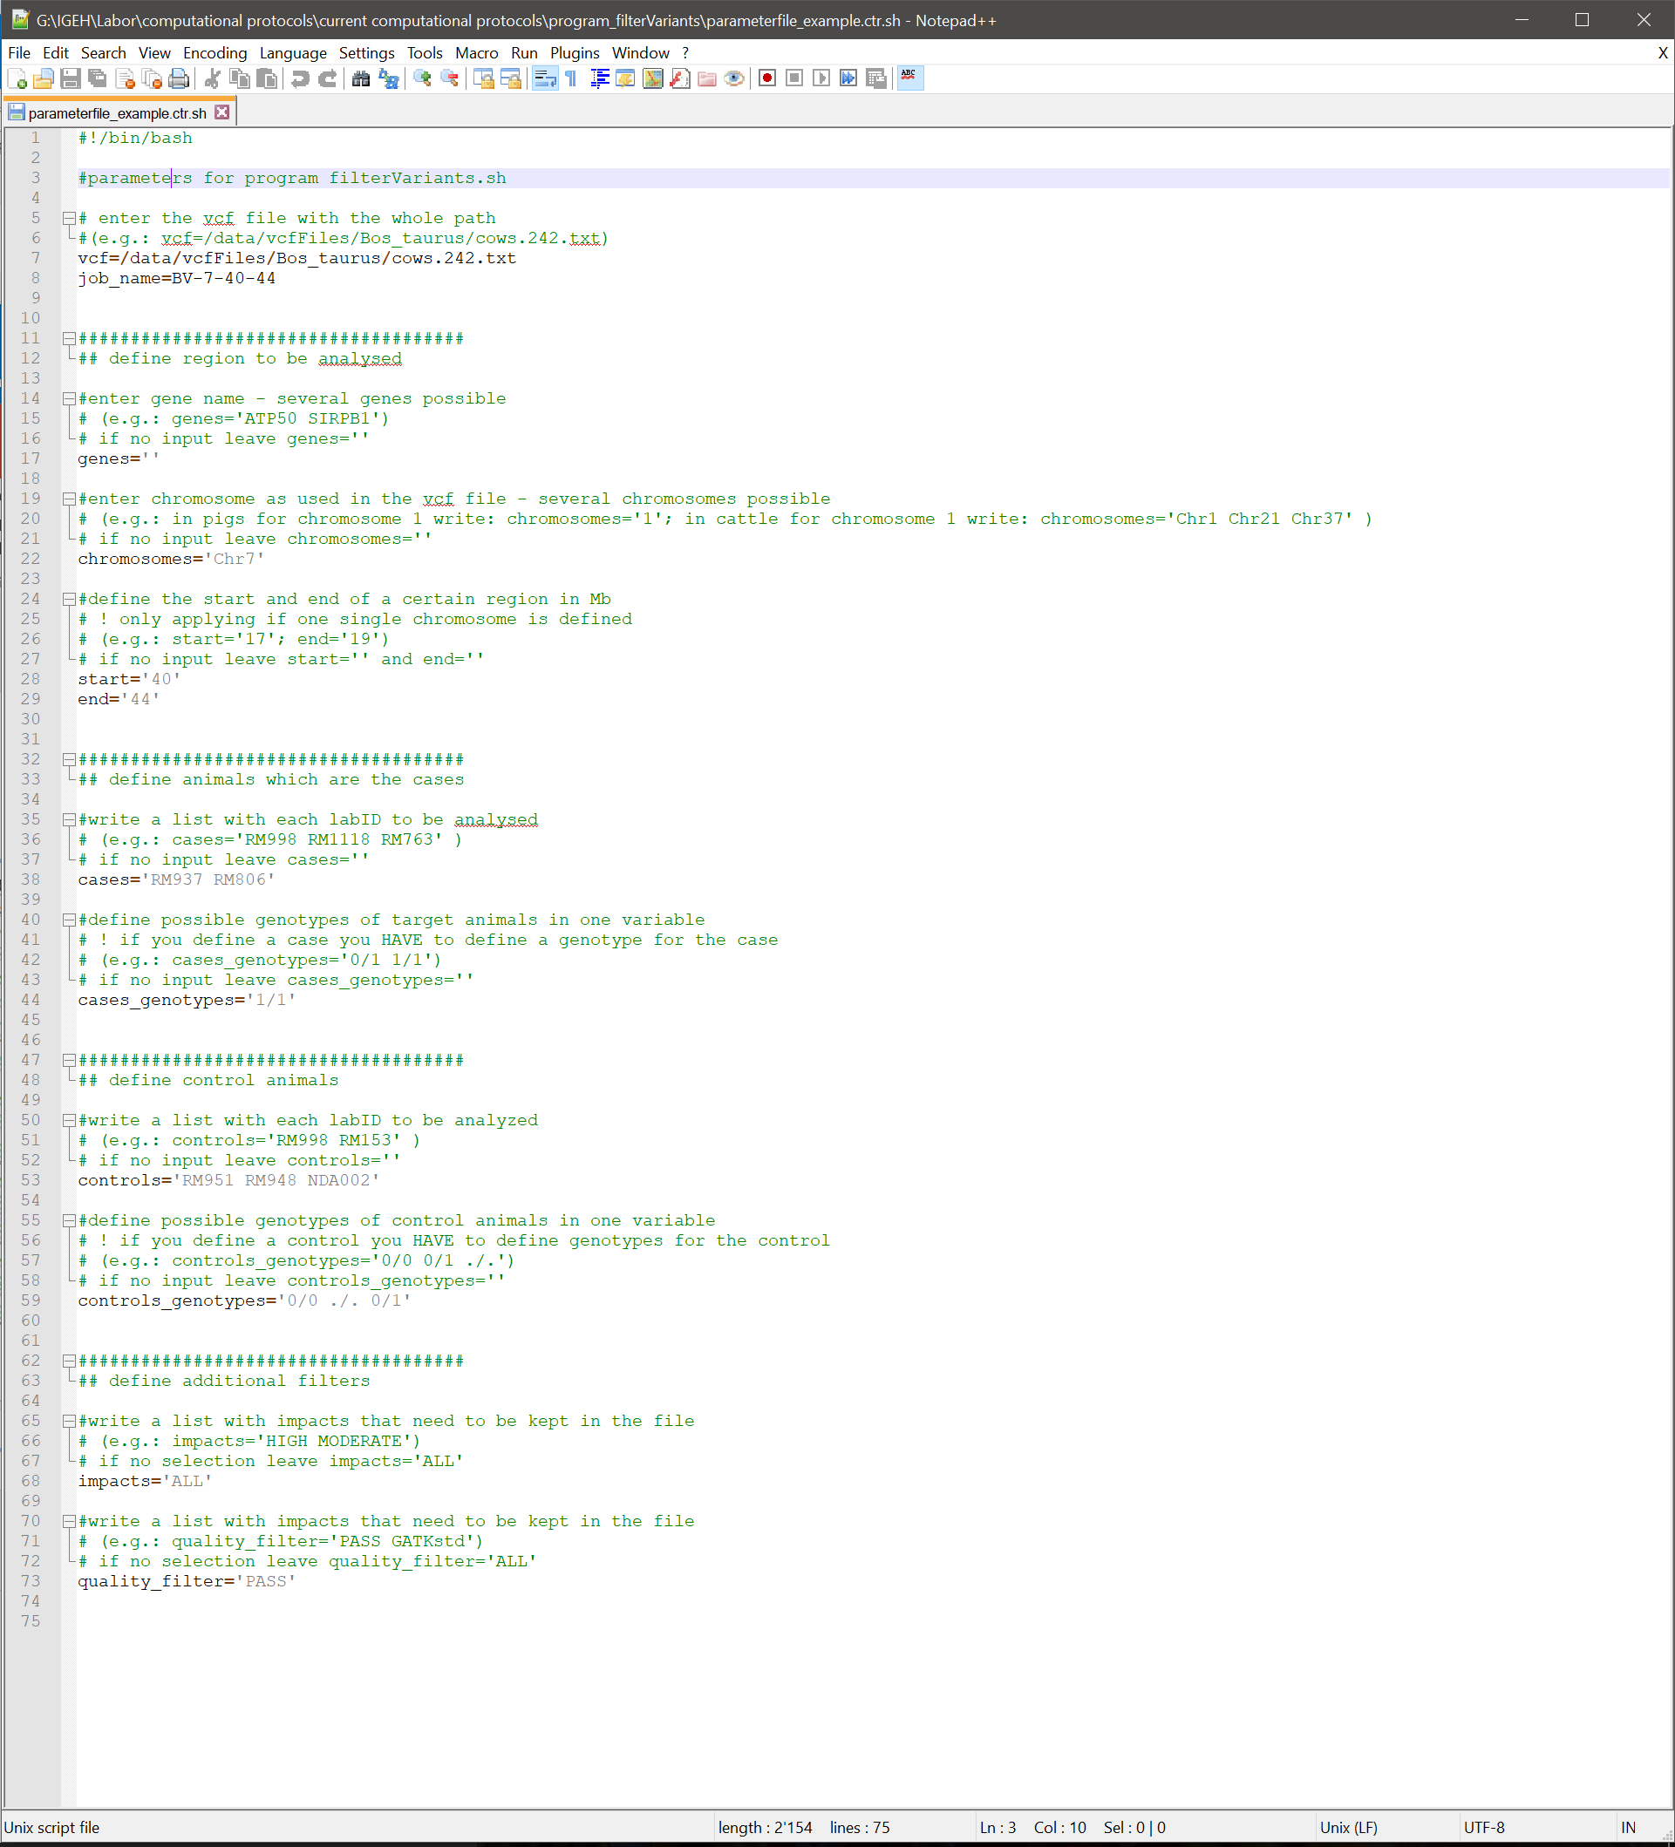
Parameterfile I
Example file in folder on drive G: G:\IGEH\Labor\computational protocols\current computational protocols\variant_filtering\filterVariantsProgram\parameterfile_empty.ctr.sh
Important!!
Enter the whole path to the VCF
Give it a unique job name
Either several chromosomes OR a region on one chromosome
If you specify an animal you have to specify a genotype
Never leave impact and quality filter empty
Notes:
Show and edit parameter file

Slide 6
Parameterfile I - extra
Chromosome names:
To find out what chromosome coding was used in the vcf type the following on a console after you logged in to the server: head /path/to/vcf/species.txt
The first column is the chromosome, eg.:
1, 2, 3, …
chr1, chr2, chr3, …
Chr1, Chr2, Chr3, …
Chromosome1, Chromosome2, Chromosome3, …
Notes:
Show and edit parameter file

Slide 7
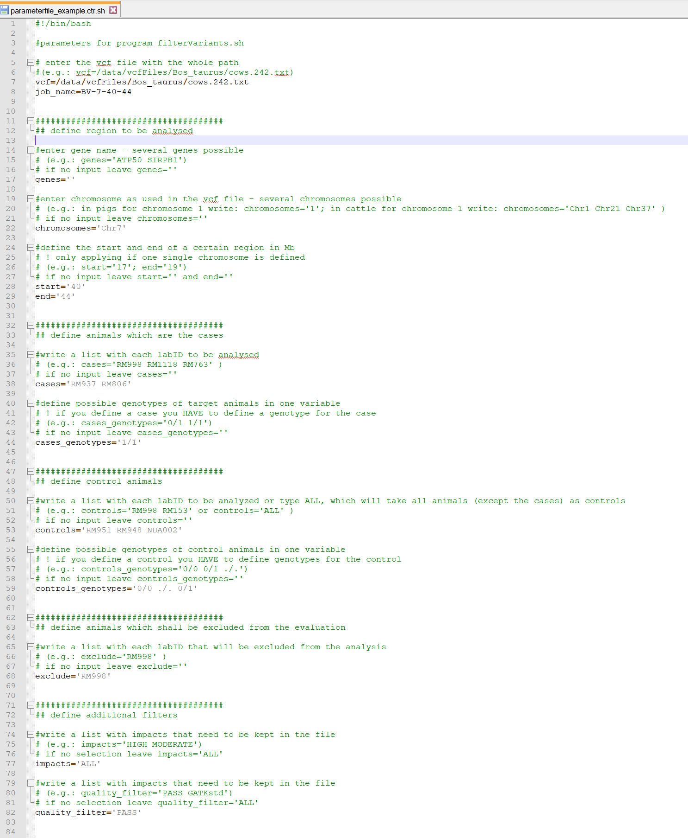
Parameterfile II
New features from 1st of April 2019:
exclude= Select animals with their Ids that should not be included in the analysis at all
Controls='ALL' selects all animals as controls only exception animals defined as cases and animals defined to be excluded
Notes:
Show and edit parameter file

Slide 8
VCFs on vetsrv06 - I
Species |  | Number of animals | File size | Number of variants | Number of unique variants
Bos tarus | Cattle | 242 | 150 GB | 142,557,689 | 39,152,777
Canis familiaris | Dog | 557 | 284 GB | 127,687,177 | 43,872,977
Equus caballus | Horse | 83 | 29 GB | 56,832,449 | 45,971,766
Felis catis | Cat | 15 | 19 GB | 109,844,963 | 37,374,211
Oryctolagus cuniculus | Rabbit | 13 | 7 GB | 47,063,863 | 41,578,429
Ovis aries | Sheep | 24 | 54 GB | 213,099,827 | 42,869,268
Sus scrofa | Pig | 6 | 11 GB | 65,497,999 | 20,488,730
Path to the files: /data/vcfFiles/speciesInLatin/filename.vcf

Slide 9
VCFs on vetsrv06 - II
This is important if storage space becomes limited:
Be aware that the VCFs are big. If you do not define a region or a chromosome in the first step, the program will make you a temporary copy of the file in your working directory. This was implemented to make sure that the original file is not being changed by accident. However, as it will take up a lot of space, it will be deleted before the program finishes.

Slide 10
Instructions
Prepare the parameterfile
Login to vetsrv06
Copy the parameterfile in your working directory
A) For fast runs type
filterVariants.sh parameterfile.ctr.sh <ENTER> Program will run on the console. You can follow the progress on the terminal.
B) For time-consuming runs type
nohup filterVariants.sh parameterfile.ctr.sh & <ENTER>
Program will run in the background. You cannot follow the progress on the terminal. But you can close the terminal or do other things on the terminal while the program keeps running.
Notes:
Logfile needed? Does it write it in a logfile anyways??

Slide 11
Output
One folder including the files
output.vcf file with variants
output.log logfile summarizing what was done
parameterfile.ctr.sh copy of the parameterfile
The output folder and the files will have the name of the job, which is defined in the parameterfile
The folder will be placed in the current working directory
Notes:
Output in best case

Slide 12
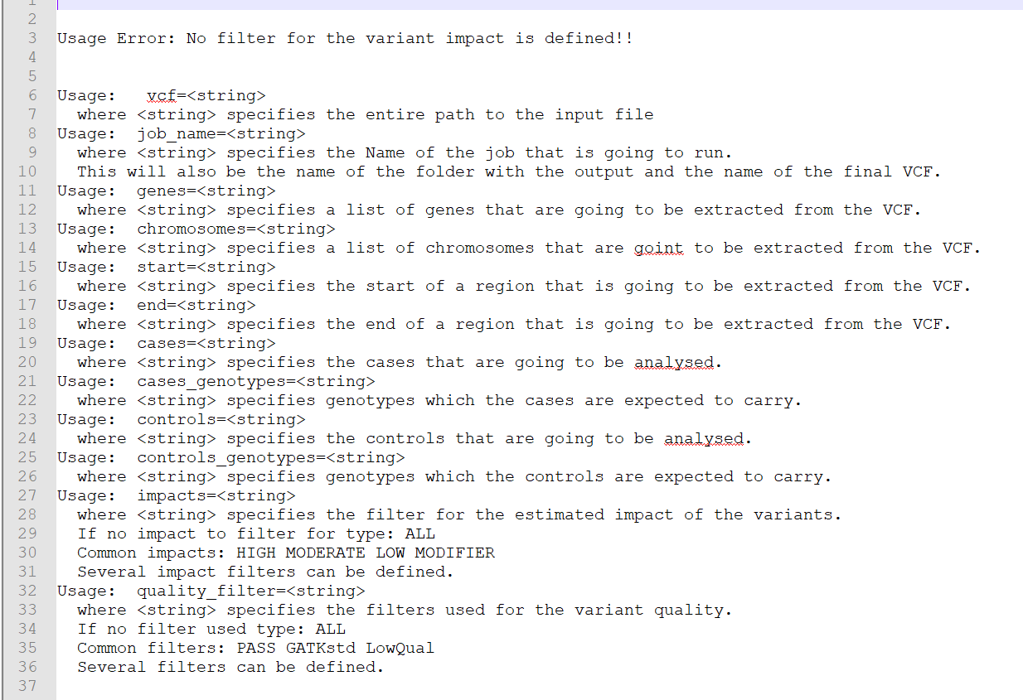
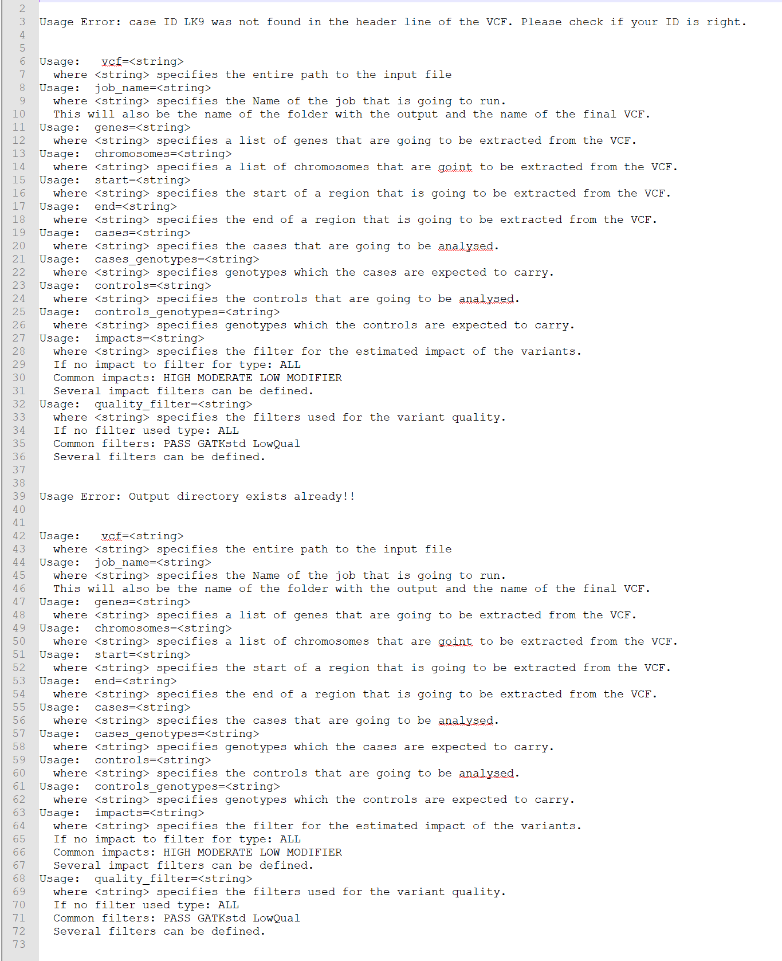
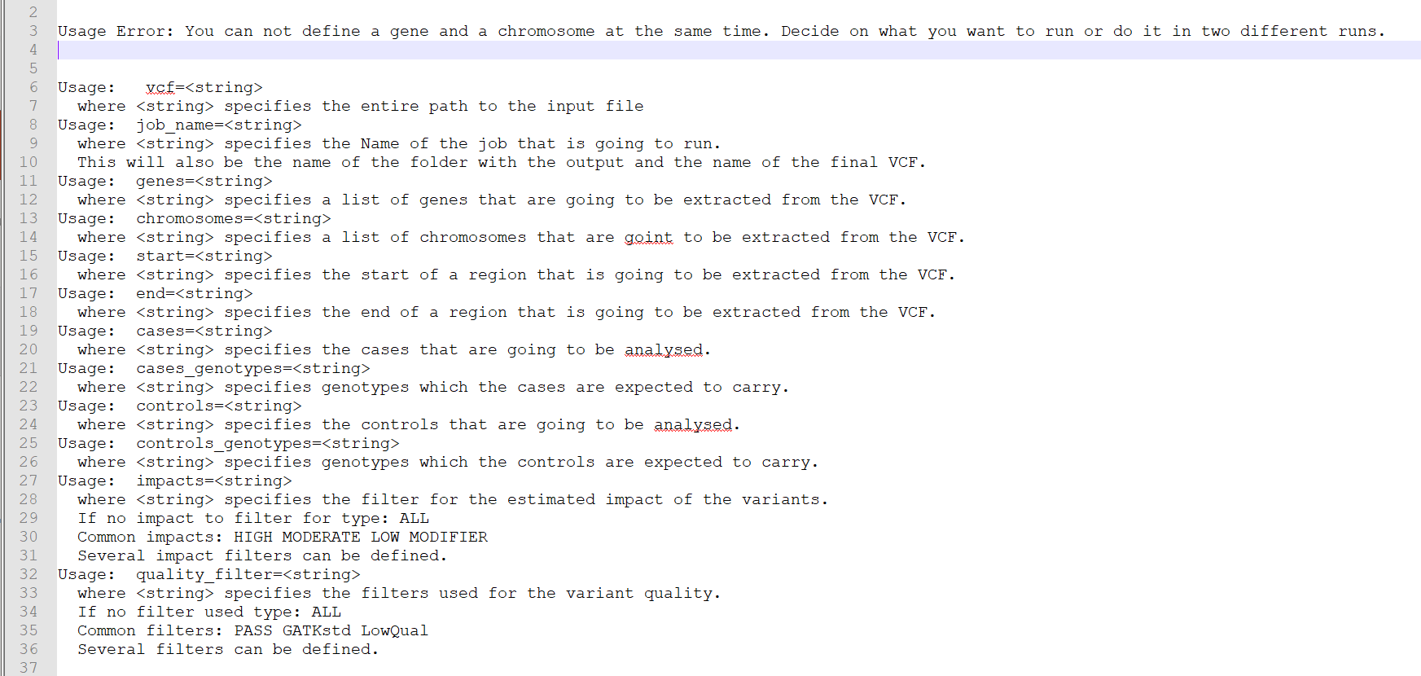
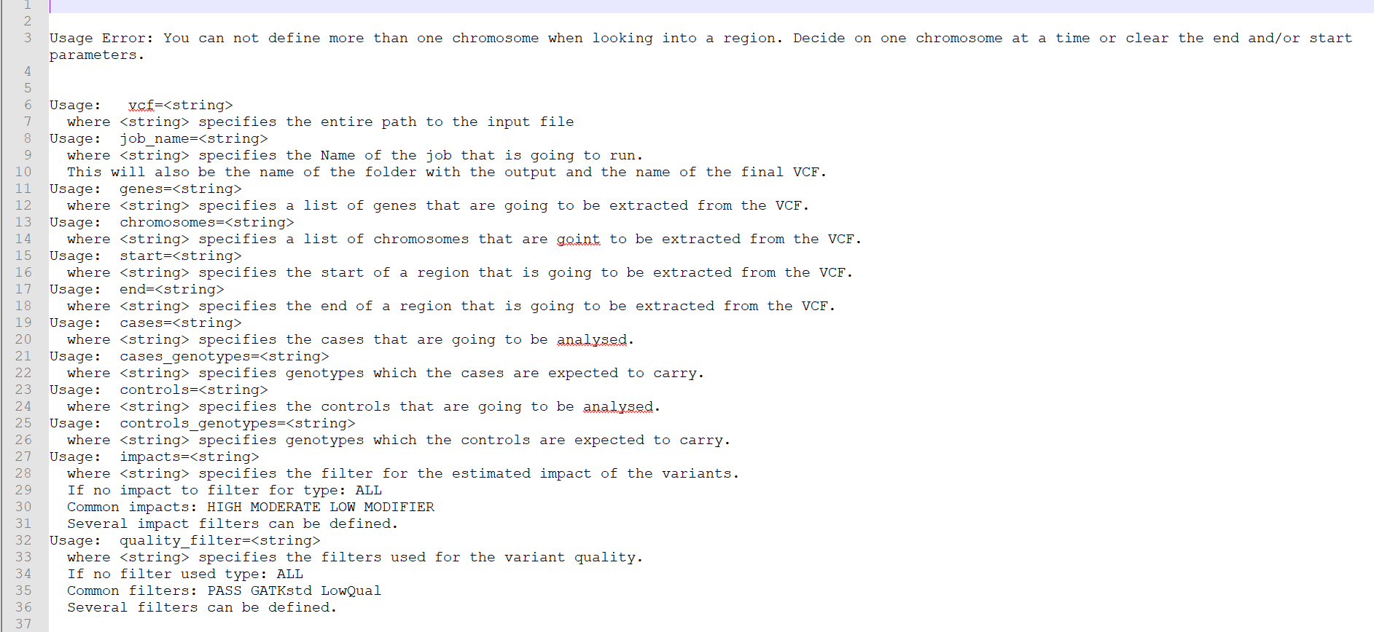
Error messages - I
Should be selfexplaining → read them!

Slide 13
Error messages - II
Some common mistakes
The input job-name is also the name of the output folder. Make sure that no folder with that name exists already
If ID's do not exist, check if you entered the right path and name of the VCF file
If the output file is just empty
check if you defined genotypes for cases and controls
check if the region is defined correct (it is in Mb!! )
check if the coding of the chromosome is the right one
make sure there are no IDs of cases in the controls!

Slide 14
Some runtimes
What was filtered |  | Cows.242.vcf | Dogs.557.vcf
chromosome | 1 | 00:11:56 | 00:23:03
Gene | GDF5 | 00:11:03 | 00:16:50
region | Chr 2 15.6Mb – 35.6Mb | 00:03:12 | 00:21:21
impact | HIGH | 00:33:32 | 00:52:03
quality | PASS | 01:15:28 | 01:46:14
Recessive inheritance | Trio: 1 case and parents | 02:57:57 | 03:57:20
Dominant inheritance | 2 cases, 2 controls | 02:59:41 | 03:45:08
Recessive lethality | 3 carriers, 5 non-carrier | 03:04:35 | 03:21:08
The program is slow for doing only those simple filtering steps.
Rather use grep on the console to filter the impact and quality.
(e.g.: grep 'PASS' /path/to/vcf/file.vcf > allPASSvariants.vcf )
Not updated for newest version: state summer 2018

Slide 15
Improving runtimes
Use the results of previous analyses
GWAS hit
Linkage
Homozygosity mapping
Reduce the number of animals
Filter only region of interest
What was filtered |  | Cows.242.vcf | Dogs.557.vcf
Whole genome | 3 cases 0/1 or 1/1, 5 controls 0/0 or ./. | 02:57:24 | 03:01:29
GWAS hit | Chr 5, 3 cases 0/1 or 1/1, 5 controls 0/0 or ./. | 00:38:35 | 00:47:59
Not updated for newest version: state summer 2018

Slide 16
Final remarks
Do not run the program on vetpc1727
Files are mounted on vetpc1727 in read-only modus. So you would have to copy the whole file before you start working with it.
There is about 1TB of storage to use, what is not enough.
Vetsrv06 has 32 cores
The program uses 1 core when it runs.
Other people are using the server too → do not run too many jobs at once!
Size of the output file
Excel has trouble with big files (> 500 Mb) → check the size before you open a file!
If it is too big then either filter stricter or split the file in several files.

Slide 17
Think before you start the program
What are you trying to proof?
Can you define a region to look into first?
Do you use all the knowledge you have about the cases?
Did you set all parameters correct?
How long will it run?
Should it run in the background?
Are there many jobs running on vetsrv06 already? (type top on the console and have a look at the currently running processes)

Slide 18

Troubleshooting
Nothing works the way it should?
Please contact me
Office 012
Phone 2328
Mail irene.haefliger@vetsuisse.unibe.ch

Slide 19

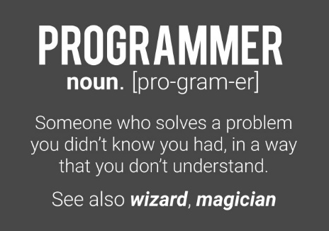

Have fun using the program!!

