Slide 1
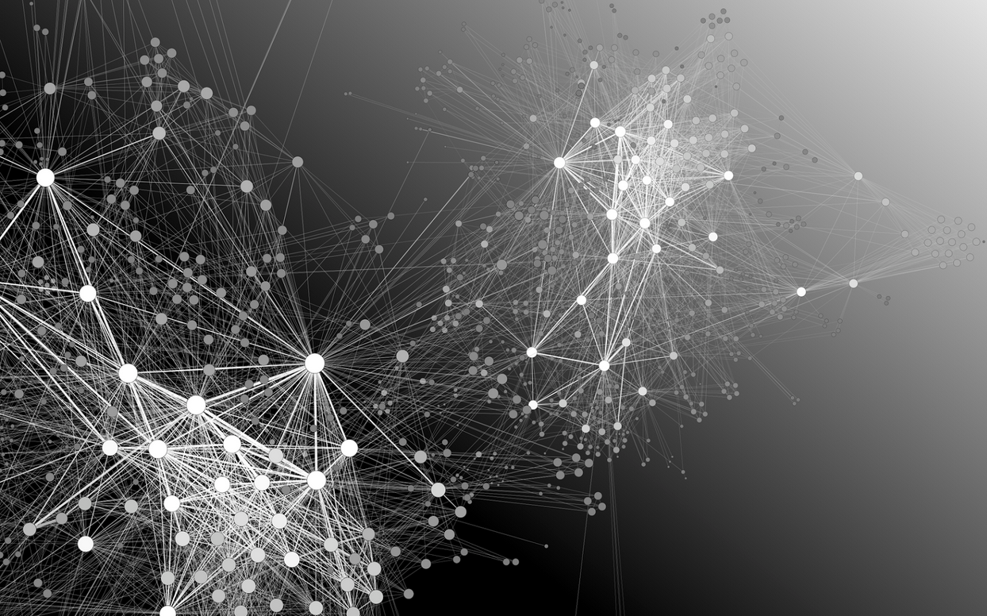
NEURAL NETWORKS
ARE WE IN DANGER?

Slide 2
Basics of a Artificial Neural Networks
Inputs
Nodes and Hidden Layers
Outputs
Weights
Activations
Ability to learn very complex higher dimensional spaces
Forward Propagation
Backward Propagation (gradient decent)
Scaling and Shrinkage

Slide 3
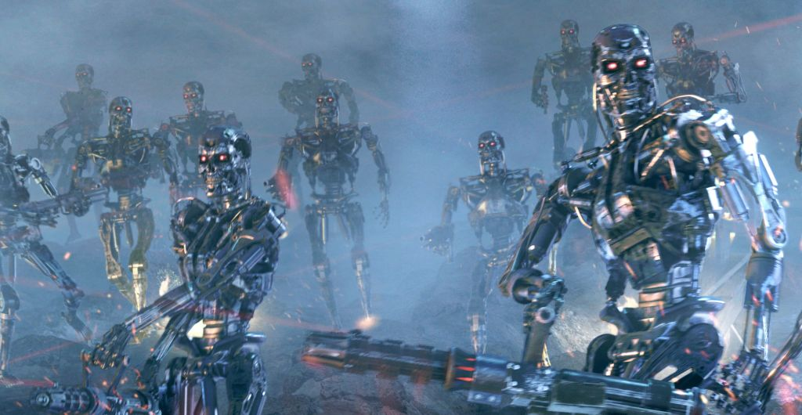
WHY THE FEAR?
SKYNET was based on ANNs
How real could this be?
Open Letter to Governments
How much data is on the internet?
Estimates based on 4 largest storages is around 1200 petabytes
Algorithm speeds make learning more efficient? MIT (Feb 2016)
“Starting a military AI arms race is a bad idea, and should be prevented by a ban on offensive autonomous weapons beyond meaningful human control”

Slide 4
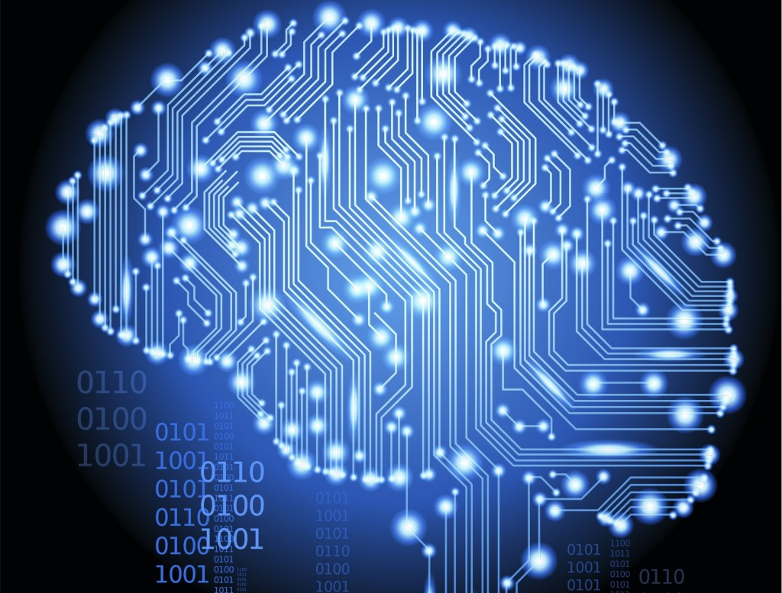
GOOGLE RANKBRAIN
RankBrain online for a year!!
3rd most important factor in web page ranking
But wait… RankBrain is still on a chain!

Slide 5
REFERENCES
http://www.inquisitr.com/2547110/skynet-lives-google-rankbrain-is-a-neural-network-artificial-intelligence-which-loves-stephen-hawking-and-elon-musk/
http://www.sciencefocus.com/qa/how-many-terabytes-data-are-internet
https://en.wikipedia.org/wiki/RankBrain
(nb) – I’ll post a very good youtube series (to slack) on the mathematics of a neural network using a basic example. Its very helpful for gaining the intuition. I’ll post it once we’ve covered it in the class.

