Slide 1
DATA SCIENCE
11 WEEK PART TIME COURSE
Week 4 - Clustering
Monday 18th April 2016

Slide 2
AGENDA
Motivation / Review
What is Clustering?
What is K-Means and how does it work?
Lab
Discussion - Homework, Project, Kaggle

Slide 3
WHAT IS CLUSTERING AND WHY DO IT?
DATA SCIENCE PART TIME COURSE

Slide 4
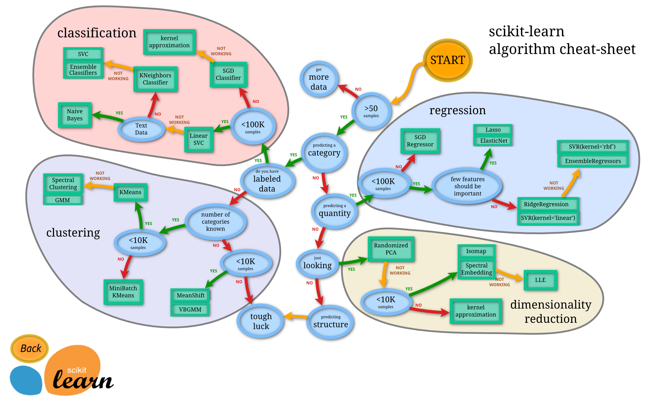

Slide 5
CLUSTERING
What is a Cluster?
Why would we do this?
What is K-Means?
x₁
x₂

Slide 6
WHAT IS A CLUSTER?
Recall unsupervised learning is when we are trying to find interesting patterns or groups in our data. We don’t have a variable we are trying to predict (a Y value).
Clustering aims to discover subgroups in our data where the points are similar to each other. So we have a collection of groups and all points belonging to the same group are similar. Points in different groups are different to each other.
We have to decide what variables we will construct the groups on. What makes them different (or similar)?

Slide 7
WHY WOULD WE CLUSTER DATA?
To enhance our understanding of a dataset by dividing the data into groups.
Clustering provides a layer of abstraction from individual data points.
The goal is to extract and enhance the natural structure of the data

Slide 8
WHY WOULD WE CLUSTER DATA?
Marketing teams might want to group customers into like groups as a way of summarising the data

Slide 9

WHY WOULD WE CLUSTER DATA?
Financial groups may want to group transactions into like groups as a way to find unusual payments

Slide 10
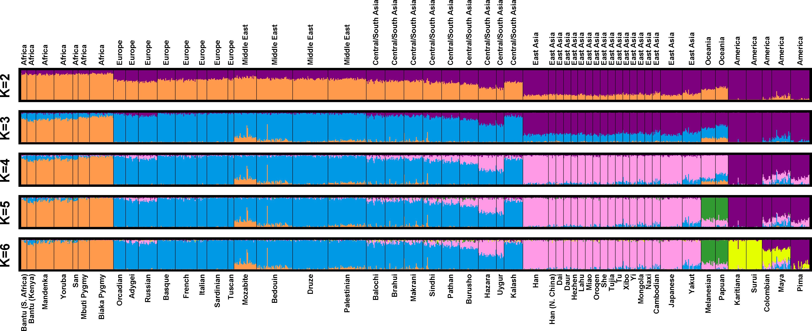
WHY WOULD WE CLUSTER DATA?
Genetics data can be clustered to identify ancestry

Slide 11
HOW DO WE CLUSTER DATA?
DATA SCIENCE PART TIME COURSE

Slide 12
KMEANS ALGORITHM
1) Choose k initial centroids (note that k is an input)
2) For each point:
- find distance to each centroid
- assign point to nearest centroid
3) Recalculate centroid positions
4) Repeat steps 2-3 until stopping criteria met

Slide 13
STEP 1 - CHOOSE CENTROIDS
There are several options:
- randomly (but may yield divergent behavior)
- perform alternative clustering task, use resulting centroids as initial k-means centroids
- start with global centroid, choose point at max distance, repeat (but might select outlier)

Slide 14
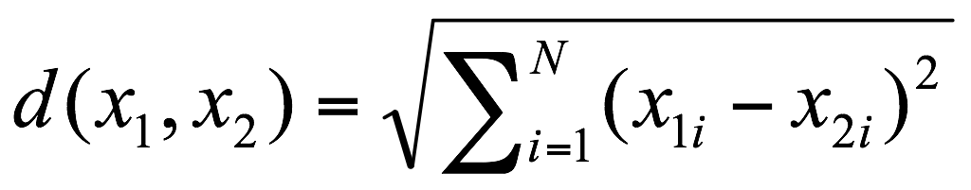
STEP 2 - ASSESS SIMILARITY
The similarity criterion is determined by the measure we choose.
In the case of k-means clustering, the similarity metric is the Euclidian distance:

Slide 15
STEP 3 - RECALCULATE CENTROID POSITIONS
Q: How do we re-compute the positions of the centres at each iteration of the algorithm?
A: By calculating the centroid (i.e., the geometric centre)

Slide 16
STEP 4 - CONVERGENCE
We iterate until some stopping criteria are met; in general, suitable convergence is achieved in a small number of steps.
Stopping criteria can be based on the centroids (eg, if positions change by no more than ε) or on the points (eg, if no more than x% change clusters between iterations).

Slide 17
KMEANS ALGORITHM
1) Choose k initial centroids
2) For each point:
- find distance to each centroid
- assign point to nearest centroid
3) Recalculate centroid positions
4) Repeat steps 2-3 until stopping criteria met
x₁
x₂

Slide 18
KMEANS ALGORITHM
1) Choose k initial centroids
2) For each point:
- find distance to each centroid
- assign point to nearest centroid
3) Recalculate centroid positions
4) Repeat steps 2-3 until stopping criteria met
x₁
x₂

Slide 19
KMEANS ALGORITHM
1) Choose k initial centroids
2) For each point:
- find distance to each centroid
- assign point to nearest centroid
3) Recalculate centroid positions
4) Repeat steps 2-3 until stopping criteria met
x₁
x₂

Slide 20
KMEANS ALGORITHM
1) Choose k initial centroids
2) For each point:
- find distance to each centroid
- assign point to nearest centroid
3) Recalculate centroid positions
4) Repeat steps 2-3 until stopping criteria met
x₁
x₂

Slide 21
KMEANS ALGORITHM
1) Choose k initial centroids
2) For each point:
- find distance to each centroid
- assign point to nearest centroid
3) Recalculate centroid positions
4) Repeat steps 2-3 until stopping criteria met
x₁
x₂

Slide 22
KMEANS ALGORITHM
1) Choose k initial centroids
2) For each point:
- find distance to each centroid
- assign point to nearest centroid
3) Recalculate centroid positions
4) Repeat steps 2-3 until stopping criteria met
x₁
x₂

Slide 23
KMEANS ALGORITHM
1) Choose k initial centroids
2) For each point:
- find distance to each centroid
- assign point to nearest centroid
3) Recalculate centroid positions
4) Repeat steps 2-3 until stopping criteria met
x₁
x₂

Slide 24
KMEANS ALGORITHM
1) Choose k initial centroids
2) For each point:
- find distance to each centroid
- assign point to nearest centroid
3) Recalculate centroid positions
4) Repeat steps 2-3 until stopping criteria met
x₁
x₂

Slide 25
KMEANS ALGORITHM
1) Choose k initial centroids
2) For each point:
- find distance to each centroid
- assign point to nearest centroid
3) Recalculate centroid positions
4) Repeat steps 2-3 until stopping criteria met
x₁
x₂

Slide 26
HOW DO WE KNOW OUR CLUSTERS ARE ANY GOOD?
DATA SCIENCE PART TIME COURSE

Slide 27
CLUSTER VALIDATION
In general, k-means will converge to a solution and return a partition of k clusters, even if no natural clusters exist in the data.
We will look at two validation metrics useful for partitional clustering, cohesion and separation.

Slide 28


CLUSTER VALIDATION
Cohesion measures clustering effectiveness within a cluster.
Separation measures clustering effectiveness between clusters.

Slide 29
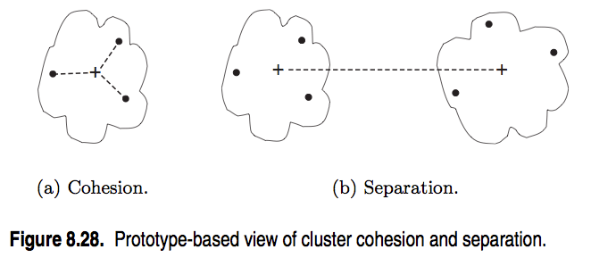
CLUSTER VALIDATION
source: http://www-users.cs.umn.edu/~kumar/dmbook/ch8.pdf

Slide 30

CLUSTER VALIDATION
One useful measure than combines the ideas of cohesion and separation is the silhouette coefficient. For point xi, this is given by:
such that:
ai = average in-cluster distance to xi
bij = average between-cluster distance to xi
bi = minj(bij)

Slide 31
CLUSTER VALIDATION
The silhouette coefficient can take values between -1 and 1.
In general, we want separation to be high and cohesion to be low. This corresponds to a value of SC close to +1.
A negative silhouette coefficient means the cluster radius is larger than the space between clusters, and thus clusters overlap

Slide 32


CLUSTER VALIDATION
The silhouette coefficient for the cluster Ci is given by the average silhouette coefficient across all points in Ci:
The overall silhouette coefficient is given by the average silhouette coefficient across all clusters:

Slide 33
CLUSTER VALIDATION
One useful application of cluster validation is to determine the best number of clusters for your dataset.
Q: How would you do this?
A: By computing the SSE or SC for different values of k.

Slide 34
CLUSTER VALIDATION
Ultimately, cluster validation and clustering in general are suggestive techniques that rely on human interpretation to be meaningful.

Slide 35
CLUSTER VALIDATION
Strengths:
K-means is a popular algorithm because of its computational efficiency and simple and intuitive nature.
Weaknesses:
However, K-means is highly scale dependent, and is not suitable for data with widely varying shapes and densities.

Slide 36
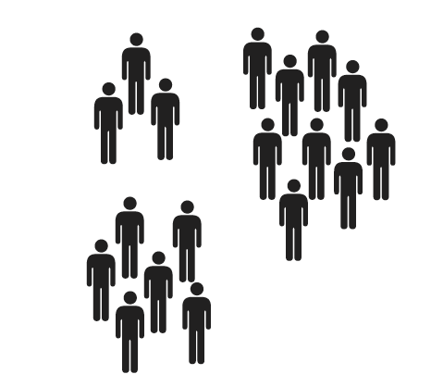
LAB
DATA SCIENCE PART TIME COURSE

Slide 37
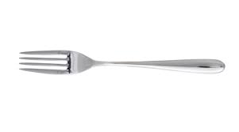
SYNCHING A FORK
git remote -v
git remote add upstream https://github.com/ihansel/SYD_DAT_3.git
git remote -v
git fetch upstream
git checkout master
git merge upstream/master
OR git reset --hard upstream/master

Slide 38
DISCUSSION TIME
Homework 1
Readings
DATA SCIENCE - Week 5 Day 1

Slide 39
HOMEWORK 1
Highlights
Everyone mentioned the T-shaped Data Scientist !!!
'Diane stresses the importance of the human-computer symbiosis (i.e. let the computer do what it does best E.g. crunch numbers/models and calculations, and let humans do what they do best, E.g. Interpret models and relationships to extract meaning from which to base a decision/recommendation.’ - Arthur
‘The most successful data scientists are those with substantial, deep expertise in at least one aspect of data science, be it statistics, big data, or business communication.’ - Flavia
DATA SCIENCE - Week 5 Day 1

Slide 40
HOMEWORK 1
Highlights
‘Collabration and team skills are cruicial in succeeding as a data scientists. ’ - Louis
‘There needs to be adequate integration between new data scientist hires and rest of the organization.’ - Anushi
‘He did mention that at the beginning of intership he did realize that being only an statistician with not programming skills will not be enough to achieve his goals as it will be a limitation in the number of thing that he could do; therefore, worked hard in order to get those skills.’ - Claudia
DATA SCIENCE - Week 5 Day 1

Slide 41
HOMEWORK 1
Highlights
‘That people and organizations tend to hire others like themselves. You need to try lots of things and talk to a lot of people. You need to fail sometimes and learn.’ - Jeremy
‘If you talk a problem though to a plastic duck, sometime you start to find the holes in your assumptions. Then you can plug them up.’ - Vijay
‘The most successful data scientists are those with substantial, deep expertise in at least one aspect of data science, be it statistics, big data, or business communication.’ - Jin
DATA SCIENCE - Week 5 Day 1

Slide 42
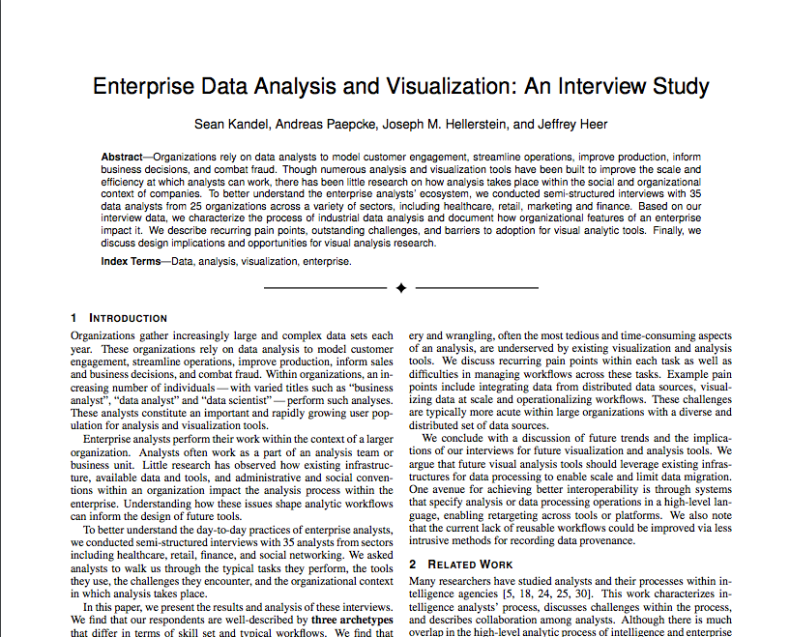

Slide 43


READINGS
Read the following before class on Monday
http://www.slideshare.net/MrChrisJohnson/algorithmic-music-recommendations-at-spotify
http://techblog.netflix.com/2012/04/netflix-recommendations-beyond-5-stars.html
DATA SCIENCE - Week 4 Day 2

Slide 44
