Slide 1
DATA SCIENCE
11 WEEK PART TIME COURSE
Week 7 - Decision Trees
Monday 2nd January 2016

Slide 2
AGENDA
..
What are decision trees?
How decision trees work
Visual example on Titanic dataset
Lab
Talks
Discussion

Slide 3
DECISION TREES
DATA SCIENCE PART TIME COURSE

Slide 4
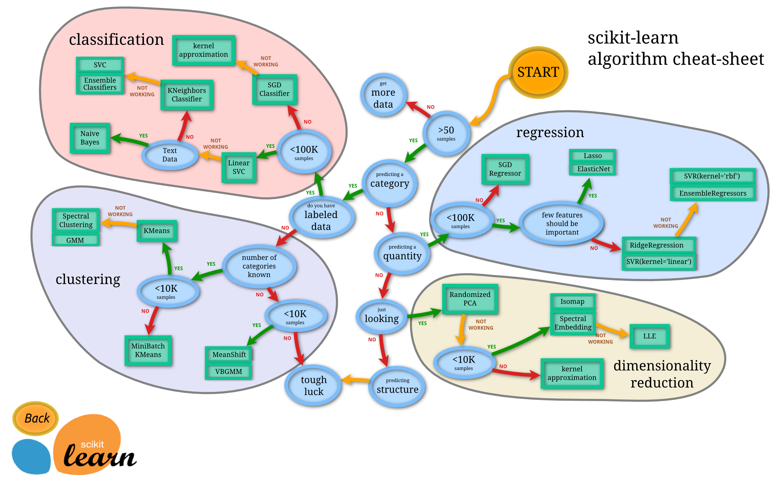

Slide 5
WHAT ARE DECISION TREES?
A supervised learning technique that can be used for classification or regression.

Slide 6
WHAT ARE DECISION TREES?
A supervised learning technique that can be used for classification or regression.
Visually engaging and easy to interpret.

Slide 7
WHAT ARE DECISION TREES?
A supervised learning technique that can be used for classification or regression.
Visually engaging and easy to interpret.
Foundation for getting into very powerful techniques.

Slide 8
WHAT ARE DECISION TREES?
A supervised learning technique that can be used for classification or regression.
Visually engaging and easy to interpret.
Foundation for getting into very powerful techniques.
Great for explaining to people!

Slide 9
DECISION TREES - SHORTCOMINGS
Prone to overfitting.

Slide 10
DECISION TREES - SHORTCOMINGS
Prone to overfitting.
Predictive power is lower in comparison to many other modern techniques.

Slide 11
DECISION TREES - HOW IT WORKS
Scans for a feature to split on that results in the greatest separation between classes in the resulting nodes.

Slide 12
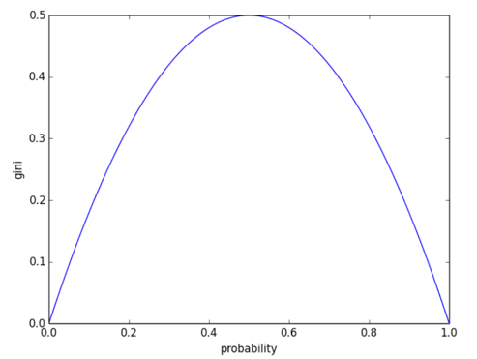
DECISION TREES - HOW IT WORKS
The Gini Index
Equal ratio of target classes
50:50
High purity
of class 0
High purity
of class 1

Slide 13
DECISION TREES - HOW IT WORKS
Scans for a feature to split on that results in the greatest separation between classes in the resulting nodes.
Non-linear.

Slide 14
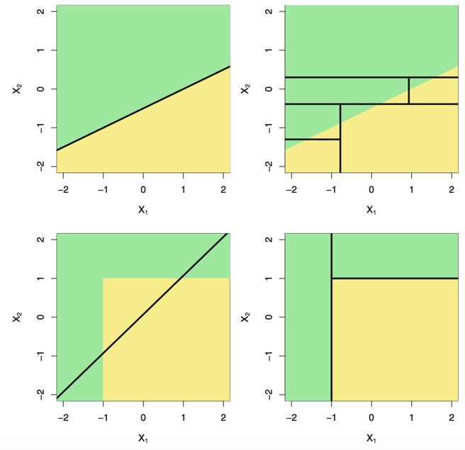
DECISION TREES - HOW IT WORKS
Linear decision boundary
Non-linear decision boundary

Slide 15
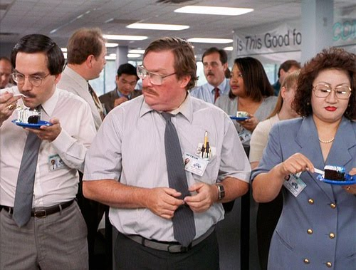
DECISION TREES - HOW IT WORKS
Scans for a feature to split on that results in the greatest separation between classes in the resulting nodes.
Non-linear
Greedy process
Splits within splits

Slide 16
DECISION TREES - HOW IT WORKS
Scans for a feature to split on that results in the greatest separation between classes in the resulting nodes.
Non-linear
Greedy process
Splits within splits
For a classification tree, we predict that each observation belongs to the most commonly occurring class of training observations in the region to which it belongs.

Slide 17
DECISION TREES - HOW IT WORKS
Scans for a feature to split on that results in the greatest separation between classes in the resulting nodes.
Non-linear
Greedy process
Splits within splits
For a classification tree, we predict that each observation belongs to the most commonly occurring class of training observations in the region to which it belongs.
We naturally get combinations of features used for our prediction.

Slide 18
VISUALISING A DECISION TREE FIT
http://www.r2d3.us/visual-intro-to-machine-learning-part-1/

Slide 19
TITANIC DATA
Target
Features
PassengerId | Survived | Pclass | Name | Sex | Age | SibSp | Parch | Ticket | Fare
1 | 0 | 3 | Braund, Mr. Owen Harris | male | 22 | 1 | 0 | A/5 21171 | 7
2 | 1 | 1 | Cumings, Mrs. John Bradley (Florence Briggs Thayer) | female | 38 | 1 | 0 | PC 17599 | 71
3 | 1 | 3 | Heikkinen, Miss. Laina | female | 26 | 0 | 0 | STON/O2. 3101282 | 8
4 | 1 | 1 | Futrelle, Mrs. Jacques Heath (Lily May Peel) | female | 35 | 1 | 0 | 113803 | 53
5 | 0 | 3 | Allen, Mr. William Henry | male | 35 | 0 | 0 | 373450 | 8
6 | 0 | 3 | Moran, Mr. James | male |  | 0 | 0 | 330877 | 8
7 | 0 | 1 | McCarthy, Mr. Timothy J | male | 54 | 0 | 0 | 17463 | 52
8 | 0 | 3 | Palsson, Master. Gosta Leonard | male | 2 | 3 | 1 | 349909 | 21
9 | 1 | 3 | Johnson, Mrs. Oscar W (Elisabeth Vilhelmina Berg) | female | 27 | 0 | 2 | 347742 | 11
10 | 1 | 2 | Nasser, Mrs. Nicholas (Adele Achem) | female | 14 | 1 | 0 | 237736 | 30

Slide 20
TITANIC DATA
In pairs, pick the two features from the titanic dataset that you believe will be the most predictive of survival.

Slide 21
TITANIC DATA
Variable | Description
survival | Survival (0 = No; 1 = Yes)
pclass | Passenger Class (1 = 1st; 2 = 2nd; 3 = 3rd)
name | Name
sex | Sex
age | Age
sibsp | Number of Siblings/Spouses Aboard
parch | Number of Parents/Children Aboard
ticket | Ticket Number
fare | Passenger Fare
cabin | Cabin

Slide 22
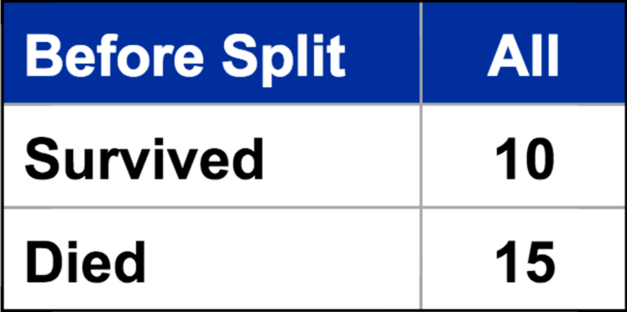

SPLITTING - USING GINI INDEX

Slide 23

SPLITTING - USING GINI INDEX

Slide 24

SPLITTING - USING GINI INDEX

Slide 25

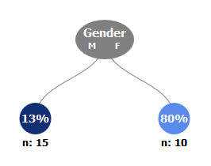
SPLITTING - USING GINI INDEX
Gini_{O}
Gender | M
Survived | 2
Died | 13
Gender | F
Survived | 8
Died | 2

Slide 26


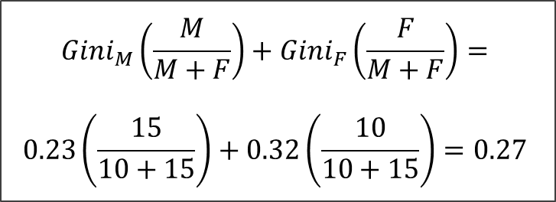
SPLITTING - USING GINI INDEX
Gini_{O}
Gini_{M}
Gini_{F}
Gini_{C}

Slide 27
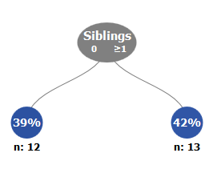
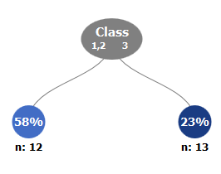
SPLITTING - USING GINI INDEX
Gender | M | F
Survived | 2 | 8
Died | 13 | 2
Gini_{C} | 0.27
Siblings | 0 | ≥1
Survived | 5 | 5
Died | 7 | 8
Gini_{C} | 0.48
Class | 1,2 | 3
Survived | 7 | 3
Died | 5 | 10
Gini_{C} | 0.42

Slide 28

TITANIC
Using BigML to demonstrate a decision tree model on the Titanic dataset.
https://bigml.com/dashboard/datasets
BigML is a cloud based machine learning tool, designed to make machine learning more approachable.

Slide 29
LAB
DATA SCIENCE PART TIME COURSE

Slide 30
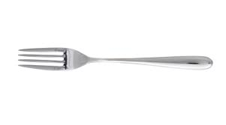
SYNCHING A FORK
git remote -v
git remote add upstream https://github.com/ihansel/SYD_DAT_3.git
git remote -v
git fetch upstream
git checkout master
git merge upstream/master
OR git reset --hard upstream/master

