Slide 1
NETWORK OF LIFE

Slide 2
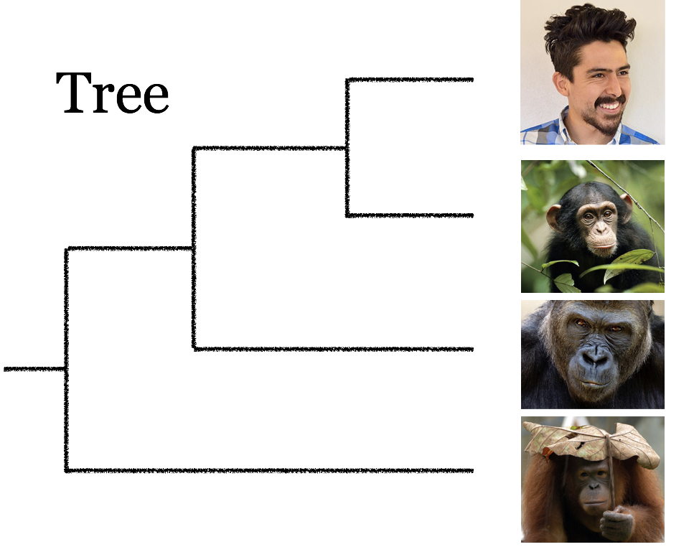
Tree
Notes:
Why do we care?
Phylogenetics studies evolution, which is depicted as a bifurcating tree. This tree represents the evolutionary history of 4 primates: human, chimpanzee, gorilla and orangutan. Humans and chimpanzees are sister species because they share a common ancestor (represented by the internal node in the tree).

Slide 3


DENTIST EXAMPLE
Others
Dentist
AIDS

Slide 4
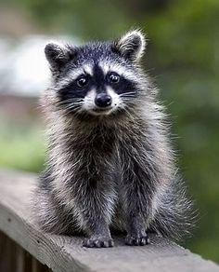
1 Species

Slide 5
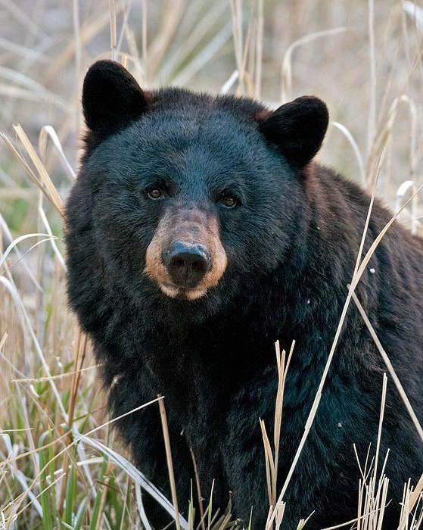
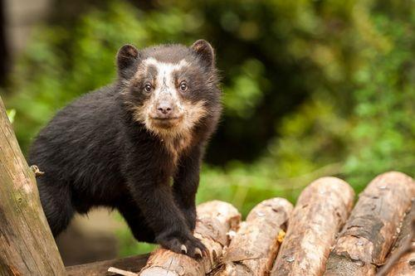
2 Species

Slide 6
3 Species

Slide 7
3 Species

Slide 8
3 Species

Slide 9
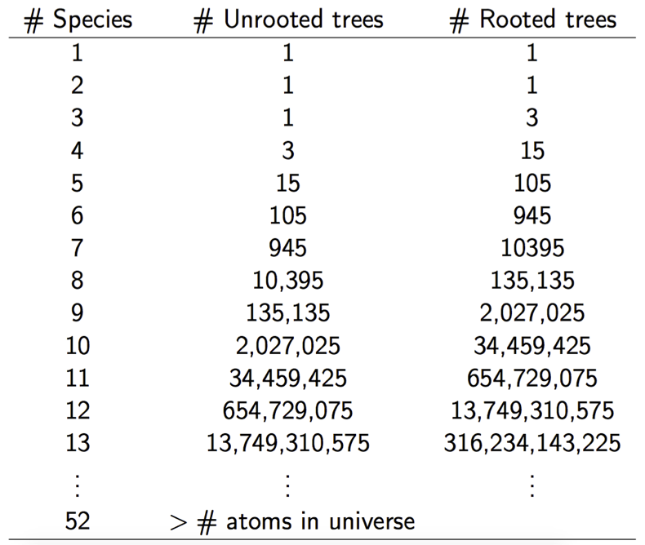

Slide 10

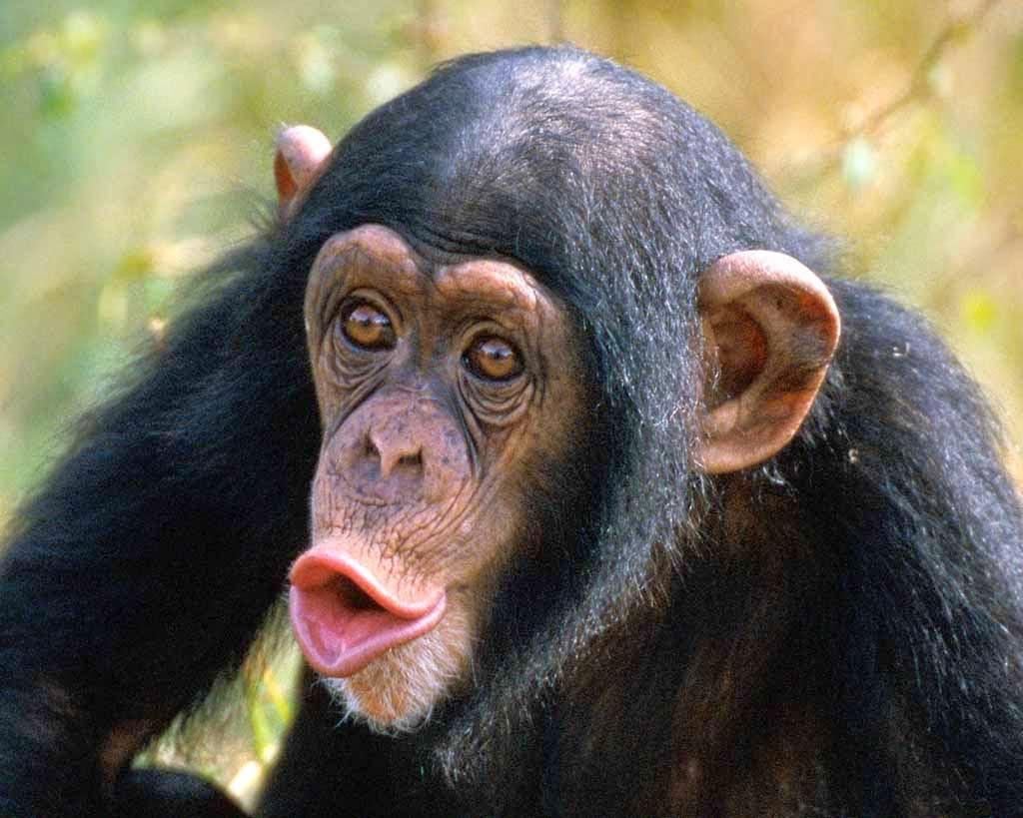
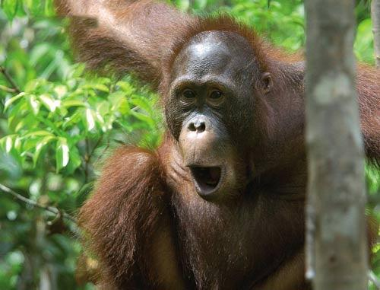
NETWORK

Slide 11


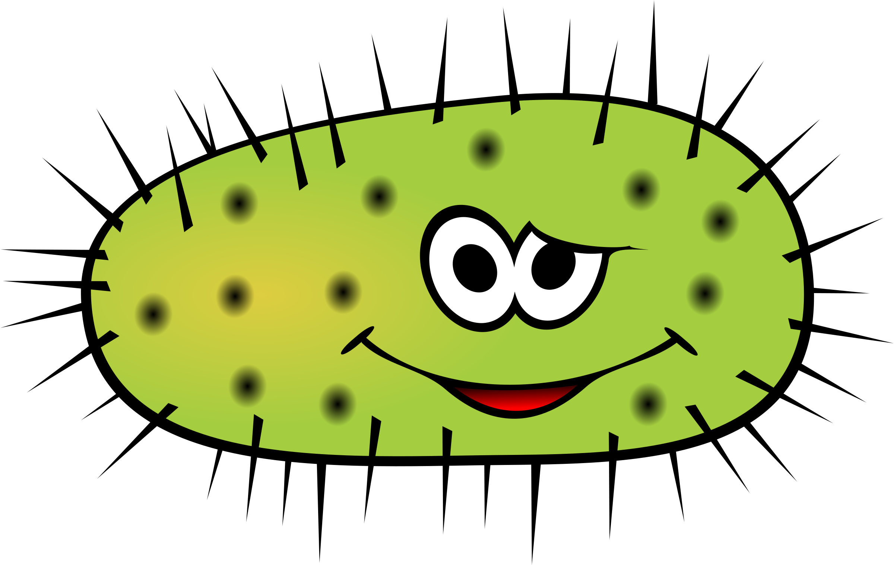
GENE FLOW

Slide 12
GENE FLOW

Slide 13
GENE FLOW

Slide 14
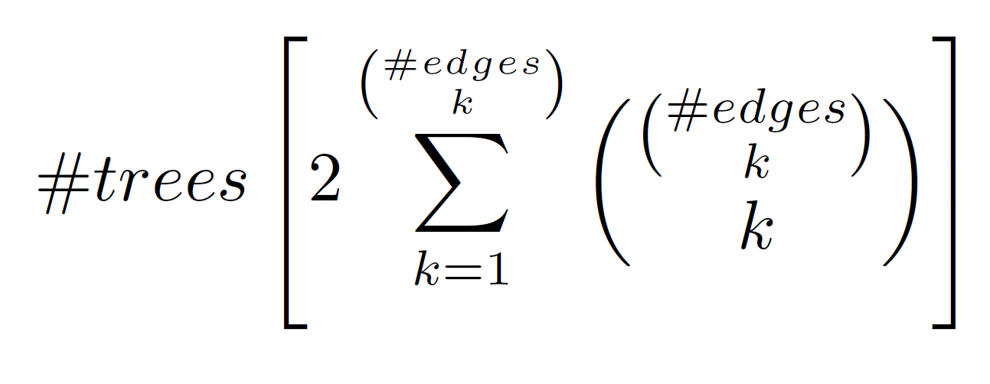
GENE FLOW

Slide 15
6
5
4
3
2
1
Time
1 2 3
Number of Species

Slide 16
8
7
6
5
4
3
2
1
Time
1 2 3 4
Number of Species

Slide 17
15
14
13121110
9
8
7
6
5
4
3
2
1
Time
1 2 3 4 5
Number of Species

Slide 18
OUR APPROACH

Slide 19
OUR APPROACH

