Slide 1
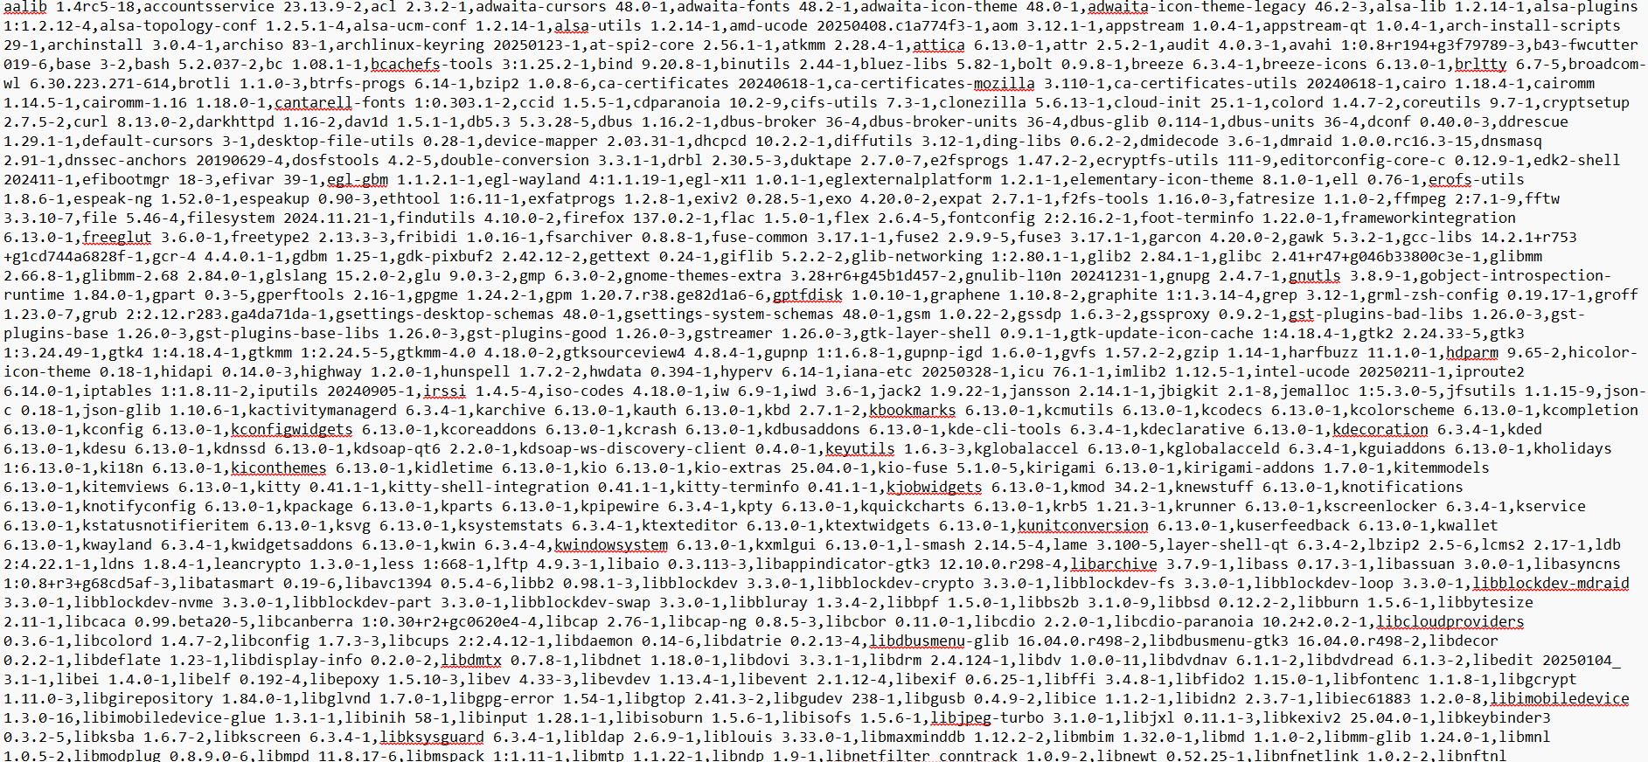
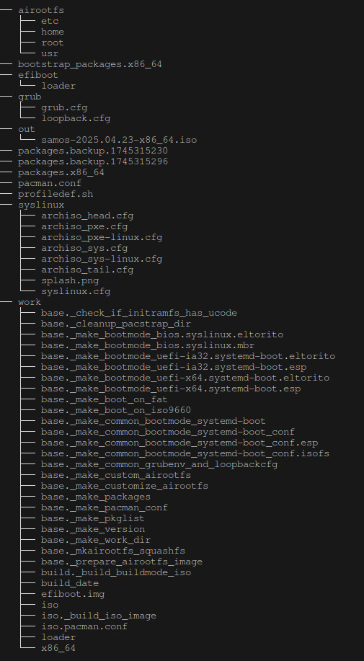
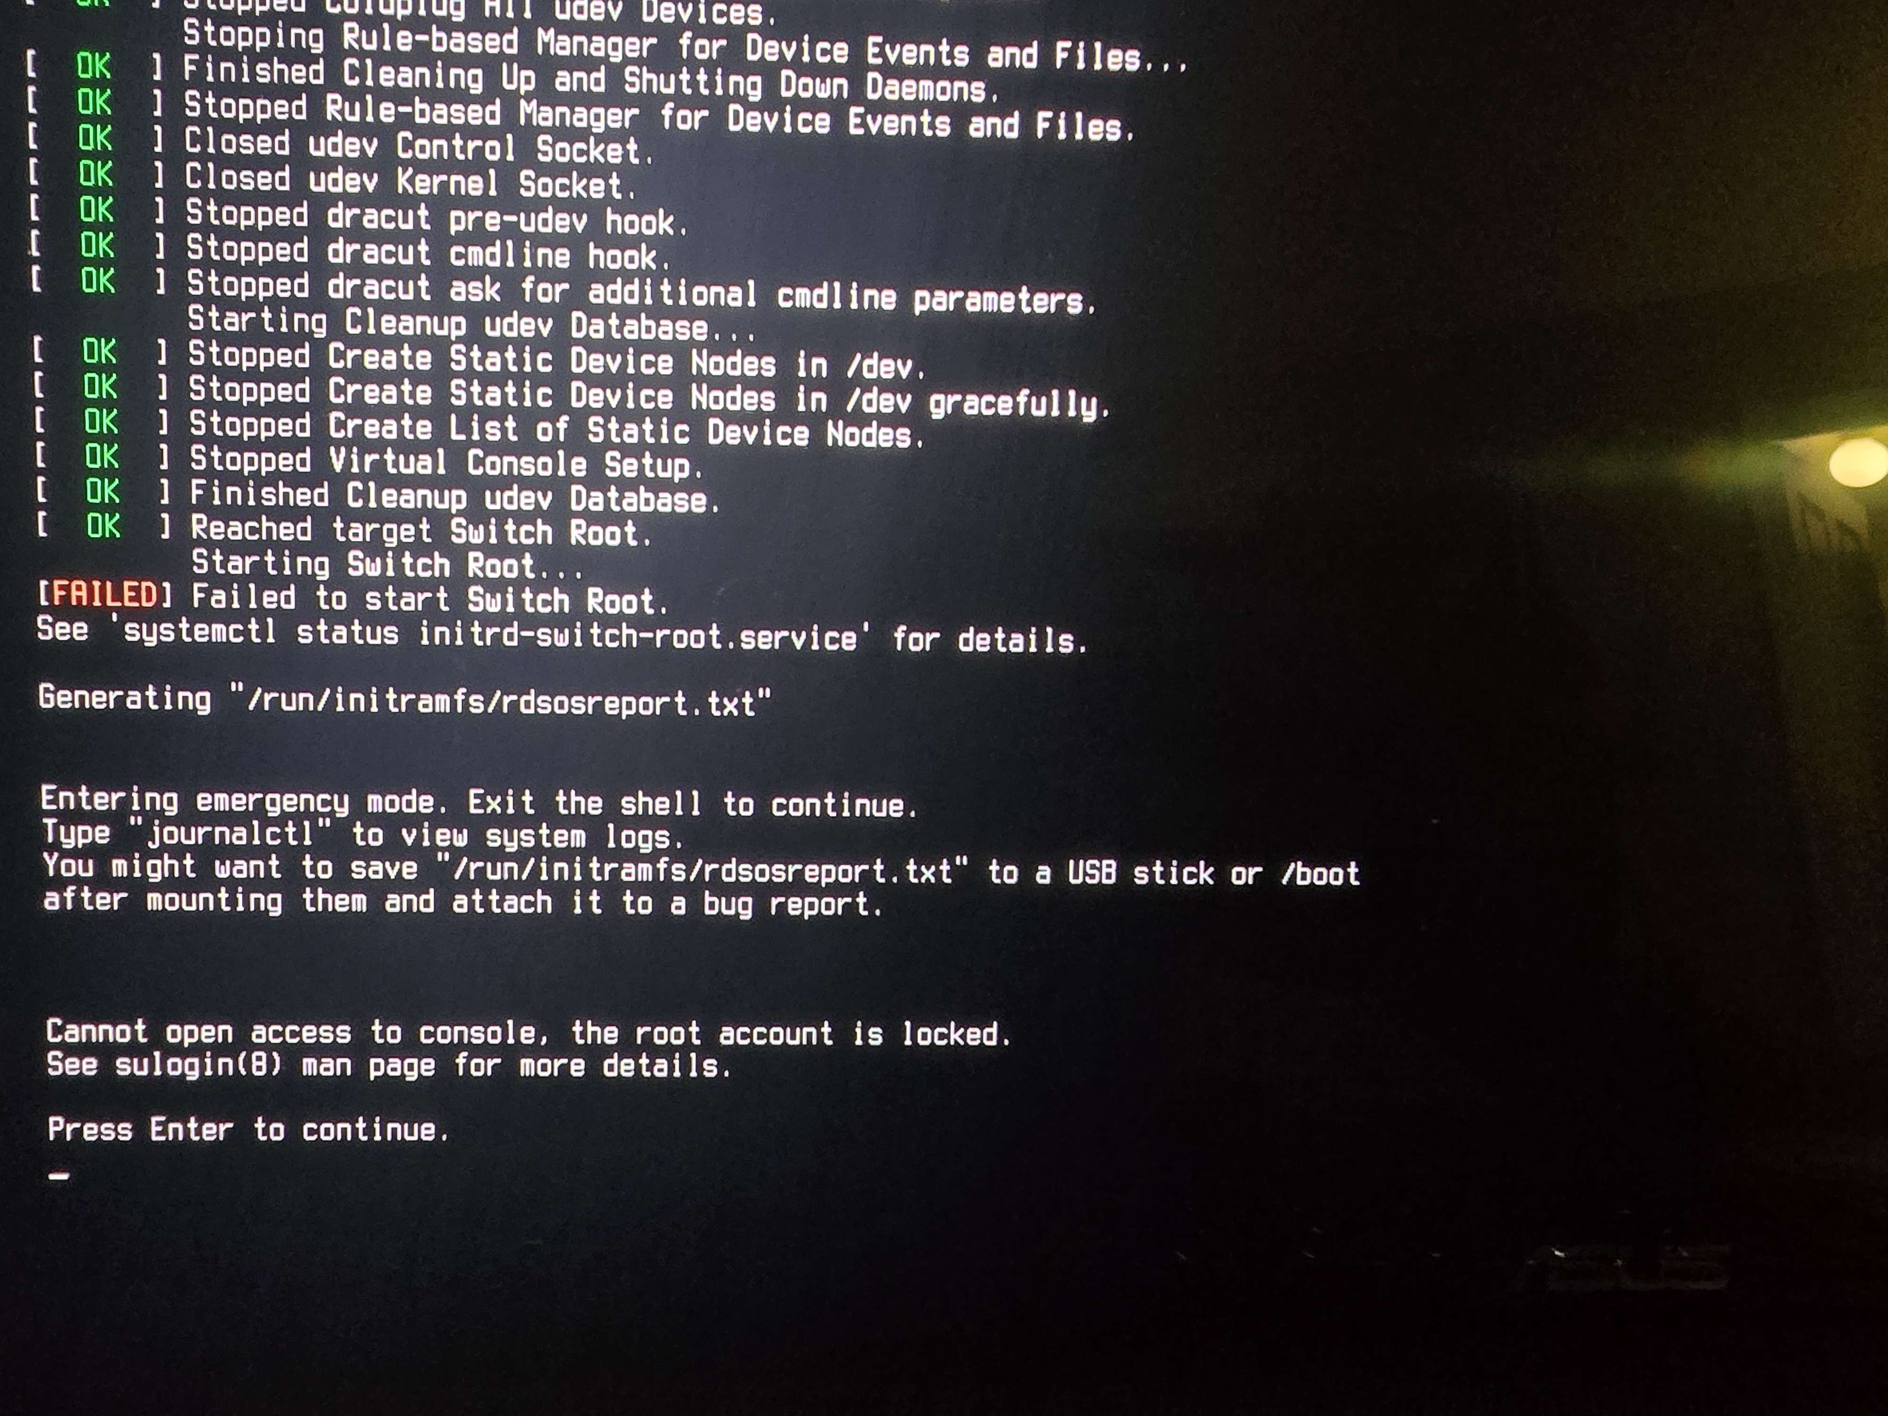
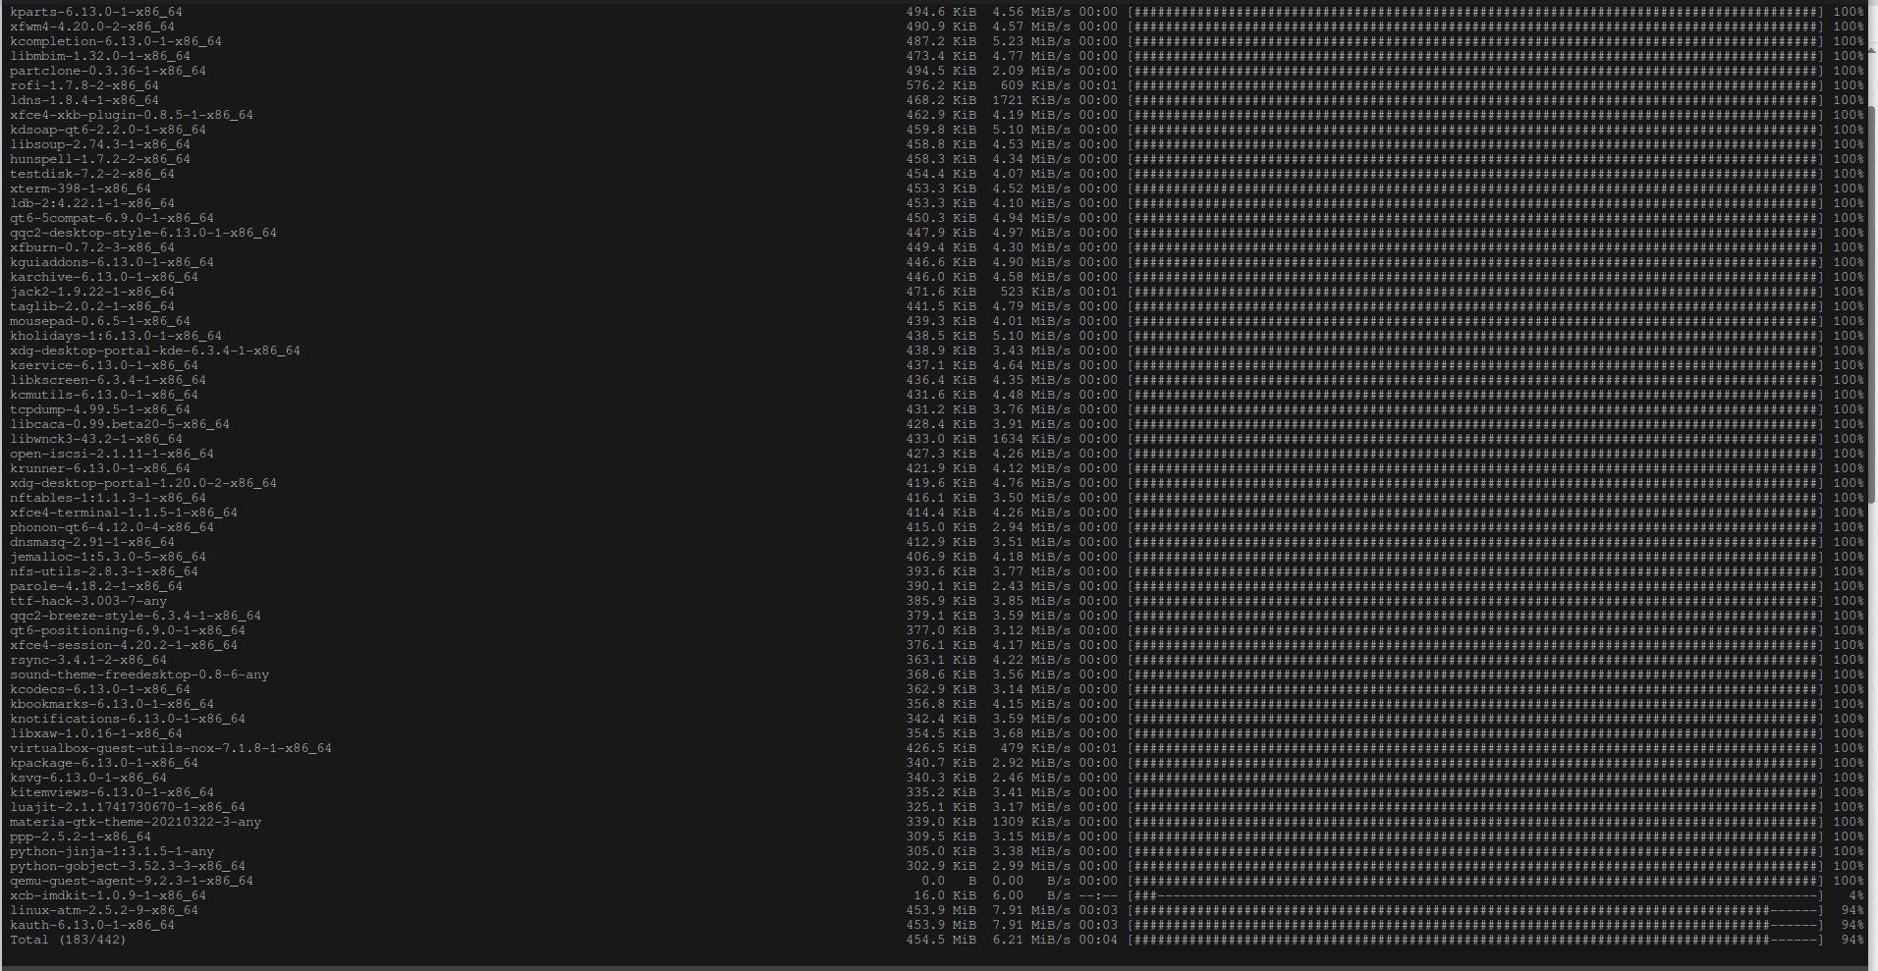
Non-Cognitive Predictors of Student Success: A Predictive Validity Comparison Between Domestic and International Students
Optimizing Lightweight Linux Distributions and Power Efficiency for Microcomputers
METHODS
Git pulled the official Linux kernel from the official Linux GitHub repo
Used “make” command in terminal which built the Linux kernel and selected basic packages(only required packages used to ensure lightweight nature, AMD and Intel)
Used “make modules_install” and “make install” commands to install the kernel- Kernel copied to “/boot” directory with correct naming conventions used (vmlinuz-* and initramfs)
Built an ISO, which was easily the most complicated and technically intense part of the project
Booted ISO in Virtual Machine(basically a simulated computer on another computer) to test- Encountered "switch root" error
Verified presence of /arch/boot/x86_64/vmlinuz-linux-zen, initramfs-linux-zen.img and intel-ucode.img, critical files necessary for the architecture of the computer
Modified isolinux.cfg to add nomodeset debug to boot parameters, allowing computer to actually use our new OS
Rebuilt ISO and confirmed that it reached switch root stage
PRESENTERS:
Ian Harrison, Bennett Jakobsen
This is the level 2 tree of our project, you can clearly see how everything is separated into the packages and boot info. Every time the OS builds, it generates the “airootfs” file, which defines everything about what will be included in the build of the OS.
BACKGROUND:
In our current age of interconnectivity, the Internet of Things(IoT) is becoming more and more prolific. IoT devices are devices that aren’t often thought of as computers, but can still connect to the internet and have functionality, such as earbuds, Ring doorbells, thermostats, or an Amazon Alexa.
Raspberry Pi and Arduino are 2 of the most common microcomputer brands, and they fall under the umbrella of IoT devices.
When a developer of software wants to make a microcomputer perform a function, they sometimes need a lot of processing power, and our lightweight Linux-based operating system is great for this use case, as it is designed to take up as little processing power as possible.
The names listed here are about half of the different packages that were required to compile our project.
This is a picture of a switch root error, a very common problem when making custom iso and distros. This issue occurs when every file and directory is not perfectly oriented, causing the airootfs.sfs file (the file that manages the boot directory) to be unsure where it must swap to boot. The first parts of the boot are handled by GRUB, this issue occurs when airoot swaps the boot to the OS's files.
This is a screenshot of the package installation, while we added around 150 additional packages to ensure compatability and ease of use, we still had around 880 total packages. While it sounds like a big number, this is extremely small by comparison to other distributions.
Notes:
Notes:
In Powerpoint, click View > Guides
Keep text within gutter guides.
Author list: Don’t split names onto two lines (e.g., “Jimmy [break] Smith”). If that happens, use a new line, unless you need the space. Bold the first names of anybody who’s presenting in person.
Intro/methods/result: Do not drop below font size 28, but if you have extra space, jack up the font size until the space is full.
Do not use color in the sidebars except in graphs/figures. It’ll pull attention from the center and slow interpretation for passersby.

