Slide 1
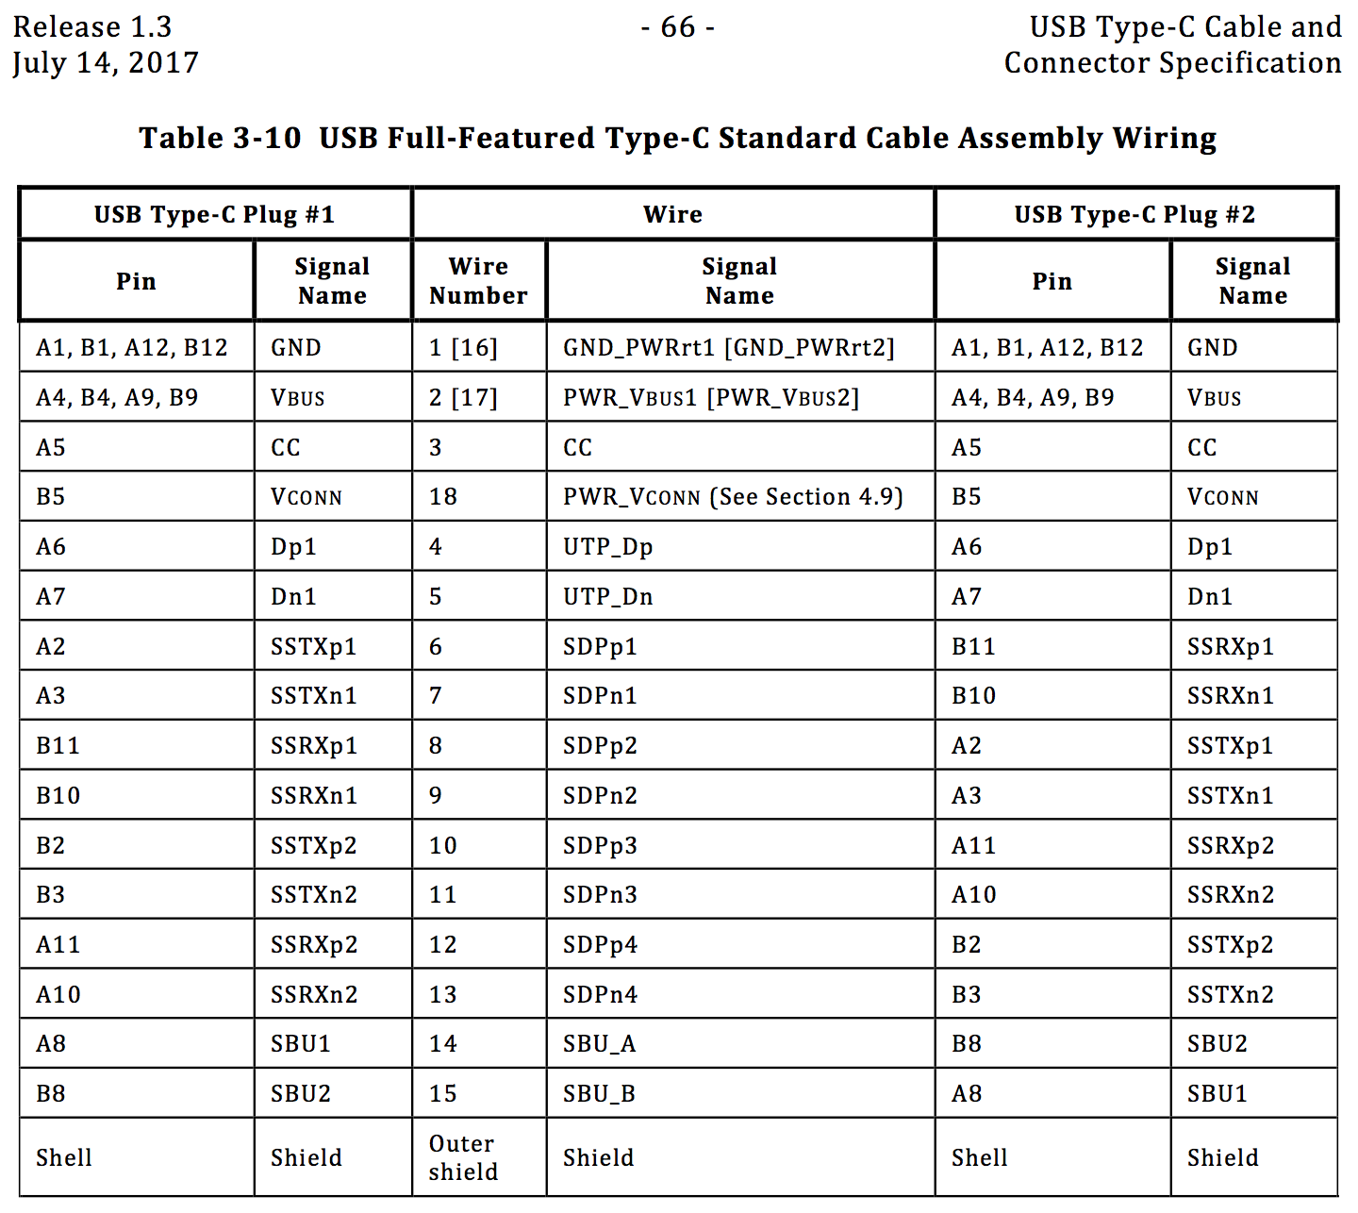
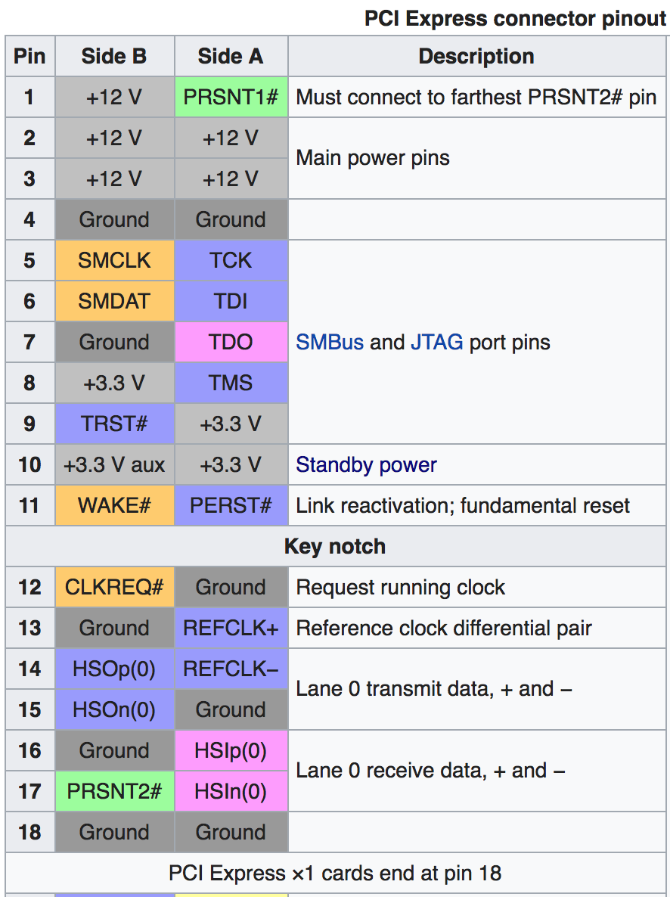
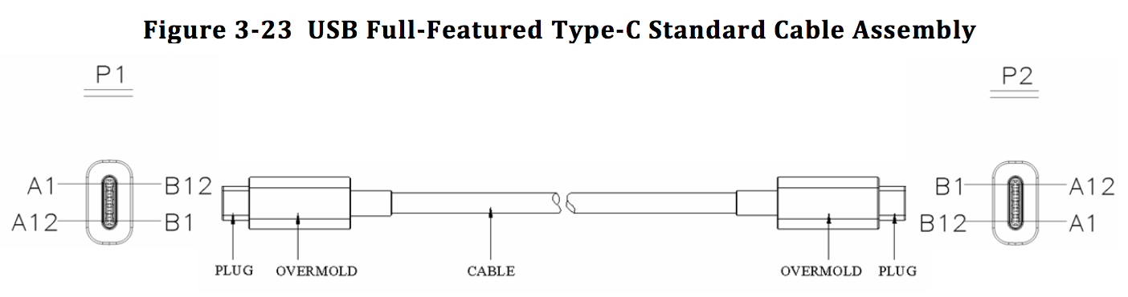
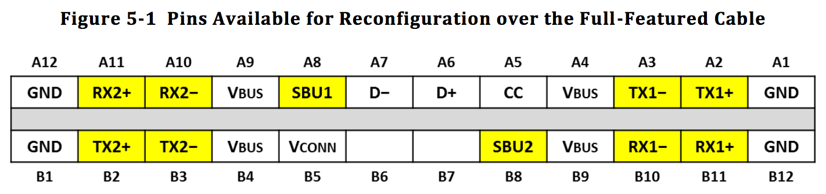
System (PCIe Card Edge)
Card (PCIe Receptacle)
GND >
GND
+12V >
+12V
+3.3V aux >
+3.3V aux
REFCLK+ >
REFCLK+
REFCLK- >
REFCLK-
HSOp(0) >
HSOp(0)
HSOn(0) >
HSOn(0)
HSlp(0) <
HSlp(0)
HSln(0) <
HSln(0)
PERST# >
PERST#
PRSNT1# >
WAKE# <
WAKE#
PRSNT2# <
+3.3V >
+3.3V
+3.3V >
+3.3V

Slide 2
USB C Bridge, Table 3-10 Straight Cable
USB C Bridge, Double-Twist Straight Cable
USB C Bridge, Twisted Cable
Host PCIe Signal | Host PCIe Pin |  | Host USB-C Signal | Wire Signal | Dev USB-C Signal | Dev USB-C Pin |  | Dev PCIe Signal
 | A12 |  | GND |  | GND | B12
 |  | B1 | GND |  | GND |  | A1
 | A11 |  | SSRXp2 |  | SSRXp1 | B11
 | A10 |  | SSRXn2 |  | SSRXn1 | B10
 |  | B2 | SSTXp2 |  | SSTXp1 |  | A2
 |  | B3 | SSTXn2 |  | SSTXn1 |  | A3
 | A9 |  | Vbus |  | Vbus | B9
 |  | B4 | Vbus |  | Vbus |  | A4
 | A8 |  | SBU1 |  | SBU2 | B8
 |  | B5 | Vconn |  | CC |  | A5
 | A7 |  | Dn1 |  |  | B7
 | A6 |  | Dp1 |  |  | B6
 |  | B6 |  |  | Dp1 |  | A6
 |  | B7 |  |  | Dn1 |  | A7
 | A5 |  | CC |  | Vconn | B5
 |  | B8 | SBU2 |  | SBU1 |  | A8
 | A4 |  | Vbus |  | Vbus | B4
 |  | B9 | Vbus |  | Vbus |  | A9
 | A3 |  | SSTXn1 |  | SSTXn2 | B3
 | A2 |  | SSTXp1 |  | SSTXp2 | B2
 |  | B10 | SSRXn1 |  | SSRXn2 |  | A10
 |  | B11 | SSRXp1 |  | SSRXp2 |  | A11
 | A1 |  | GND |  | GND | B1
 |  | B12 | GND |  | GND |  | A12
Host PCIe Signal | Host PCIe Pin |  | Host USB-C Signal | Wire Signal | Dev USB-C Signal | Dev USB-C Pin |  | Dev PCIe Signal
 | A12 |  | GND |  | GND | B12
 |  | B1 | GND |  | GND |  | A1
 | A11 |  | SSRXp1 |  | SSRXp2 | B11
 | A10 |  | SSRXn1 |  | SSRXn2 | B10
 |  | B2 | SSTXp1 |  | SSTXp2 |  | A2
 |  | B3 | SSTXn1 |  | SSTXn2 |  | A3
 | A9 |  | Vbus |  | Vbus | B9
 |  | B4 | Vbus |  | Vbus |  | A4
 | A8 |  | SBU2 |  | SBU1 | B8
 |  | B5 | CC |  | Vconn |  | A5
 | A7 |  |  |  | Dn1 | B7
 | A6 |  |  |  | Dp1 | B6
 |  | B6 | Dp1 |  |  |  | A6
 |  | B7 | Dn1 |  |  |  | A7
 | A5 |  | Vconn |  | CC | B5
 |  | B8 | SBU1 |  | SBU2 |  | A8
 | A4 |  | Vbus |  | Vbus | B4
 |  | B9 | Vbus |  | Vbus |  | A9
 | A3 |  | SSTXn2 |  | SSTXn1 | B3
 | A2 |  | SSTXp2 |  | SSTXp1 | B2
 |  | B10 | SSRXn2 |  | SSRXn1 |  | A10
 |  | B11 | SSRXp2 |  | SSRXp1 |  | A11
 | A1 |  | GND |  | GND | B1
 |  | B12 | GND |  | GND |  | A12
Host PCIe Signal | Host PCIe Pin |  | Host USB-C Signal | Wire Signal | Dev USB-C Signal | Dev USB-C Pin |  | Dev PCIe Signal
GND | A12 |  | GND |  | GND | B12 |  | GND
GND |  | B1 | GND |  | GND |  | A1 | GND
BRIDGE_EN < | A11 |  | SSRXp1 |  | SSRXp1 | B11 |  | > PERST#
PRSNT1# < | A10 |  | SSRXn1 |  | SSRXn1 | B10 |  | > PRSNT2#
PERST# > |  | B2 | SSTXp1 |  | SSTXp1 |  | A2 | < BRIDGE_EN
PRSNT2# > |  | B3 | SSTXn1 |  | SSTXn1 |  | A3 | < PRSNT1#
+3V3 > | A9 |  | Vbus |  | Vbus | B9 |  | > +3V3
+3V3 > |  | B4 | Vbus |  | Vbus |  | A4 | > +3V3
+12V > | A8 |  | SBU2 |  | SBU2 | B8 |  | > +12V
3V3_AUX > |  | B5 | CC |  | CC |  | A5 | > 3V3_AUX
 | A7 |  |  |  |  | B7
 | A6 |  |  |  |  | B6
REFCLK+ > |  | B6 | Dp1 |  | Dp1 |  | A6 | > REFCLK+
REFCLK- > |  | B7 | Dn1 |  | Dn1 |  | A7 | > REFCLK-
 | A5 |  | Vconn |  | Vconn | B5
+12V > |  | B8 | SBU1 |  | SBU1 |  | A8 | > +12V
+3V3 > | A4 |  | Vbus |  | Vbus | B4 |  | > +3V3
+3V3 > |  | B9 | Vbus |  | Vbus |  | A9 | > +3V3
PE_T0+ > | A3 |  | SSTXn2 |  | SSTXn2 | B3 |  | < PE_R0+
PE_T0- > | A2 |  | SSTXp2 |  | SSTXp2 | B2 |  | < PE_R0-
PE_R0+ < |  | B10 | SSRXn2 |  | SSRXn2 |  | A10 | > PE_T0+
PE_R0- < |  | B11 | SSRXp2 |  | SSRXp2 |  | A11 | > PE_T0-
GND | A1 |  | GND |  | GND | B1 |  | GND
GND |  | B12 | GND |  | GND |  | A12 | GND

