Slide 1


MALAKAND CAMPUS CHAKDARA KPK PAKISTAN

Slide 2
RIPHAH INTERNATIONAL UNIVERSITY
MALAKAND CAMPUS CHAKDARA KPK PAKISTAN

Slide 3
Lecture 10
Special purpose Diodes
(Light Emitting Diode (LED))
MALAKAND CAMPUS CHAKDARA KPK PAKISTAN

Slide 4
The Light-Emitting Diode (LED) :
Light-emitting diode, usually called a LED is a semiconductor diode that emits incoherent narrow-spectrum of light when electrically biased in the forward direction of the p-n junction, as in the common LED circuit.
LEDs are typically used as on/off indicator lights in electrical appliances such as televisions, video cameras, computers, and stereos etc.
They are also used to display numbers in some alarm clocks, radios, and microwave ovens.

Slide 5
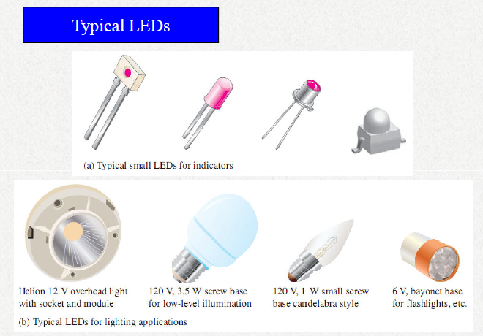
The Light-Emitting Diode (LED) :

Slide 6
Basic Operation of LEDs :
When the device is forward-biased, electrons cross the pn junction, from the n-type material and recombine with holes in the p-type material.
These free electrons are in the conduction band and at a higher energy than the holes in the valence band.
The difference in energy between the electrons and the holes corresponds to the energy of visible light.

Slide 7
Basic Operation of LEDs :
When recombination takes place, the recombining electrons release energy in the form of photons.
The emitted light tends to be monochromatic (one color) that depends on the band gap (and other factors).
A large exposed surface area on one layer of the semi-conductive material permits the photons to be emitted as visible light.
This process is called electroluminescence

Slide 8
The Light-Emitting Diode (LED) :
Energy gap of the these diode must be greater than 1.8 eV. i.e.
Eg > 1.8 eV
And as already discussed that electrons in the semiconductor recombine with electron holes, releasing energy in the form of photons.
And the energy released in the form of photon contains Energy as
E = hf
Also f = E / h
E is the energy of the photon in Joules.
h is Planck's constant. 6.63 * 10^-34 Joule seconds.
f is the frequency of the light in hertz.

Slide 9
The Light-Emitting Diode (LED) :
Also f = E / h
It means that if E is high , frequency will be high and vice versa.
The frequency of photon decides its color wither it is blue, red, yellow etc.
And if the frequency “f” is very less it will not gives suffiencint energy to photon and hence photon ( emitted light ) can not be seen by human eye.
So in order to see the light the frequency must be
f > visible light frequency. (So E (Gap) > 1.8 eV)

Slide 10
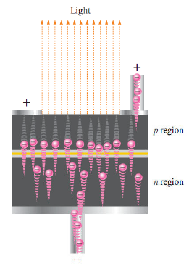
Electro-luminescence:

Slide 11
Light Emitting Diode (LED):
The semiconductor gallium arsenide (GaAs) was used in early LEDs.
The first visible red Leds were produced using gallium arsenide phosphide (GaAsP) on a GaAs substrate.
The efficiency was increased using gallium phosphide (GaP) substrate, resulting in bright red LEDs and also allowing yellow LEDs.
GaAs LEDs emit infrared (IR) radiation, which is invisible.
Later, GaP was used as the light-emitter to achieve pale green light.
Blue LEDs using silicon carbide (SiC) and ultrabright blue LEDs made of gallium nitride (GaN) became available.

Slide 12
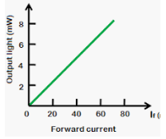
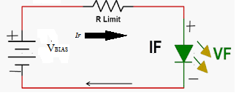
LED Biasing:
The forward voltage across an LED is considerably greater than for a silicon diode.
Typically the maximum VF for LEDs is between 1.2V and 3.2 V, depending on the device.
Reverse breakdown for LED is much less than for a silicon rectifier diode ( 3V to 10V ) .
The Led emits light in response to a sufficient forward current.
Forward biased operation

Slide 13
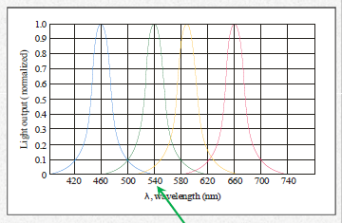
LED Biasing:
LEDs emit a specific range of wavelengths which depend on the construction and dye material used.
The wavelength is given on the specification sheet. LEDs are available for visible light and infrared.
wavelength of green LED

Slide 14
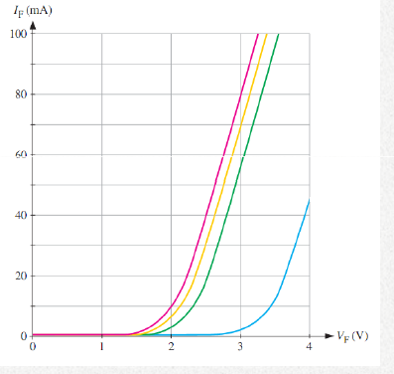
V-I characteristics of LED :
V-I characteristics of visible light LEDs

Slide 15
LED Diode :
The forward voltage drop can vary from about 1.5 V to over
3 V depending on the type of diode, its color, and the
amount of forward current. You need to take into account the
specified maximum current allowed and the diode’s forward
drop when choosing a limiting resistor.
Other specifications, such as maximum power dissipation are
given on the manufacturer’s specification sheet. To determine
the power dissipated by the LED, multiply the forward
voltage by the forward current. P=IV

Slide 16
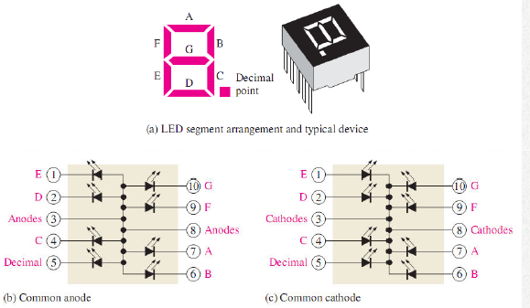
The 7-segment LED display :

Slide 17
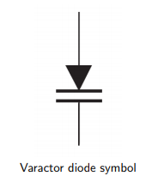
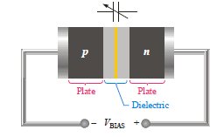
Varactor Diodes :
varactor diode is a special purpose diode operated in reverse-bias to form a voltage-controlled capacitor.
The varactor diode is also known as variable-capacitance diode because the junction capacitance varies with the amount of reverse-bias voltage.

Slide 18
Varactor Diodes :
As we know Zener diode can operate in both reverse biased and forward biasing condition but the varactor diode always function in reverse biasing condition.
Its doping level is high to increases capacitance of its depletion region, here the capacitance term is used because its operation is similar to the capacitor

Slide 19
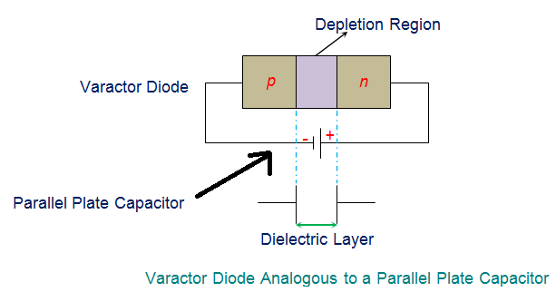
Varactor Diodes :
As we discussed that the depletion region in the p-n junction decreases as the voltage increases in case of forward bias and vice versa.
Under such condition, the p-n junction can be considered to be analogous to a capacitor ( as shown in below figure) where the “p” and “n” layers represent the two plates of the capacitor while the depletion region acts as a dielectric separating them.

Slide 20

Varactor Diodes :
Thus one can apply the formula used to compute the capacitance of a parallel plate capacitor even to the varactor diode.
Hence mathematical expression for the capacitance of varactor diode is given by
C_{j} is the total capacitance of the junction.
ε is the permittivity of the semiconductor material.
A is the cross-sectional area of the junction.
d is the width of the depletion region.

Slide 21

Varactor Diodes operation :
It can be concluded that the capacitance of the varactor diode can be varied by varying the magnitude of the reverse bias voltage as it varies the width of the depletion region, “d”.
From the capacitance equation:
d is inversely proportional to C.
This means that the junction capacitance of the varactor diode decreases with an increase in the depletion region width caused to due to an increase in the reverse bias voltage.

Slide 22
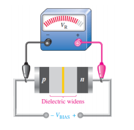
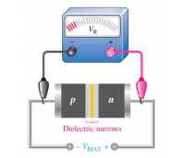
Varactor Diodes operation :
If the reverse-bias voltage increases: The depletion region widens, effectively increasing the plate separation, thus decreasing the capacitance.
When the reverse-bias voltage decreases:
The depletion region narrows, the separation
distance decrease and thus increasing the
Capacitance.

Slide 23
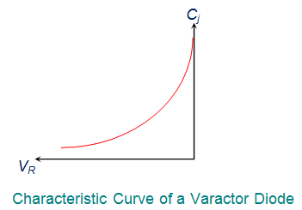
Varactor Diodes C-V curve :
In other words varactor diodes are manufactured with an intention to obtain a definite C-V curve which can be accomplished by controlling the level of doping during the process of manufacture.

Slide 24
Varactor Diodes Advantages :
These varactor diodes are compact in size, economical, reliable and less prone to noise when compared to other diodes. Hence, they are used in:
Tuning circuits to replace the old style variable capacitor tuning of FM radio.
Signal modulation and demodulation.
Adjusting bridge circuits.
Frequency multipliers

Slide 25


Thank You

