Slide 1


MALAKAND CAMPUS CHAKDARA KPK PAKISTAN

Slide 2
RIPHAH INTERNATIONAL UNIVERSITY
MALAKAND CAMPUS CHAKDARA KPK PAKISTAN

Slide 3
Course Name : Applied Physics/ Basic Electronics
Credit Hour : 3
Teacher : Engr. Syed Ishfaq Ahmad
MALAKAND CAMPUS CHAKDARA KPK PAKISTAN

Slide 4
Lecture 1 introduction to Applied Physics/ basic Electronics
MALAKAND CAMPUS CHAKDARA KPK PAKISTAN

Slide 5
Why we study physics?
MALAKAND CAMPUS CHAKDARA KPK PAKISTAN

Slide 6

Physics, which comes from the Greek word “phúsis”, meaning “nature,” is concerned with describing the interactions of energy, matter, space, and time to uncover the fundamental mechanisms that underlie every phenomenon.

Slide 7
You just need to think about all the technological devices you use on a regular basis.
For example, Computers, smartphones, global positioning systems (GPSs), MP3 players, and satellite radio might come to mind.
Then, think about the most exciting modern technologies you have heard about in the news, such as trains that levitate above tracks, and microscopic robots that fight cancer cells in our bodies etc etc. All these groundbreaking advances, rely on the principles of physics.

Slide 8
The advantages of physics in everyday life can be as basic as the conversion of electrical energy to heat to make the morning coffee/tea or as complex as plotting a space shuttle flight from Earth into orbit.

Slide 9
Atom
An atom is the smallest particle of an element that retains the characteristics of that element.
Each type of atom has a certain number of electrons and protons.
The nucleus consists of positively charged particles called protons and uncharged particles called neutrons.

Slide 10
The basic particles of negative charge are called electrons.
Electrons near the nucleus have less energy as compare to those in more distant/far away orbits.
Electrons with the highest energy exist in the outermost shell of an atom and are relatively loosely bound to the atom.

Slide 11
The process of raising or transferring an electron from a lower energy state to a higher energy state is called excitation.
The departure of a valence electron leaves a previously neutral atom with an excess of positive charge (more protons than electrons).
The process of losing a valence electron is known as ionization, resulting a positive ion. (the reverse is also ionization but resulting a negative ion).

Slide 12
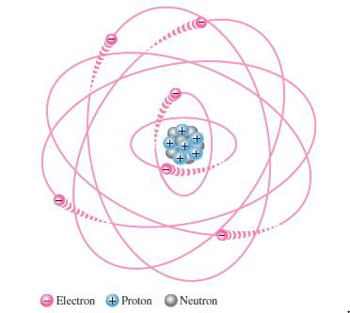
The escaped valence electron is called a free electron.

Slide 13
Electronic configuration
In simple words, Electron configurations are a simple way of writing down the locations of all of the electrons in an atom.
The protons ( positively charged ) which are located in the nucleus attract electrons( negatively charged) which are located around the nucleus in their orbits/shells.

Slide 14
Electronic configuration
We also know that that they mutually repel each other.
As a result of this attraction and repulsion, causing them to spread out around the nucleus in regular patterns thus form a very delicate geometric structure called orbital that form the distinct regions around the nucleus that each electron traces out.

Slide 15
Electronic configuration
The reason that electrons tend to stay in their separate orbitals rather than piling on top of one another is the Pauli Exclusion Principle, a theorem from quantum mechanics that dictates that no two electrons can ever be in the same place.
The orbitals represent identifiable “addresses” for each electron around an atom.

Slide 16
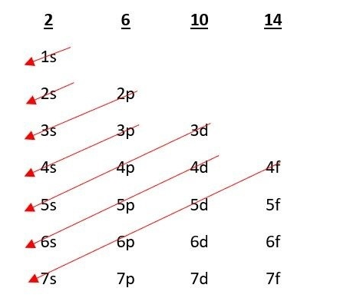
Electronic configuration
Now lets have a look where these electrons are located for this purpose we need to know the electronic configuration.
s, p , d , f are orbitals where,
s accommodates 2 electrons.
p accommodates 4 electrons.
d accommodates 6 electrons.
f accommodates 10 electrons.

Slide 17
TERMINOLOGIES
ELECTRIC CHARGE:
Electric Charge is the amount of energy or electrons that pass from one body to another by different modes like conduction, induction or other specific methods.
Symbolically, it is
Q = ne
where q is a charge, n is a number of electrons.
e is a charge on 1 electron (1.6 × 10-19C)

Slide 18
TERMINOLOGIES
The two very basic natures of electric charges are:
Like charges repel each other
Unlike charges attract each other.
If there is excess of electrons, the body is said to be negatively-charged. Conversely, if there is deficiency of electron , the body is said to be positively-charged.

Slide 19
TERMINOLOGIES
ELECTRIC CURRENT:
It is the rate of flow of electric charge.
If a charge of q coulombs flows across any point in a conductor in time t seconds, then
Current= charge/ time (or i=q/t)

Slide 20
TERMINOLOGIES
Its unit is ampere (A).
Conventional current is the net rate of flow of positive charge whereas electronic current is the net rate of flow of negative charge.

Slide 21
TERMINOLOGIES
ELECTRIC POTENTIAL:
The ability of a charge to do work represent its potential.
Voltage or potential difference is the energy required to move a unit charge through an element, measured in volts (V).

Slide 22
TERMINOLOGIES
ELECTRIC POTENTIAL:
Voltage=work done/charge (or V= W/q).
Electric potential for a point charge is, V = K q/r,
where q is amount of charge (can be positive, negative), r is the distance from point charge till the point P and K is the coulomb constant= 9x10¹⁰ N.m² /C².

Slide 23
TERMINOLOGIES
ENERGY:
Energy is the capacity of doing work, measured in Joules (J).
Power:
power is the work done in a unit of time. Measured in Watt=1joule/1sec.
Work:
Work can be defined as transfer of energy. In physics we say that work is done on an object when you transfer energy to that object. If one object transfers (gives) energy to a second object, then the first object does work on the second object.
W= F x d

Slide 24

Thank You

