Slide 1


MALAKAND CAMPUS CHAKDARA KPK PAKISTAN

Slide 2
RIPHAH INTERNATIONAL UNIVERSITY
MALAKAND CAMPUS CHAKDARA KPK PAKISTAN

Slide 3
Lecture 2 introduction to Applied Physics/ basic Electronics
MALAKAND CAMPUS CHAKDARA KPK PAKISTAN

Slide 4
Lets remind some from the previous lecture:
1. Atom: An atom is the smallest particle of an element that retains the characteristics of the that element.
2.Each element has a unique atomic structure.
3. The nucleus consists of positive charge particle called “Protons”.
And neutral or uncharged particles called “Neutrons”.
4. while the negative particle in orbits are called “Electrons”.
+
-

Slide 5
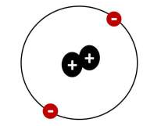
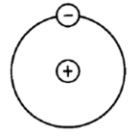
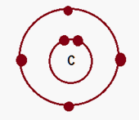
5. each type of atom has a certain number of electrons and proton that distinguish it from the atoms of all other elements.
For instance, the simplest of that of Hydrogen atom which has one proton and one electron, Helium has two protons and two electrons while carbon has six electrons, two in the first orbit and four electrons in the 2nd orbit.
Hydrogen Atom
Helium Atom
Carbon Atom

Slide 6
carbon which has two Electron in the inner shell called Core Electrons and four in the outer shell ( Valance shell) which is called Valance Electrons.
Valance Electron
Core electron
Carbon Atom

Slide 7

Electronic configuration
In simple words, Electron configurations are a simple way of writing down the locations of all of the electrons in an atom.
The protons ( positively charged ) which are located in the nucleus attract electrons( negatively charged) which are located around the nucleus in their orbits/shells.

Slide 8
Electronic configuration
We also know that that they mutually repel each other.
As a result of this attraction and repulsion, causing them to spread out around the nucleus in regular patterns thus form a very delicate geometric structure called orbital that form the distinct regions around the nucleus that each electron traces out.

Slide 9
Electronic configuration
The reason that electrons tend to stay in their separate orbitals rather than piling on top of one another is the Pauli Exclusion Principle, a theorem from quantum mechanics that dictates that no two electrons can ever be in the same place.
The orbitals represent identifiable “addresses” for each electron around an atom.

Slide 10
Electronic configuration
Now lets have a look where these electrons are located, for this purpose we need to know the electronic configuration.
Energy level have sublevels
Sublevels are s , p , d and f where,
s accommodates 2 electrons having 1 orbital.
p accommodates 6 electrons having 3 orbitals.
d accommodates 10 electrons having 5 orbitals.
f accommodates 14 electrons having 7 orbitals.
these orbitals are the final location where
electrons exist.

Slide 11
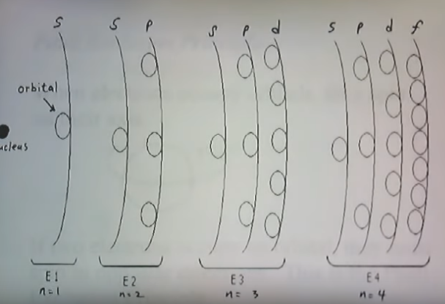

Slide 12
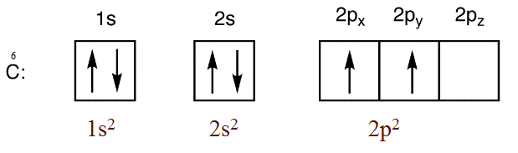
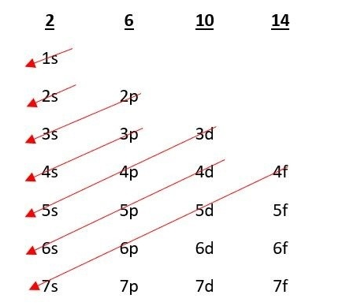
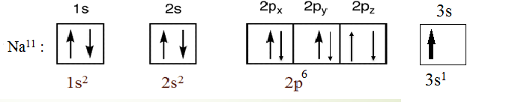
C⁶ = 1s² 2s² 2p²
Na¹¹ = 1s² 2s² 2p⁶ 3s¹

Slide 13
Band Theory :
This theory explains the quantum state that an electron takes inside metal solid. Every molecule comprises of various discrete energy levels. The way electrons behave inside a molecule is well explained through this theory.
This theory defines the following groups of materials in terms of their electrical properties.
1.Conductor,
2.Semiconductor
3.Insulator.

Slide 14
1.Conductor:
Conductors are material which conduct electricity. The overlapping of the valence band and conduction band allows the easy flow of electrons through them. There is no Fermi level between the valence band and the conduction band. When the small voltage is applied, the conductor will result in a large amount of current.
For example. Iron, Aluminum, Silver, Gold

Slide 15
2.Insulator:
Insulators are the material which do not allow any flow of electric current through them. The valence band and conduction band are separated by the energy band gap of 6eV. Thus electrons do not move from valence band to conduction band under the influence of any thermal agitation. The bond between the atoms is the covalent bond and ionic bond. The electron holds the atom very tightly and does not permit electron flow.
For example. Wood, Rubber, Plastic.

Slide 16
3.Semiconductor:
Semiconductors are the material whose conductivity lies between insulators and conductors. At absolute zero temperature, the semiconductor behaves like an insulator whereas by providing thermal agitation, the charge carriers start moving from valence band to conduction band. The valence band and conduction band are separated by the energy band gap of nearly 1eV. The bonding between atoms is the covalent bond.
For example. Si, Ge, the energy band gap for Si=.7eV while for Ge=1.1eV..

Slide 17
In every solid material there are two bands; solid
Valance Band: The energy band which is formed by the grouping the rang of energy levels of the valance electrons or we can see the outermost orbit electron is called valance band.
The electrons present in the valance band are loosely bound to the nucleus as they are far away from the center.
When an electron acquires enough additional energy, it can leave the valance shell , becomes a free electron, and thus exists is another band of energy called conduction band.
Valance band
Conduction band

Slide 18
The term free is applied to any electron that’s has separated from the fixed lattice structure and its very sensitive to any applied electric field such as established by voltage source or any difference in potential.
Conduction Band: The energy band which is formed by grouping the range of energy levels of free electrons is know as conduction band. Generally this band is empty but as discussed early when an electron is energized by an external source, it jumps from valance band to conduction band and thus called Free electron.
Free electrons in the conduction band have higher energy than the electrons in the valance band and thus these electrons are responsible for conduction.

Slide 19
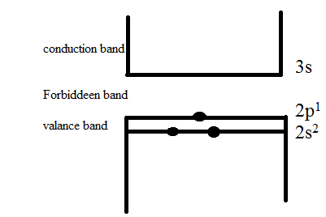


Lets say we have an element,
Here 2s & 2p as these orbitals have electrons so they come closer and form valance band while 3s is empty so it goes up and form conduction band, and the gap formed is known as Forbidden gap.
Empty band
Valance band

Slide 20
So the band theory divide the materials in three groups on the basis of,
a) If the forbidden gap is very high between valance band and conduction band, the material thus called insulator. ( Fg ≥ 5ev where 1ev = 1.6 x 10⁻¹⁹J)
b) If the valance band and conduction band overlaps each other, the material would be Conductor. ( Fg=0, overlapped)
c) If the forbidden gap is very low between valance band and conduction band, the material thus called Semiconductor. (Fg ≤ 3ev where 1ev = 1.6 x 10⁻¹⁹J)

Slide 21
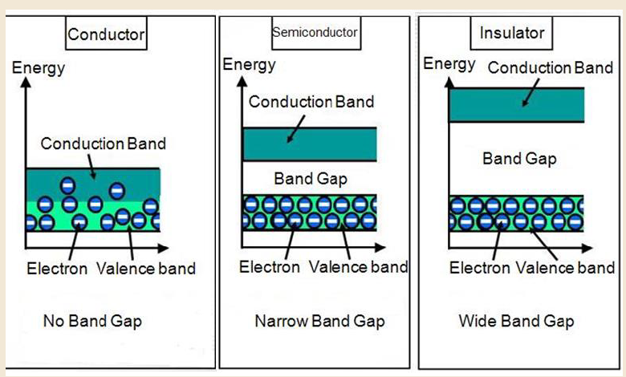

Slide 22

Thank You

