Slide 1


MALAKAND CAMPUS CHAKDARA KPK PAKISTAN

Slide 2
RIPHAH INTERNATIONAL UNIVERSITY
MALAKAND CAMPUS CHAKDARA KPK PAKISTAN

Slide 3
Lecture 3&4
Semiconductor (intrinsic and extrinsic materials)
MALAKAND CAMPUS CHAKDARA KPK PAKISTAN

Slide 4
Lets recall from previous class,
a) If the forbidden gap is very high between valance band and conduction band, the material thus called insulator. ( Fg ≥ 5ev where 1ev = 1.6 x 10⁻¹⁹J)
b) If the valance band and conduction band overlaps each other, the material would be Conductor. ( Fg=0, overlapped)
c) If the forbidden gap is very low between valance band and conduction band, the material thus called Semiconductor. (Fg ≤ 3ev where 1ev = 1.6 x 10⁻¹⁹J)

Slide 5
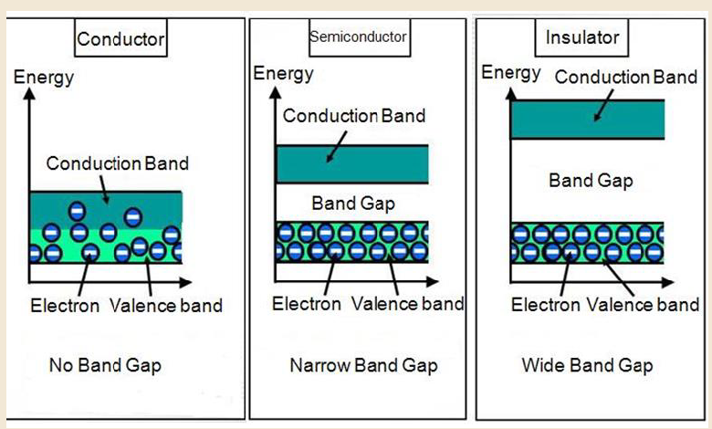

Slide 6
Semiconductor:
Semiconductors are the material whose conductivity lies between insulators and conductors. A semiconductor in its pure state is neither a good conductor nor a good insulator.
At absolute zero temperature, the semiconductor behaves like an insulator whereas by providing thermal agitation, the charge carriers start moving from valence band to conduction band.

Slide 7
The valence band and conduction band are separated by the energy band gap of nearly 1eV. The bonding between atoms is the covalent bond.
In general, semiconductor materials fall into two of the classes:
>Single-crystal and compound.
Single-crystal such as germanium( Ge) and silicon( Si) a repetitive crystal structure,
whereas compound semiconductors such as gallium arsenide (GaAs), cadmium sulfide(Cds), gallium nitride (GaN) and gallium arsenide phosphide (GaAsP) are constructed of two semiconductor materials of different atomic number.

Slide 8
The following three semiconductors used most frequently in the construction of electronic devices are:
Silicon(Si), Germanium(Ge) and gallium arsenide (GaAs),
whereas the energy band gap for Si=0.7eV,
for Ge=1.1eV
and for GaAs = 1.52 eV.

Slide 9
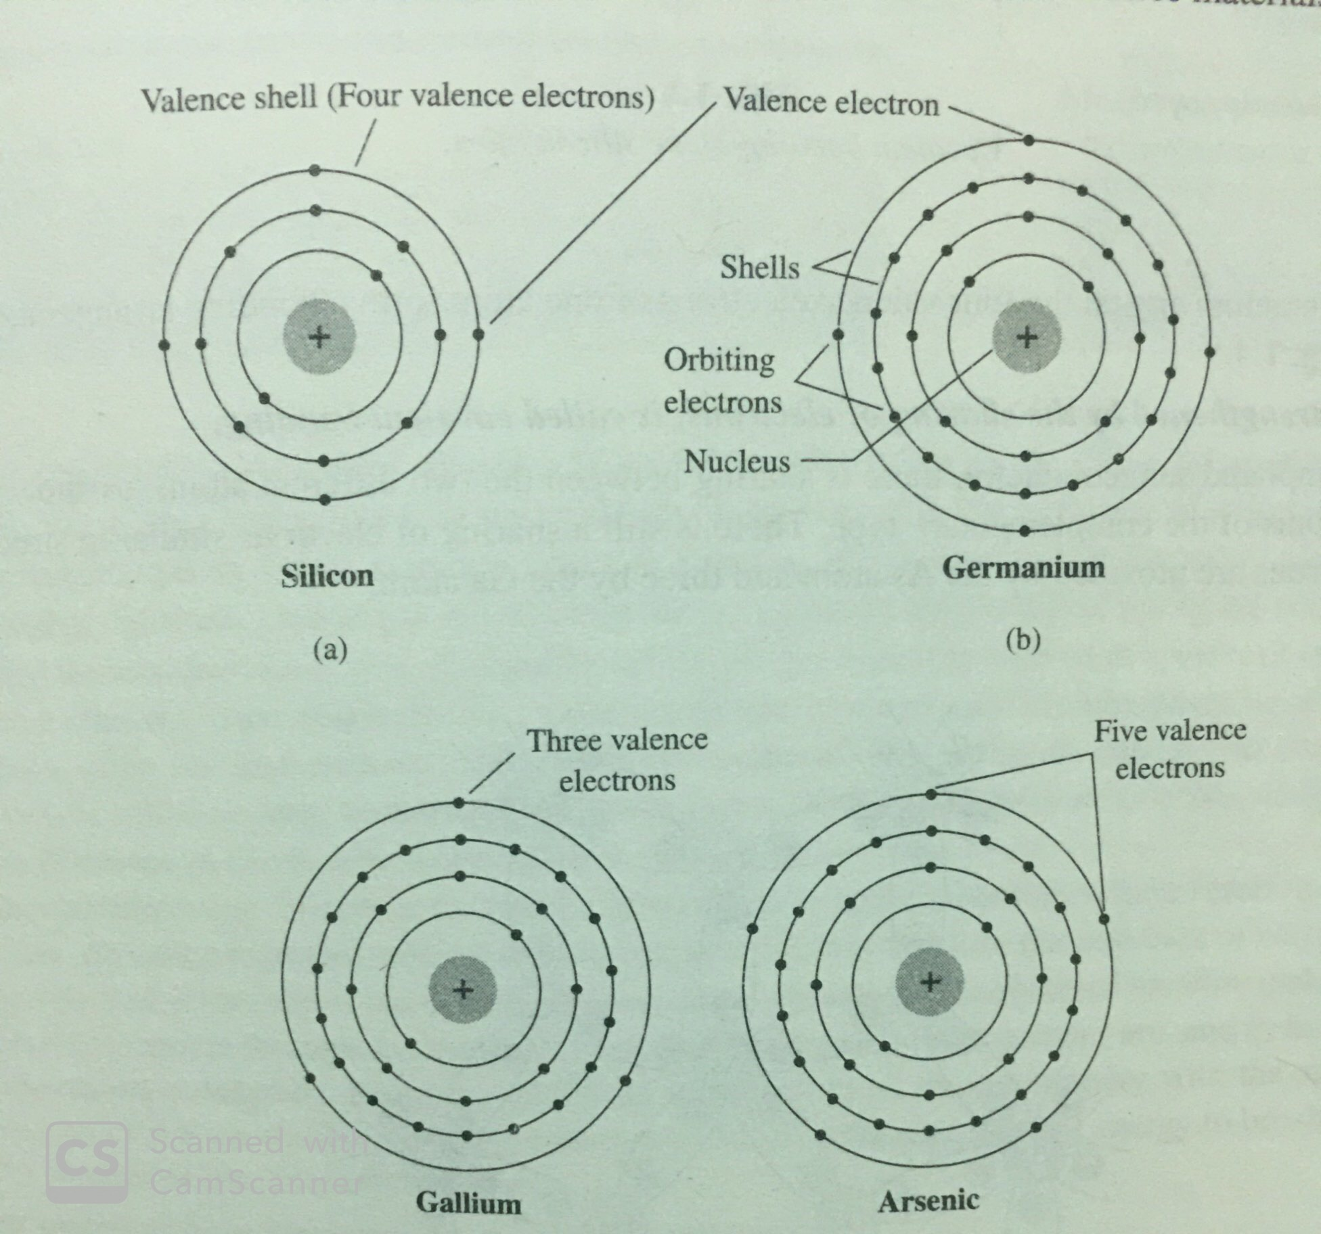
Atomic Structure of Si, Ge, Ga, As

Slide 10
In the previous slide, we came to know that
Silicon has 14 orbiting electrons, germanium has 32 electrons, gallium has 31 electrons and arsenic has 33 electrons
Si and Ge has four electrons in the outermost shell, which are called valance electrons.
Ga has three valance electrons and As has five valance electrons.
Those with three electrons are called Trivalent
Atoms that have four electrons are called Tetravalent.
Those with five are called Pentavalent.

Slide 11
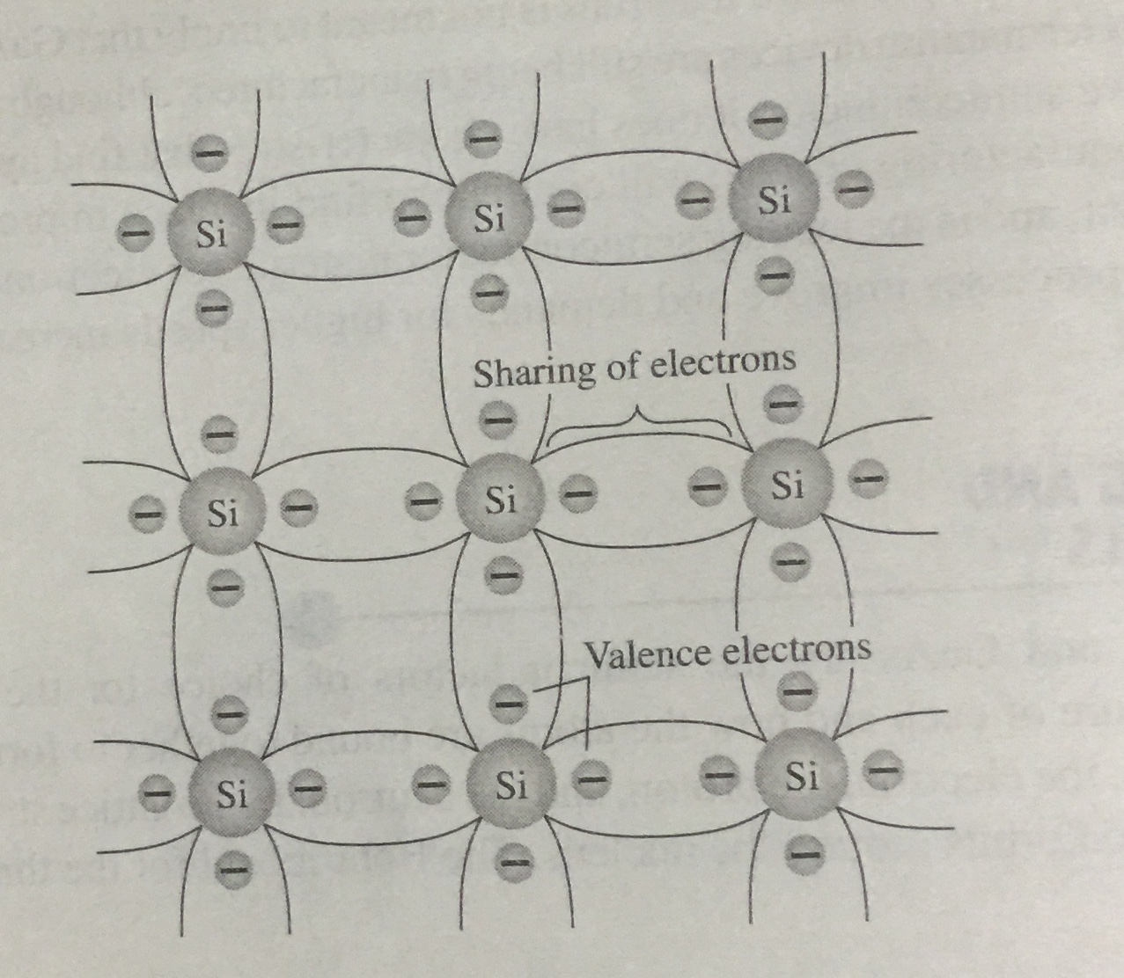

This bonding of atoms, strengthened by the sharing of electrons, is called covalent bond
Covalent bonding of the Si atom

Slide 12
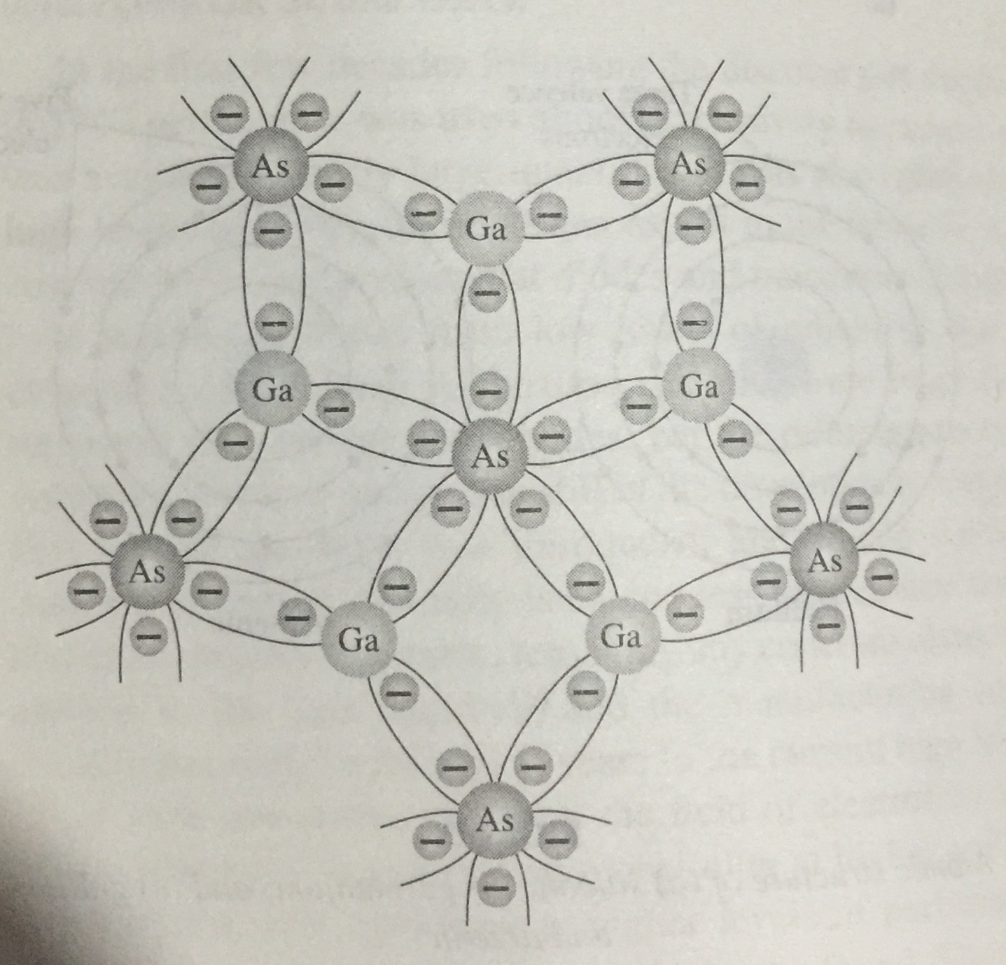
Covalent bonding of the GaAs crystal

Slide 13
Although the covalent bond will result in a stronger bond between the valance electrons and their parent cell.
It is possible for the valance electron to absorb sufficient kinetic energy from external causes to break the covalent bond and assume the “free” state.
The external causes is due to light energy in the form of photons and thermal energy (Heat) from the surrounding medium.
At room temp, there are 1.5 x 10¹⁰ free electrons in 1 cm³ of intrinsic silicon material.

Slide 14
Also its important to remember that, Semiconductor materials exhibit an increased level of conductivity with the application of heat. As the temperature raises, an increasing number of valance electrons absorb sufficient thermal energy to break the covenant bond and to contribute to the number of free electrons therefore,
Semiconductor materials have a negative temperature coefficient.

Slide 15
Semiconductors types / classifications:
There are two basic groups or classifications that can be used to define the different semiconductor types:
1) Intrinsic material:
The term intrinsic is applied to any semiconductor material that has been carefully refined to reduce the number of impurities to a very low level- essentially as pure as can be made available through modern technology.

Slide 16
An intrinsic type of semiconductor material made to be very pure chemically. As a result it possesses a very low conductivity level having very few number of charge carriers, namely holes and electrons, which it possesses in equal quantities.
One of the characteristics of the intrinsic material is the free electrons in the material due to external causes are referred to as intrinsic carriers.
The second most important characteristic which is more significant is said to be “relative mobility (μn) of the free electrons in the material,

Slide 17
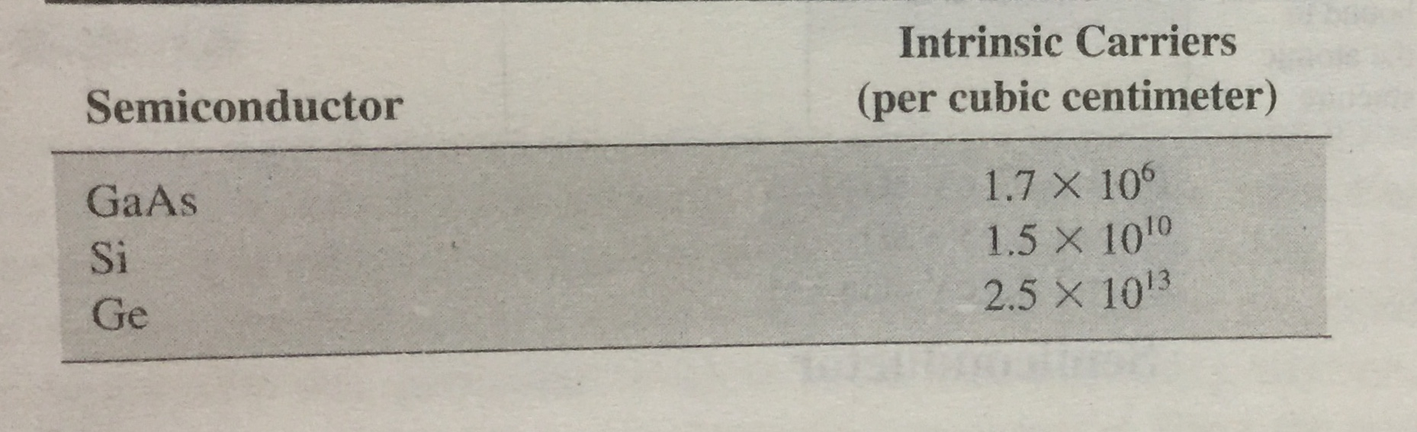
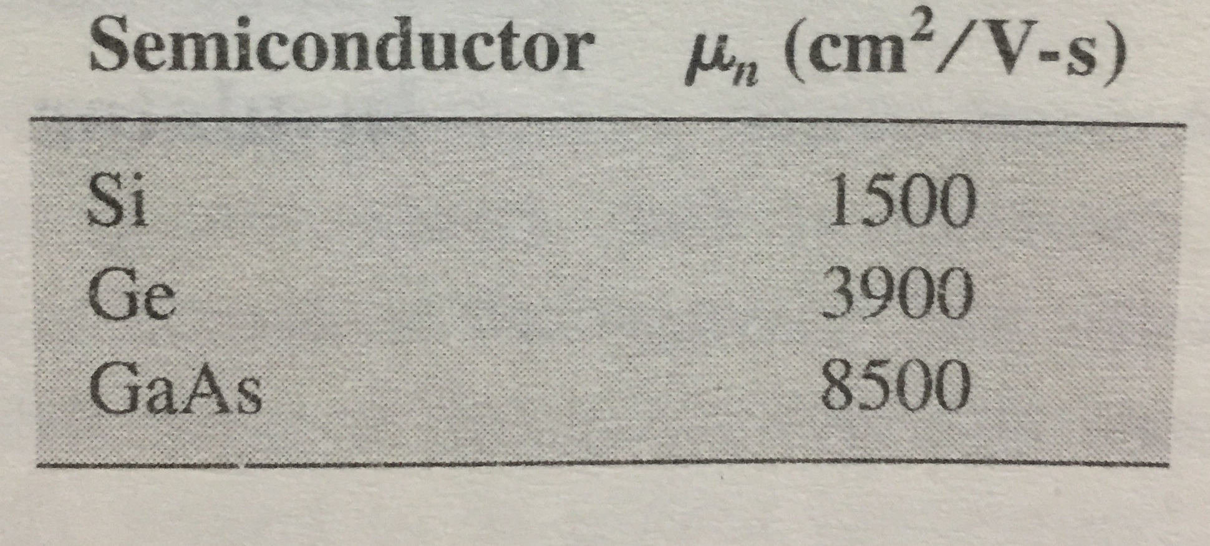
Relative mobility (μn) is the ability of free electrons/ carriers to move throughout the material.
Intrinsic carriers
Relative Mobility Factor (μn)

Slide 18
An intrinsic (pure) silicon crystal at room temperature has sufficient heat (thermal ) energy for some valance electrons to jump the gap from the valance band into the conduction band becoming free electrons.
As an electron jumps to the conduction band, a vacancy is left in the valance band within the crystal. This vacancy is called hole.

Slide 19
For every electron raised to the conduction band by means of external energy , there is one hole left in the valance band, creating what is called an electron-hole pair.
Its recombination occurs when a conduction band electron loses energy and falls back into a hole in the valance band.
A number of conduction (free) electrons that are unattached to any atom and are essentially drifting randomly throughout the material. There is also an equal amount of holes in the valance band created. When these electrons jump into the conduction band.

Slide 20
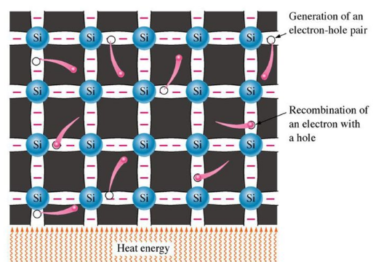
Conduction electrons and holes

Slide 21
When a voltage is applied across a piece of intrinsic silicon, the thermally generated free electrons are free to move randomly in the crystal structure are now easily attracted by the positive end.
This moment of free electron is one type of current in a intrinsic semi-conductive material and is called electron current.

Slide 22
Another type of current occurs in the valance band where the holes are created by the free electrons exists. Electrons remaining in the valance band are still attached to their atoms and are not free to move randomly in the crystal.
However, a valance electron can move into a nearby hole with little changes in its energy level, thus leaving another hole where it came from. Effectively the hole has moved from one placed to another in the crystal structure, this is called hole current.

Slide 23
2)Extrinsic Semiconductor:
A semiconductor to which an impurity at controlled rate is added to make it conductive is known as an extrinsic Semiconductor.
Or we can say that
A semiconductor material that has been subjected to the doping process is called an extrinsic material.

Slide 24
The characteristics of pure semiconductor material can be altered significantly by the addition of specific impurity items .
The addition of these impurities can alter the band structure sufficiently to totally change the electrical properties of the material.
As a result of this doping there are two types of extrinsic semiconductors.
n-Type Semiconductor
p-Type Semiconductor

Slide 25
Doping:
The process by which an impurity is added to a semiconductor is known as Doping. The amount and type of impurity which is to be added to a material has to be closely controlled during the preparation of extrinsic semiconductor.
Generally, one impurity atom is added to a 10¹⁰ atoms of a semiconductor.
The purpose of adding impurity in the semiconductor crystal is to increase the number of free electrons or holes to make it conductive.

Slide 26


Thank You

