Slide 1


MALAKAND CAMPUS CHAKDARA KPK PAKISTAN

Slide 2
RIPHAH INTERNATIONAL UNIVERSITY
MALAKAND CAMPUS CHAKDARA KPK PAKISTAN

Slide 3
Lecture 7
Diode applications
(PN junctions as a rectifier, clipper and clamper circuits)
MALAKAND CAMPUS CHAKDARA KPK PAKISTAN

Slide 4
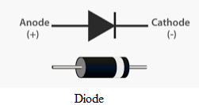
Diode (pn-junction ) applications:
Due to its ability to conduct current in one direction while blocking current in the other direction is essential to the operation of many types of circuits. Of one the circuit is know as rectifiers.
Rectifiers are the circuits that convert Ac voltage into Dc Voltage.
Rectifiers are found in all Dc power supplies that operates from Ac voltage source.
Rectifiers can be half-wave rectifiers or full-wave rectifiers.

Slide 5
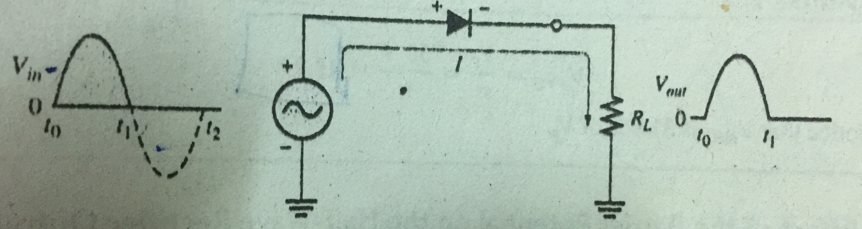
PN-junction as rectifier:
1) Half-wave Rectifier:
A half-wave rectifier is that type of rectifier that allows only one half of cycle of Ac voltage waveform and blocks the other half-cycle.
Half-wave Rectifier

Slide 6
1) Half-wave Rectifier:
In the above figure the Diode is connected to an Ac source and to a load resistance, RL, forming a half- wave rectifier.
By using the ideal model of diode, the sinusoidal input voltage (Vin) goes positive during the interval when t=0→ t1 , the diode behaves like the short-circuit equivalence i.e. forward-biased and conducts through the load resistor.
Half-wave Rectifier

Slide 7
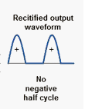
1) Half-wave Rectifier:
During the second half from t1 → t2, when the input voltage goes negative , the diode behaves like open-circuit i.e. reverse-biased, as there is no current, so the voltage across the load resistor is 0v.
The net result is that only the positive half-cycles of the ac input voltage appear across the load.
Since the output does not change polarity.
So the output look like
Half-wave Rectifier

Slide 8
Average value of the Half-wave output voltage:
The average value of the half-wave rectified output voltage is the value you would measure on a dc voltmeter.
Mathematically, it is determined by finding the area under the curve over a full cycle and dividing by 2π ,.
Vavg = Vp / π →eq.1
where
Vp is the peak value of the voltage
π = the number of radian in a full cycle
Vavg = average value of the half-waved rectified signal
This equation shows that V average is approximately 31.8% of Vp for a half- wave rectified voltage.

Slide 9
Average value of the Half-wave output voltage:
Or we can say the V average now has a net positive area above the axis over a full period and its value determined by
Vavg = 0.318 Vp → eq.2
Vavg = 0.318 (Vp- Vk ) eq.3
For example : what is the value of the half-wave rectified voltage if Vp= 50v ?
by putting Vp in eq.1
Vavg = Vp / π
= 50/ 3.14= 15.9 v

Slide 10
Average value of the Half-wave output voltage:
by putting Vp in eq.2
V avg = 0.318 Vp
= 0.318 x 50 = 15.9v
What would be the average voltage value if we use silicon diode where Vk=0.7v?
By using eq.3 Vavg = 0.318 (Vp- Vk )
= 0.318( 50- 0.7)
= 0.318 x 49.3
= 15.68v

Slide 11
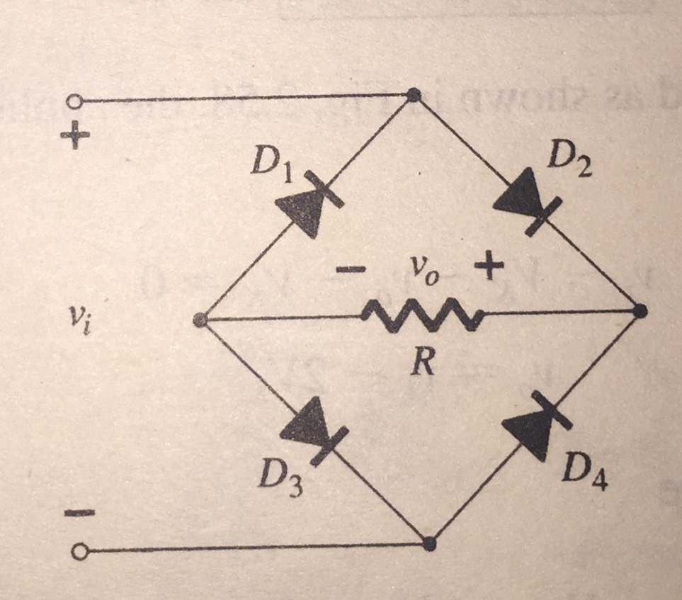
2)Full-wave Rectifier:
A Full Wave Rectifier is a circuit, which is used to convert a sinusoidal input into a pulsating dc voltage using both half cycles of the applied Ac voltage. It uses a total of four diodes. It is also called full-wave bridge rectifier.
There are total 4 diodes connected
as shown in the diagram. The output
voltage Vo is taken across the resistor
R.
Full-wave rectifier

Slide 12
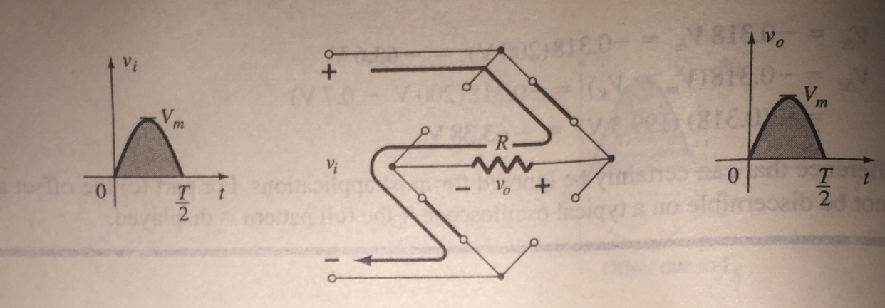
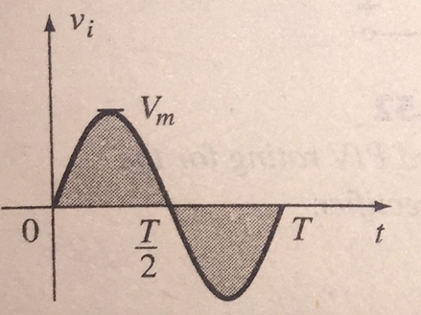
2)Full-wave Rectifier:
During the period t=0 to T/2, the input sinusoidal is the first half (positive cycle ),as D1 & D4 are in the off state while D2 & D3 are conducting.
Since the diodes are ideal the load
so the load voltage across resistor R is
Vo=Vi
Full-wave rectifier
Input signal D2 & D3 are conduction. Output

Slide 13
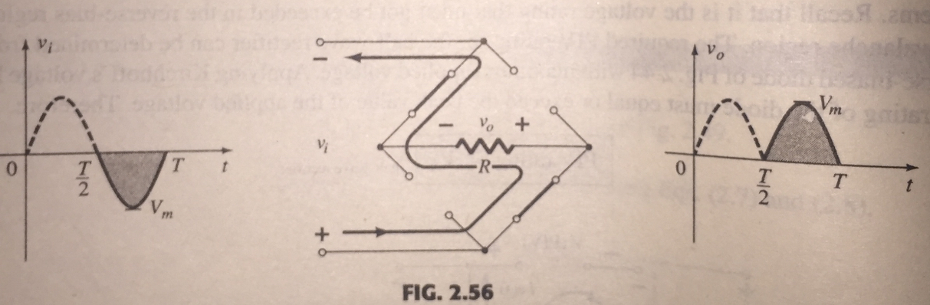
2)Full-wave Rectifier:
Whereas for the negative cycle of the input
voltage the conducting diodes are D1 & D4.
The point of noting here is that, the polarity
across the load resistor R is the same.
Full-wave rectifier
Input signal D1 & D4are conduction. Output

Slide 14
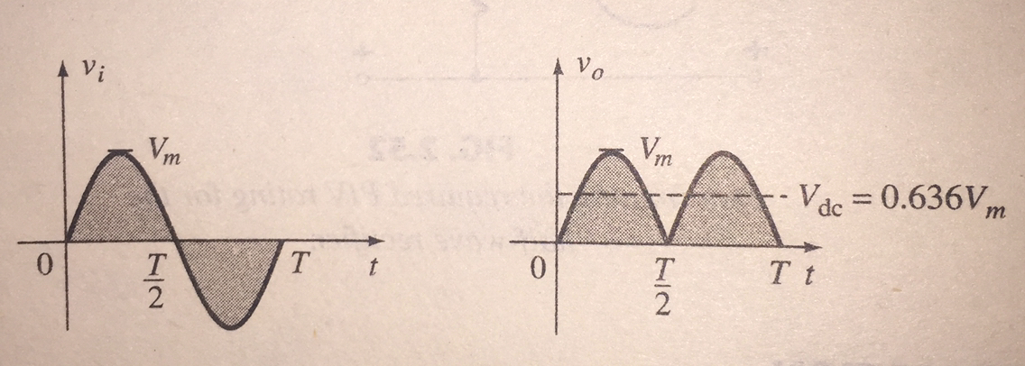
2)Full-wave Rectifier:
The result of the second half is also a positive plus.
Input voltage output voltage after one complete cycle
Full-wave rectifier

Slide 15
2)Full-wave Rectifier:
Since the area above the axis for one full cycle is now twice that obtained for as half-wave system. The dc level has also been doubled.
So eq.2 becomes
Vavg = 2(0.318 Vp) → eq.4
Vdc = 0.636 Vm
If instead of ideal diode, a silicon is used, then the application of Kirchhoff’s voltage law around the conduction path results in
Vi-Vk-Vo-Vk = 0
so Vo = Vi-2Vk
Note: Here the notations can be used as
Vavg= Vdc
Vp= Vm

Slide 16
2)Full-wave Rectifier:
so Vo = Vi - 2Vk
The peak value of the output voltage is therefore
Vo max = Vm - 2Vk
For situation where Vm >> 2Vk, the following equation can be applied for the average value with a high a relatively high level of accuracy
Vdc ≈ 0.636( Vm - 2Vk)

Slide 17


Thank You

