Slide 1


MALAKAND CAMPUS CHAKDARA KPK PAKISTAN

Slide 2
RIPHAH INTERNATIONAL UNIVERSITY
MALAKAND CAMPUS CHAKDARA KPK PAKISTAN

Slide 3
Lecture 8
Diode applications
(PN junctions as a rectifier, clipper and clamper circuits)
MALAKAND CAMPUS CHAKDARA KPK PAKISTAN

Slide 4
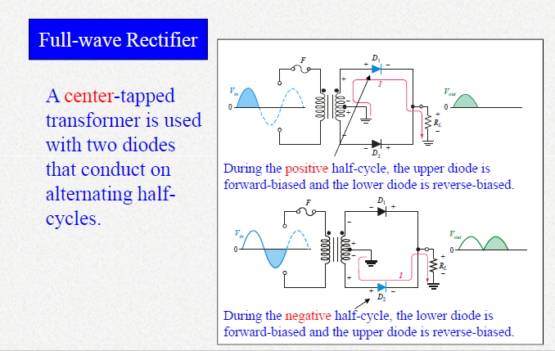
f

Slide 5
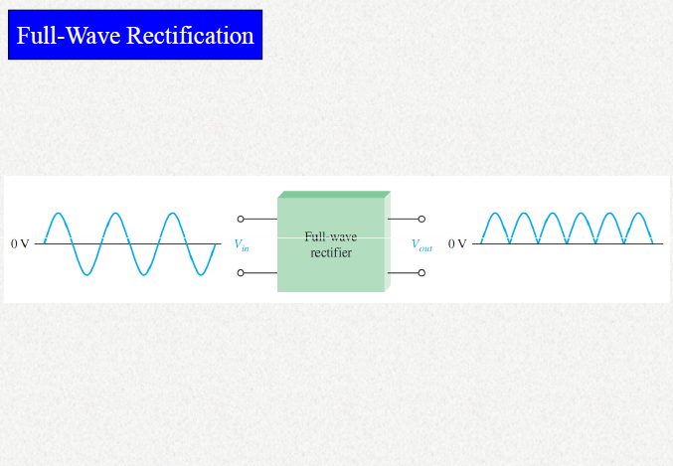
f

Slide 6
Diode Limiting (Clipping) Circuits:
A diode limiter (clipper) is a circuit that limits (or clips) either the
positive or negative part of the input voltage.
A biased limiter is one that has a bias voltage in series with the diode, so that a specific voltage level can be selected for limiting.

Slide 7
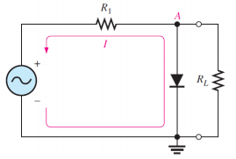
Diode Limiting (Clipping) Circuits:
Diode Clipping Circuit

Slide 8
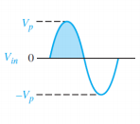

Diode Limiting (Clipping) Circuits:
As the input voltage goes positive, the diode (silicon =0.7v) becomes forward biased and conducts current.
So in the figure the point A is limited to +0.7v when the input voltage exceeds this limited.
But when the input voltage goes below 0.7v, the diode is reverse
biased and appears as an open. The output voltage looks like the
negative part of the input voltage, but
Diode Clipping Circuit

Slide 9
Diode Limiting (Clipping) Circuits:
But with a magnitude determined by the voltage divider formed by R1 and the load resistor, RL .
Vout = ( RL / R1 +RL) Vin → voltage divider formula for finding output voltage
If R1 is small compared to RL then
Vout = Vin
Limiting of the positive alternation. The diode is forward biased during the positive alternation (above 0.7v) and reverse biased during the negative alternation.
Diode Clipping Circuit

Slide 10
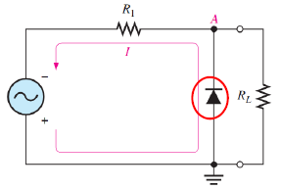

Diode Limiting (Clipping) Circuits:
When the diode is turned around, the negative part of the input voltage is clipped off.
When the diode is forward biased during the negative part of the input voltage, point A is held at -0.7v by the diode drop.
When the input voltage goes above -0.7v, the diode is no longer forward-biased, and a voltage appear across RL proportional to the input voltage.
Limiting of the negative alternation. The diode is forward biased during the negative alternation (below -0.7v) and reverse biased during the positive alternation.
Diode Clipping Circuit

Slide 11
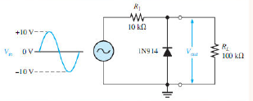

Example:
What would you expect to see displayed on an oscilloscope connected across R_{L} in the limiter shown in below figure?
Sol:
The diode is forward-hinged and conducts when the input voltage goes below -0.7 V. So, for the negative limiter, determine the peak output voltage across RL by the following equation:
Vout = ( RL / R1 +RL)Vin
= (100 kΩ / 10 kΩ + 100kΩ) 10v
= 9.09v

Slide 12
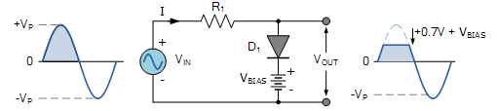
Biased limiter:
The level to which an ac voltage is limited can be adjusted by adding a bias voltage VBIAS in a series in a diode.
The voltage across the series combination must be greater than VBIAS + 0.7V before the diode becomes sufficiently forward biased to conduct.
For example in the below figure, the VBIAS is set at 4.0 volts.
then the sinusoidal voltage at the diode’s anode terminal must be greater than 4.0 + 0.7 = 4.7 volts for it to become forward biased.
Any anode voltage levels above this
bias point are clipped off.
Positive Bias Diode Clipping

Slide 13
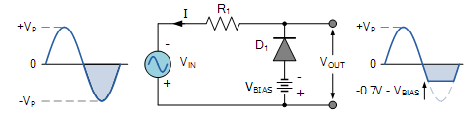
Biased limiter:
By the turning the diode around and the battery bias voltage as well as in the following figure.
So when a diode conducts the negative half cycle of the output waveform is held to a level –VBIAS – 0.7V as shown.
Negative Bias Diode Clipping

Slide 14
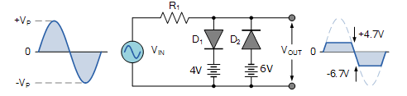
Biased limiter:
But if as per requirements where both the positive and the negative half cycles are to be clipped.
Then two biased clipping diodes are used.
One of it should be set at 4v( positive biased voltage) and other at 6v (negative biased voltage) as in the following figure.
Diode Clipping of Different Bias levels

Slide 15
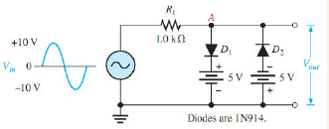

Example :
The following figure shows a circuit combining a positive limiter with a negative limiter. Determine the output voltage waveform.
Solution:
When the voltage at point A reaches +5.7 V, diode D1 conducts and limits the wave-form to +5.7 V. Diode D2 does not conduct until the voltage reaches —5.7 V. Therefore. positive voltages above +5.7 V and negative voltages below -5.7 V are clipped off. The resulting output voltage waveform is shown in the following Figure

Slide 16
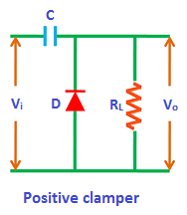
Diode Clamping Circuits:
A clamper is an electronic circuit that prevents a signal from exceeding a certain defined magnitude by shifting its DC value.
Clamper is a circuit which adds Dc value to an Ac wave form without changing its form.
For example in Amplifier, a clamper is used to re-insert DC voltage level into an AC waveform which is lost by passing through an electronic circuits.
Clampers are sometimes known as dc restorers.
The clamper does not restrict the peak-to-peak excursion of the signal, but moves it up or down by a fixed value as per requirements.
A capacitor is in series with the load. A positive clamper is shown below.

Slide 17
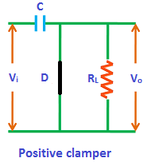
How positive Clamper Operates?
As the negative input signal comes, the diode become forward biased and behaves as short circut.as shown below and hence no voltage appear at output Vo.
The current flows towards the capacitor and charge it to the peak value of input sinusoidal voltage Vm.
As input current or voltage decreases after attaining its maximum value -Vm, the capacitor holds the charge until the diode remains forward biased.

Slide 18
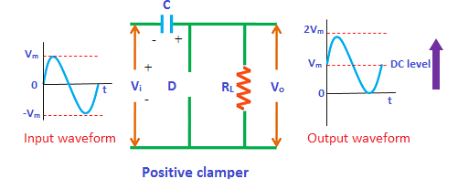
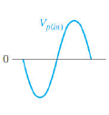
How positive Clamper Operates?
During the positive half cycle, the diode is reverse biased and hence behaves as open circuit as shown in the figure.
When the positive half cycle begins, the diode is in the non-conducting state as already discussed and the charge stored in the capacitor is discharged (released).
The voltage appeared at the output is equal to the sum of the voltage stored in the capacitor (Vm) and the input voltage (Vm) { I.e. Vo = Vm+ Vm = 2Vm} which have the same polarity with each other. As a result, the signal shifted upwards.

Slide 19
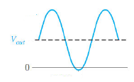
How positive Clamper Operates?
The peak to peak amplitude of the input signal is 2Vm, similarly the peak to peak amplitude of the output signal is also 2Vm. Therefore, the total swing of the output is same as the total swing of the input.

Slide 20


Thank You

