Slide 1


MALAKAND CAMPUS CHAKDARA KPK PAKISTAN

Slide 2
RIPHAH INTERNATIONAL UNIVERSITY
MALAKAND CAMPUS CHAKDARA KPK PAKISTAN

Slide 3
Lecture 9
Special purpose Diodes
(Zener diode and voltage regulator)
MALAKAND CAMPUS CHAKDARA KPK PAKISTAN

Slide 4
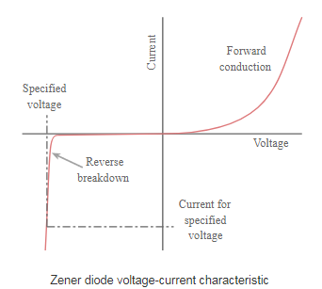

Zener Diode:
The Zener diode is a silicon pn-junction that is designed to operate in the reverse breakdown region.
A major application of the Zener Diodes is as a type of voltage regulator for providing stable reference voltages for use in
power supply
Voltmeter
And many other instruments.

Slide 5
Zener Diode:
When a Zener diode is forward biased it behaves like an ordinary silicon diode.
When the Zener diode is reverse biased with a voltage less than VZ it blocks the current, like an ordinary silicon diode.
When the reverse bias voltage reaches VZ the voltage is limited to around this value, but it can conduct very large currents.
The electrical behavior was first explained by by Clarence Melvin Zener

Slide 6
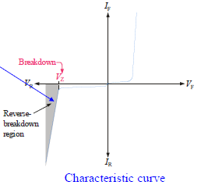
Zener Diode:
The breakdown has a constant breakdown voltage. This makes it useful as a voltage reference, which is its primary application.
Zener region

Slide 7
Zener Diode:
As we know that in normal diodes, the breakdown voltage is very high and the diode gets damaged totally if a voltage above the breakdown diode is applied.
But Zener diode behaves differently where the breakdown voltage is not as high and does not lead to permanent damage of the Zener diode if the voltage is applied.
There are two types of reverse breakdown in a Zener diode : avalanche and Zener.
As the reverse voltage applied to the Zener diode increases towards the specified Breakdown Voltage (Vz), a current starts flowing through the diode and this current is known as the Zener Current( Iz) and this process is known as Avalanche Breakdown.

Slide 8
Zener Breakdown:
Zener breakdown is caused by a Field emission process and Avalanche breakdown is caused by a collision-ionization process.
As reverse bias potential is increased, there is an increase in the magnitude of the associated electric field. They break the covalent bonds between the valence electrons and the core of the atoms and hence free electrons become available for conduction.
This type of breakdown is known as Zener breakdown.

Slide 9
Zener Breakdown:
As discussed the reverse bias increases the width of the depletion layer. The carriers travel a longer path and gain high momentum as the electric field is high as well.
Such high momenta carriers can knock off valence electrons in the atoms in their path. These primary new electrons can create new secondary electrons through the same process of collision and ionization and thus produces a large number of carriers called an avalanche of free carriers.
This is known as Avalanche breakdown as this produces a large reverse current in the diode corresponding to the critical value of voltage known as breakdown voltage.

Slide 10
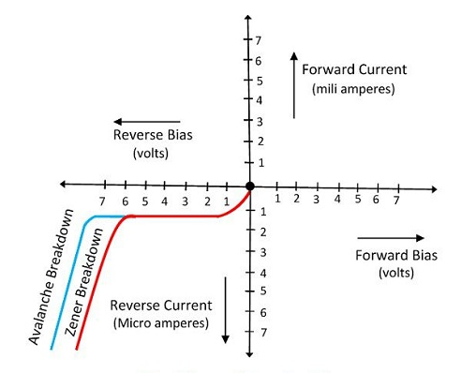
Zener Diode:
Zener diodes with breakdown voltages of less than 6v operate in Zener breakdown.
Those with breakdown voltages greater than 6v operate in predominantly in avalanche breakdown.

Slide 11
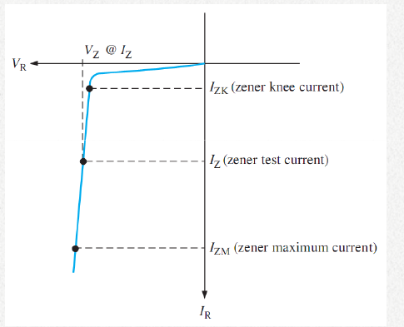
Zener Diode Breakdown characteristics:
As the reverse (VR)increased, the reverse current (IR) remains extremely small up to the “knee” of the curve.
The reverse current is also called the Zener current(IZ). At this point, the breakdown effect begins; the internal Zener impedance (ZZ), begins to decreases as the reverse current increases rapidly.
From the bottom of the knee, the Zener breakdown voltage (VZ) remains essentially constant although it increases slightly as the Zener current IZ increases.

Slide 12
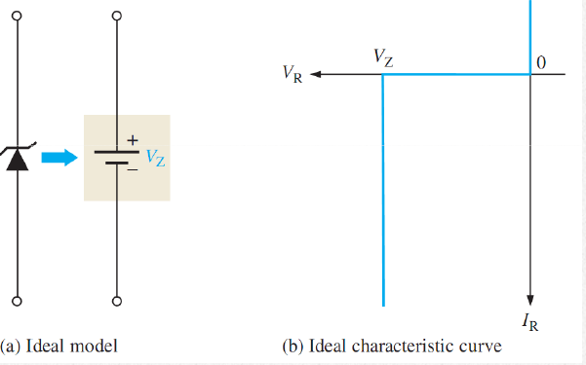
Zener Diode equivalent circuits:
The ideal model shows a Zener diode in reverse
breakdown. It has a constant voltage drop equal to
the nominal Zener voltage.
This constant voltage drop is represented by a dc
voltage source which simply indicates that the effect
of reverse breakdown is a constant voltage across the
Zener terminal.

Slide 13
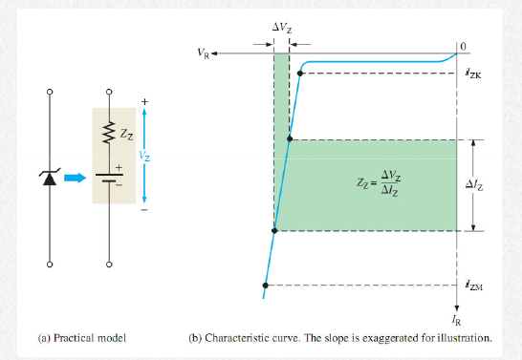
Zener Diode equivalent circuits:
The figure shows the practical model of Zener diode.
Where the Zener impedance (ZZ) is included.
Since the actual voltage curve is not ideally vertical,
a change in the Zener current (ΔIZ ) produces a small
change in Zener voltage (ΔVZ ), therefore by
Ohm’s law
ZZ= ΔVZ / ΔIZ

Slide 14
Zener Diode equivalent circuits:
VS
practical model
Ideal model

Slide 15

Temperature coefficient of Zener Diode:
The Temperature Coefficient of a Zener diode can be specified as the percent change in Zener voltage for each degree Celsius change in temperature.
Alternatively, it can be specified in terms of change in voltage per degree Celsius change in temperature.
TC= ΔVZ / ΔT
A positive TC means that the Zener voltage increases with an increase in temperature or decreases with a decrease in temperature.
A negative TC means that the Zener voltage decreases with an increase in temperature or increases with a decrease in temperature
where TC has units of %/oC.

Slide 16
Temperature coefficient of Zener Diode:
The temperature coefficient can be positive or negative, depending on the Zener voltage.
Above 5.6 V, Zener diodes generally have a positive temperature coefficient
Below 5.6 V, they have a negative temperature coefficient.

Slide 17
Zener Diode as voltage Regulator :
The ability to keep the reverse voltage across its terminal essentially constant is the key feature of the Zener diode.
A Zener diode operating in breakdown acts as voltage regulator because it maintains a nearly constant voltage across its terminals over a specified range of reverse –current values.
A minimum value of reverse current IZK must be maintained in order to keep the diode in breakdown for voltage regulator.

Slide 18
Zener Diode as voltage Regulator :
From the figure , when the reverse current is
reduced below the knee of the curve, the voltage
decreases drastically and regulation is lost.
Also there is a maximum current IZM , above
which the diode may be damaged due to excessive
power dissipation.
So basically, the Zener diode maintains a nearly
a constant voltage across its terminals for values of
reverse current ranging from IZK to IZM

Slide 19
Zener Diode as voltage Regulator :
It is also important to note that the breakdown voltage is determined by the properties of the p and n regions of the diode, at the junction (depletion or space-charge layer) viz doping.
A highly doped material would have a lower breakdown voltage and vice versa. The Zener region of any IV characteristics curve can therefore be controlled by appropriate doping. The Zener voltage can range from anywhere between less than 1 V to a few 100 volts.
The maximum value depends on the power rating of the device.

Slide 20
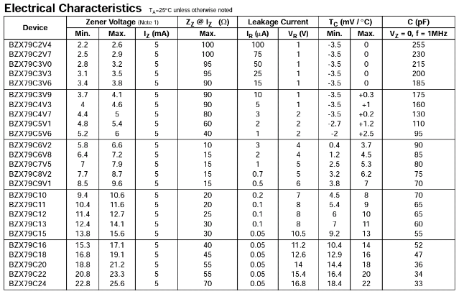
Zener Diode Datasheet:

Slide 21


Thank You

