Slide 1
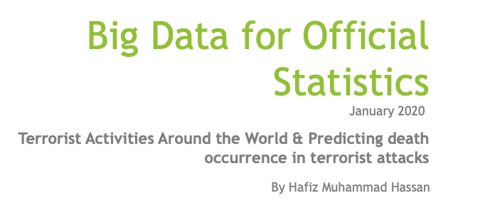

Slide 2
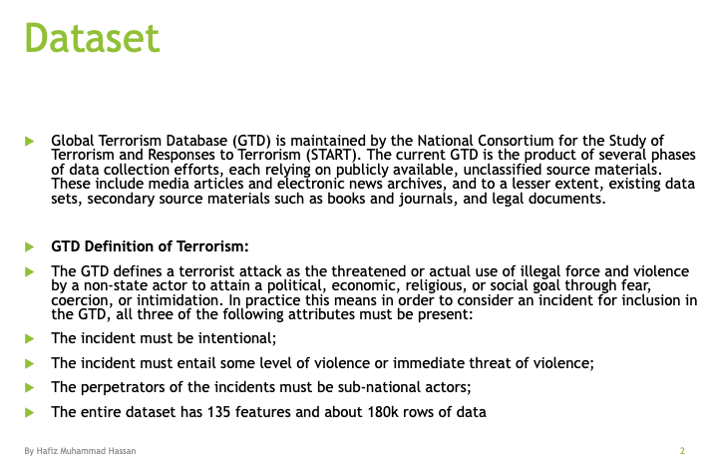

Slide 3
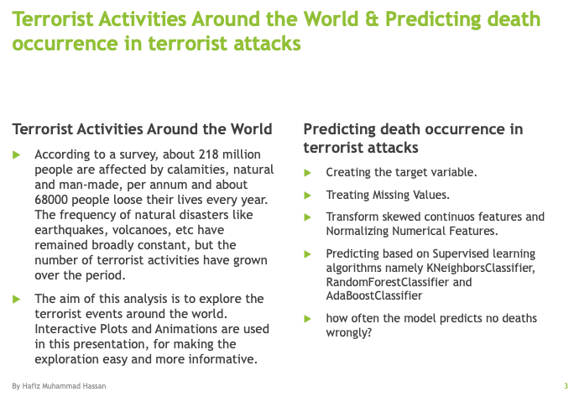

Slide 4
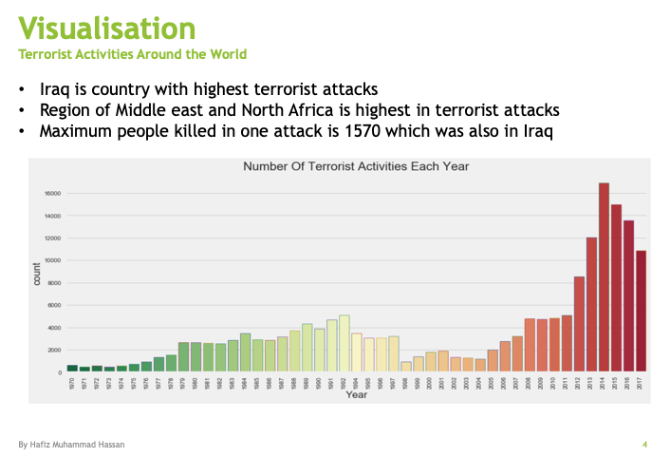
Clearly the number of terrorist activities have gone up sharply after 2000.

Slide 5
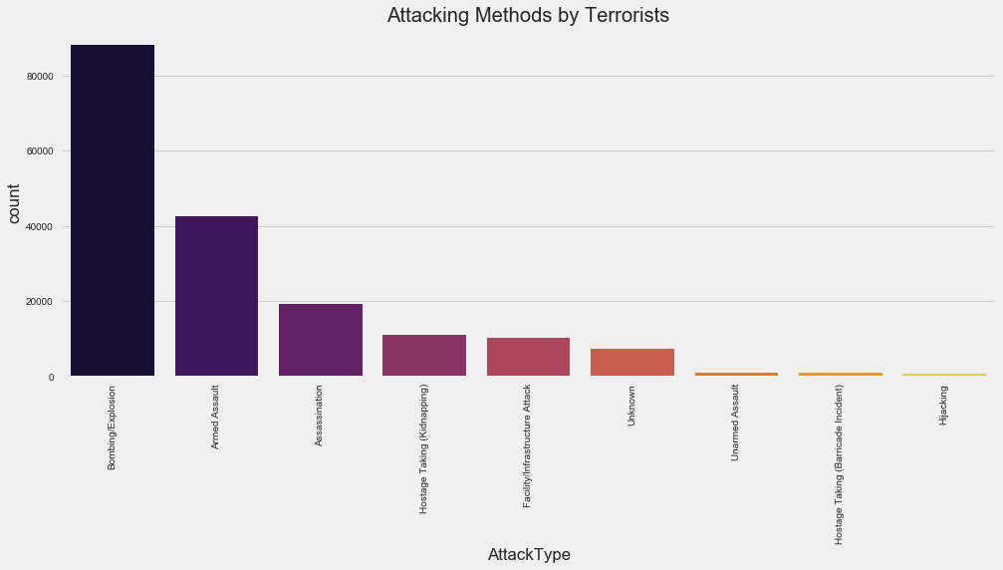
Attacking Methods by Terrorists Bombing Explosion

Slide 6
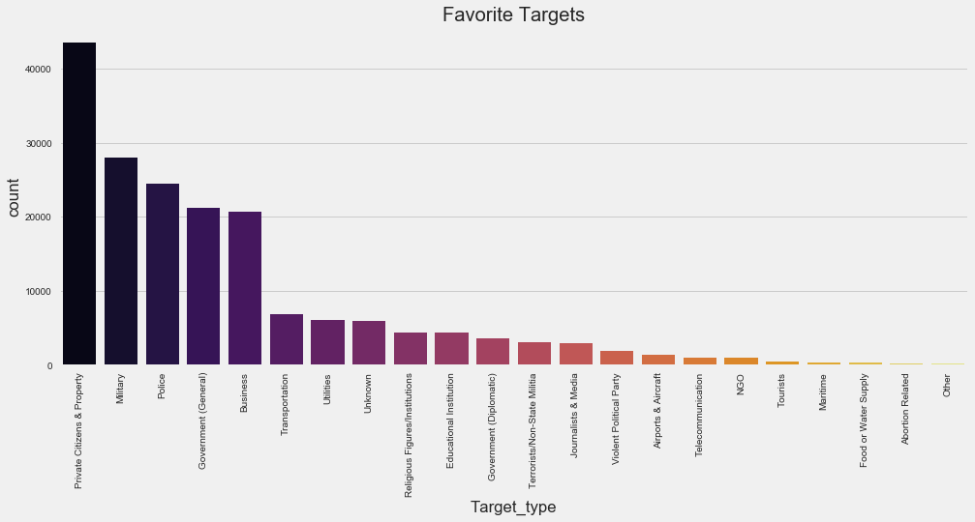
Favorite Targets Private Citizens and Property

Slide 7
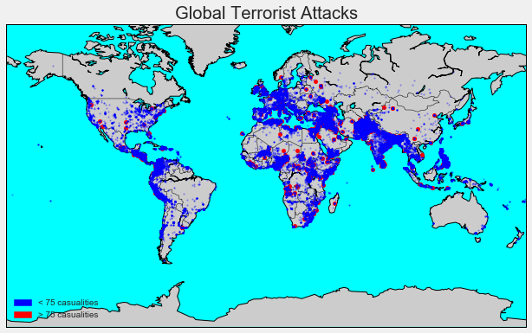
Global Terrorist Attacks
The below basemap shows the places of attacks. The red circles are those that had more than 75 casualities(wounded+killed)..

Slide 8
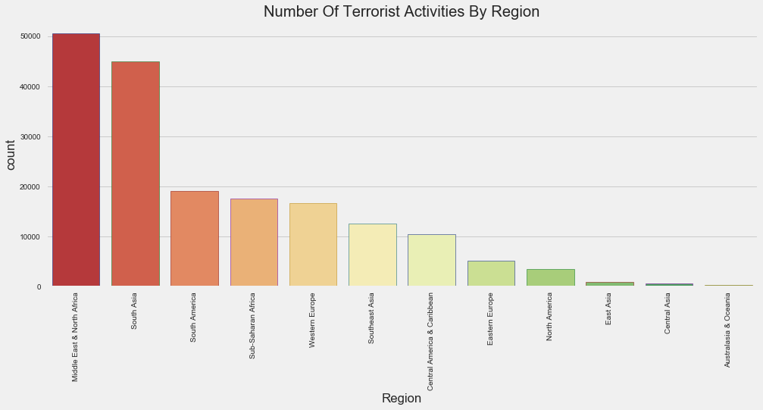
Terrorism By Region
Middle East and North Africa are the most terrorism prone regions followed by South Asia.

Slide 9
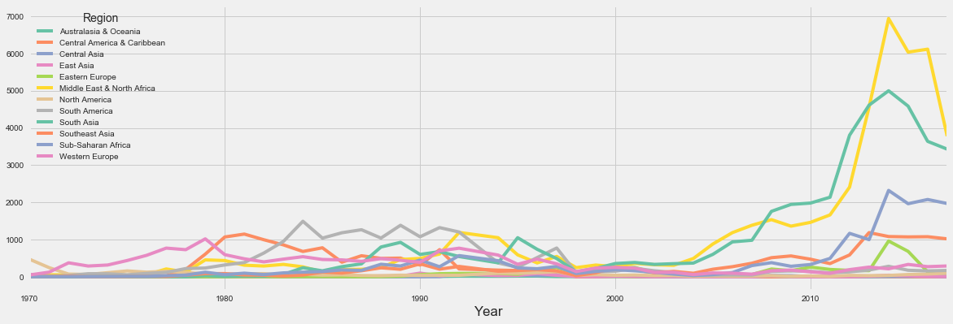
Trend in Terrorist Activities
Middle-East, North Africa, South Asia have seen a shoot in the number of terrorist activities over the years

Slide 10
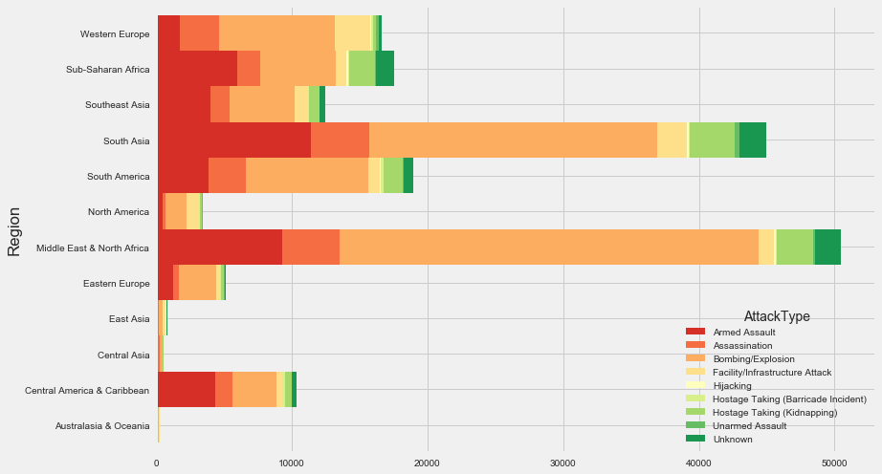
Attack Type vs Region
Bombing and Armed assaults, as seen above are the most prominent types of Attack irrespective of Regions.

Slide 11
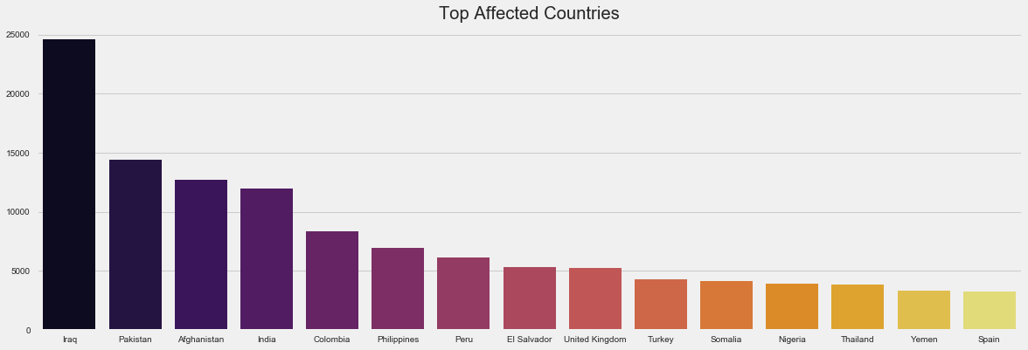
Terrorism By Country
Iraq has witnessed a very large number of terrorist activities followed by Pakistan.

Slide 12
Attacks vs Killed
In Iraq number of killed is almost 3 folds more

Slide 13
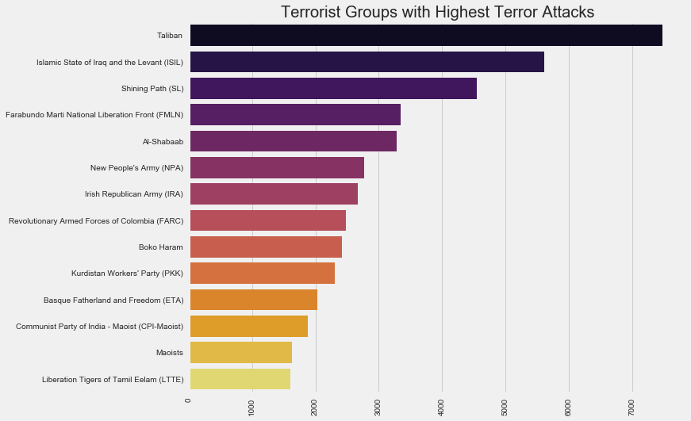
Most Notorious Groups
Taliban have highest terror attacks

Slide 14
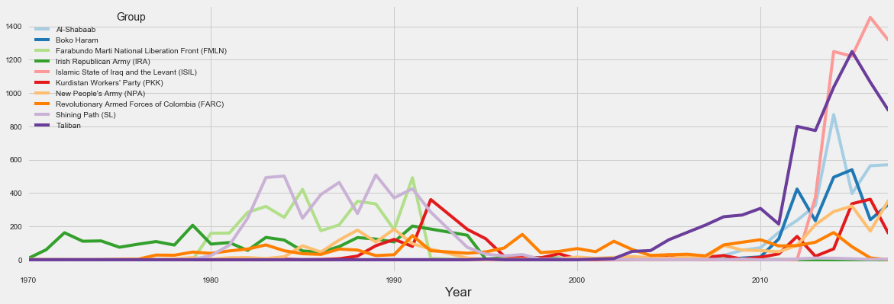
Activity of Top Terrorist Groups
The Irish Republican Army(IRA), is the oldest terrorist group started back in the 1960-1970, maybe after the World War 2 due to the mass killing

Slide 15
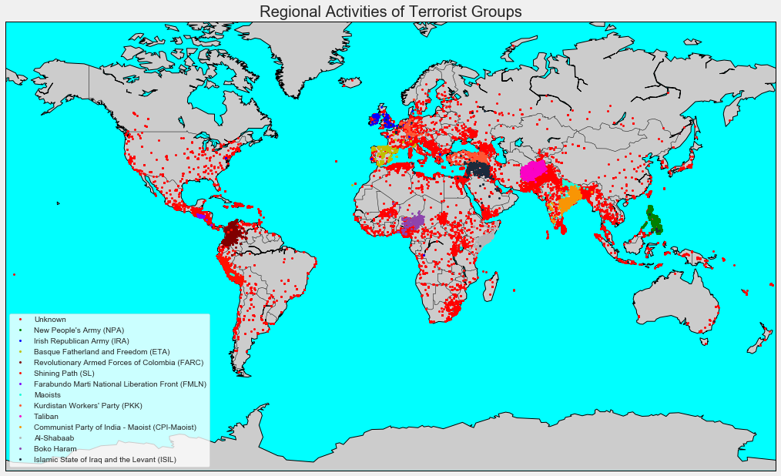
Regions Attacked By Terrorist Groups
ISIL is looks to be the notorious group in Iran and Iraq or broadly Middle-East. Similarly Taliban is concentrated in Afghanistan and Pakistan.

Slide 16
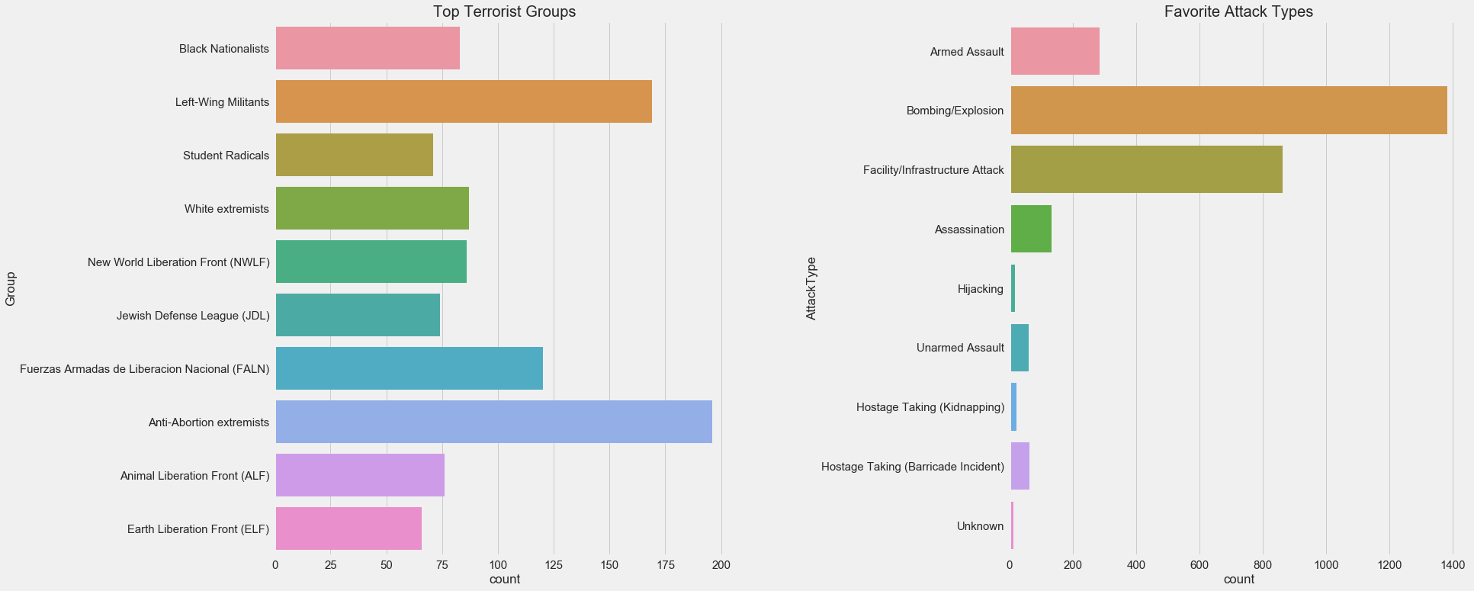
Terror Activities in USA
Most Notorious Groups in USA and Favorite Attack Type

Slide 17
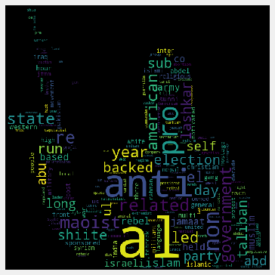
Motive Behind Attacks
Motive simply means the reason for doing something. Now this reason may be anything, personal grudges, revolt against government, religious sentiments, etc. In this part we will try to analyse what are the main reasons behind the terrorist activities.
Some of the most dangerous terrorist group names like 'al' for al-kaeda looks prominent. Some other words like 'government' and 'anti' also show attacks dur to resentment against the government.

Slide 18
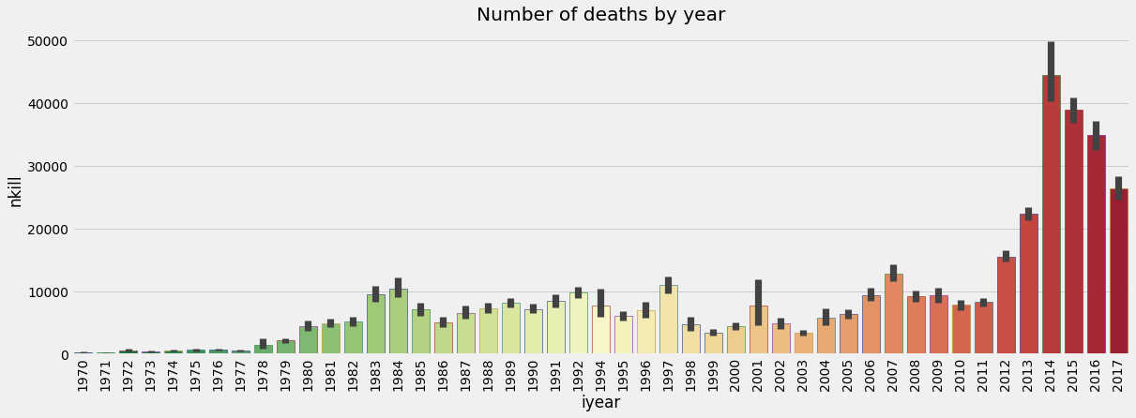
Predicting Death Occurrence
In 48.56% of incidents at least one death occurred
2014 is the year when most deaths occurred

Slide 19
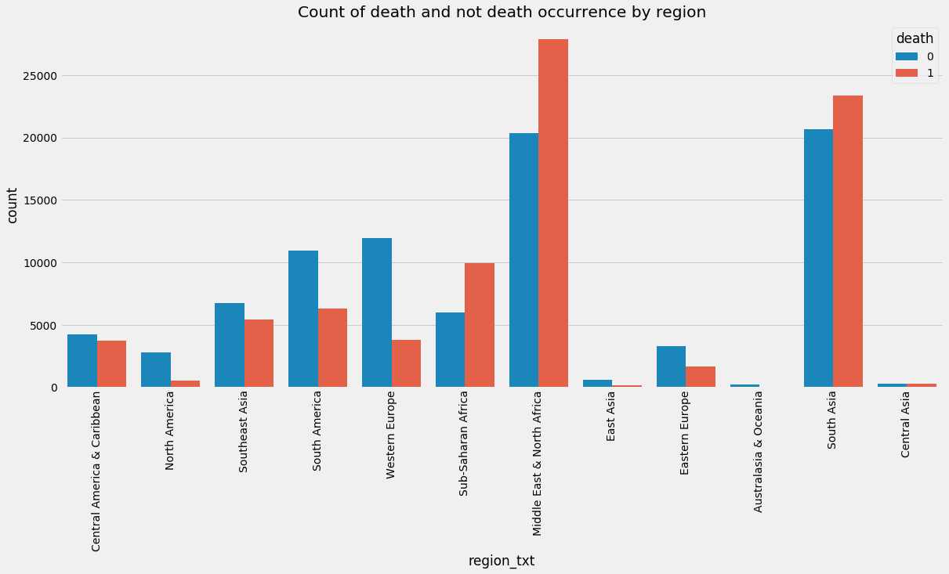
Number of deaths by region
Middle and Africa has more number deaths as there are more attacks

Slide 20
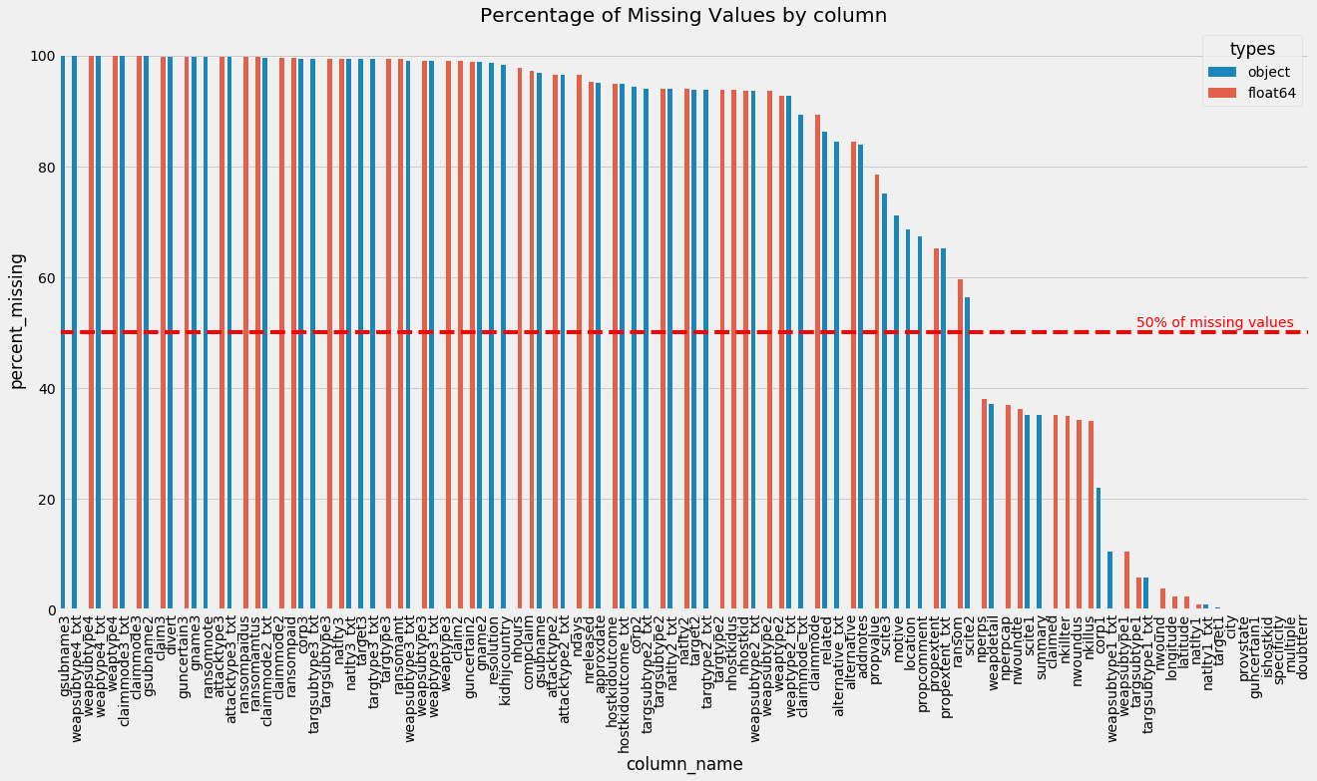
Treating Missing Values
Avoid features with more than 50% of missing values
Number of features before dropping columns with >50% of NAN: 135
Number of features after dropping columns with >50% of NAN: 57

Slide 21
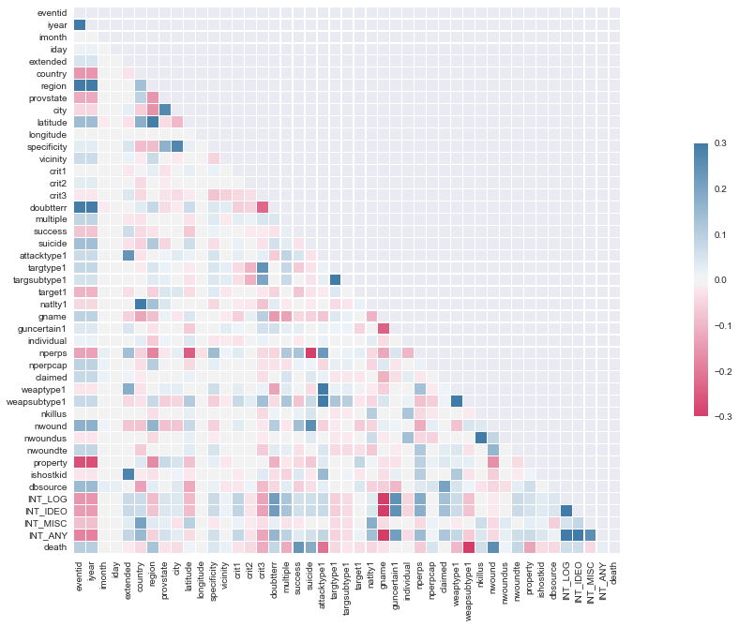
Correlation and Most important Features

Slide 22
Prediction using different Models
After getting most important features, I shuffled and split the 'features' and 'income' data into training and testing sets.
After that training sets has 137102 samples and testing set has 34276 samples.
After that I have DecisionTreeClassifier with random state of 43 and predicted the accuracy it was around 80.79% and fbeta_score 80.03% which computes weighted harmonic mean and precision recall.
After that I have imported three supervised learning models from sklearn and devided the data into 1%, 10% and 100% for traning and trained the models on that.
KNeighborsClassifier trained on 1371 samples, then on 13710 samples then on 137102 samples. Same goes for AdaBoost and Random Forest Calssifiers.
Then I calculated the accuracy and Fbeta scores. Random Forest was the pefect winner which predicted accuracy 80, 83 and 86 and same fb_beta scores.
After that I have try to improve the model by avoiding the features which have importance below 2%.
After that result was really good, I got 85% accuracy and f_score as 85 too.
I tuned the model more and divided the data into 64% train 16% validation 20% test.
On the test it gave me 86% accuracy and f_score as 85%

Slide 23
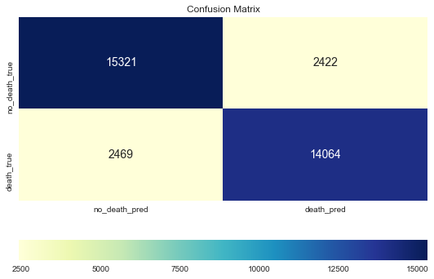
How often the model predicts no deaths?
I created a confusion matrix around that. Only 2422 times model predicted wrong. So we can say that our initial goal to predict death accuracy completed with only 14.93% cases it is wrong.

