Slide 1
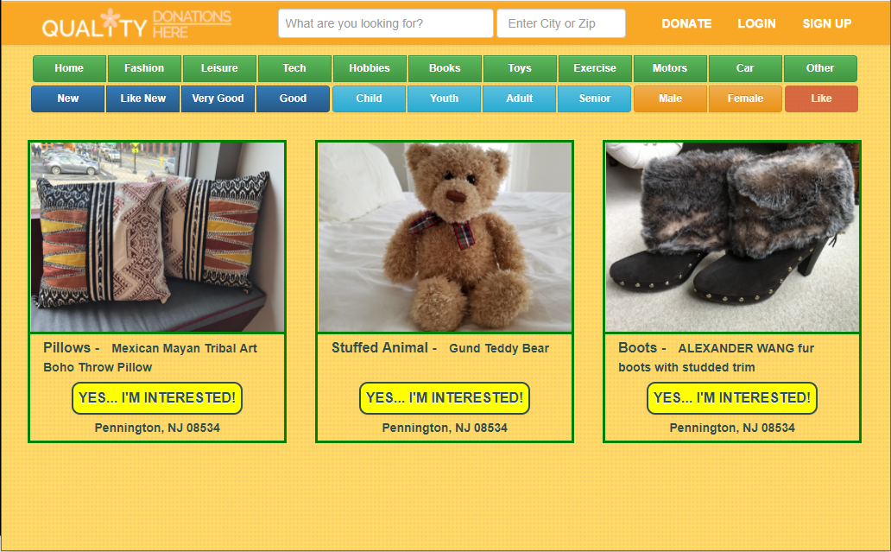
Quality Donations Here
By Lisa Zapson

Slide 2
What is Quality Donations Here?
A free exchange of quality goods.
A place where…
People can upload pictures, details and select tags for the items they want to donate.
People can shop, by searching on keywords, location and tags, for items they want to own.
People can make arrangements to meet and pickup items.
Idea by: Priya Polla
Logo by: Geony Ayyad

Slide 3
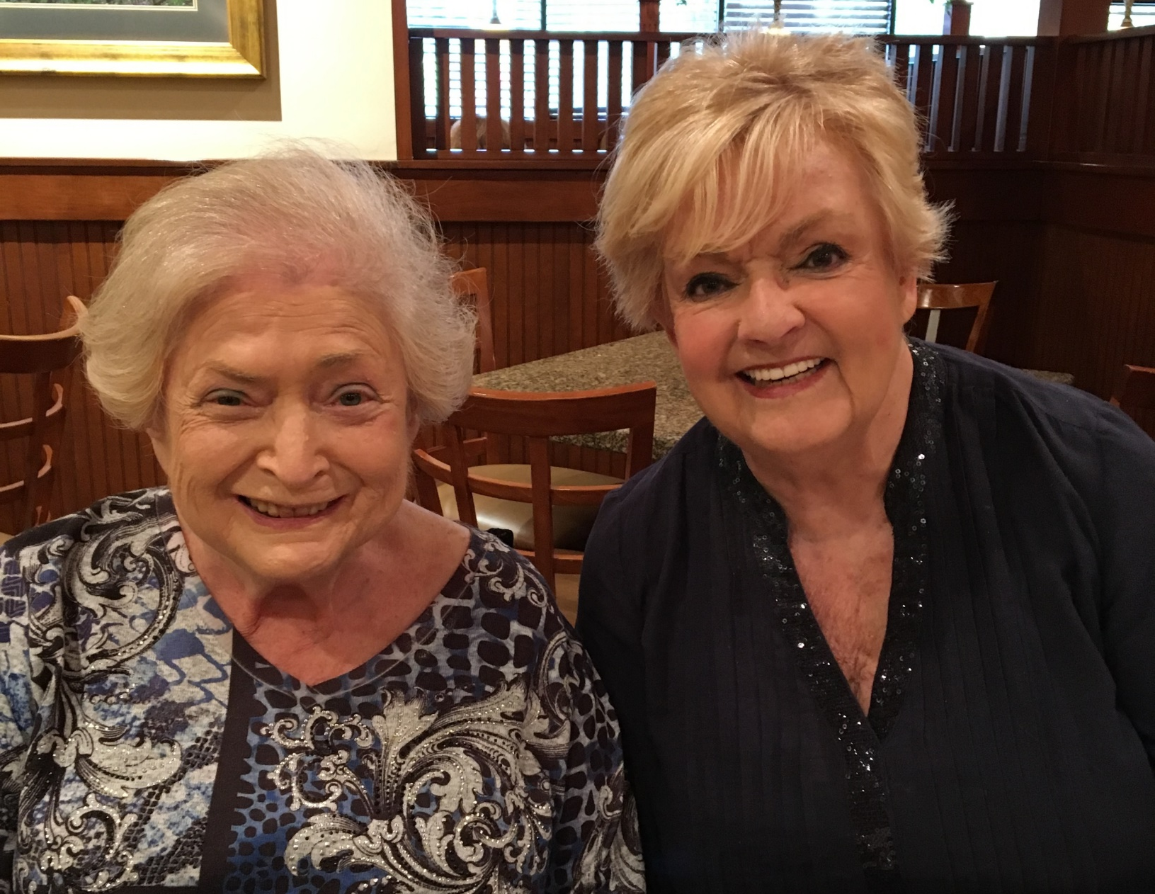
Inspiration
To find a home for my mom’s things that someone else would love and cherish.

Slide 4
Technologies
MERN (MongoDB, Express, React, Node.js) Stack
Bootstrap
User Authentication
MVC Paradigm
RESTful API

Slide 5
Future Enhancements
Add unit and functional testing.
Remove uploaded image if not saved item.
Implement form validations.
Rethink tags and searching.
Mobile-friendly
Add sign in with Google.
Functionality to select “Yes… I’m Interested”.
Functionality where people can make arrangements to meet and pickup items.
Functionality to edit and delete items.

Slide 6
Appreciation
I want to offer my gratitude to Funda, Adam and Juan, for your assistance, enthusiasm and kindness.
I want to thank all my classmates for making this class a very enjoyable experience. I am inspired by all of you.
A special thank you to Franklin, for your ability and willingness to teach us, and for your patience, enthusiasm and kindness.

Slide 7
Questions ???

