Slide 1


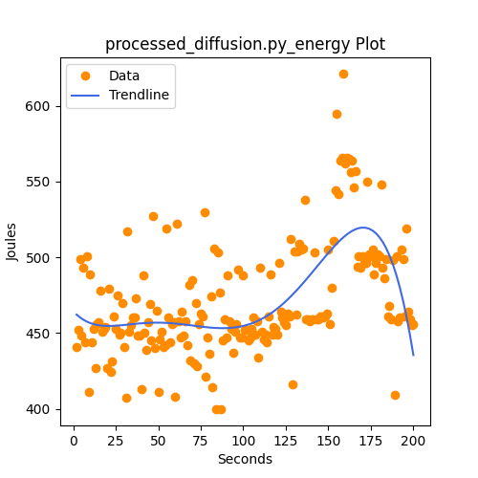
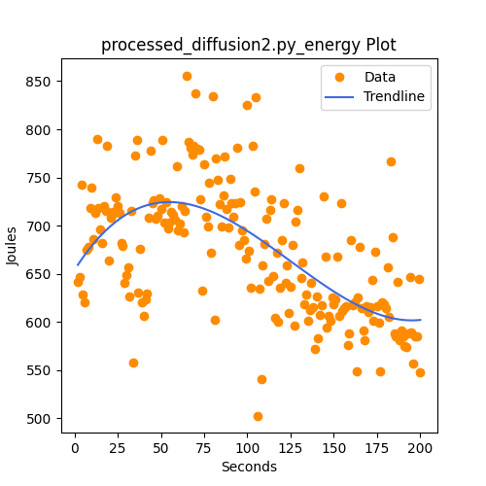
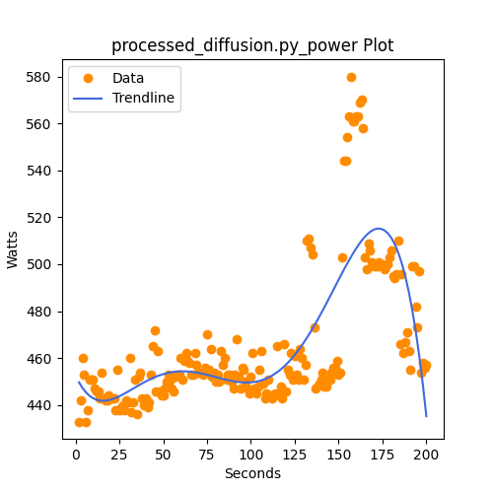
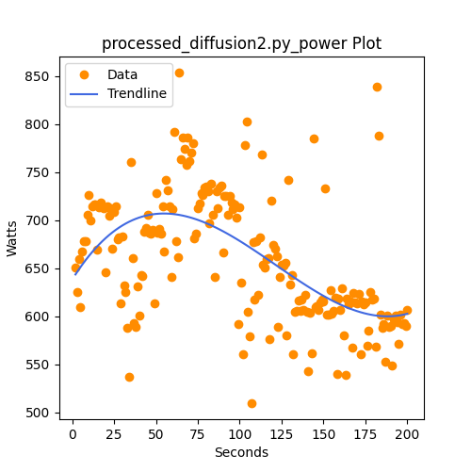


Towards a Better Understanding of AI
Ian Hastings¹, Oscar Hernandez², Aaron Welch³
¹Next Generation Pathways to Computing, ²Computational Sciences and Engineering, ³Computer Science and Mathematics
3. Method and Results
1. Abstract
f
Artificial intelligence is everywhere. It's been implemented into graphic design, advertisements, search engines, and even teaching. Tech companies are in an arms race to develop the most accurate and highest performing AI, paying top dollar for power large-scale data centers. But as we use AI, it uses energy. But what determines the amount of energy used? And how do AIs work in the first place? My name is Ian Hastings, and I analyzed different sizes of AI models and compared their energy and power usage.
Base Model Energy
Refined Model Energy
Base Model Power
Refined Model Power
Seconds
Seconds
Seconds
Seconds
The energy and power consumed by the refined model is much higher than the base model.
4. Results
2. Background
Refined Diffusion Model
Base Diffusion Model
Prompt: "A hyper realistic photograph of a dew-covered spider web sparkling in the morning sun. Each strand is individually discernible, with water droplets reflecting the vibrant colors of a nearby flower."
AI Process:
- First: The input text is tokenized
- Then: Relationships between tokens are computed
- Finally: Output is decoded
Precision vs Consumption
6. References and Acknowledgements
5. Next Steps
Run more models to compare performance across different sizes
I acknowledge my mentors Aaron Welch and Oscar Hernandez for their support and contributions to this project.
This research was supported in part by an appointment to the RENEW Pathway Summer Schools Program at Oak Ridge National Laboratory, sponsored by the U.S. Department of Energy and administered by the Oak Ridge Institute for Science and Education.
This research used resources of the Oak Ridge Leadership Computing Facility at the Oak Ridge National Laboratory, which is supported by the Office of Science of the U.S. Department of Energy under Contract No. DE-AC05-00OR22725.
Plinko Diagram
Compare very different model structures and their consumption of power
Like plinko, the input is shifted based on the parameters and training of the AI
Use a performance monitor, like Vampir, to analyze every detail
Notes:
Below: Tips, OLCF Acknowledgement, CADES Acknowledgements.
Tips Don’t use font smaller than 20 pt. Use more pictures/plots and less words
Feel free to rearrange the boxes, their number, labels, sizes and images to suit your content. You may choose to reveal information gradually as if you have 3-5 slides that build up to make your poster or display it all at once—whichever best supports your explanation.
Keep the poster size and orientation.
Be creative
If you use a movie, make sure the “freeze frame” supports a printed poster.
Use ACM style references see
https://www.acm.org/publications/authors/reference-formatting for reference style guide.
Acknowledgements
Pick the ones that apply, this will help your poster get approved in Resolution should you choose to present it at the OLCF user meeting or SMC Conference.
OLCF : This research used resources of the Oak Ridge Leadership Computing Facility at the Oak Ridge National Laboratory, which is supported by the Office of Science of the U.S. Department of Energy under Contract No. DE-AC05-00OR22725.
CADES: This research used resources of the Compute and Data Environment for Science (CADES) at the Oak Ridge National Laboratory, which is supported by the Office of Science of the U.S. Department of Energy under Contract No. DE-AC05-00OR22725.

