Slide 1
Assiut National University
Dr. Prof. Ibrahim Elawady – Software Engineering
Ahmed Abdelfattah Saad - CS
Khaled Ibrahim Abdelmonem - CS
Khaled Ayman Elwan - SE
We represent to you…

Slide 2
EasyFix

Slide 3
FOR Homeowners and small business owners who need reliable repair and maintenance services WHO Struggle to find trustworthy and quick technicians for their urgent or regular maintenance needs EASYFIX IS A Digital platform for home maintenance and repair services THAT Allows users to easily access specialized technicians for various home repairs, with quick booking and flexible scheduling options UNLIKE Traditional methods of randomly searching for technicians or relying on unverified recommendations OUR PRODUCT Offers a superior experience by ensuring fast response times and high-quality service through a technician rating system, secure payment options, and real-time tracking of technician location.

Slide 4
UI/UX Design

Slide 5
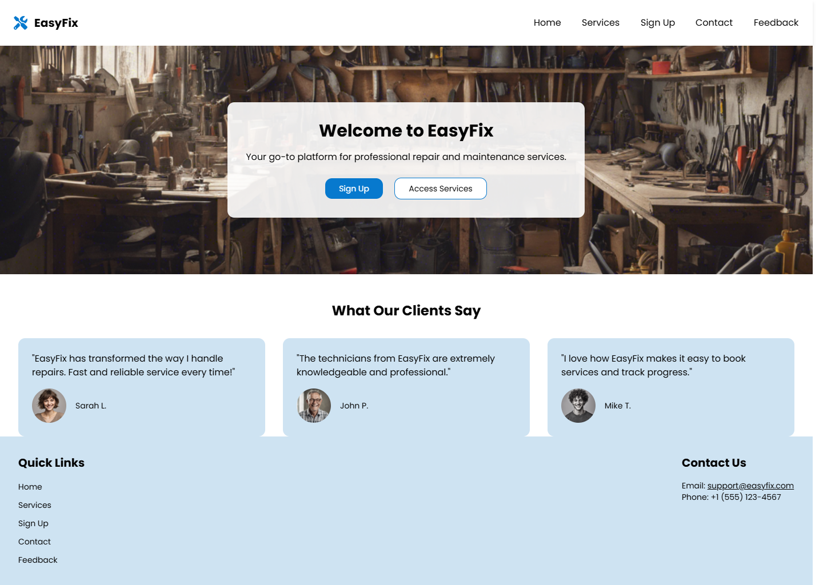
Home
Page

Slide 6
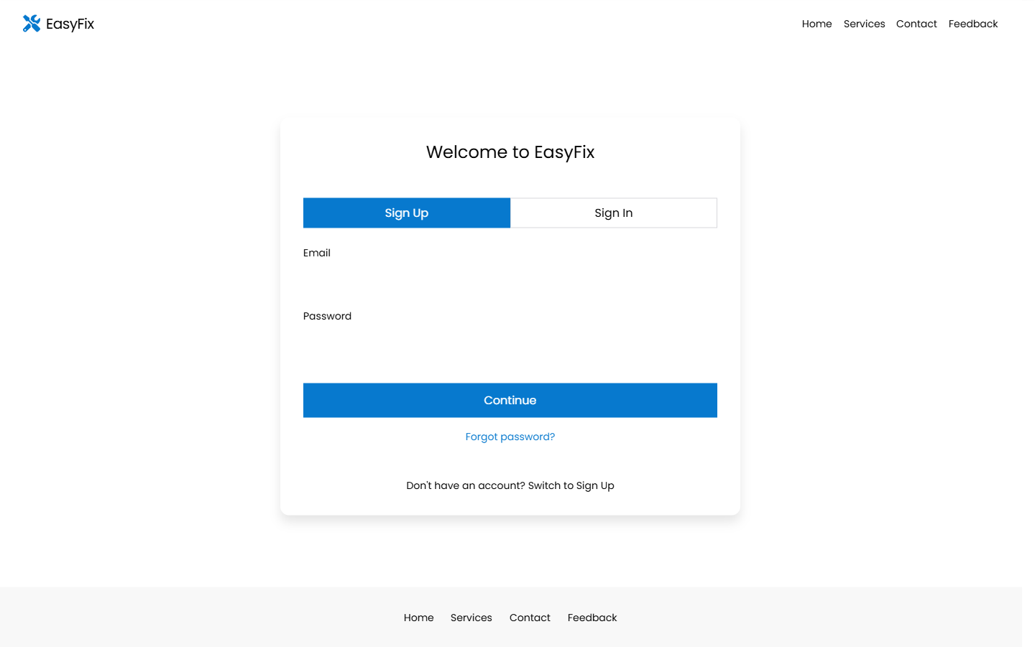
Sign Up / Sign In
Page

Slide 7
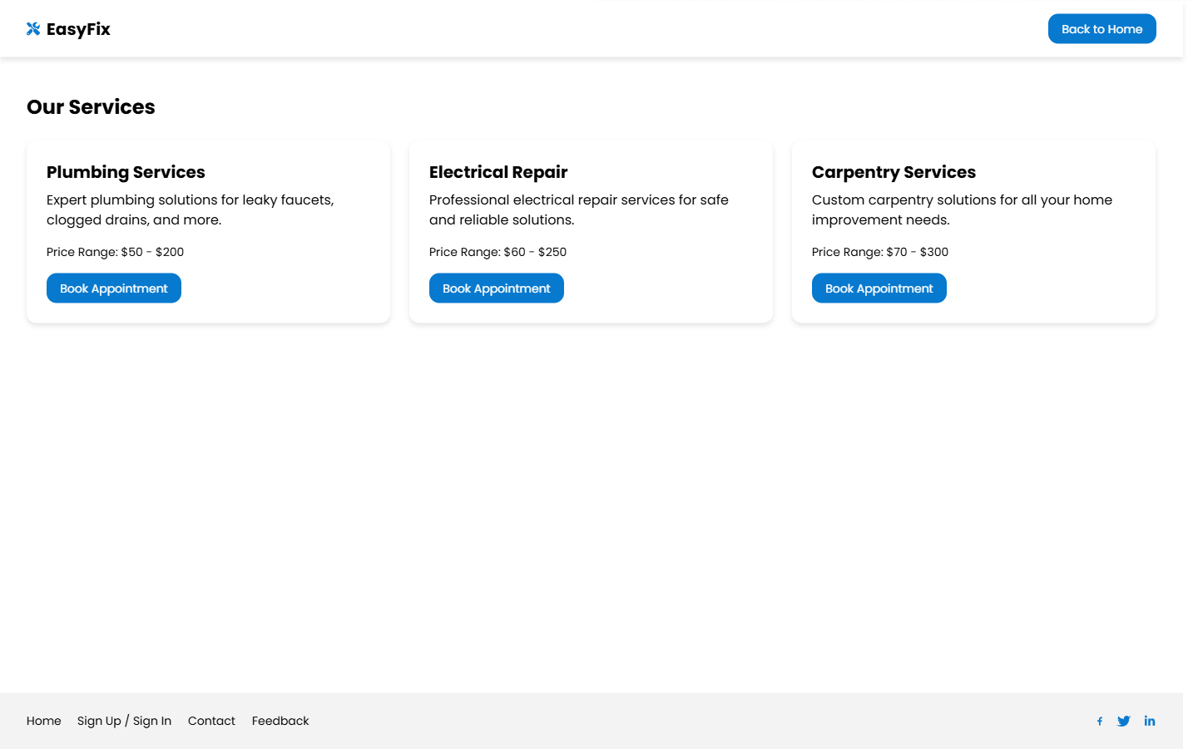
Services
Page

Slide 8
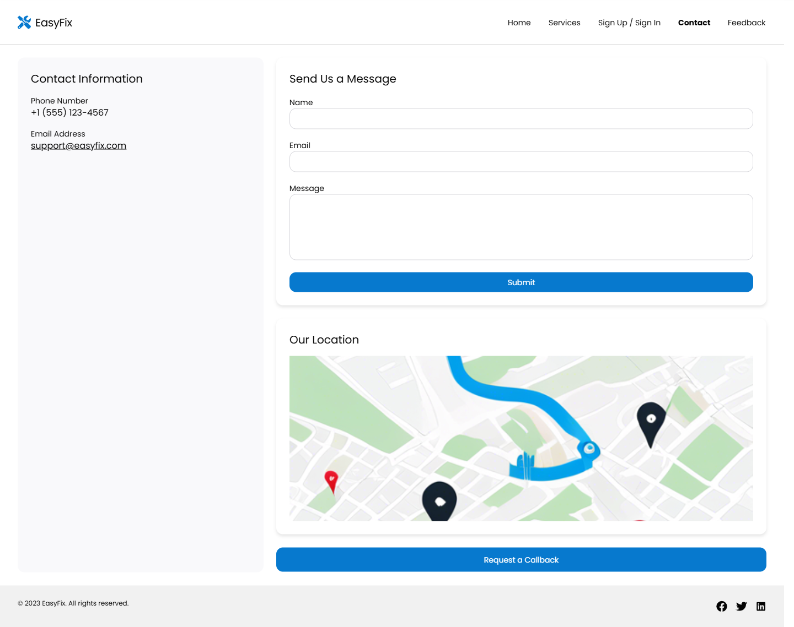
Contact
Page

Slide 9
Work Plan

Slide 10
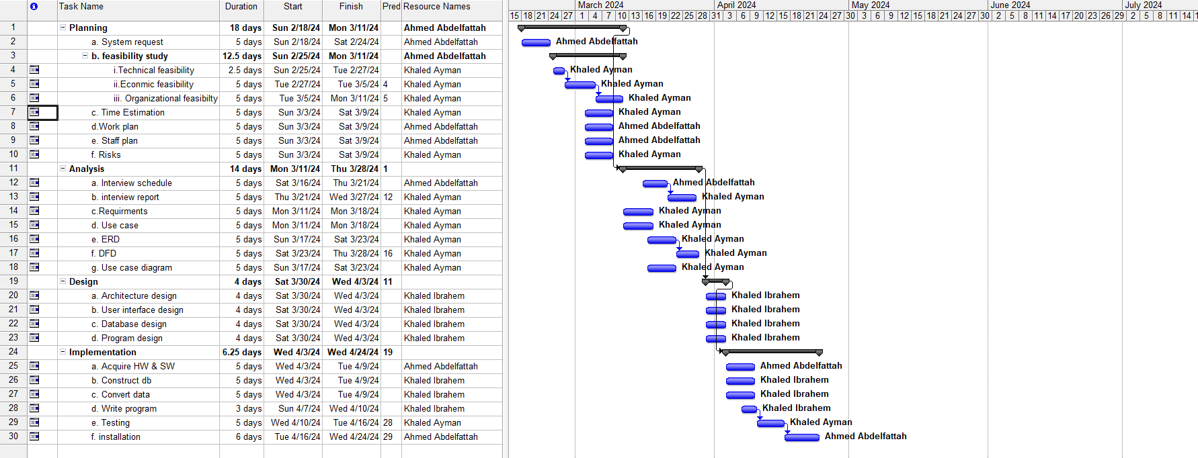

Slide 11
ER Modeling

Slide 12
Entities
- User
- Technician
- Service
- Booking
- Payment
- Review
- Location
- Admin
ER Diagram
User (1) —— (M) Booking
Technician (1) —— (M) Booking
Service (1) —— (M) Booking
Booking (1) —— (1) Payment
User (1) —— (M) Review
Technician (1) —— (M) Review
Technician (1) —— (1) Location
Admin (1) —— (M) User/Technician

Slide 13
Relationships
- User-Booking: A user can have multiple bookings, but a booking is associated with one user.
- Technician-Booking: A technician can handle multiple bookings, but each booking is assigned to one technician.
- Service-Booking: Each booking is for one specific service, but a service can be booked multiple times.
- Booking-Payment: Each booking can have one payment associated with it, and a payment is linked to one booking.
- User-Review: A user can write multiple reviews, but each review is associated with a specific user.
- Technician-Review: A technician can receive multiple reviews, but each review targets a specific technician.
- Technician-Location: A technician has one current location, but their location updates over time.
- Admin-User/Technician: Admins can manage both users and technicians (add, remove, verify)

Slide 14
ER Model

Slide 15
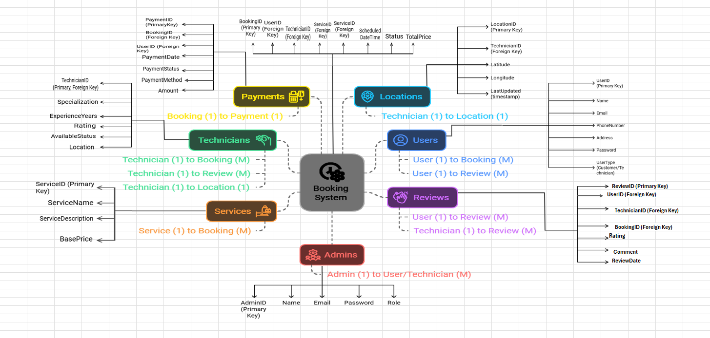

Slide 16
Context diagram

Slide 17
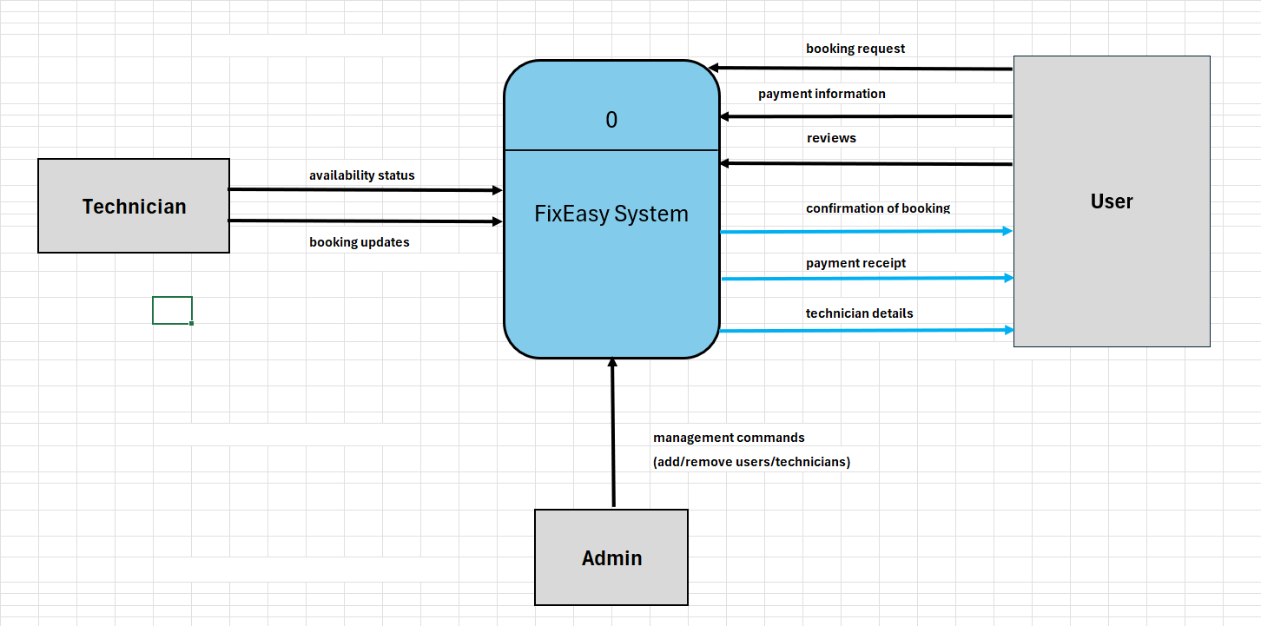

Slide 18
DFD Level 0

Slide 19
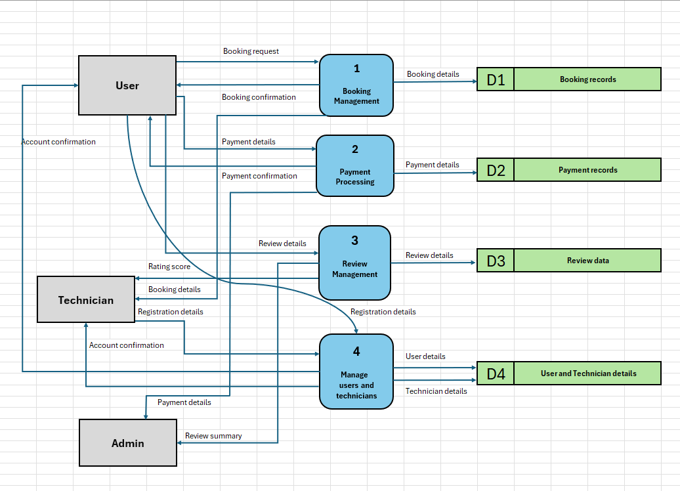

Slide 20
DFD Level 1

Slide 21
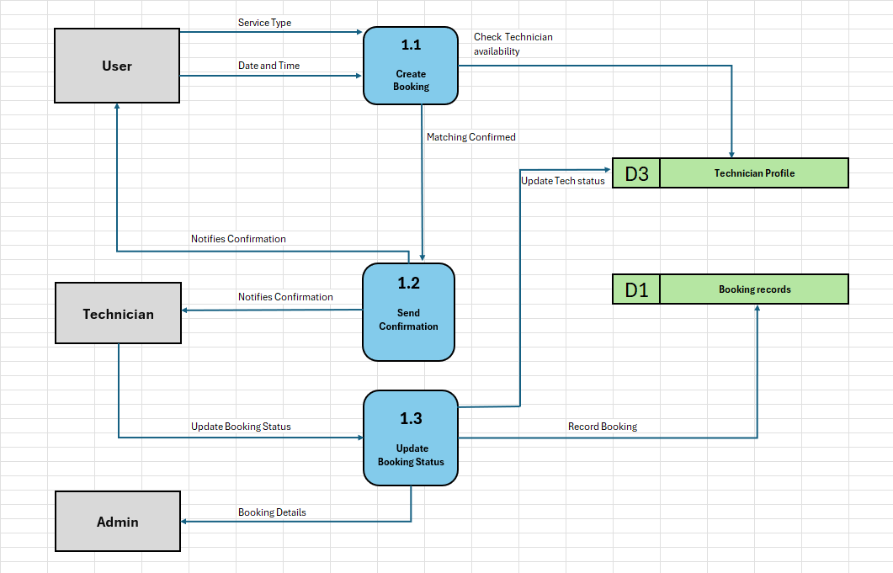

Slide 22

THANK YOU!

