Slide 1
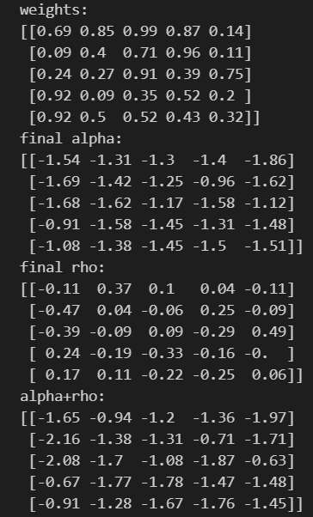
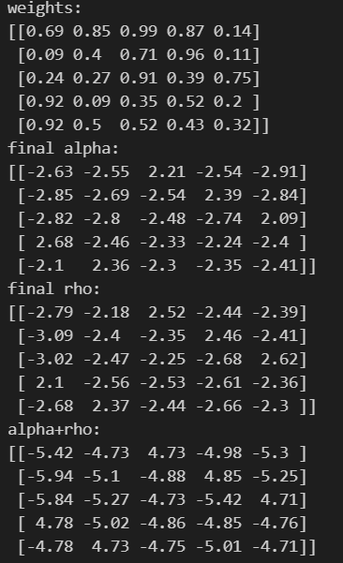
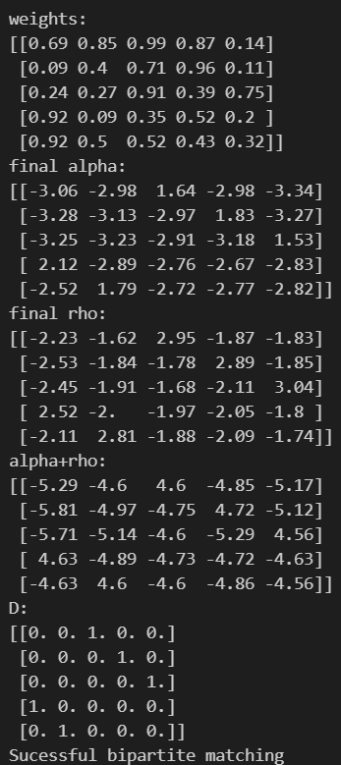
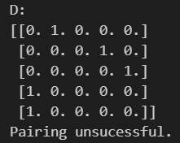
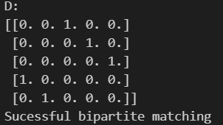
logSumExp
Max, but initial rho and alpha = 0
Max, initial rho and alpha given by dataset
Message passing results

Slide 2
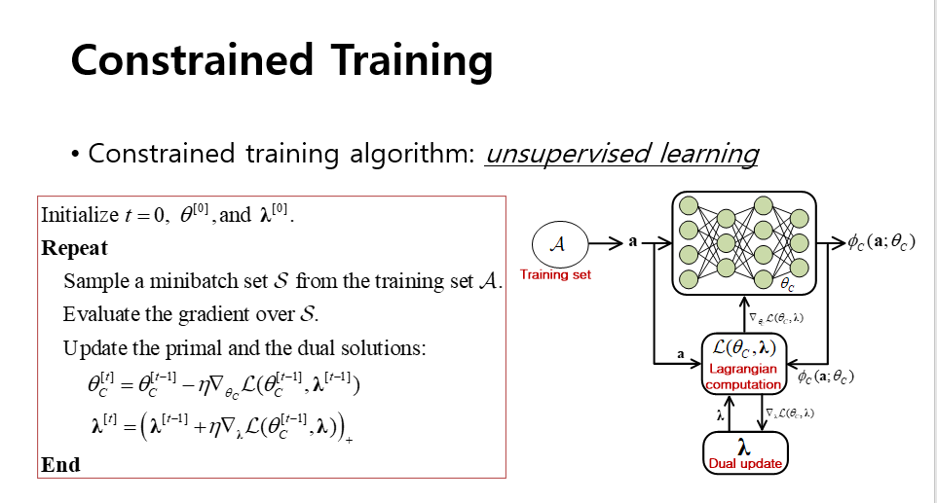
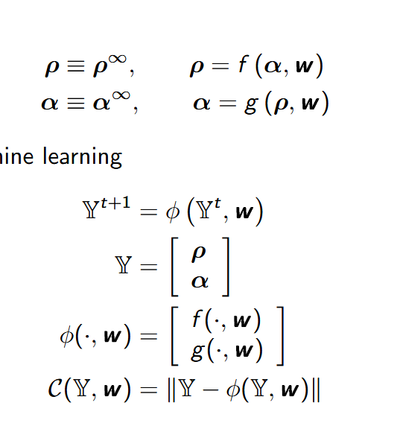


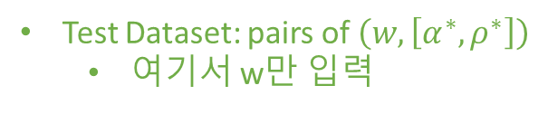

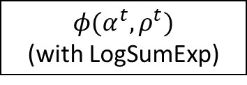
Test Dataset: pairs of $\left(w, \left[α^{∗},ρ^{∗}\right]\right)$
여기서 w만 입력
ANN
weights
$$α^{t},ρ^{t}$$
gradient
Cost
$$α^{t+1},ρ^{t+1}$$
$$φ(α^{t},ρ^{t})$$
(with LogSumExp)
Cost: $MAE([α^{t},ρ^{t}]−\left[α^{t+1},ρ^{t+1}\right])$

