Slide 1
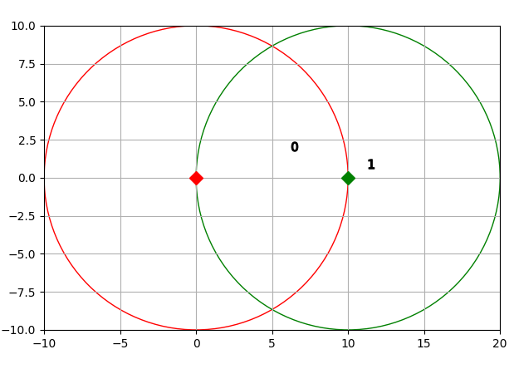
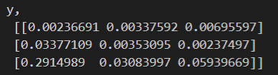
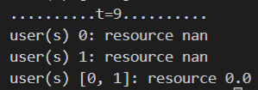

Slide 2
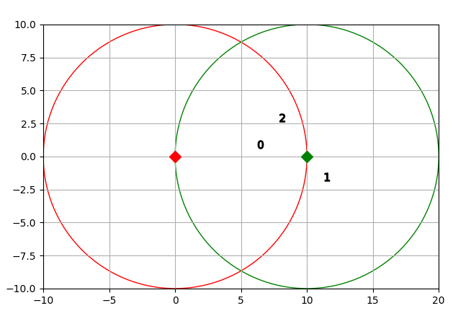
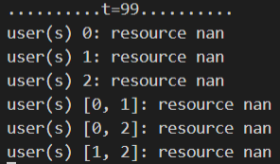
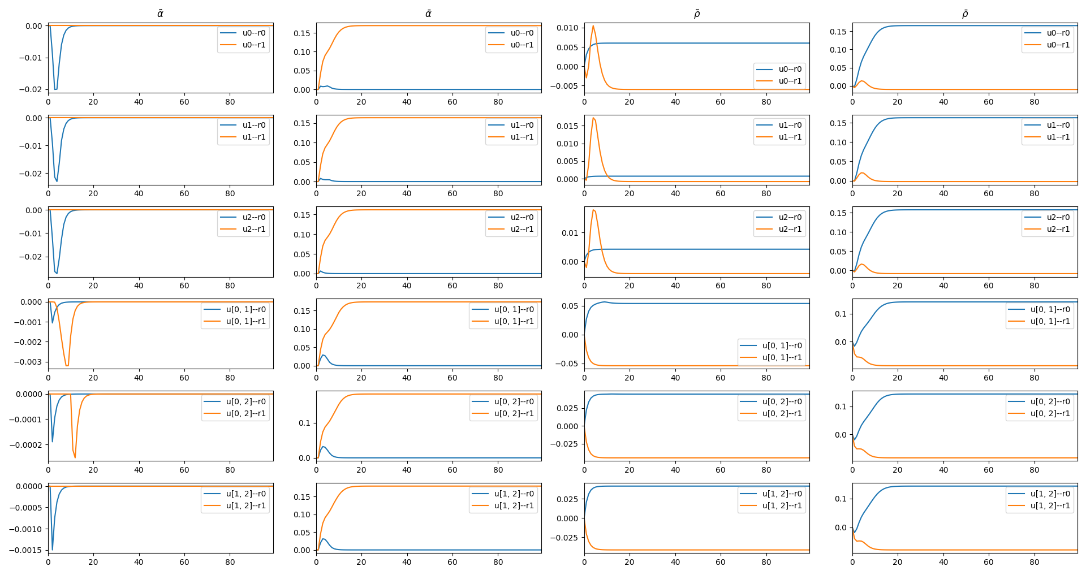
y
0 - [[0.0097191 0.00372929]
1 - [0.0020373 0.00127996]
2 - [0.00869968 0.00447521]
0, 1 - [0.08562246 0.03154682]
0, 2 - [0.08343495 0.03866797]
1, 2 - [0.07861366 0.03703504]]

