Slide 1
Chatbot to Recommend Products from Hobby
Advance Topic Presentation
Ishrak Hayet
KUID: 3001877
YouTube Video Link: https://youtu.be/abJ2Zv4LFwI

Slide 2
Introduction
A conversational agent that learns conversation patterns over time
The chatbot eventually asks or infers the user’s hobby
Tells the user about product recommendations based on the hobby

Slide 3
Datasets
Hobby Dataset:
https://www.kaggle.com/muhadel/hobbies
Amazon (AU) Dataset:
https://data.world/promptcloud/amazon-australia-product-listing

Slide 4
Tools Used
Attempt 1 (Cloud)
Amazon Lex
AWS Lambda
AWS S3
AWS IAM
Attempt 2 (Local)
Python
Gensim Word2Vec
Chatterbot
Sqlite

Slide 5
Attempt 1 (Cloud)
Amazon Lex
Amazon platform for building chatbots using wake phrase, launch phrase, utterances, slots
Able to connect to AWS lambda to pass messages as events
AWS Lambda
Serverless Application Model that creates function endpoints to cater to requests
AWS S3
Simple Storage Service to store objects in bucket containers
AWS IAM
Service for regulating access, permissions, roles and policies

Slide 6
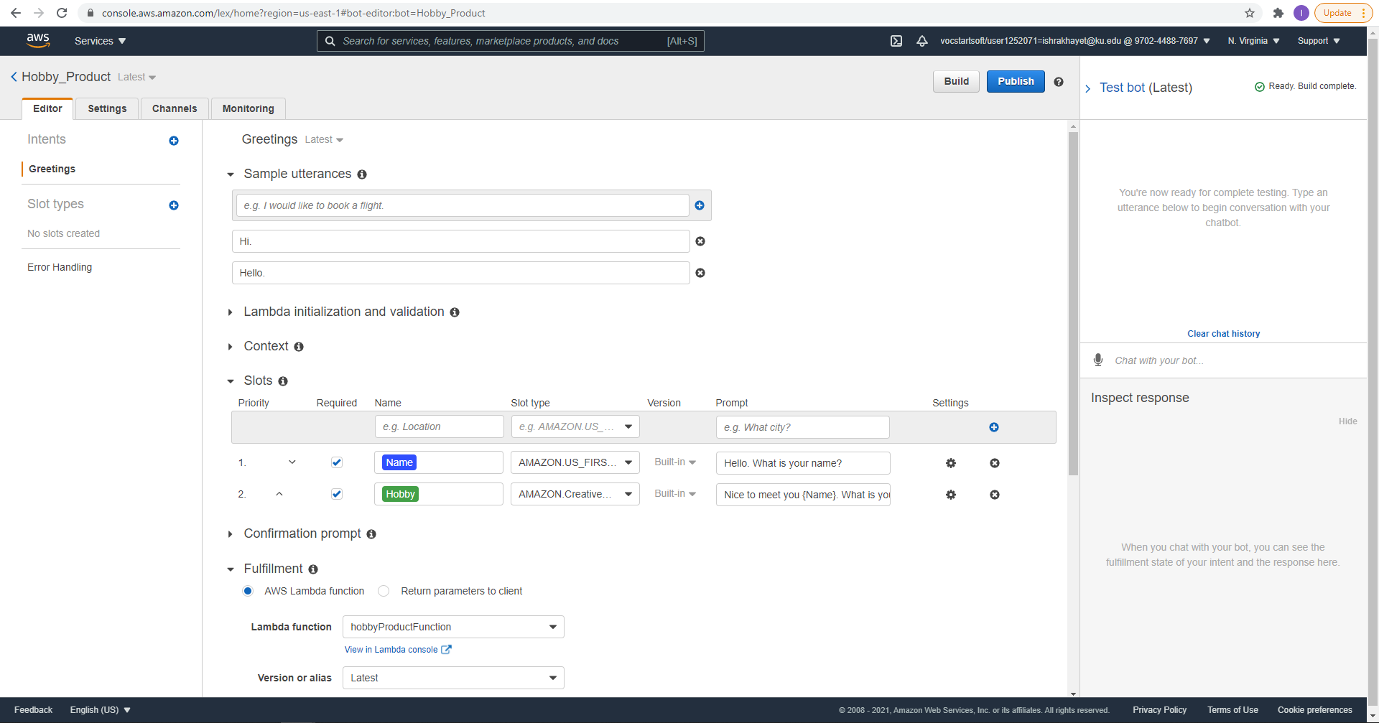
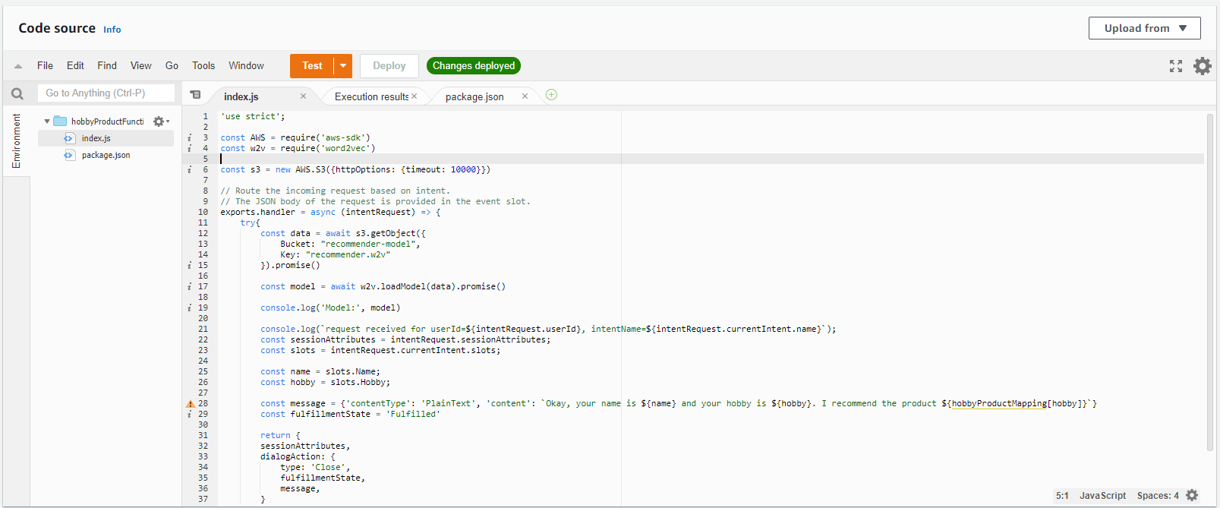
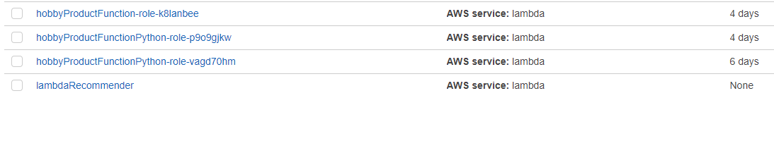
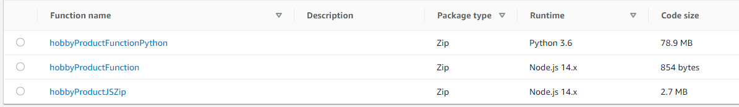
Attempt 1 (Cloud)
Fig. Amazon Lex
Fig. Amazon Lambda Code
Fig. Amazon IAM
Fig. Amazon Lambda

Slide 7
Attempt 2 (Local)
Python
I am using the Python language in an Ipython Jupyter Notebook
Gensim Word2Vec
Word2Vec is an embedding library that creates word representations using vectors
Semantically similar words are placed in the same cluster
Chatterbot
Library to train a conversational agent for learning conversational patterns by chatting with a user
Stores previous messages to relate to other or new messages

Slide 8
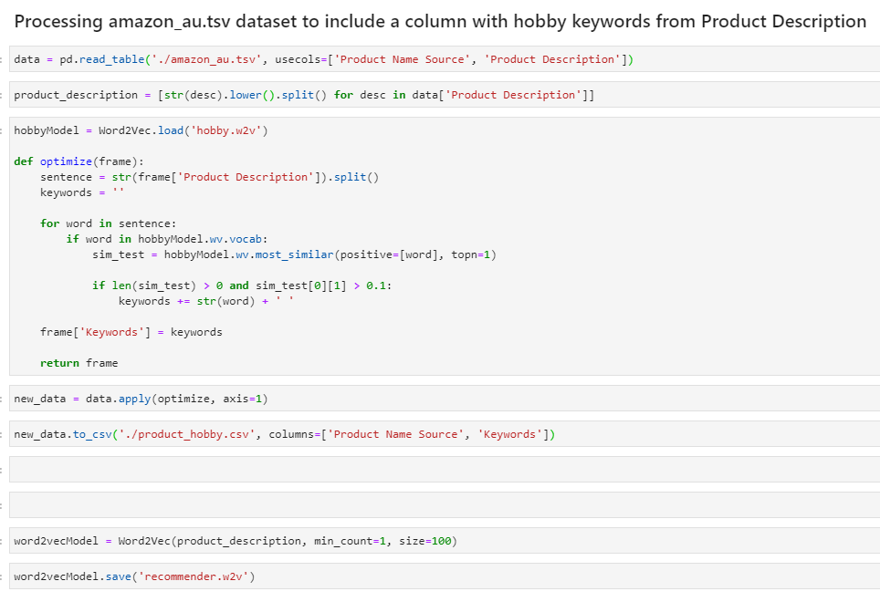
Word2Vec on Dataset
Here I am training separate Word2Vec embedding models that convey semantic relationship between the different words in the hobby dataset and product description tags from Amazon dataset

Slide 9
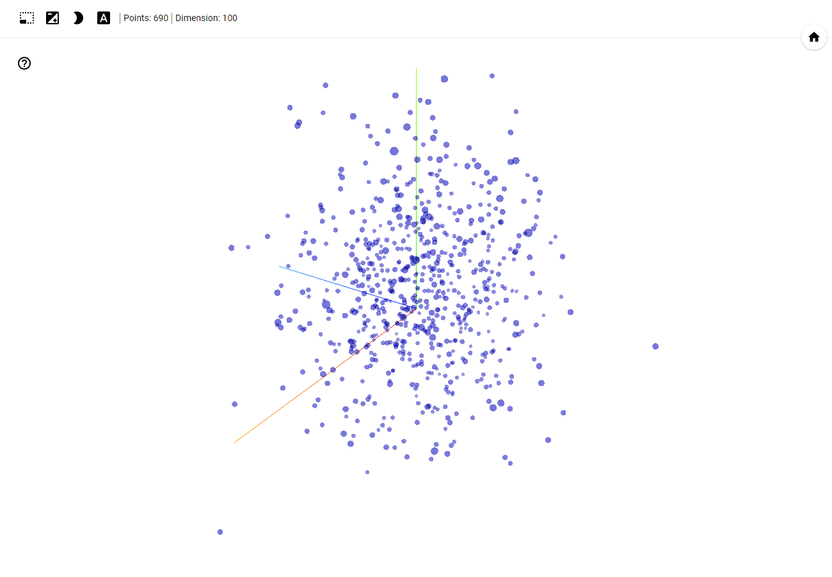
Hobby Embeddings

Slide 10
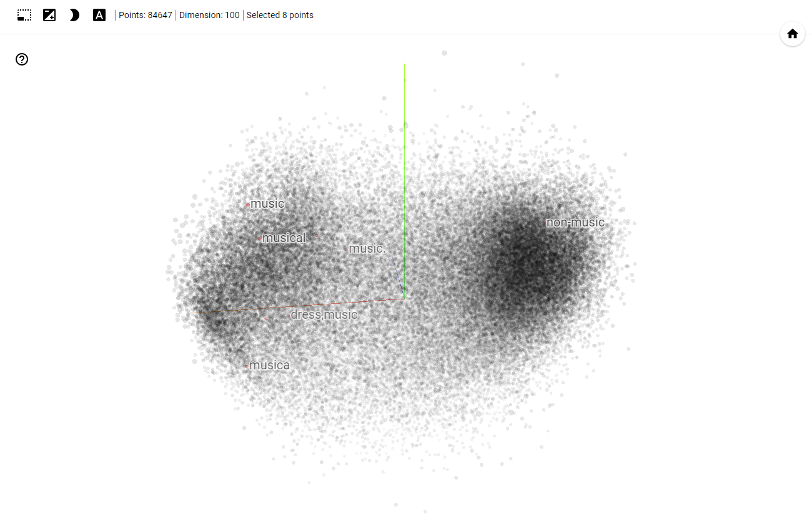
Product Embeddings

Slide 11
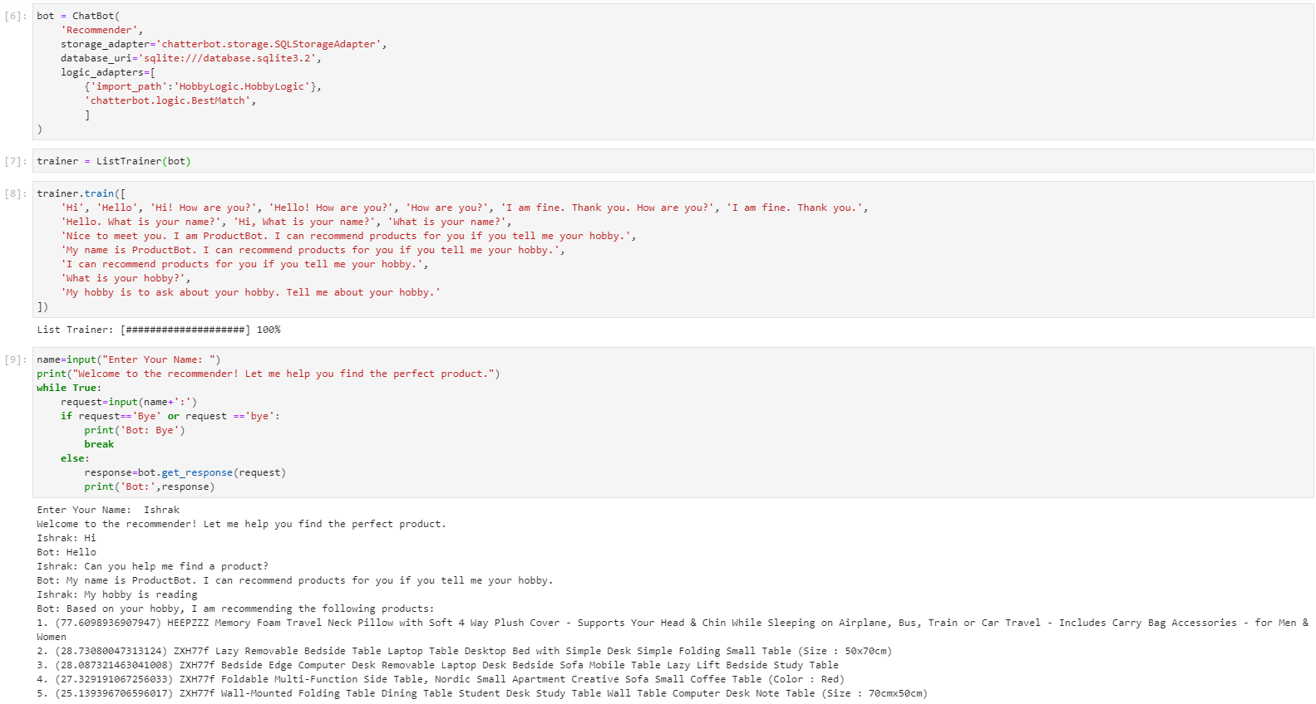
Chatterbot

Slide 12
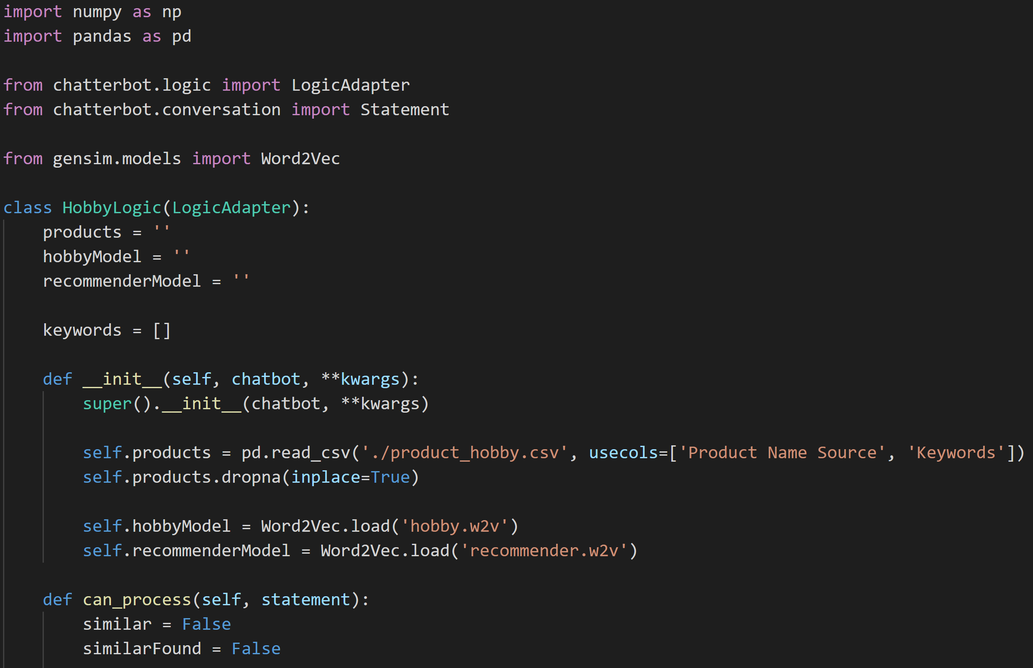
HobbyLogic Adapter (init)

Slide 13
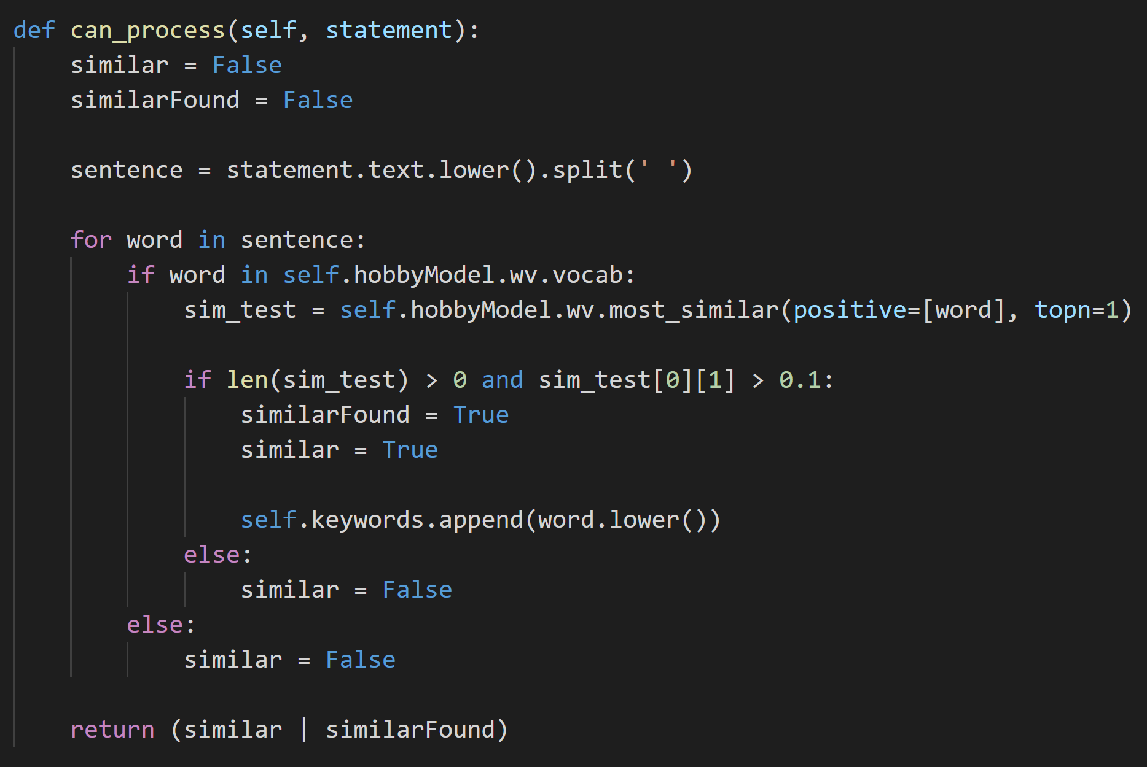
HobbyLogic Adapter (can_process)

Slide 14
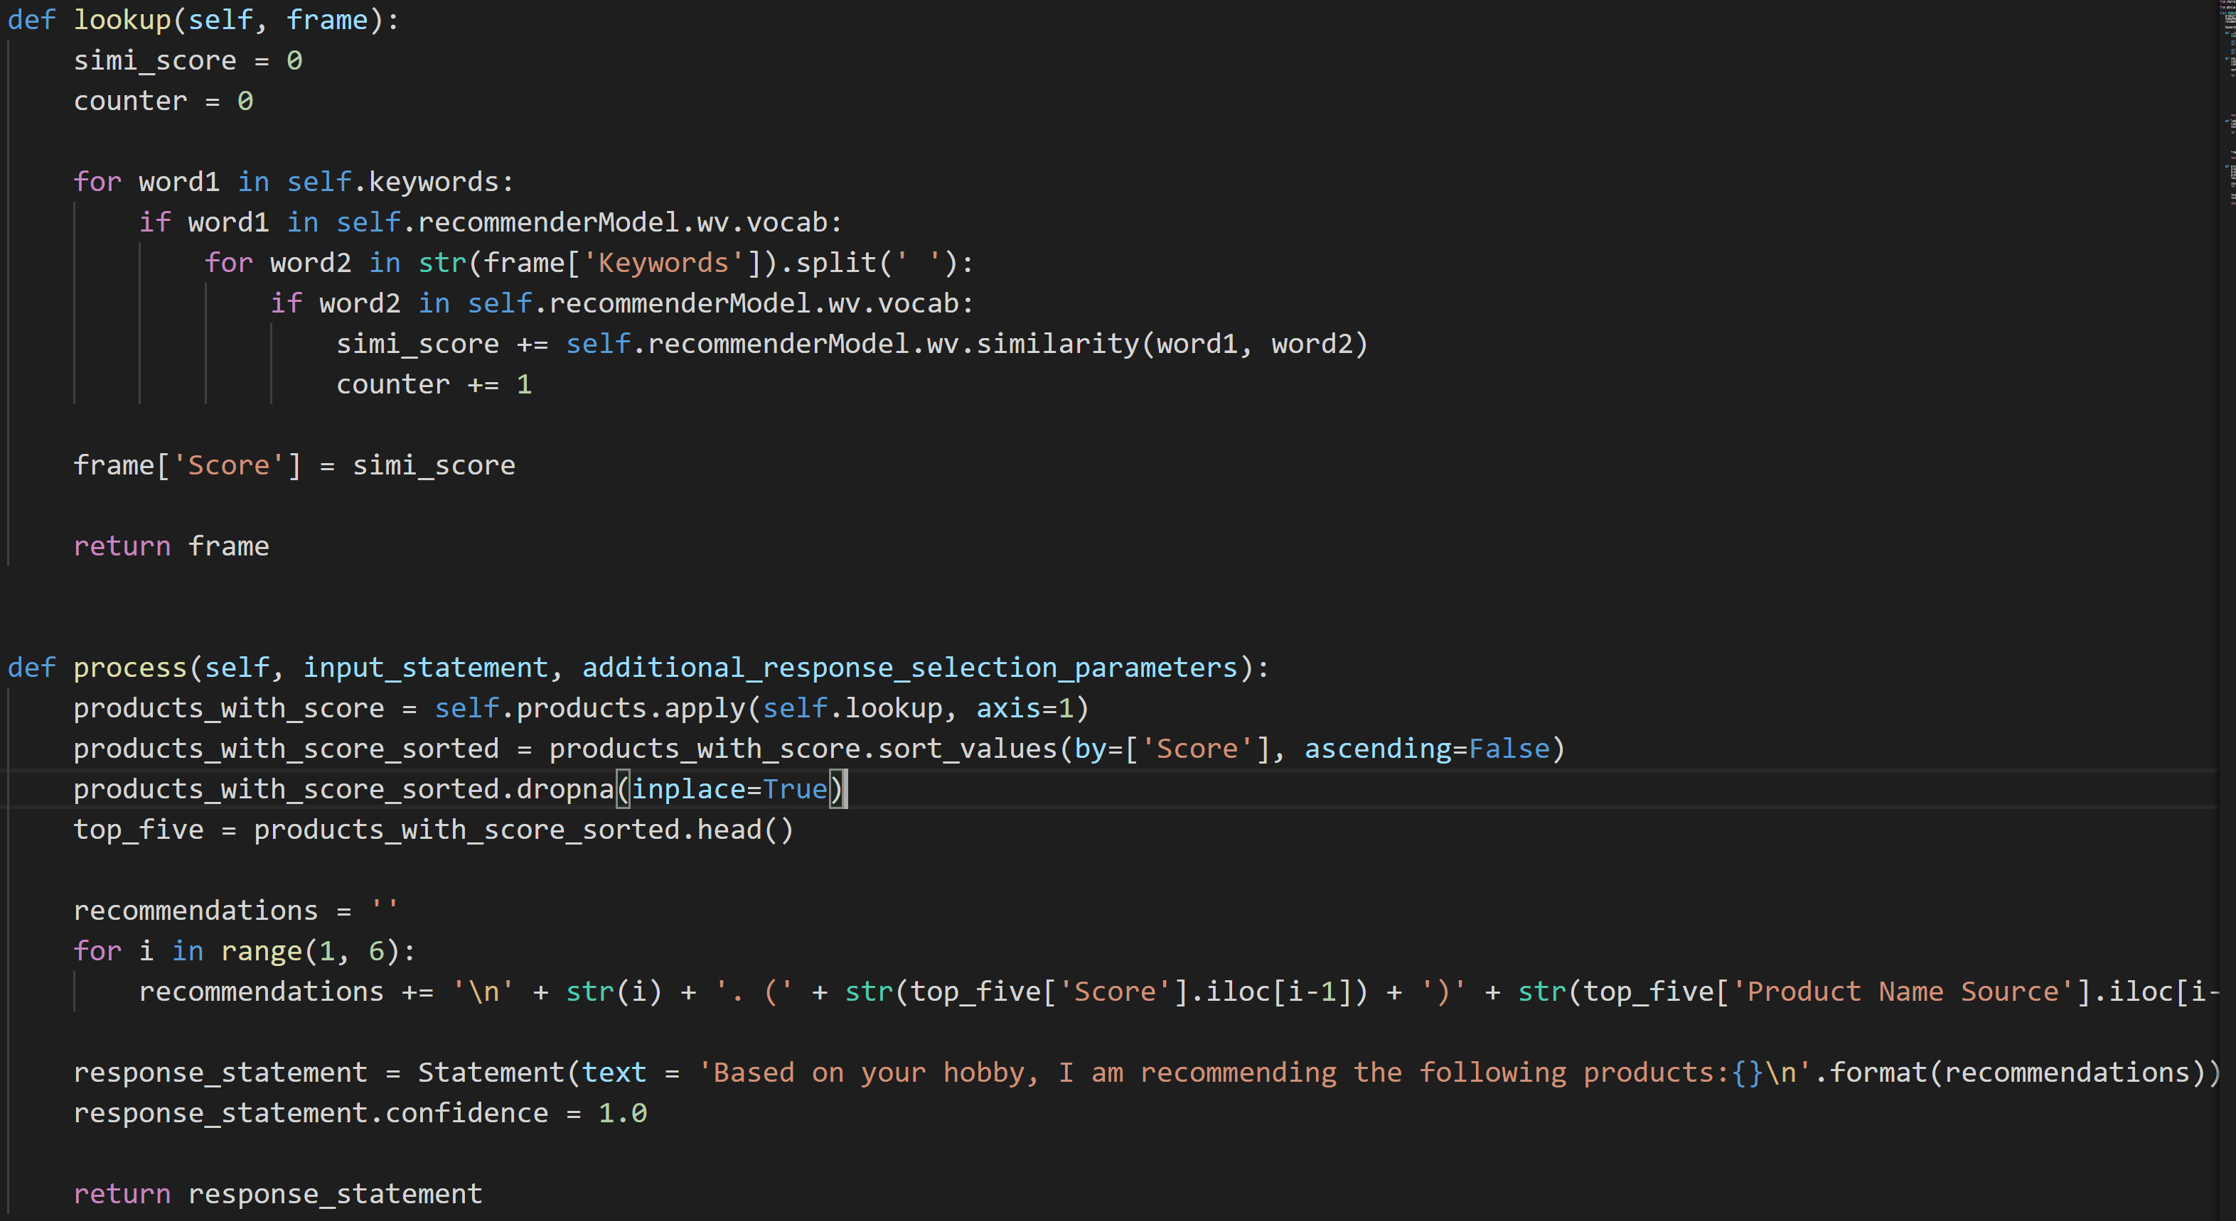
HobbyLogic Adapter (lookup & process)

Slide 15
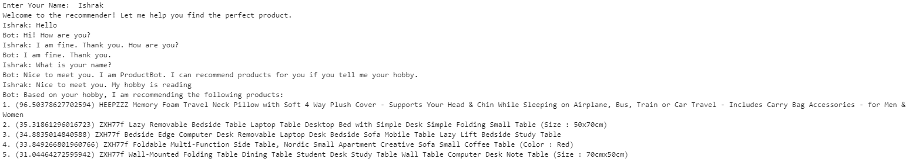
Conversation

Slide 16
References
1. https://www.kaggle.com/muhadel/hobbies
2. https://data.world/promptcloud/amazon-australia-product-listing
3. https://chatterbot.readthedocs.io/en/latest/conversations.html
4. https://www.datacamp.com/community/tutorials/building-a-chatbot-using-chatterbot
5. https://radimrehurek.com/gensim/auto_examples/tutorials/run_word2vec.html
6. https://www.javaer101.com/en/article/985198.html
7. https://www.tensorflow.org/tensorboard/tensorboard_projector_plugin
8. https://projector.tensorflow.org/

