Slide 1
Session-based Purchase Prediction and Explanation
Data Intelligence Lab@Yonsei
Professor: Seung-won Hwang
Leader: Jin-young Yeo
Team GAZUA: Ju-hyuk Lee, Yoo-jin Kim, In-ho Choi

Slide 2
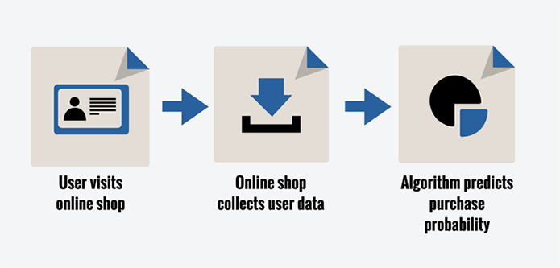
Purchase Prediction

Slide 3
Related Works
Purchase prediction with user data
Session-based Recommendations with RNN
2015 ICLR
Logined
User data
Model
Prediction
Raw session data
RNN
Recommendation

Slide 4
Limitation – Only logined user
Necessity
People usually visit online shop without login
Prediction Target
Raw session data with clicks (RecSys Challenge 2015)
Session ID
Session ID, Timestamp, Item ID, Category, Purchase, Price, Quantity
Session ID, Timestamp, Item ID, Category, Purchase, Price, Quantity
Session ID, Timestamp, Item ID, Category, Purchase, Price, Quantity

Slide 5
Limitation – Lack of Explainability
Necessity
Hard to understand black-box models
People wouldn’t trust the output from black-box models
Explanation Method
“Why should I trust you?” Explaining the Predictions of Any Classifier (2016 KDD)
Local
Interpretable
Model-agnostic
Explanations

Slide 6
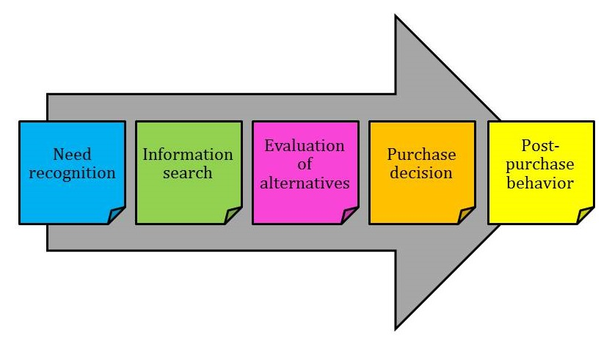
Limitation – Lack of Explainability

Slide 7

Problems on the dataset
Imbalanced dataset
Click log data: 9 million sessions, 33 million entries
Purchase log data: 1.1 million buys
Imbalanced $→$ Overfitting in neural model

Slide 8
Aim of Research
Naive Neural-based Prediction
Black-box
Overfitting
Limitations
Prediction and Explainable AI
Oversampling
Solutions
Buyer Decision Process
ACGAN
Proposal

Slide 9
Current Progress - Training ACGAN
Real Session representation
for GAN
Latent vector
Real or Fake
Generator
Discriminator
Fake
buyer session
One-hot vector
(Buyer)
Buyer or Non-buyer

Slide 10
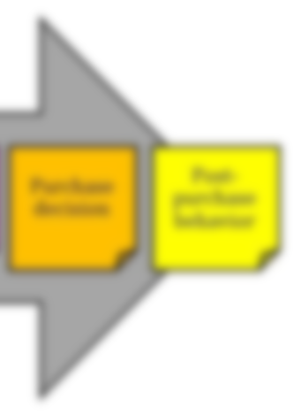
Data Analysis – Session Characteristic
[Non-buyer session]
[Buyer session]
Category coverage ↑
Product coverage ↑
Average duration ↓
Category coverage ↓
Product coverage ↓
Average duration ↑

Slide 11
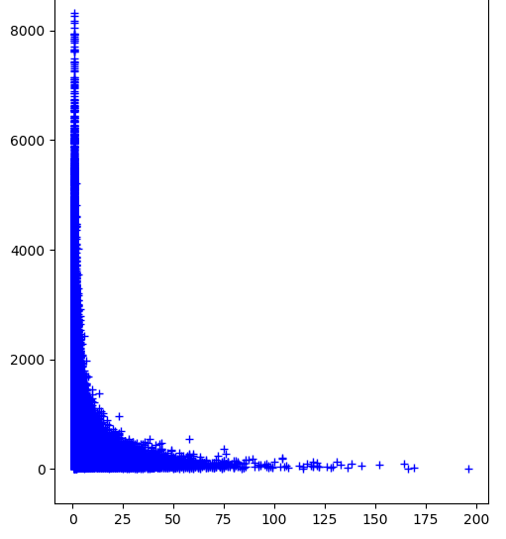
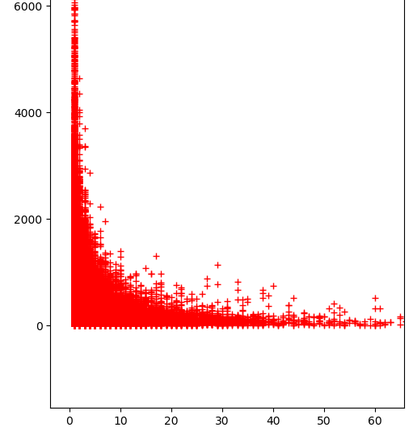
Data Analysis – Session Characteristic
# of Buyer session: 509,696
# of Non buyer session: 8,740,033 509,696
sampling
Buyer
Non-buyer
Average duration
Average duration
Product coverage
Product coverage

Slide 12
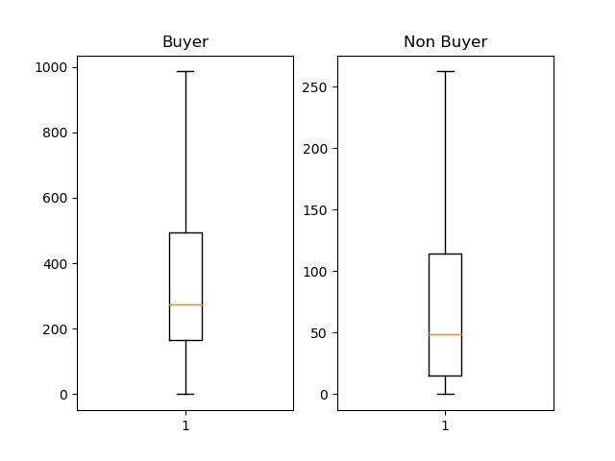
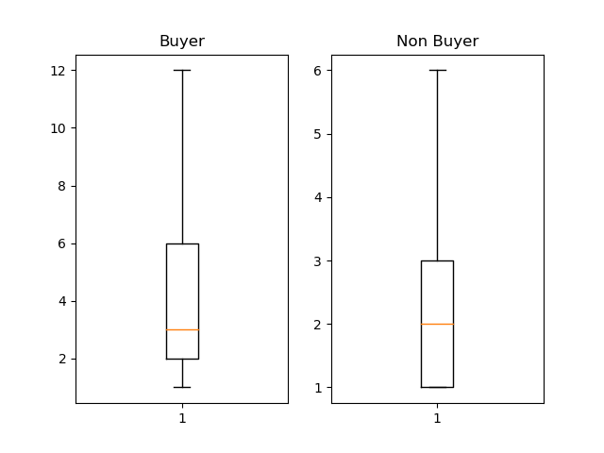
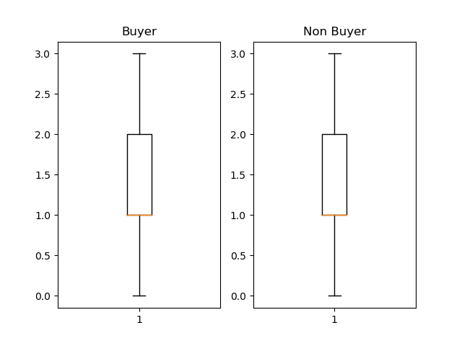
Data Analysis – Session Characteristic
# of Buyer session: 509,696
# of Non buyer session: 8,740,033 509,696
sampling
500
120
6
3
200
2
10
1
Average Duration
Product Coverage
Category Coverage

Slide 13

Data Analysis – Session Characteristic
$\text{Product} \text{coverage} ∝ \frac{1}{\text{Average} \text{duration}}$
Category coverage is not an important factor.
Product coverage: Buyer > Non-buyers
Average duration: Buyer >> Non-buyer

Slide 14

Session Characteristic - Entropy
Lottery
$\log{\frac{1}{0.0001}}≈9.21$
$\log{\frac{1}{0.9999}}≈0.0001$
Information gain
$\log{\frac{1}{p}}$
More information for less probability
X | P(X)
Win | 0.0001
Lose | 0.9999
WOW!!!!!!!!
Ok.. I knew it.

Slide 15

Session Characteristic - Entropy
Lottery
$\log{\frac{1}{0.0001}}≈9.21$
$\log{\frac{1}{0.9999}}≈0.0001$
Dart
$\log{\frac{1}{0.1}}≈2.30$
$\log{\frac{1}{0.9}}≈0.11$
X | P(X)
Win | 0.0001
Lose | 0.9999
WOW!!!!!!!!
Ok.. I knew it.
Great!
0.6
Hey, come on!
0.1
0.3

Slide 16
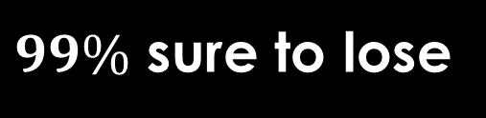

Session Characteristic - Entropy
Lottery
$0.0001⋅\log{\frac{1}{0.0001}}+0.9999⋅\log{\frac{1}{0.9999}}$
$≈0.00102099$
Dart
$0.1⋅\log{\frac{1}{0.1}}+0.9⋅\log{\frac{1}{0.9}}$
$≈0.329$
$99\%$ sure to lose
Cannot expect

Slide 17
Session Characteristic - Entropy
[Non-buyer session]
[Buyer session]
Category coverage ↑
Product coverage ↑
Average duration ↓
Category coverage ↓
Product coverage ↓
Average duration ↑

Slide 18
Session Characteristic - Entropy
4
4
2
2
2
2
2
0.5
0.5
0.5
0.5
Product coverage = 5
Average duration = 2
Entropy = log 5
Product coverage = 6
Average duration = 1.6
Entropy = log 5 – (log4)/5

Slide 19

Session representation for GAN
GAN learns distribution $P\left(b_{c}, S\right)=P\left(b_{c}\right)⋅p(S∣b_{c})$
Distribution for characteristic of buyers (denote by $b_{c}$)
Category preference
Brand preference
Sale preference
Season
High/low purchaser
Entropy
Distribution for sequential data given $b_{c}$ (denote by $P(S∣b_{c})$ )
$S=(click_{1},click_{2},click_{3},⋯,click_{N})$
$$(0,0,3,0,2,0,0,1,0,0,0.8,0.2,1,0.5,0.31)$$

Slide 20
Future Plan - Training ACGAN
Real Session representation
for GAN
Latent vector
Real or Fake
Generator
Discriminator
Fake
buyer session
One-hot vector
(Buyer)
Buyer or Non-buyer

Slide 21

Choose ACGAN Model
MNIST ACGAN (base line)
MNIST ACGAN (simulating imbalanced data)
[0~4] $∪$ [6~9] $→$ class 1
5 $→$ class 2
MNIST_WACGAN
ACGAN + WGAN

Slide 22
Future Plan - Overview
Original data
Session representation for GAN
ACGAN
Generated data
Neural Model
Prediction
Buyer
Decision
Process
Explainable Model
Explanation

Slide 23
References
[1] "Why Should I Trust You?" Explaining the Predictions of Any Classifier (http://www.kdd.org/kdd2016/papers/files/rfp0573-ribeiroA.pdf)
[2] Session-based Recommendations with Recurrent Neural Networks (https://arxiv.org/pdf/1511.06939.pdf)
[3] 1시간만에 GAN(Generative Adversarial Network) 완전 정복하기 (https://www.youtube.com/watch?v=odpjk7_tGY0)
[4] Conditional Image Synthesis With Auxiliary Classifier GANs (https://arxiv.org/pdf/1610.09585.pdf)
[5] eCommerceGAN : A Generative Adversarial Network for E-commerce (https://arxiv.org/abs/1801.03244)
[6] Predicting Online Purchase Conversion for Retargeting (https://dl.acm.org/citation.cfm?id=3018715)
[7] Predicting User Purchase in E-commerce by Comprehensive Feature Engineering and Decision Boundary Focused Under-Sampling (https://dl.acm.org/citation.cfm?id=2813517)
[8] RecSys Challenge 2015 (http://2015.recsyschallenge.com/challenge.html)

