Slide 1
Session-based Purchase Prediction and Explanation
Data Intelligence Lab@Yonsei
Professor: Seung-won Hwang
Leader: Jin-young Yeo
Team GAZUA: Ju-hyuk Lee, Yoo-jin Kim, In-ho Choi

Slide 2
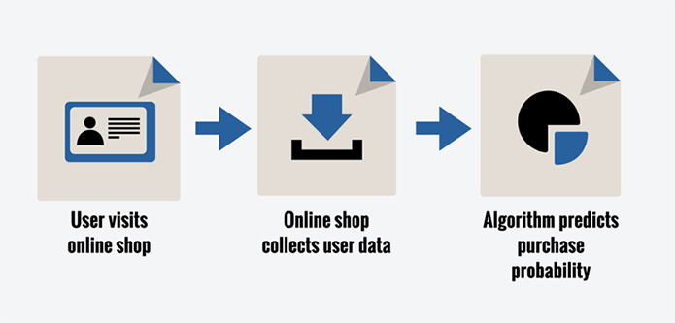
Purchase Prediction

Slide 3
Related Works
Purchase prediction with user data
Session-based Recommendations with RNN
2015 ICLR
Logined
User data
Model
Prediction
Raw session data
RNN
Recommendation

Slide 4
Limitation – Only logined user
Necessity
People usually visit online shop without login
Prediction Target
Raw session data with clicks (RecSys Challenge 2015)
Session ID
Session ID, Timestamp, Item ID, Category, Purchase, Price, Quantity
Session ID, Timestamp, Item ID, Category, Purchase, Price, Quantity
Session ID, Timestamp, Item ID, Category, Purchase, Price, Quantity

Slide 5
Limitation – Lack of Explainability
Necessity
Hard to understand black-box models
People wouldn’t trust the output from black-box models
Explanation Method
“Why should I trust you?” Explaining the Predictions of Any Classifier (2016 KDD)
Local
Interpretable
Model-agnostic
Explanations

Slide 6
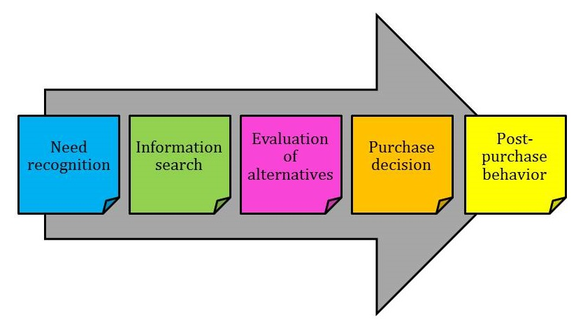
Limitation – Lack of Explainability

Slide 7

Problems on the dataset
Imbalanced dataset
Click log data: 9 million sessions, 33 million entries
Purchase log data: 1.1 million buys
Imbalanced $→$ Overfitting in neural model

Slide 8
Aim of Research
Naive Neural-based Prediction
Black-box
Overfitting
Limitations
Prediction and Explainable AI
Oversampling
Solutions
Buyer Decision Process
ACGAN
Proposal

Slide 9
Current Progress - Training ACGAN
Real Session representation
for GAN
Latent vector
Real or Fake
Generator
Discriminator
Fake
buyer session
One-hot vector
(Buyer)
Buyer or Non-buyer

Slide 10
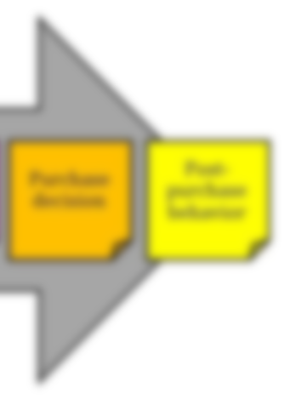
Session Characteristic - Entropy
[Non-buyer session]
[Buyer session]
Category coverage ↑
Product coverage ↑
Average duration ↓
Category coverage ↓
Product coverage ↓
Average duration ↑

Slide 11
Session Characteristic - Entropy
4
4
2
2
2
2
2
0.5
0.5
0.5
0.5
Product coverage = 5
Average duration = 2
Entropy = log 5
Product coverage = 6
Average duration = 1.6
Entropy = log 5 – (log4)/5

Slide 12
Session representation for GAN
12 , Timestamp , Item ID , Purchase , Price , Quantity , Category
12 , Timestamp , Item ID , Purchase , Price , Quantity , Category
12 , Timestamp , Item ID , Purchase , Price , Quantity , Category
12 , Timestamp , Item ID , Purchase , Price , Quantity , Category
1 dimensional features
Average duration of items
Average duration of categories
Total duration
Item entropy
Category entropy
Item count
Average item count per category

Slide 13
Session representation for GAN
12 , Timestamp , Item ID , Purchase , Price , Quantity , Category
12 , Timestamp , Item ID , Purchase , Price , Quantity , Category
12 , Timestamp , Item ID , Purchase , Price , Quantity , Category
12 , Timestamp , Item ID , Purchase , Price , Quantity , Category
second
fifth
High dimensional features | Vector representation
Category(13-d) | (0, 0, 1, 0, 1, 1, 0, 0, 0, 0, 1, 0, 0)
Time(24-d) | (0, 0, 0, …, 0.5, 1, 0.5, …, 0, 0, 0)
15:00

Slide 14
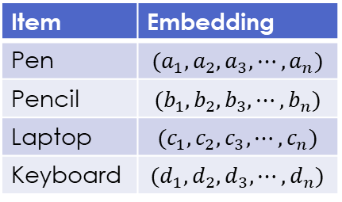
Item2vec & word2vec
sentence1: The first method is automatic
sentence2: It allows for a far method
sentence3: It is not automatic
session1: pen pencil laptop keyboard clock
session2: shoe jacket laptop cell-phone
session3: keyboard mouse laptop cell-phone
Item | Embedding
Pen | $$(a_{1},a_{2},a_{3},⋯, a_{n})$$
Pencil | $$(b_{1},b_{2},b_{3},⋯, b_{n})$$
Laptop | $$(c_{1},c_{2},c_{3},⋯, c_{n})$$
Keyboard | $$(d_{1},d_{2},d_{3},⋯, d_{n})$$
[9] Item2Vec: Neural Item Embedding for Collaborative Filtering

Slide 15
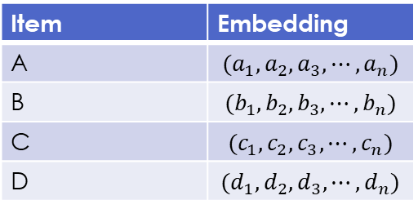
Session representation for GAN
Item | Embedding
A | $$(a_{1},a_{2},a_{3},⋯, a_{n})$$
B | $$(b_{1},b_{2},b_{3},⋯, b_{n})$$
C | $$(c_{1},c_{2},c_{3},⋯, c_{n})$$
D | $$(d_{1},d_{2},d_{3},⋯, d_{n})$$
[10] Deep Neural Networks for YouTube Recommendations
Component-wise average of items
Name | Value
Embedding (128-d) | -0.0616 , 0.1547,...,-0.1428 , -0.0648
Category (13-d) | 0,…,1,…,0
Hour (24-d) | 0,…,0.5,1,0.5,…,0
Average duration of items | 117.0
Average duration of categories | 351.0
Total duration | 351.0
Item entropy | 0.9472
Category entropy | 0.0
Item count | 3
Average Item count per category | 3.0

Slide 16
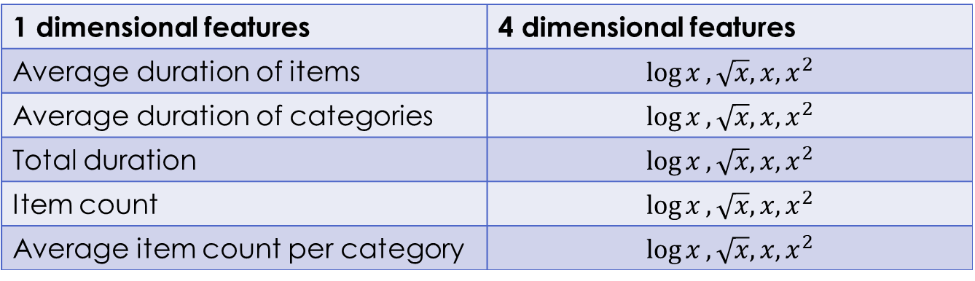
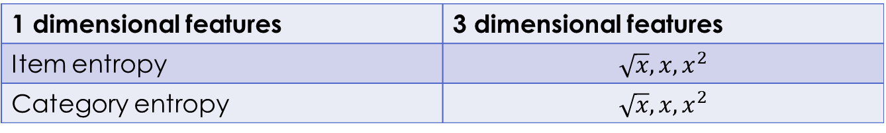
Session representation for GAN
1 dimensional features | 4 dimensional features
Average duration of items | $$\log{x}, \sqrt{x}, x, x^{2}$$
Average duration of categories | $$\log{x}, \sqrt{x}, x, x^{2}$$
Total duration | $$\log{x}, \sqrt{x}, x, x^{2}$$
Item count | $$\log{x}, \sqrt{x}, x, x^{2}$$
Average item count per category | $$\log{x}, \sqrt{x}, x, x^{2}$$
1 dimensional features | 3 dimensional features
Item entropy | $$\sqrt{x}, x, x^{2}$$
Category entropy | $$\sqrt{x}, x, x^{2}$$
[5] eCommerceGAN : A Generative Adversarial Network for E-commerce
[10] Deep Neural Networks for YouTube Recommendations

Slide 17


Session representation for GAN
Generator output
$$−1<\tanh{x}<1$$
Features
Embedding (128-d)
Category (13-d)
Hour (24-d)
Average duration of items (4-d)
Average duration of categories (4-d)
Total duration (4-d)
Item entropy (3-d)
Category entropy (3-d)
Item count (4-d)
Average Item count per category (4-d)
$$−1≤\frac{x−min}{max−min}×2−1≤1$$

Slide 18
Current Progress - Training ACGAN
Real Session representation
for GAN
Latent vector
Real or Fake
Generator
Discriminator
Fake
buyer session
One-hot vector
(Buyer)
Buyer or Non-buyer

Slide 19
Choose ACGAN Model
Optimizer: adam
adam_lr = 0.0002
adam_beta_1: 0.6
Latent vector: 96-d
Training process
Discriminator : generator = 1:1
mini-batch (batch size = 128)
Epoch: 15

Slide 20




For Epoch(15):
For # of batches:
1 (Sigmoid)
191
128
64
$$P_{r}$$
Train
Discriminator
Real (batch size: 128)
Fake (batch size: 128)
2 (softmax)
$$P_{c}$$
96
64
128
191 (tanh)
Latent vector (96-d)
(batch size*2 = 256)
Class label (int32)
$$P_{r}$$
Train
Generator
D
$$P_{c}$$

Slide 21
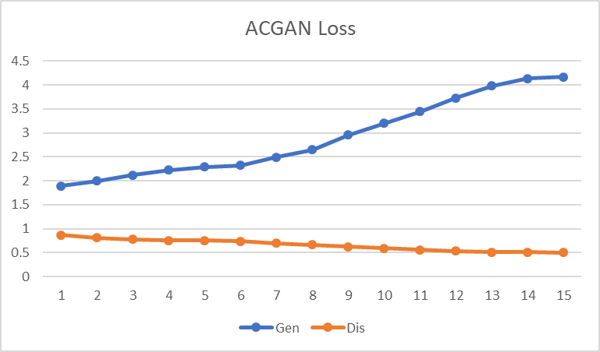
Result & Future Plan
Generator loss is increasing
Mode collapsing
Possible Solution
Add dist(real, fake) loss
Feature matching
Mini-batch discrimination
Historical averaging (remember before)
Use WGAN

Slide 22
Future Plan - Overview
Original data
Session representation for GAN
ACGAN
Generated data
Neural Model
Prediction
Buyer
Decision
Process
Explainable Model
Explanation

Slide 23
References
[1] "Why Should I Trust You?" Explaining the Predictions of Any Classifier (http://www.kdd.org/kdd2016/papers/files/rfp0573-ribeiroA.pdf)
[2] Session-based Recommendations with Recurrent Neural Networks (https://arxiv.org/pdf/1511.06939.pdf)
[3] 1시간만에 GAN(Generative Adversarial Network) 완전 정복하기 (https://www.youtube.com/watch?v=odpjk7_tGY0)
[4] Conditional Image Synthesis With Auxiliary Classifier GANs (https://arxiv.org/pdf/1610.09585.pdf)
[5] eCommerceGAN : A Generative Adversarial Network for E-commerce (https://arxiv.org/abs/1801.03244)
[6] Predicting Online Purchase Conversion for Retargeting (https://dl.acm.org/citation.cfm?id=3018715)
[7] Predicting User Purchase in E-commerce by Comprehensive Feature Engineering and Decision Boundary Focused Under-Sampling (https://dl.acm.org/citation.cfm?id=2813517)
[8] RecSys Challenge 2015 (http://2015.recsyschallenge.com/challenge.html)
[9] Item2Vec: Neural Item Embedding for Collaborative Filtering (https://arxiv.org/vc/arxiv/papers/1603/1603.04259v2.pdf)
[10] Deep Neural Networks for YouTube Recommendations (https://static.googleusercontent.com/media/research.google.com/ko//pubs/archive/45530.pdf)

