Slide 1

Network Load Balancing with In-network Reordering Support for RDMA
Cha Hwan Song Xin Zhe Khooi Raj Joshi Inho Choi Jialin Li Mun Choon Chan

Slide 2





Remote Direct Memory Access (RDMA)
RDMA is the emerging standard in modern DCs
Application
Buffer
Host OS (TCP)
RDMA NIC
+ probably more !
Performance
Versatility
Practicality
High throughput
Low latency
Low CPU overhead
RDMA + RPC
RDMA + Storage
RDMA + AI/ML
Production-level deployment in DCs
[1] Gao, Yixiao, et al. “When cloud storage meets RDMA”. NSDI 2021 [2] Bai, Wei, et al. “Empowering azure storage with RDMA”. NSDI 2023

Slide 3

This Talk: Network Load Balancing for RDMA
Despite such benefits, RDMA does not fully exploit the high path diversity in DCNs.
Existing LB schemes do not fit well with RDMA.
Why, and what is the solution?

Slide 4
Prior Load Balancing Designs
Per-flow
Per-flowlet
Per-packet
Coarsed-grained
Reroute granularity
Fine-grained

Slide 5

Prior Load Balancing Designs
Per-flow [e.g., ECMP]
ECMP (Equal Cost Multi Path) is de-facto standard for RoCEv2*
RDMA over Converged Ethernet
H(Pkt) % 2 == 0
H(Pkt) % 2 == 1
e.g., Hashing 5-tuple to decide the
egress link
Cannot evenly distribute flows based on their sizes
* InfiniBand Trade Association. 2020. InfiniBand Architecture Specification Release 1.4 Annex A17: RoCEv2

Slide 6
Prior Load Balancing Designs
Per-packet [e.g., spraying, DRILL]
Per-packet rerouting provides a near-optimal load balance
Out-of-order!
Spray, or to the smallest Eg.Queue
2
1
Rerouting decision for every packet
RDMA is highly sensitive to out-of-order packets
Resilient datacenter load balancing in the wild [SIGCOMM’17]

Slide 7



Prior Load Balancing Designs
Per-packet [e.g., spraying, DRILL]
Per-packet rerouting provides a near-optimal load balance
Unlike TCP, a “single” out-of-order packet largely increases FCT with spurious ReTx and rate decrease
Out-of-order!
Randomly craft 1 out-of-order pkt
Spray, or to the smallest Eg.Queue
Sender NVIDIA CX-6
Tofino Switch
Receiver NVIDIA CX-6
Rerouting decision for every packet
FCT normalized to in-order msg | 10KB msg | 1MB msg
50th-percentile | 1.65x | 2.65x
99th-percentile | 1.25x | 3.27x
RDMA is highly sensitive to out-of-order packets

Slide 8
Prior Load Balancing Designs
Per-flowlet [e.g., Conga, Letflow, PLB]
Per-flowlet rerouting avoids out-of-order arrivals via timegaps
Flowlet 1
>∆
Flowlet 2
>∆
Flowlet 3
Reroute only if there is enough inactive timegap between two packets
Hard to find time gaps in RDMA
CONGA: Distributed congestion-aware load balancing for datacenters [SIGCOMM’14]
Let it flow: Resilient asymmetric load balancing with flowlet switching [NSDI’17]
PLB: congestion signals are simple and effective for network load balancing [SIGCOMM’22]

Slide 9
Prior Load Balancing Designs
Per-flowlet [e.g., Conga, Letflow, PLB]
Per-flowlet rerouting avoids out-of-order arrivals via timegaps
Experiment: A bulk data transfer with 8 concurrent connections
Flowlet 1
>∆
Flowlet 2
>∆
Flowlet 3
Reroute only if there is enough inactive timegap between two packets
flowlet’s timegap threshold (∆)
Hard to find time gaps in RDMA

Slide 10
Prior Load Balancing Designs
Per-flowlet [e.g., Conga, Letflow, PLB]
Per-flowlet rerouting avoids out-of-order arrivals via timegaps
Experiment: A bulk data transfer with 8 concurrent connections
Less chances to reroute
Batch process
HW-based packet pacing*
* Yuanwei Lu, et al., Multi-Path Transport for RDMA in Datacenters, [NSDI’18]

Slide 11

Design Goal
How to get here?
Fine grained
Per-packet
Reroute granularity
Per-flowlet (for TCP)
Per-flowlet (for RDMA)
Coarsed grained
Better
Per-flow
Out-of-order
Preserving pkt order
In-order

Slide 12
Idea – In-network Packet Reordering
“Restore” packets back in-order before reaching to end-hosts

Slide 13
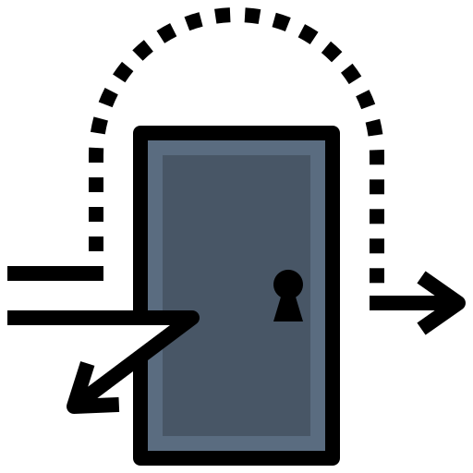

Idea – In-network Packet Reordering
“Restore” packets back in-order before reaching to end-hosts
End-host is not a viable option
RDMA’s host OS bypass
Fixed-function RDMA HW
RDMA

Slide 14
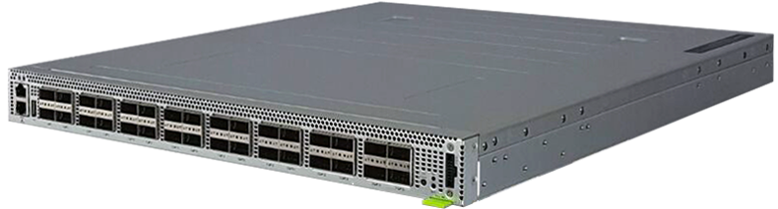
Idea – In-network Packet Reordering
“Restore” packets back in-order before reaching to end-hosts
Opportunity
~128 FIFO queues per Eg. port
Intel Tofino2 Programmable Switch
Queue pause/ resume capability

Slide 15

Challenges in Packet Reordering on Switches
Hard to restore “arbitrary” packet orders on switches:
Lack of sorting primitives on switching hardware
Limited resource and time for storing and flushing packets at line-rate
Costly to store pkts to FIFO queues and flush them
1
2
3
4
Next SEQ = 1
flush in relays
FIFO queues

Slide 16
Challenges in Packet Reordering on Switches
Hard to restore “arbitrary” packet orders on switches:
Lack of sorting primitives on switching hardware
Limited resource and time for storing and flushing packets at line-rate
Costly to store pkts to FIFO queues and flush them
How to “constrain” the packet reordering patterns?
1
4
Next SEQ = 1
3
flush in relays
2
FIFO queues

Slide 17

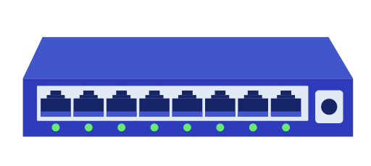
ConWeave (short for Congestion Weaving)
High-level Overview
Rerouting
Reordering
network
ConWeave SrcToR
ConWeave DstToR
ToR-to-ToR mechanism, i.e., end-host agnostic

Slide 18


ConWeave (short for Congestion Weaving)
High-level Overview
Rerouting
Reordering
network
ConWeave SrcToR
ConWeave DstToR
Hard to find time gaps
Cautiously split and reroute flows for the ease of reordering
Arbitrary packet order is not manageable

Slide 19



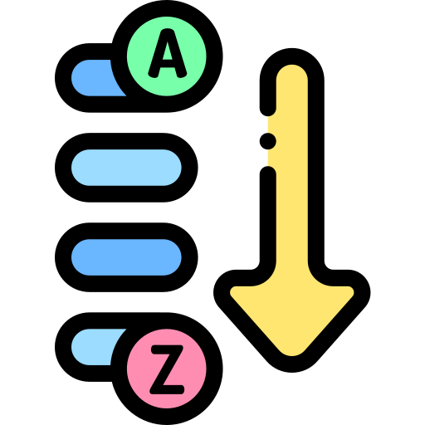
ConWeave (short for Congestion Weaving)
Key Components in ConWeave
Path Monitoring
Path Selecting
Cautious Rerouting
Pkt Reordering
Agile and lightweight congestion detection
Telemetry-driven congestion evasion
Tight incorporation with switch’s reordering capability
Efficient queue flush via strict priority
This Talk!
* More details in the paper

Slide 20



Cautious Rerouting
Key Idea
Reroute “only if” there is no inflight out-of-order packets
→ Enable switch to reorder a flow using a single reorder queue
ConWeave SrcToR
ConWeave DstToR
Normal queue (for all flows)
Current path is congested!

Slide 21
Cautious Rerouting
Key Idea
Reroute “only if” there is no inflight out-of-order packets
→ Enable switch to reorder a flow using a single reorder queue
ConWeave SrcToR
ConWeave DstToR
Normal queue (for all flows)
T
Tag “TAIL” – last pkt before rerouting

Slide 22
Cautious Rerouting
Key Idea
Reroute “only if” there is no inflight out-of-order packets
→ Enable switch to reorder a flow using a single reorder queue
ConWeave SrcToR
ConWeave DstToR
Normal queue (for all flows)
T
Reroute!

Slide 23
Cautious Rerouting
Key Idea
Reroute “only if” there is no inflight out-of-order packets
→ Enable switch to reorder a flow using a single reorder queue
ConWeave SrcToR
ConWeave DstToR
Normal queue (for all flows)
T
Reroute!
Out-of-order!

Slide 24
Cautious Rerouting
Key Idea
Reroute “only if” there is no inflight out-of-order packets
→ Enable switch to reorder a flow using a single reorder queue
ConWeave SrcToR
ConWeave DstToR
Normal queue (for all flows)
T
Reroute!
Reorder queue
Dynamically assign reorder queue!

Slide 25
Cautious Rerouting
Key Idea
Reroute “only if” there is no inflight out-of-order packets
→ Enable switch to reorder a flow using a single reorder queue
“TAIL” says that all packets from OLD path have arrived
→ Flush reorder queue
ConWeave SrcToR
ConWeave DstToR
Normal queue (for all flows)
T
Reroute!
Reorder queue

Slide 26
Cautious Rerouting
Key Idea
Reroute “only if” there is no inflight out-of-order packets
→ Enable switch to reorder a flow using a single reorder queue
ConWeave SrcToR
ConWeave DstToR
Normal queue (for all flows)
T
Reroute!
Release the reorder queue, and redirect a flow to normal queue
Reorder queue

Slide 27
Cautious Rerouting
Key Idea
Reroute “only if” there is no inflight out-of-order packets
→ Enable switch to reorder a flow using a single reorder queue
”CLEAR” – no more inflight out-of-order packets
ConWeave SrcToR
ConWeave DstToR
Normal queue (for all flows)
Reroute!
Release the reorder queue, and redirect a flow to normal queue
Reorder queue

Slide 28

Cautious Rerouting
Key Idea
Reroute “only if” there is no inflight out-of-order packets
→ Enable switch to reorder a flow using a single reorder queue
(0) Monitoring*
TAIL
(1) Reroute
(2) Buffer
”CLEAR” – no more inflight out-of-order packets
ConWeave SrcToR
ConWeave DstToR
(3) Flush
CLEAR
Normal queue (for all flows)
ConWeave reroutes a flow when congestion is detected* while delivering packets in order
* More details in the paper

Slide 29


Evaluation
Experiment Setup
RoCEv2 with Lossless Ethernet (i.e., PFC-enabled)
2x4 Leaf-Spine topology with all 25G links (oversubscription ratio 2:1)
Total 16 RDMA nodes (mix of NVIDIA CX-5 and CX-6)
Comparison: ECMP, Letflow^{[1]} (flowlet ∆ = 100µs), DRILL^{[2]} (per-packet)
Network load: 80%
RPC workload
[1] Let it flow: Resilient asymmetric load balancing with flowlet switching [NSDI’17]
[2] Resilient datacenter load balancing in the wild [SIGCOMM’17]

Slide 30

ConWeave is effective in reducing RDMA FCTs
Average
99.9th-percentile
600
6000
120
16.8%
2000
Flow Completion Time (µs)
90
44.4%
1500
60
1000
30
500
0
0
ECMP
Letflow
DRILL
ConWeave
ECMP
Letflow
DRILL
ConWeave
Flowlet and per-packet rerouting performs worse than ECMP, if not on par
Avg and 99.9-percentile FCT reduction by 16.8% and 44.4%, respectively

Slide 31

Buffer and Queue Usage Overhead for Reordering
Experiment setup
8x8 Leaf-Spine (128 hosts), all 100Gbps links
Network load: 80%
Diverse workloads such as RPC, Storage, and Hadoop
Packet buffer overhead
Queue usage overhead
Maximum size of buffer usage per switch
< 2.5 MB
Maximum number of queue usage per port < 10
Switches have 10’s of MBs of packet buffer and up to 128 physical queues

Slide 32



Summary
ConWeave – Network Load Balancer for RDMA
Path Monitoring
Path Selecting
Cautious Rerouting
Pkt Reordering
Agile and lightweight congestion detection
Congestion-evasive rerouting
Tight incorporation with switch’s reordering capability
Efficient queue flush via strict priority
Finer-granularity + in-order delivery
RoCEv2 Compatible

Slide 33

Thank you!
songch@comp.nus.edu.sg
Credit of icons: flaticon.com

Slide 34




BACKUP SLIDE – ConWeave Packet Loss
TAIL loss
Queue will not be flushed
Calculate “expected TAIL arrival time” and flush if timeout
Packet Loss
(TAIL, CLEAR)
No more rerouting of the flow
CLEAR loss
Resume after sufficient inactive time
Leveraging in-band telemetry

Slide 35

BACKUP SLIDE – Challenge. Path Monitoring
Goal: Timely monitor current path’s congestion
Piggybacking is slow to know a current path’s congestion
Probing current path
Congested
SrcToR
DstToR
Piggyback!
Notification delay = DATA (forward) delay + Piggyback (backward) delay
→ Inevitably high!
→ Sol: Set high-prio.

Slide 36

BACKUP SLIDE – Challenge. Restoring Packet Order
Queue pause/ resume cap.
Goal: Restoring packet back in-order
~128 FIFO queues per Eg. port
Hard to restore “arbitrary” packet orders
Intel Tofino2
: Lack of sorting primitives and limited FIFO queues
Costly to store pkts to FIFO queues and flush them in relay
Recirculation increases more out-of-order packets
1
2
3
4
Next SEQ = 2
Recirc. & flushing
…
6
5
Next SEQ = 1
2
3
4
flush in relays
enqueue rate > flush rate

Slide 37
BACKUP SLIDE – Motivating Results
Observation from our RoCEv2 Testbed
Existing solutions perform worse than ECMP, if not on par.
Lossless RDMA (RoCE)
Network Load = 50%
RPC workload
Flow Completion Time (µs)
25G
X 8
X 8
: NVIDIA CX-5/6 25G Port
Flowlet (timegap threshold)
Per-pkt

Slide 38
BACKUP SLIDE – Evaluation on Simulation
Fat-tree topology with 256 hosts, 100Gbps, 60% Network Load
Average, short msgs
Average, long msgs

