Slide 1

FPGA based Tx and Rx for Communication using LEDs / LDs
Kalbhavi Vadhi Raj (B21EE030)
Pranav Chakravarthy (B21EE050)
Under the guidance of
Dr. Nitin Bhatia
Department of Electrical Engineering
Indian Institute of Technology Jodhpur

Slide 2
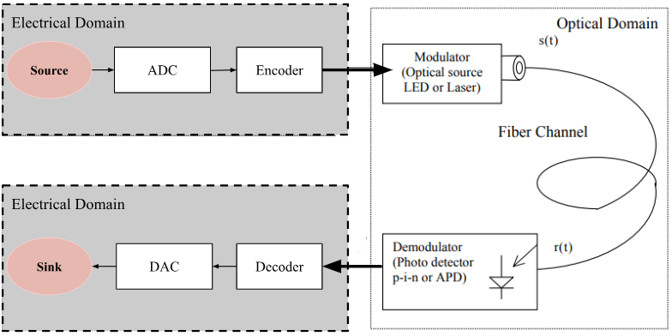
Overview of the Project
Source - Audio
ADC Schemes - 12 - bit PCM
Encoder - LDPC
Decoder - Iterative LDPC decoder
DAC - PWM
Sink - Speaker

Slide 3
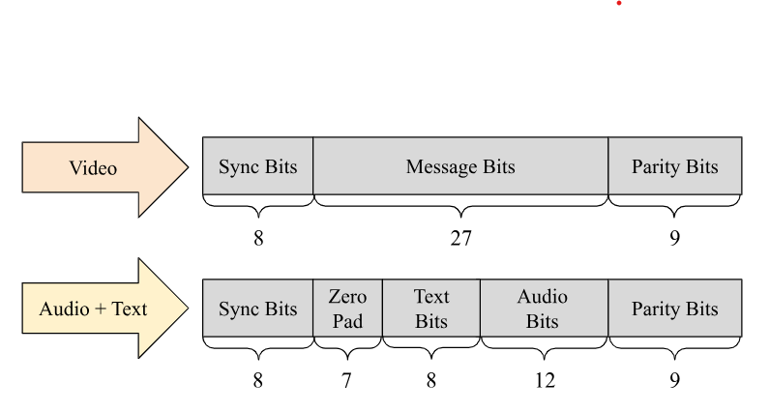
Forward Error Correction (FEC)
Involves the deliberate addition of redundancy to a data sequence at the transmitter.
This redundancy is structured to allow the receiver to detect and correct a limited number of bit errors introduced by a noisy channel without needing feedback from the receiver to the transmitter.
Beneficial in applications where high data rates are critical, such as audio and video transmission.
Frame Structure

Slide 4
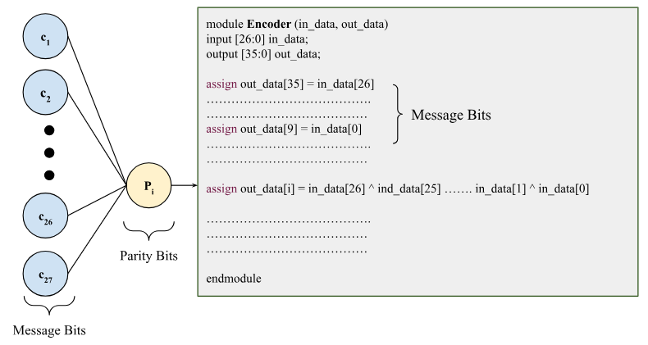
Encoder
Functionality:
Takes a 27-bit input message block.
Produces a 36-bit encoded output.
Mathematical Representation: c=m⋅G Where:
m: 27-bit message vector.
G: Generator Matrix.
c: 36-bit encoded output
Innovation Component: Implemented a Python Script which can take any generator matrix and give the corresponding verilog code for both the encoder and decoder

Slide 5
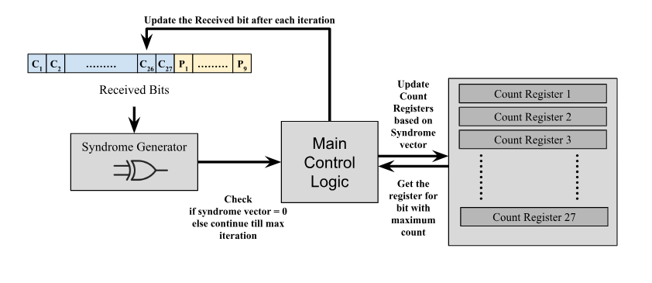
Decoder (Bit Flip Algorithm)

Slide 6
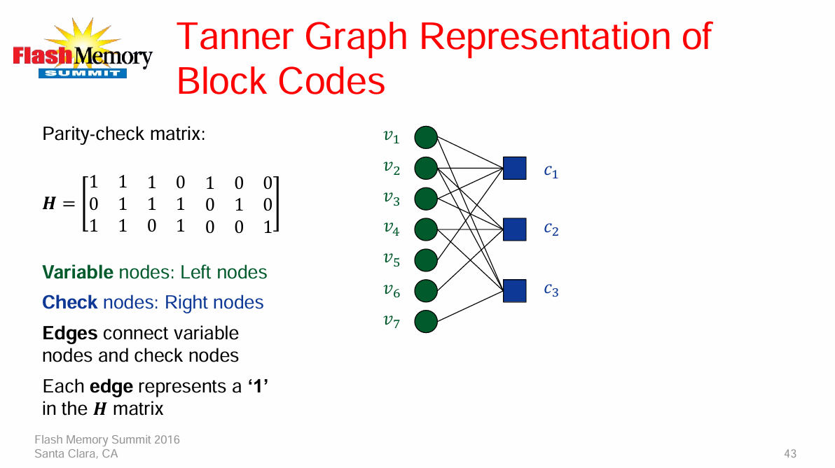
LDPC E

Slide 7
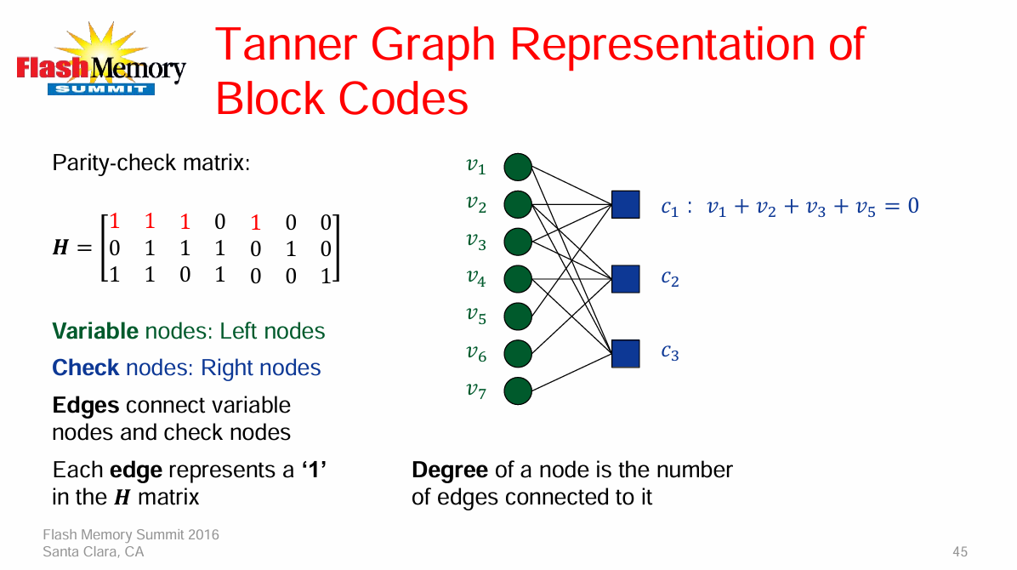

Slide 8


Slide 9
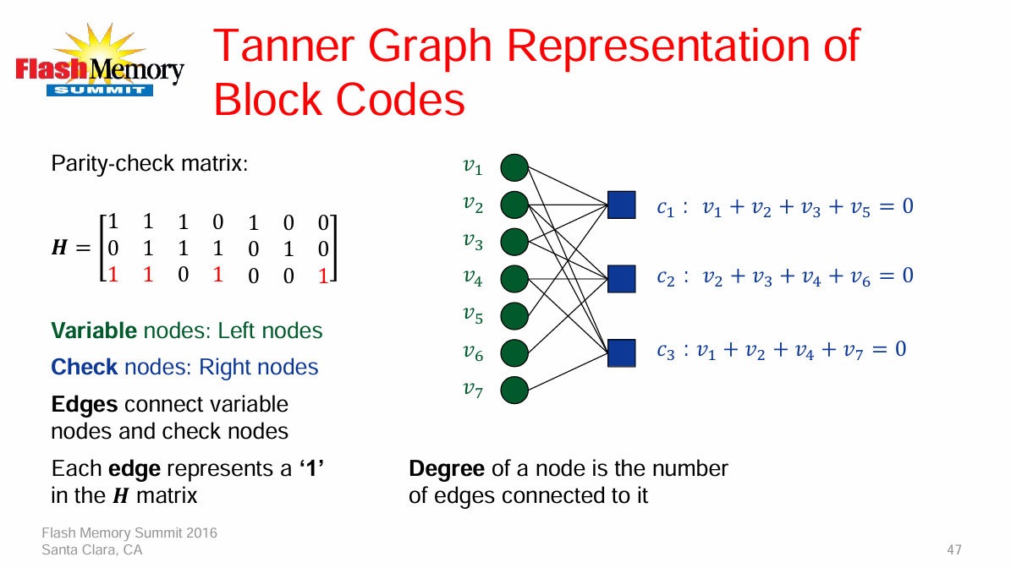

Slide 10
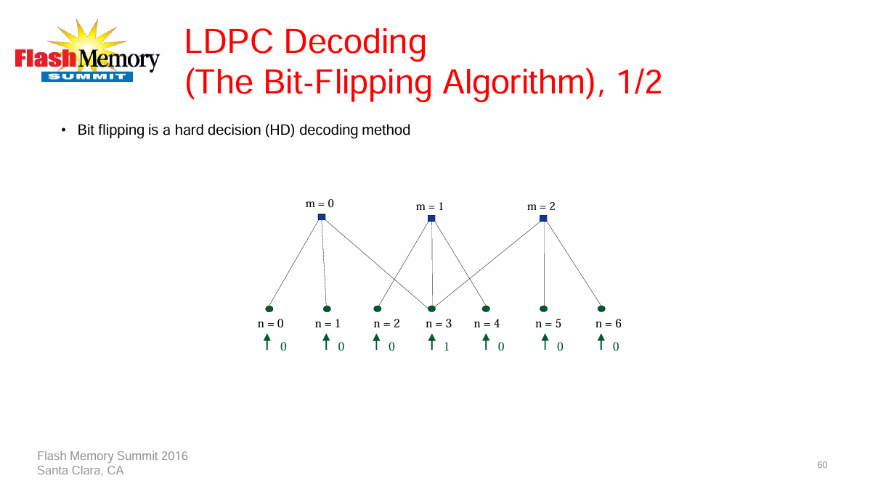

Slide 11
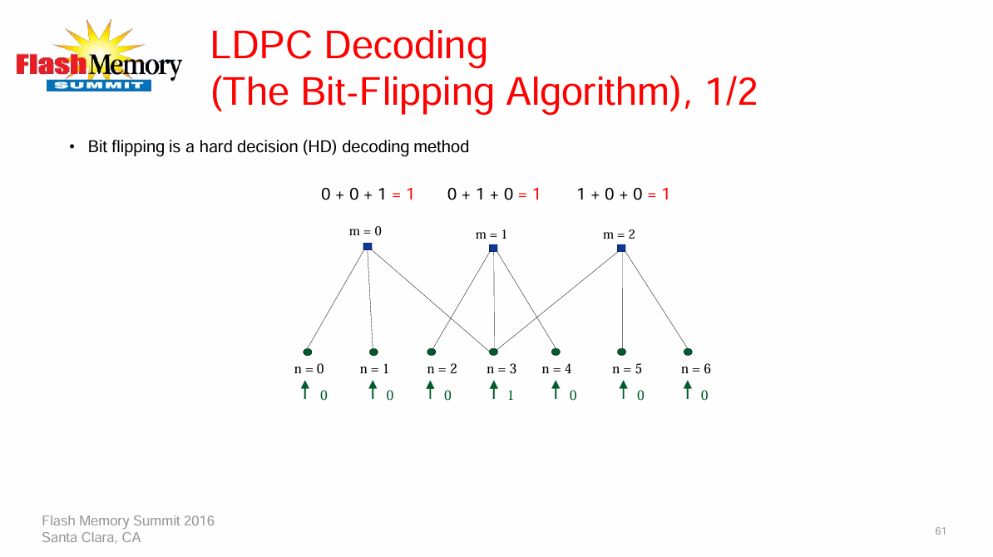

Slide 12
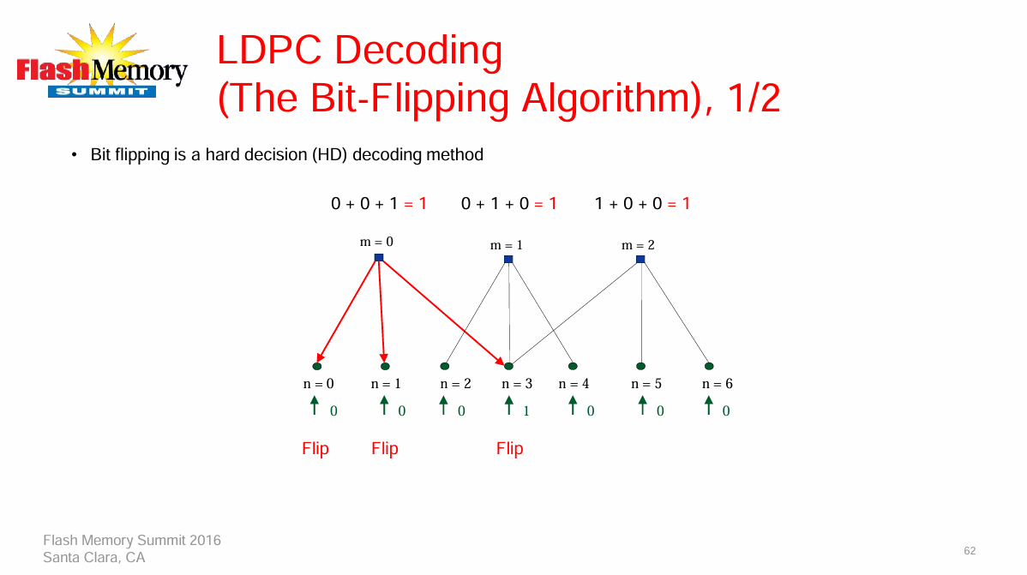

Slide 13
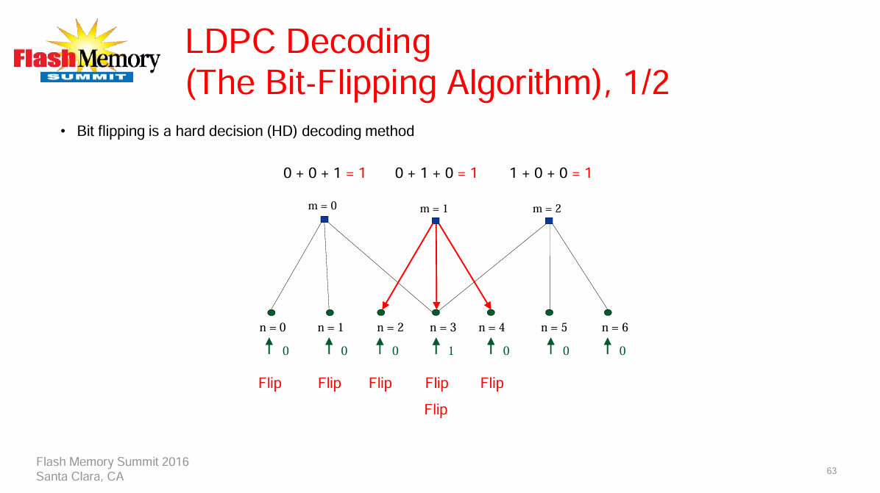

Slide 14
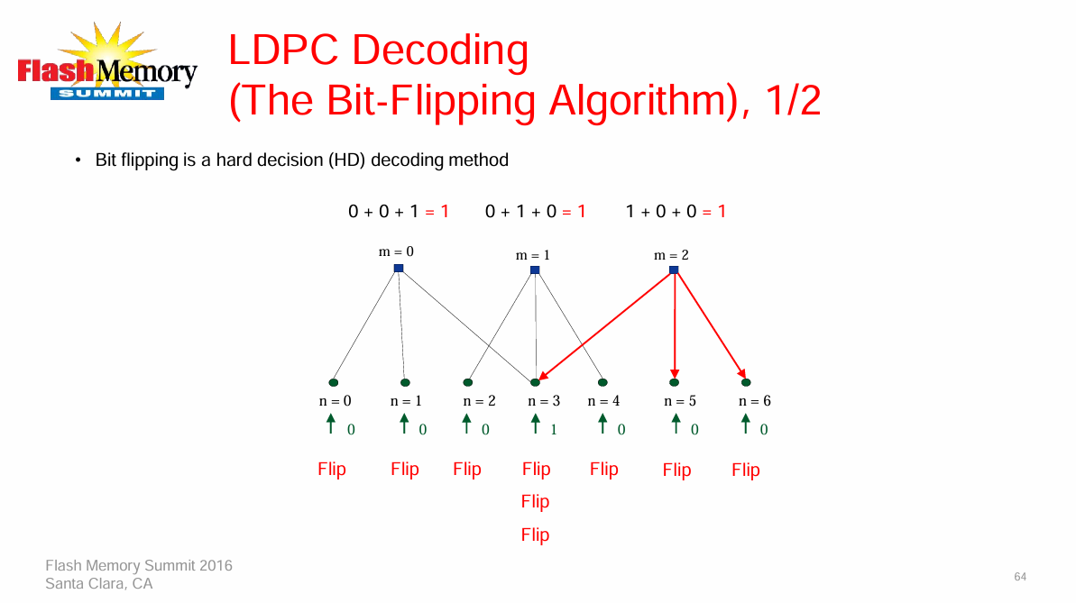

Slide 15
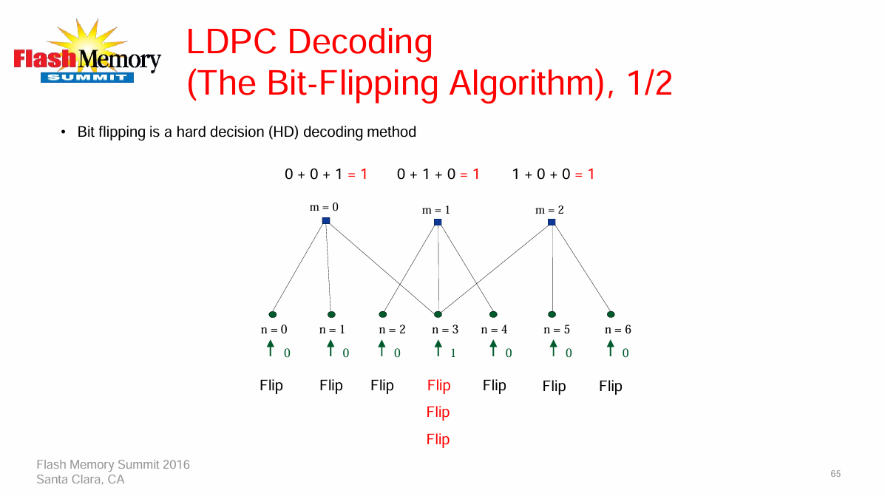

Slide 16


Slide 17
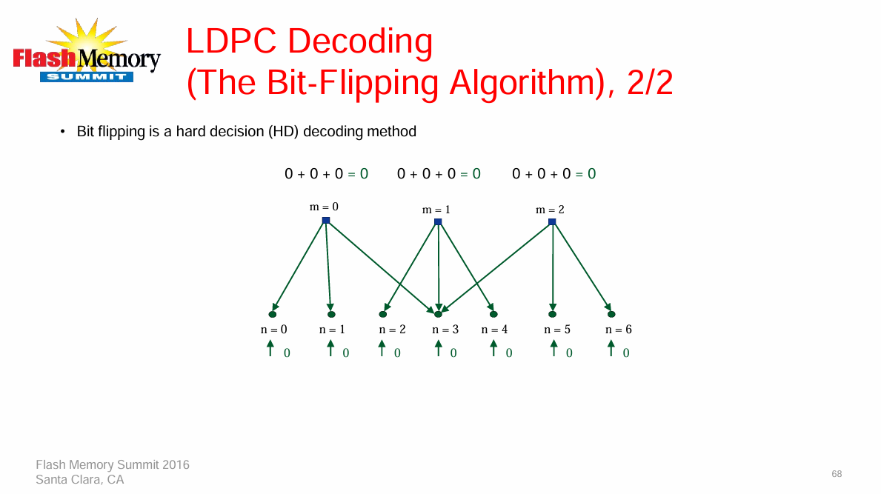

Slide 18
Analog-to-Digital Converter
We have used the XADC module present in the Pynq-Z2’s Zynq-7020 SoC for sampling and quantization.
The XADC is a 12-bit 1 MSPS ADC.
We sample the incoming signal at a rate of 50 Kilo Samples Per Second.

Slide 19
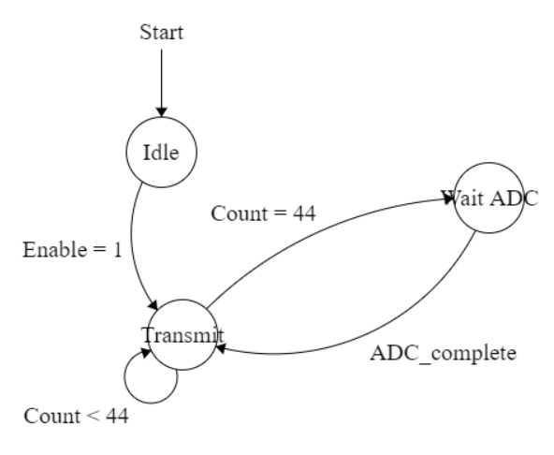
Transmitter FSM
The transmitter FSM waits for the ADC conversion to complete which takes 20 us before it begins transmitting the data.
The transmitter once again goes into the WAIT state after all the 44 bits in the frame have been transmitted.
We are not using a buffer as the bit transmission rate is 3.125 Mbps. Thus, each frame is transmitted before the next ADC conversion completes.

Slide 20
Transmitter Block Diagram
Analog
Signal
(0 - 1V)
ADC
Frame Extension
LDPC Encoder
36 - bits
12 - bits
50 ksps
27 - bits
8 - bits
Sync Bits
8’b10101010
44 - bits
1 - bit output
Tx Module
Ksps - kilo samples per sec

Slide 21
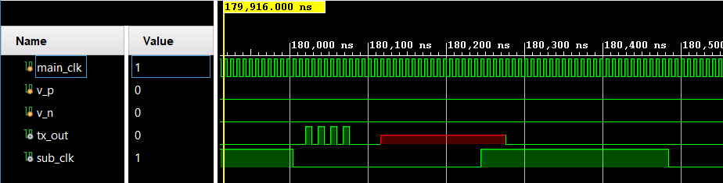
Transmitter Simulation
We see that the transmitter is working as intended.
The X here indicates where the data should have been as it is not possible to simulate XADC.

Slide 22
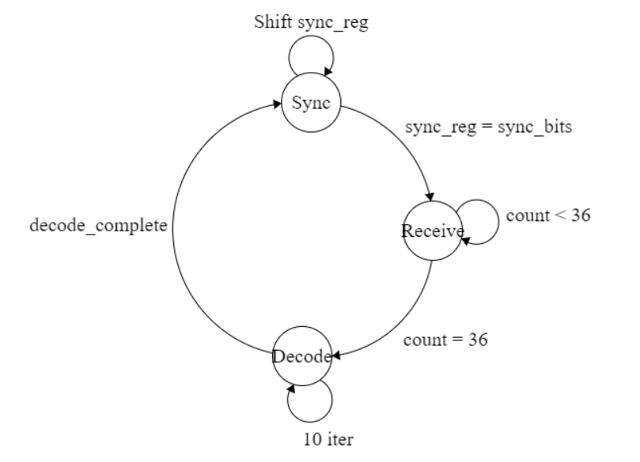
Receiver FSM
The receiver first waits for the synchronization bits which are used to indicate the start of the frame.
After it ascertains that all the sync bits have been received, it starts taking the message bits.
After all message bits have been received, it goes into Decode state where LDPC decoding happens.

Slide 23
Receiver Block Diagram
1 - Bit
( From Tx)
Rx Module
LDPC
Decoder
Frame
Deduction
12 - bits
36 - Bit
Received Frame Data
20 - bits
PWM
Output
PWM Module

Slide 24
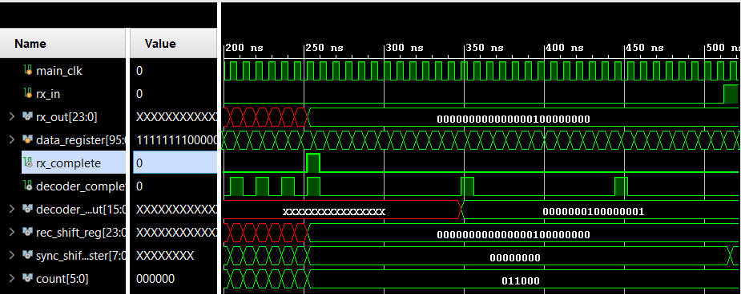
Receiver Simulation
We see that the receiver is working as intended. The rx_complete signal goes high when the receiver receives all the bits in the frame.

Slide 25
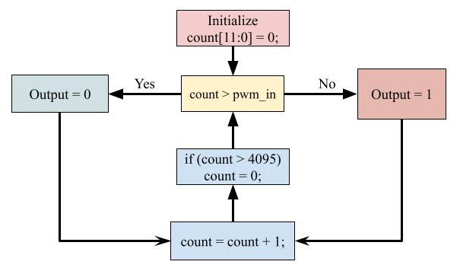
PWM Module

Slide 26
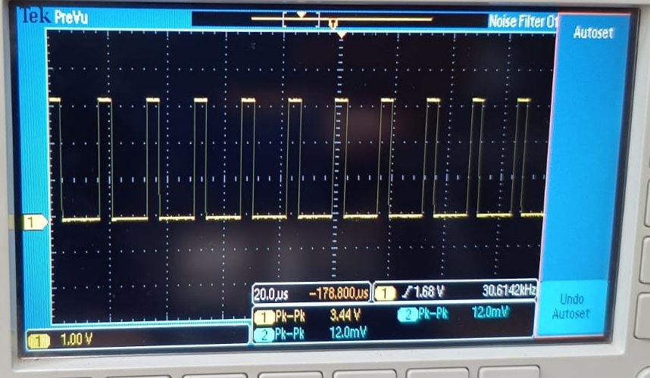
PWM Result on Oscilloscope

Slide 27
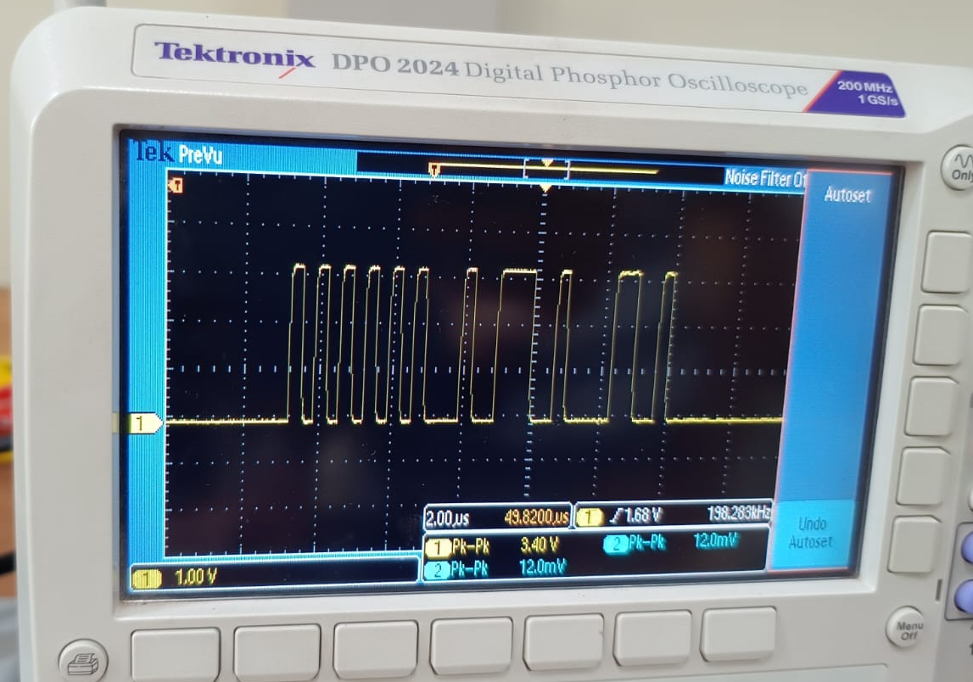
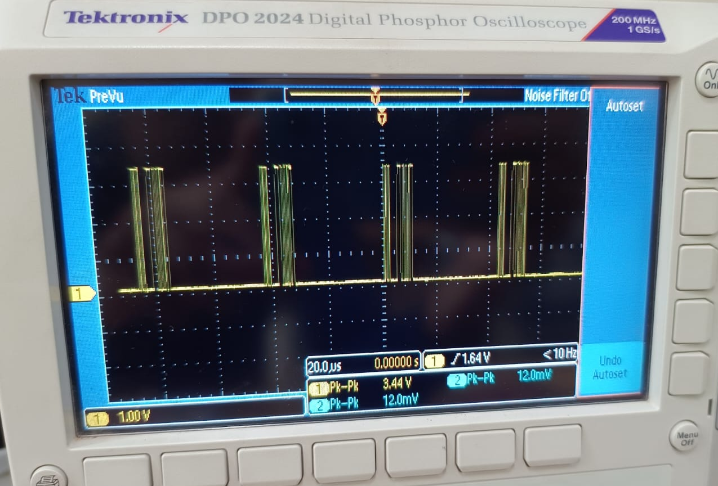
Transmitted Frame on Oscilloscope
Single Frame
Multiple Frames

Slide 28
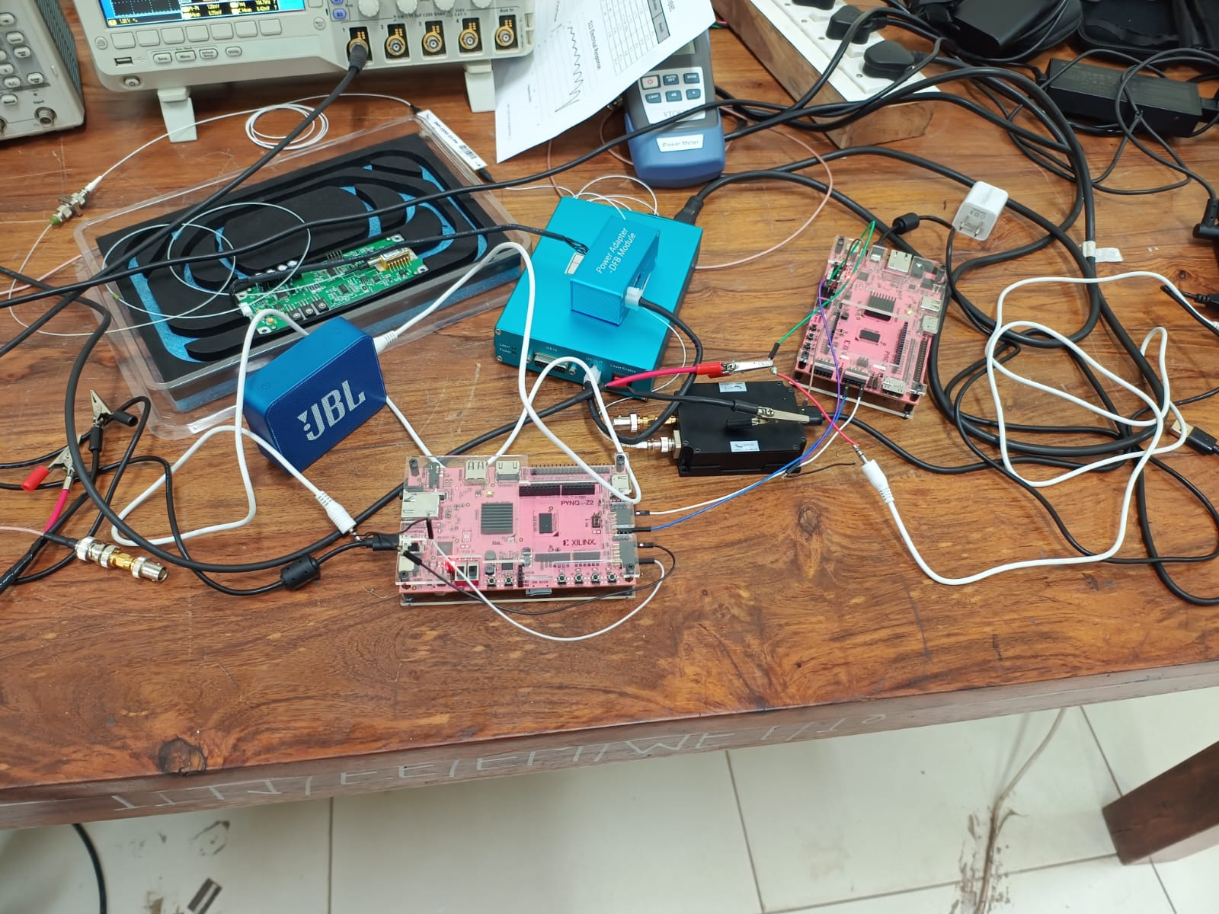
Experimental Setup
Analog Input to Tx - > Audio from laptop 3.5mm jack.
Output from Rx - > PWM output is given to the Speaker.

Slide 29
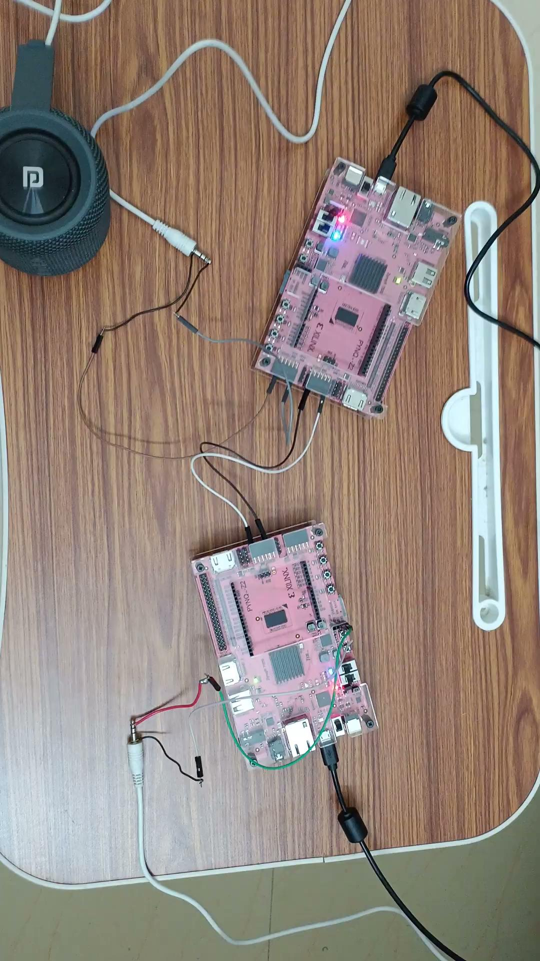
Demonstration

Slide 30
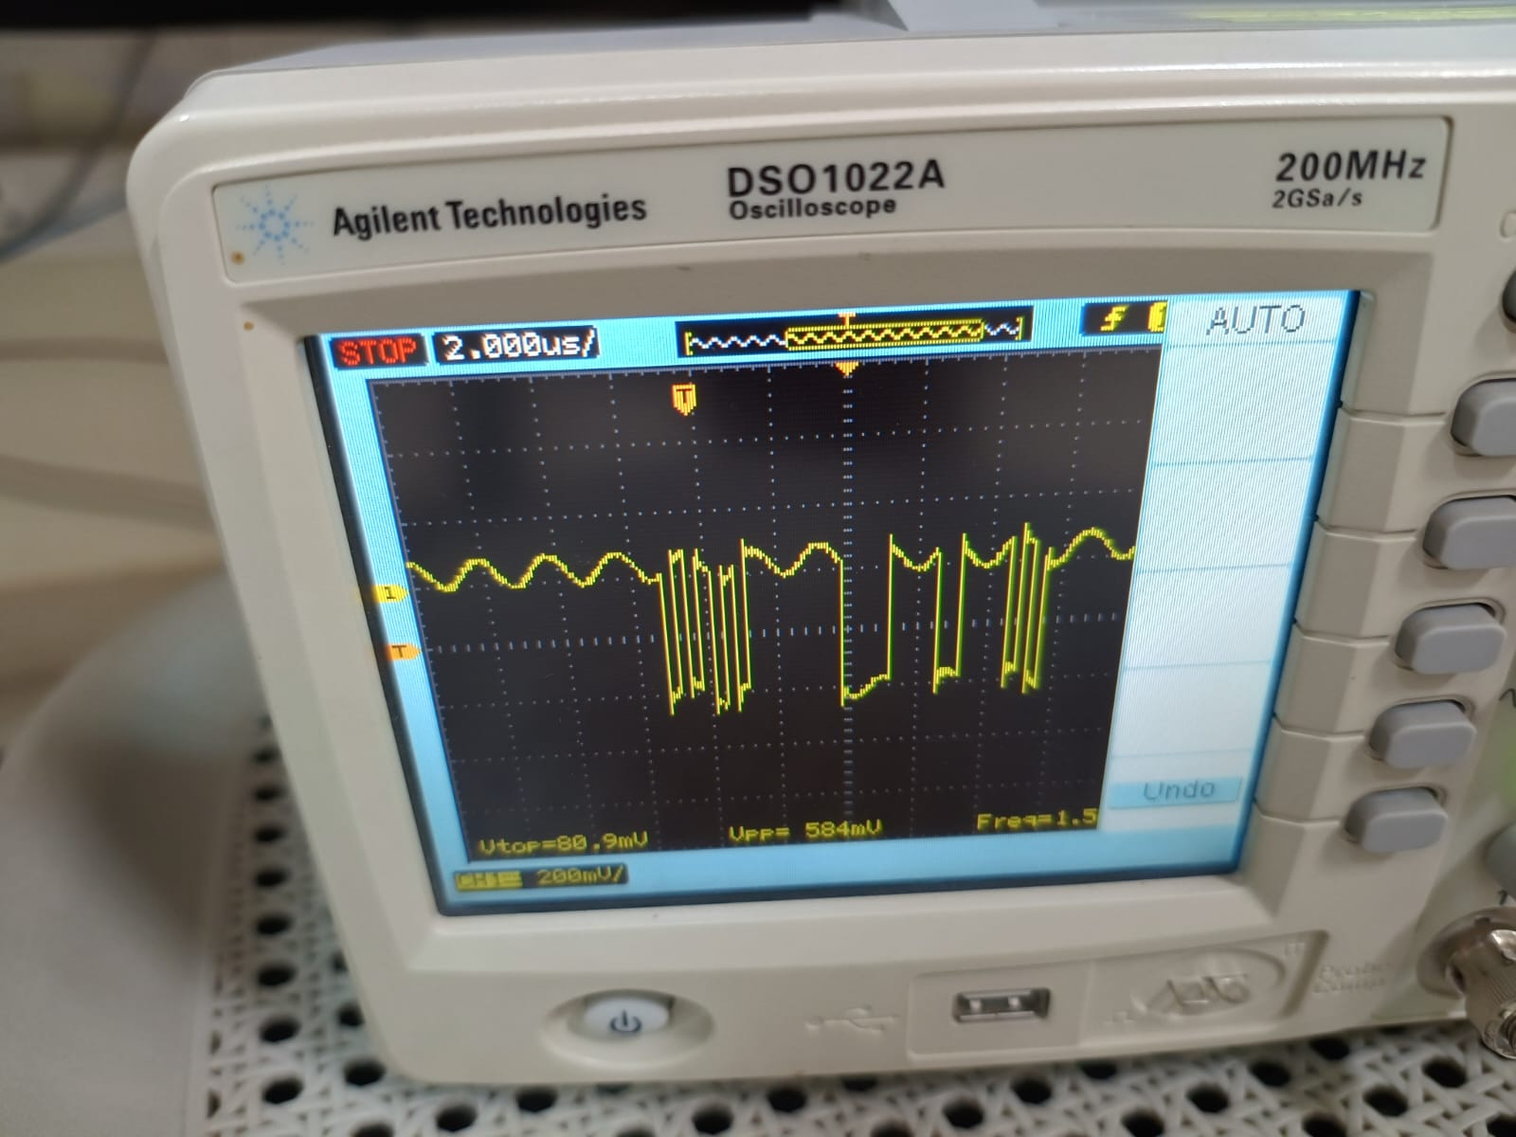
Output at Transducer

Slide 31
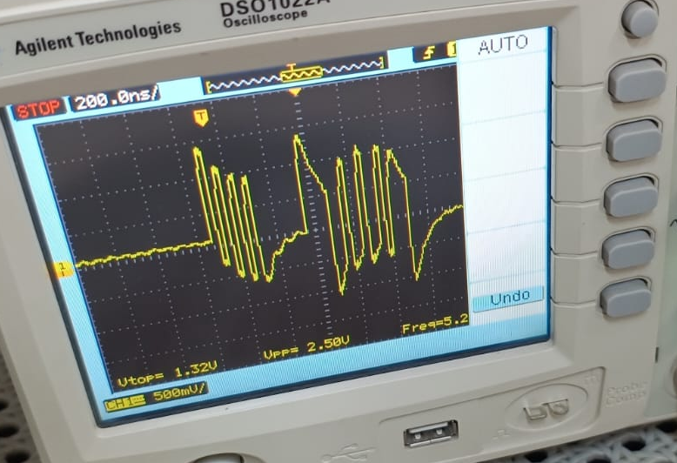
Output of RF Amplifier

Slide 32
Thank You!!!

