Slide 1
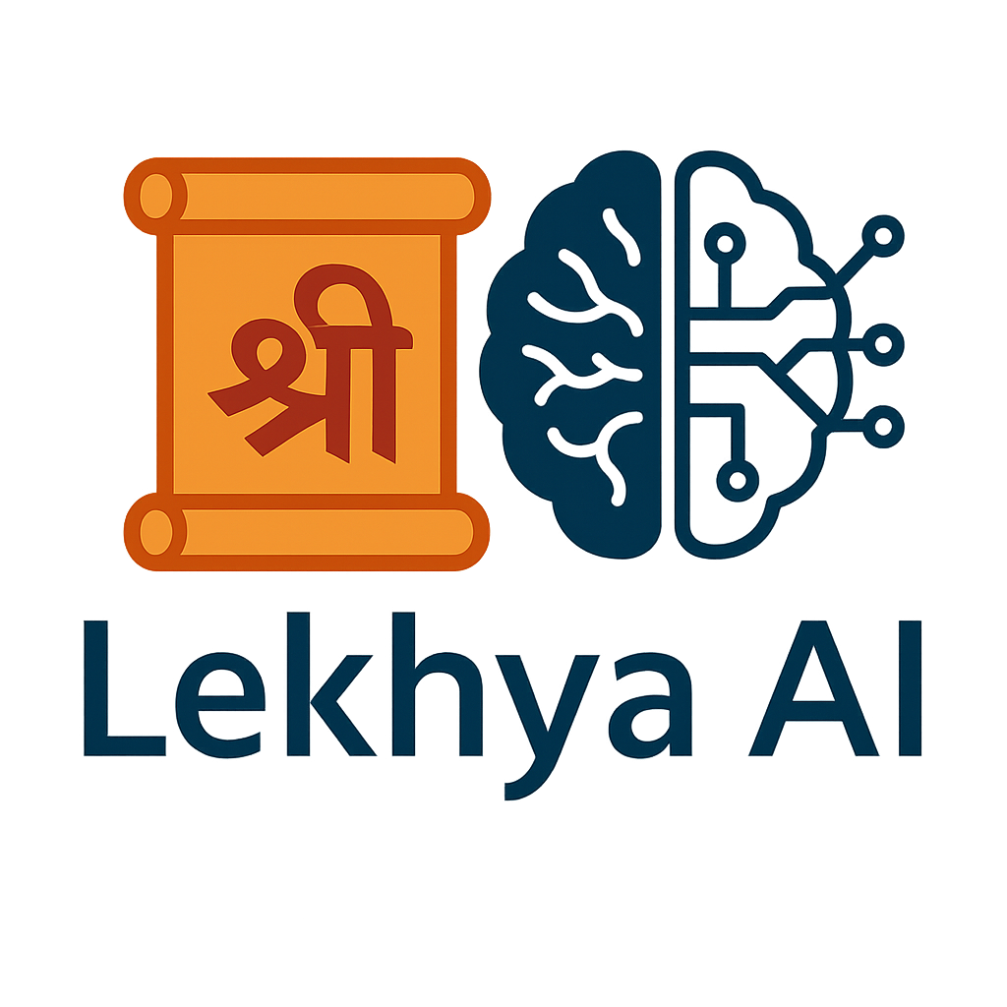


SUBMITTED TO ICDAR 2026
UniLipi: A Unified Multi-Script OCR for Historical Indic Manuscripts
A single OCR foundation model trained jointly across 13 Indic scripts.
Tathagata Ghosh · Sai Madhusudan Gunda · Simran Singh Sandral · Ravi Kiran Sarvadevabhatla
International Institute of Information Technology, Hyderabad
13
32.5M
6.9%
85M
INDIC SCRIPTS
SYNTHETIC LINES
OVERALL CER
PARAMETERS
tathagata.ghosh@research.iiit.ac.in · sai.gunda@research.iiit.ac.in · ssandral@gitam.in · ravi.kiran@iiit.ac.in

Slide 2
Abstract
Optical character recognition (OCR) for handwritten Indic manuscripts is essential for large-scale digitization and computational access to manuscript heritage. Existing approaches, however, are typically developed for one script at a time and require substantial script-specific customization — limiting scalability and practical deployment. We present UniLipi, a unified multi-script OCR model for handwritten Indic manuscripts trained jointly across 13 Indic scripts within a single framework. UniLipi directly handles realistic manuscript conditions: extreme variation in line geometry, large variation in line length, and partial interruptions from holes, stains, or pictorial illustrations. To operate effectively under ultra low-resource conditions, the model leverages script-aware synthetic manuscript data generation, substantially reducing reliance on real annotated data. Beyond historical manuscripts, UniLipi serves as an effective foundational pretrained model — its learned representations enable strong OCR performance for contemporary Indic handwriting and extend to several non-Indic scripts including Tibetan, Italian, Latin, and Chinese. In addition to transcription, UniLipi predicts script identity and per-line native character counts, supporting practical manuscript cataloging workflows.
UniLipi · ICDAR 2026 Submission
Abstract 2 / 10

Slide 3
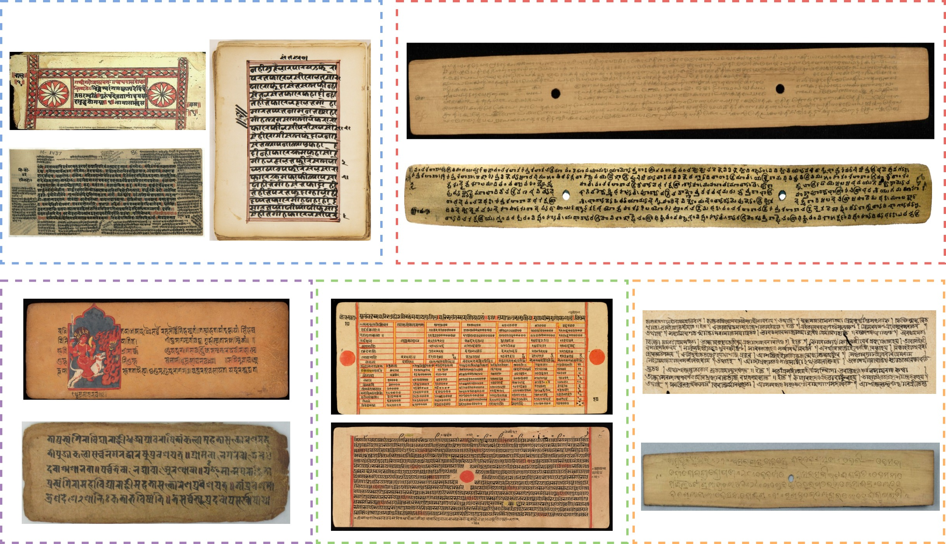
Diversity of Indic Manuscripts
Indic manuscripts span centuries, regions, and writing substrates. UniLipi targets 13 scripts drawn from five regional traditions:
North / Central Indian
Devanagari · Sharada · Modi
Western Indian
Gurmukhi · Jaini
Eastern Indian
Bengali · Odia
Southern Indian
Grantha · Telugu · Malayalam · Kannada
Himalayan / Buddhist
Newar · Siddham
Manuscript lines exhibit substantial diversity in substrate (palm leaf, paper), layout geometry, stroke thickness, ink, and orthographic structure.
UniLipi · ICDAR 2026 Submission
Diversity 3 / 10

Slide 4
Contributions
UniLipi
The first unified foundational multi-script OCR model for handwritten Indic scripts, trained jointly across 13 distinct Indic scripts within a single framework.
Script-aware Synthetic Data
A reference-conditioned synthetic manuscript generation approach that reduces reliance on large volumes of real annotated handwritten data.
Auxiliary Supervision
An OCR system that, in addition to transcription, predicts script identity and per-line glyph count — useful for downstream cataloging workflows.
UniLipi · ICDAR 2026 Submission
Contributions 4 / 10

Slide 5
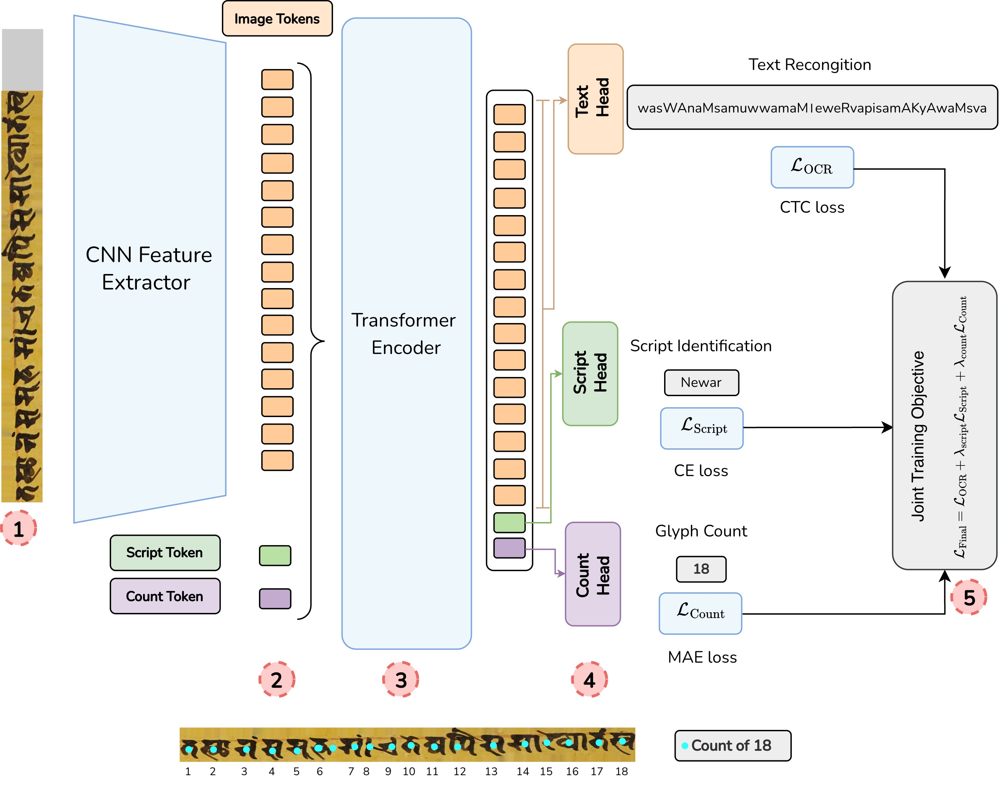
Method — UniLipi Architecture
UniLipi is a unified multi-task OCR model. Given a manuscript line image, it jointly predicts a text sequence in the unified Roman WX representation, a script identity label, and a per-line glyph count.
Joint training objective
L = L_OCR + λ_script · L_script + λ_count · L_count
Multi-task supervision encourages the encoder to learn richer representations that capture textual content, script identity, and structural length information together — improving transcription accuracy across diverse manuscripts.
UniLipi · ICDAR 2026 Submission
Method 5 / 10

Slide 6
Reference-Conditioned Synthetic Data
Real annotated manuscript lines are extremely scarce for many Indic scripts. We synthesize training data by lifting appearance and geometric priors from real reference manuscripts — yielding ~2.5M synthetic lines per script and 32.5M total across 13 scripts.
1
Sample Roman WX line and transliterate to target script.
2
Extract writing mask, font size, ink color from a reference.
3
Composite rendered text onto diffusion-inpainted background.
4
Output line + WX text + script label + glyph-count.
UniLipi · ICDAR 2026 Submission
Synthetic 6 / 10

Slide 7
Results — Overall Scores
Ablation Study
UniLipi (weighted across 13 scripts)
Single-component swaps vs. final UniLipi design.
6.9%
Modified Component
Default
CER ↓
MAE ↓
IAST as vocab
Roman WX
11.0
1.7
Dedicated vocab / script
Roman WX
14.1
1.9
CER ↓ OCR transcription error
No script token
Auxiliary tokens
7.1
1.3
No count token
Auxiliary tokens
9.3
—
8.6%
No script & count
Auxiliary tokens
9.7
—
Mono CER ↓ per-script monolingual baseline
Encoder — 4 layers
6 layers
9.3
1.5
Encoder — 8 layers
6 layers
8.1
1.3
1.1
Cross-Entropy loss
CTC loss
8.3
1.4
UniLipi (Final)
Default design
6.9
1.1
Count-MAE ↓ per-line glyph count error
Unified multi-script training outperforms dedicated per-script models.
UniLipi · ICDAR 2026 Submission
Results 7 / 10

Slide 8
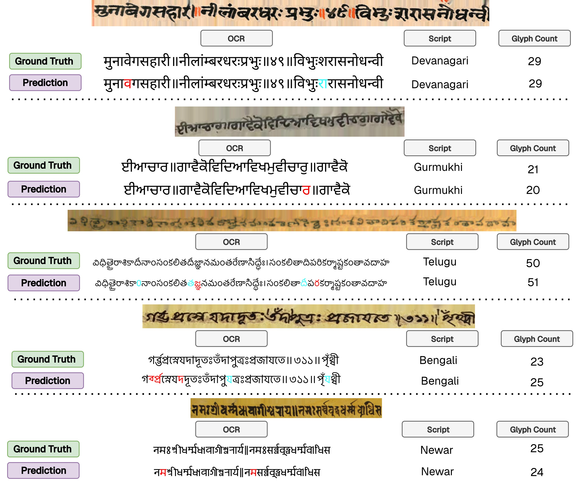
Qualitative Results
UniLipi transcription on a representative script from each region. Red = deletions · Blue = substitutions / additions.
UniLipi · ICDAR 2026 Submission
Qualitative 8 / 10

Slide 9
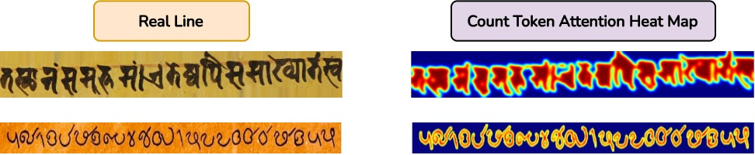
Count-Token Attention Heatmap
What does the count token learn?
The count token's attention map localizes glyph-level structure along the line. This serves as: • auxiliary supervision during training, giving the encoder a structural prior; • a lightweight quality-control cue at inference — large gaps between predicted token count and visual glyph count flag likely OCR errors.
UniLipi · ICDAR 2026 Submission
Heatmap 9 / 10

Slide 10
Thank you
Questions and early-access requests are welcome.
CONTACT
sai.gunda@research.iiit.ac.in
Project page · unilipi (coming soon)
Code · github.com/lekhya-ai/UniLipi

