Slide 1
Interoperability Test Bed Architecture (Draft)
Gazelle
GI = Gazelle User Interface
Test Setup
GI
Vendor A
PIX Source
Test Case
Artifacts
(XML)
Profiles
(XML)
NIST Resource
Repository
Web Service
Test Case Manager
GI
Vendor B
PIX Source
Test Case
Artifacts
(XML)
GI
Vendor C
PIX Manager
NIST HL7 V2
Message Generation
Web Service
Execution
Engine
Results
Report
Files (XML)
GI
Vendor D
PIX Consumer
NIST HL7 V2
Validation
Web Service
Validation Report
and
Juror Document
NIST HL7 V2
Test Agent(s)
Web Service
Message
Database
Use dedicated/specific ports based on test set up
Proxy (Mirth and/or DIL)
Network
Vendor login to Gazelle
Vendors set up Tests (Gazelle Manages)
Vendors reviews Test Case
Vendors configure systems
Gazelle begins test orchestration
Vendor A, B, & D read data specification
Vendor A sends message to Vendor C
Proxy captures message and forwards
Gazelle retrieves message from database
Gazelle accesses the validation service
Validation sends report to Gazelle to display
Vendor B sends message to Vendor C (8-11 repeat)
Vendor C processes messages
Vendors D sends query message to C
Repeat steps 8-11
Gazelle displays comprehensive view of test results
R. Snelick 04/12/13

Slide 2
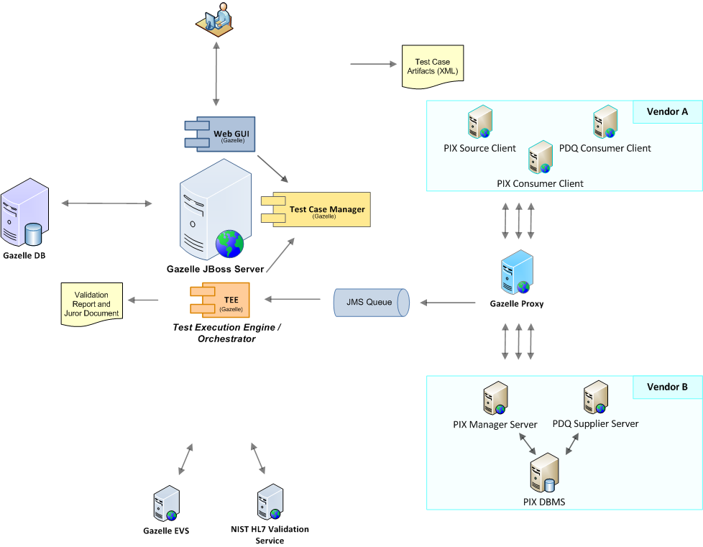
Interoperability Test Bed Architecture – Virtual Connectathon
1. Vendor login and registration
4. Vendors configure their systems
2. Vendor sets up Tests
5. Vendor A (Initiator) starts a new Test Instance (which activates a single Test Step) or activates a different Test Step of an existing Test Instance
3. Vendor reviews Test Cases
22. Gazelle displays comprehensive view of test results
6. Vendor A sends PIX/PDQ update/query message to Proxy/Port configured for Vendor B responding service
21. Response message returned to Vendor A
8 & 16. Proxy forwards Message Id to JMS Queue asynchronously
7. Proxy intercepts the initiator message
15. Proxy intercepts the response message
13. PIX/PDQ initiator message is forwarded to Vendor B PIX/PDQ responding service.
9 & 17. TEE gets JMS message from queue and loads message meta data from Proxy DB
14. Vendor B processes initiator request message and returns response message
10 & 18. TEE maps the Proxy message to Test Step instance and stores mapping in Gazelle DB
11 & 19. TEE validates message using NIST and Gazelle validation services
12 & 20. TEE updates Test Step and Test Instance execution status

