Slide 1

AdventureWorks Sales, Product & Customer Analytics
DATA ANALYTICS PROJECT
Where growth is coming from, where value leaks, and what to do next
Presented by
Iheanyi Okwara
Data Analyst | October 2026
Notes:
This deck turns the four-page AdventureWorks dashboard (Executive, Map, Product Detail, Customer Detail) into a story: growth is strong, but the quality of that growth needs attention in products, returns and customer value.

Slide 2
Executive summary
Revenue has tripled, but growth is driven by more customers, not deeper spend, and returns need attention
$24.9M
$10.5M
25.2K
2.2%
Revenue
Profit (42% margin)
Orders
Return rate
What's working
What's concerning
What we recommend
Monthly revenue up from $0.58M (Jan 2020) to $1.83M
42% profit margin
Revenue per order is rising
Revenue per customer fell ~74%
Sport-100 helmets return at 2.7–3.3%
Top products by orders add under 2% of revenue
Grow basket value and high-income reach
Fix helmet and shorts returns
Segment customers by value, not frequency
Notes:
Four headline KPIs frame the business: $24.9M revenue, $10.5M profit (a 42% margin), 25.2K orders and a 2.2% return rate. The three columns summarise the story: strong growth, three quality concerns, and three recommended moves.

Slide 3
Four questions leadership needs answered
The dashboard was built to answer these business problems
1
Is growth healthy?
2
Are we selling the right products?
Revenue is climbing, yet monthly orders slipped and revenue per customer has fallen sharply.
Accessories drive order volume, but the 10 most-ordered products bring in under 2% of revenue.
3
Where are returns eroding value?
4
Which customers and markets matter most?
Sport-100 helmets and shorts return well above the 2.2% average.
Frequent buyers spend little, high-income customers are 11% of orders, and Europe shows small bubbles.
Notes:
The four problems map to the four dashboard pages: Executive (growth and mix), Product Detail (returns and targets), Map (markets) and Customer Detail (value and segments).

Slide 4
Monthly revenue has roughly tripled
A step-change from July 2021 lifted revenue from ~$0.5M to $1.83M a month
3.2×
June 2022 revenue vs January 2020 ($1.83M vs $0.58M)
+47%
2021 revenue (~$9.4M) vs 2020 (~$6.4M)
42%
profit margin ($10.5M on $24.9M)
Monthly values read from the dashboard line chart; approximate.
Notes:
Revenue dipped in late 2020, then stepped up from July 2021 and kept climbing, with a December 2021 spike of about $1.63M. The monthly values on this chart are read from the dashboard, so treat them as approximate; they sum to roughly the $24.9M total. Margin is $10.5M / $24.9M = 42%.

Slide 5
Revenue is up, orders are not
June revenue rose 3.3% while orders fell 0.9%, so each order is worth more
Monthly revenue
Monthly orders
Revenue per order
$1.83M
$1.77M
2,146
2,165
$853
$818
This month
Prior month
This month
Prior month
This month
Prior month
Change: +3.3%
Change: −0.9%
Change: +4.3%
Reading it: price and mix are carrying growth, so order volume is the metric to watch.
Dashboard fix: the Monthly Returns card shows +1.78%, but returns fell from 169 to 166. Check its variance formula.
Notes:
Revenue per order is derived: $1.83M / 2,146 = about $853 versus $1.77M / 2,165 = about $818, a 4.3% rise. Orders are slightly down. Separately, returns went from 169 to 166, a 1.8% decline, yet the dashboard card displays +1.78%, which suggests the variance is calculated in the wrong direction.

Slide 6
Accessories lead on order volume
Accessories account for 45% of category orders, ahead of Bikes and Clothing
17.0K
Accessories orders, the largest category
Tires & Tubes
most ordered product type
Category orders add to 37.9K versus 25.2K total orders, because one order can span several categories.
Notes:
Accessories 17.0K, Bikes 13.9K, Clothing 7.0K. Tires and Tubes is the most ordered product type. The category figures exceed total orders, so they count orders containing each category rather than unique orders.

Slide 7
Top sellers by orders earn little revenue
The 10 most-ordered products bring in ~$0.47M, about 1.9% of the $24.9M total
Product | Orders | Revenue | Return %
Water Bottle - 30 oz. | 3,983 | $39,755 | 1.95%
Patch Kit/8 Patches | 2,952 | $13,506 | 1.61%
Mountain Tire Tube | 2,846 | $28,333 | 1.64%
Road Tire Tube | 2,173 | $17,265 | 1.55%
Sport-100 Helmet, Red | 2,099 | $73,444 | 3.33%
AWC Logo Cap | 2,062 | $35,882 | 1.11%
Sport-100 Helmet, Blue | 1,995 | $67,120 | 3.31%
Fender Set - Mountain | 1,975 | $87,041 | 1.36%
Sport-100 Helmet, Black | 1,940 | $65,270 | 2.68%
Mountain Bottle Cage | 1,896 | $38,062 | 2.02%
1.9%
of total revenue from the 10 most-ordered products
$87K
Fender Set - Mountain: top revenue in this list
3 of 10
top sellers are Sport-100 helmets, all above-average returns
Red = return rate above the 2.2% company average. Revenue rounded to the nearest dollar.
Notes:
Summing the ten revenue figures gives about $466K, or 1.9% of $24.9M. These are high-volume, low-ticket items. Revenue must therefore come largely from higher-priced products such as bikes, which the dashboard does not break out by revenue. The three Sport-100 helmet colours have return rates of 3.33%, 3.31% and 2.68%.

Slide 8
Helmets are the returns hotspot
All three Sport-100 helmets return above the 2.2% average; shorts are the most returned product type
2.2%
company-wide return rate (benchmark)
+1.1 pts
Sport-100 Helmet, Red above the average
Shorts
most returned product type
Notes:
Return rates for the top ten products by orders. Helmets at 3.33%, 3.31% and 2.68% sit above the 2.2% company rate, while the AWC Logo Cap is lowest at 1.11%. Shorts are flagged on the dashboard as the most returned product type, though the dashboard does not show the rate.

Slide 9
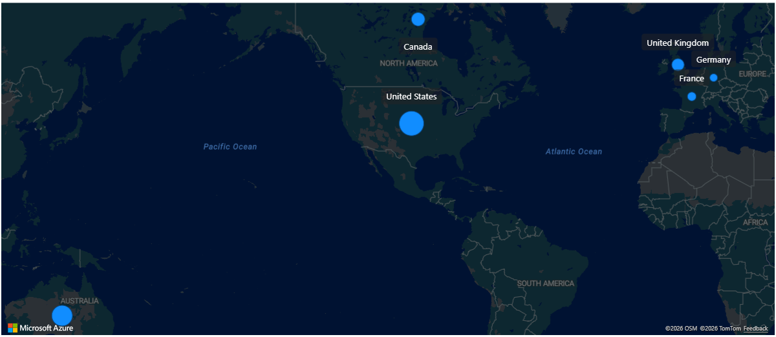
Six markets, led by the US and Australia
Sales span North America, Europe and the Pacific, but European bubbles are the smallest
6 countries
across 3 regions
US + Australia
largest bubbles on the map
Source: AdventureWorks dashboard, Map page.
Europe
The dashboard does not label what bubble size measures, so confirm the metric before using this for planning.
UK, Germany and France: the smallest presence
Notes:
The map shows the United States and Australia with the largest bubbles, Canada and the United Kingdom mid-sized, and Germany and France smallest. The bubble metric is not labelled on the dashboard, so these are relative comparisons to be confirmed.

Slide 10
Road Tire Tube is missing every target
Orders, revenue and profit all land 5–9% below their monthly targets
Orders
213 of 234
63%
91%
profit margin on Road Tire Tube ($1,044 on $1,668)
Revenue
$1,667.82 of $1,804
$7.83
92%
revenue per order, a low-ticket, high-margin item
Profit
$1,044 of ~$1.1K
Profit target shown as ~$1.1K on the dashboard, so that percentage is approximate.
95%
Notes:
For the selected product, Road Tire Tube: orders 213 versus a target of 234 (91%), revenue $1,667.82 versus $1,804 (92%), profit $1,044 versus about $1.1K (about 95%). Margin is $1,044 / $1,667.82 = 63%. Revenue per order is $1,667.82 / 213 = $7.83.

Slide 11
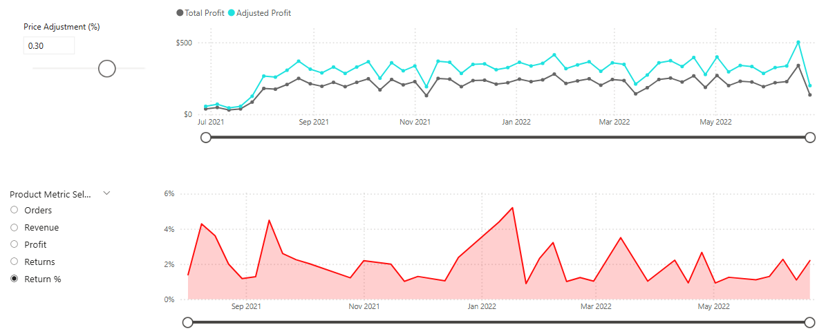
Pricing upside, but returns are volatile
The price what-if lifts Road Tire Tube profit by roughly 40–50%, while return rates swing between 1% and 5%
~+45%
adjusted vs total profit at the current slider setting (read from chart)
~5%
return-rate peak in early 2022, vs ~1–2% typical
Source: AdventureWorks dashboard, Product Detail page (Jul 2021–Jun 2022).
Caveat: the slider is set to 0.30 (labelled %). Confirm the unit and whether the model assumes demand stays flat after a price change.
Jul 2021
first month of Road Tire Tube data in these charts
Notes:
The cyan adjusted-profit line sits roughly 40-50% above the grey total-profit line for most of the period, read visually from the chart. That depends on the price adjustment input, which is 0.30 and labelled as a percentage, so confirm whether it means 0.3% or 30%, and whether volume is held constant. The red return-rate area chart is typically 1-2% with spikes to about 4-5%.

Slide 12
Revenue per customer fell about 74%
Growth came from adding customers: spend per customer dropped in two steps, mid-2020 and mid-2021
$1,431
overall revenue per customer (17.4K customers)
~$3.2K → ~$0.85K
Jan 2020 to Jun 2022
Likely cause: new-customer surges. Confirm with the data engineers.
Values read from the dashboard line chart at roughly quarterly points; approximate.
Notes:
$24.9M / 17.4K customers = $1,431 revenue per customer. The trend line falls from about $3.2K in early 2020 to under $1K by 2022, with sharp drops around July 2020 and mid-2021. Monthly revenue rose about 55% in July 2021 while revenue per customer fell, which implies the customer base grew much faster than revenue. This is an inference and should be confirmed.

Slide 13
High-income customers are under-penetrated
High income is only 11% of orders, and Professionals lead the occupation mix
Implication: premium bikes and apparel are a natural lever for the high-income segment, which today buys the least.
Notes:
Income: Average 11.6K, Low 10.3K, High 2.8K orders, so High is roughly 11% of the 24.7K shown. Occupation: Professional 7.9K, Skilled Manual 6.0K, Management 4.4K. The dashboard shows only these three occupation labels.

Slide 14
Frequent buyers are not valuable buyers
Top customers by orders spend ~$65 an order; the top customer by revenue spends ~$2,068
2.5%
of revenue from the top 100 customers ($615K of $24.9M)
$12,408
Mr. Maurice Shan: top by revenue, on just 6 orders
Frequent-buyer figure: top-10 customers by orders, revenue ÷ orders (~$1.5–1.8K over 24–26 orders). Average order = $24.9M ÷ 25.2K.
Notes:
The top 100 customers total 1,272 orders and about $615K, only 2.5% of revenue, so there is no revenue concentration risk. Customers with 24-26 orders have $1.4-1.8K of revenue, about $60-70 per order, consistent with accessory-heavy baskets. The top customer by revenue spent $12,408 across 6 orders, about $2,068 per order. Average order value is $24.9M / 25.2K, about $988.

Slide 15
Recommendations
Four moves to grow value per customer, cut returns and protect the margin
1
2
3
4
Grow basket value
Fix returns at the source
Segment by value
Test pricing and markets
Bundle accessories with bikes and apparel, and cross-sell at checkout. Target high-income customers with premium ranges.
Investigate Sport-100 helmet fit, quality and sizing guidance, and review shorts. Aim to bring helmets to the 2.2% average.
Move from frequency to value segments. Run loyalty and upsell for frequent low-spend buyers, and a VIP track for high-value ones.
Validate the Road Tire Tube price what-if with a controlled test. Pilot a European growth push once the map metric is confirmed.
Suggested order: returns first (fastest margin win), then value segmentation, then pricing and market pilots.
Notes:
Each recommendation answers one business problem: growth quality, returns, customer value and markets/pricing. Pricing and geographic moves should be piloted rather than rolled out, because the dashboard's what-if and map metrics need confirmation first.

Slide 16
Roadmap and success metrics
Quick wins in 30 days, structural changes by day 90
1
Days 1–30
2
Days 31–60
3
Days 61–90
Fix the Returns variance formula, confirm map and what-if definitions, and root-cause helmet returns.
Launch accessory bundles and checkout cross-sell. Build value-based customer segments.
Pilot the pricing test and a European campaign. Review results and scale what works.
Proposed targets (to be validated with stakeholders)
2.2% → 2.0%
3.3% → 2.5%
$853 → $900
91% → 100%
Company return rate
Sport-100 Helmet, Red return rate
Revenue per order
Road Tire Tube orders vs target
Notes:
These targets are proposals to anchor discussion, not figures from the dashboard. Revenue per order of $853 is the June 2022 value derived on the growth-quality slide.

Slide 17
Key takeaways
1
Growth is real, but it is customer-led
Revenue tripled while revenue per customer fell ~74%.
2
Volume and value are different products
Top sellers by orders add under 2% of revenue; helmets return above average.
3
Value, not frequency, should guide customers
Top-frequency buyers spend ~$65 an order; high-income customers are under-served.
Prepared by
Data Analyst
AdventureWorks Performance Analytics
Iheanyi Okwara
Notes:
Close with the three messages and invite questions. Next step is the 30-day validation and returns root-cause work.

