Slide 1
First presentation
Single Image Super Resolution

Slide 2
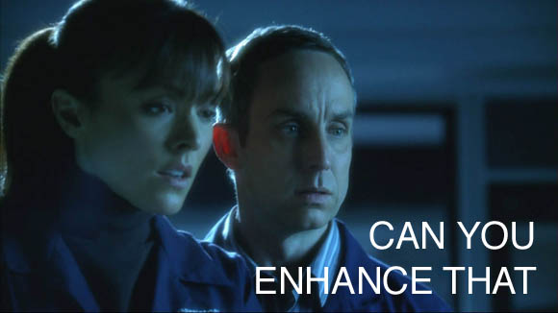
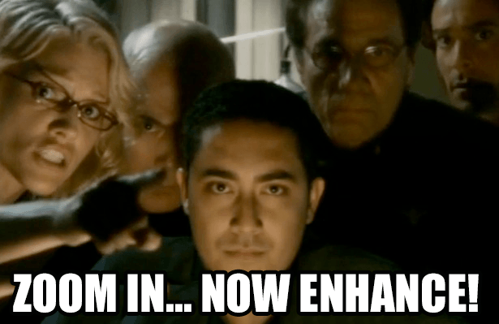
Motivation

Slide 3

Def

Slide 4

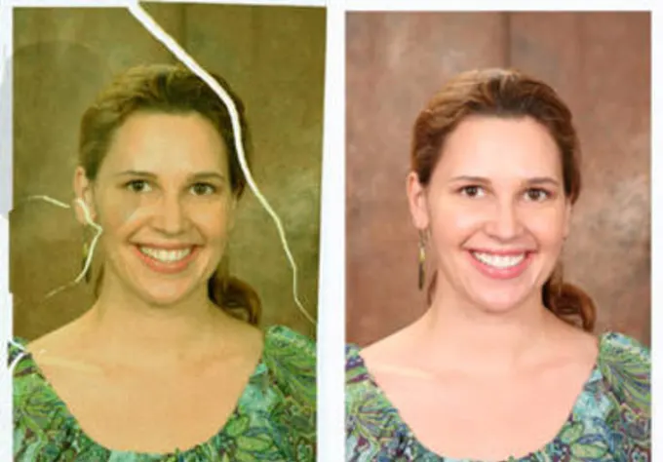
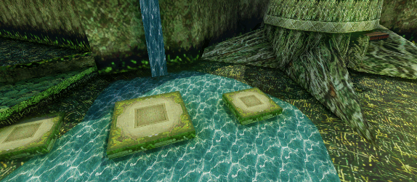
Other use cases

Slide 5
SR categories (part1)

Slide 6
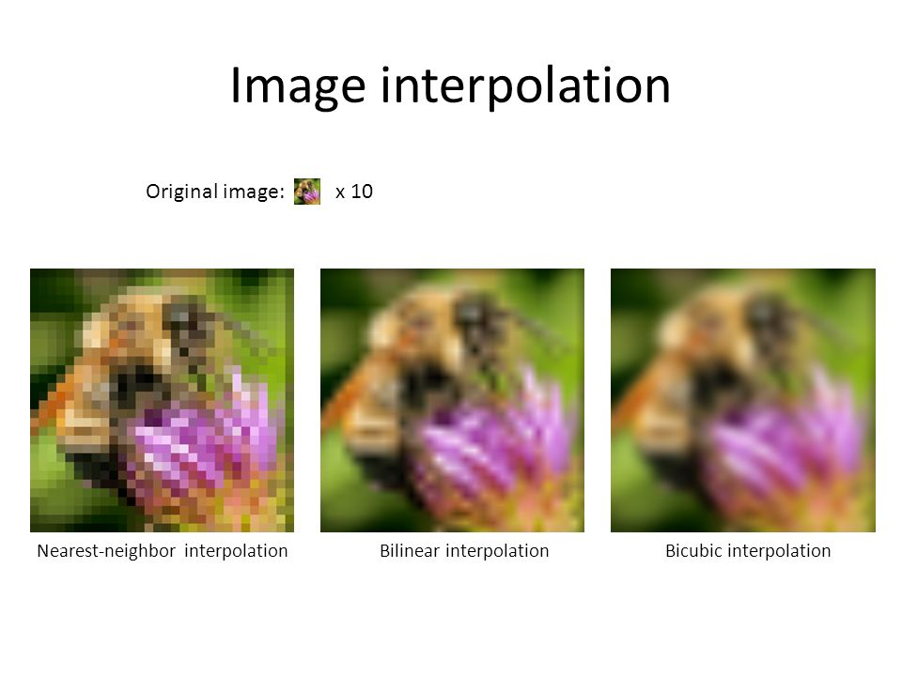
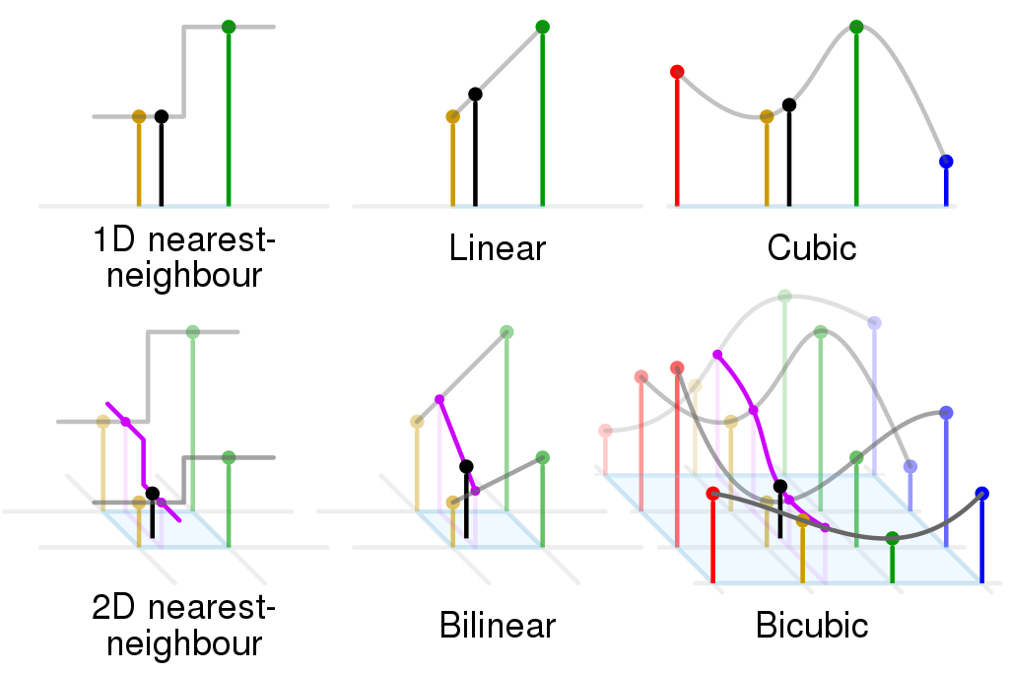
Interpolation examples

Slide 7
SR categories (part2)

Slide 8
3 categories of reconstruction alg

Slide 9
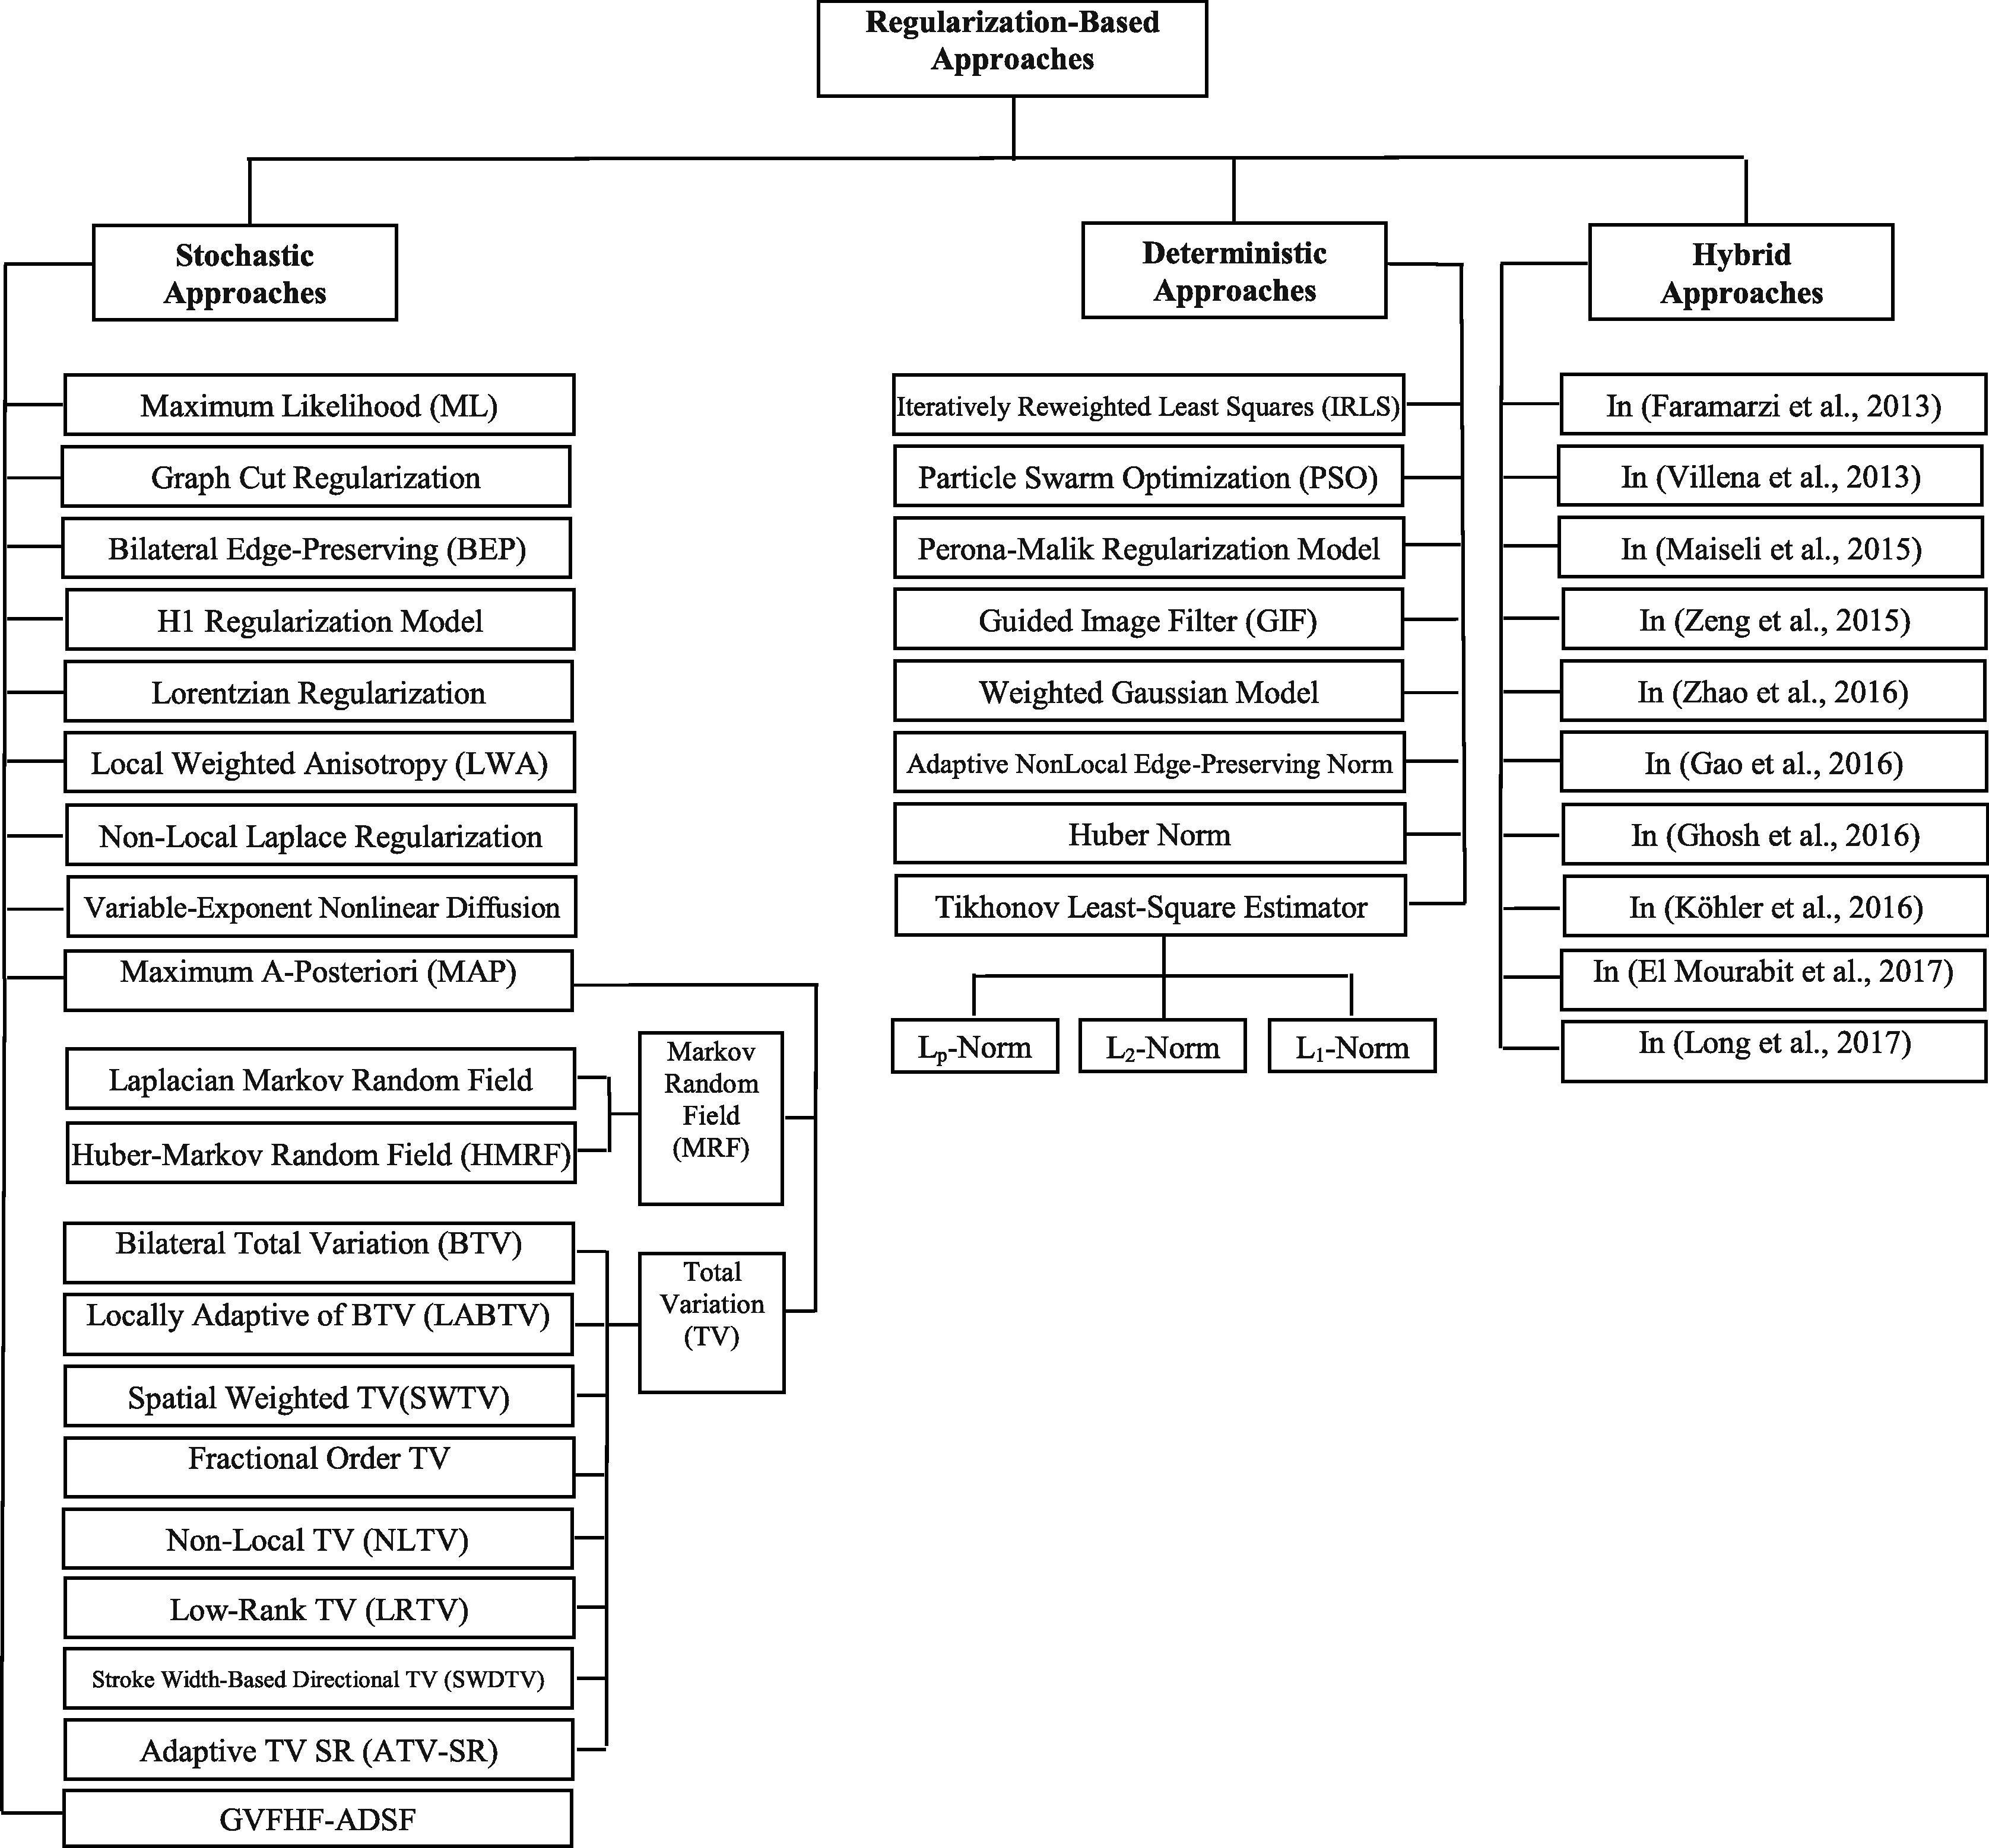

Slide 10
TV regularization

Slide 11
SR categories (part3)
Talk about ML methods briefly
Concentrate on DL methods

Slide 12
SRCNN and neural networks

Slide 13
Other DL methods
Elaborate other DL methods
Talk about residual methods

Slide 14
SRGANs

