Slide 1
REAL TIME STOCK PRICE PREDICTION
USING APACHE SPARK FRAMEWORK
Group 9
Hetal Shah 014537016
Ling Zhuo 013704782
Travis Mazzy 013784966
Liubov Tovbin 013747890

Slide 2
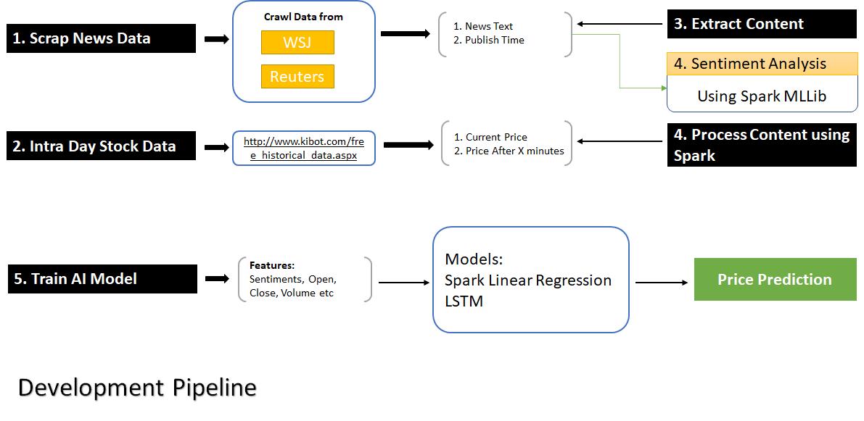

Slide 3
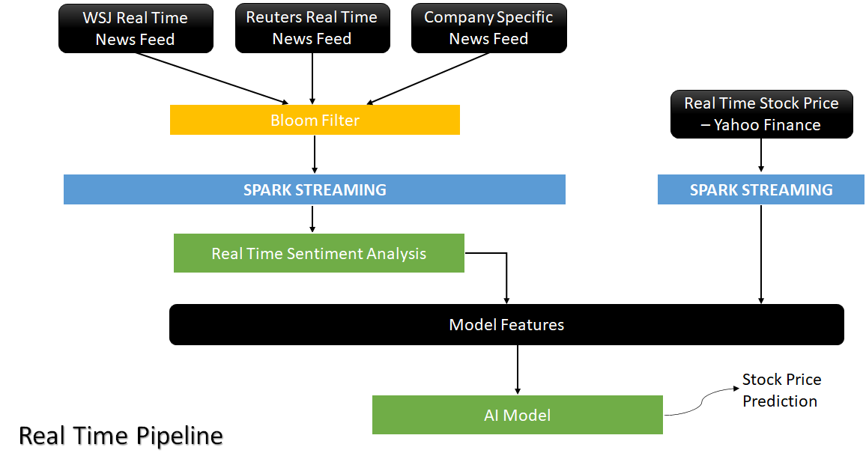

Slide 4
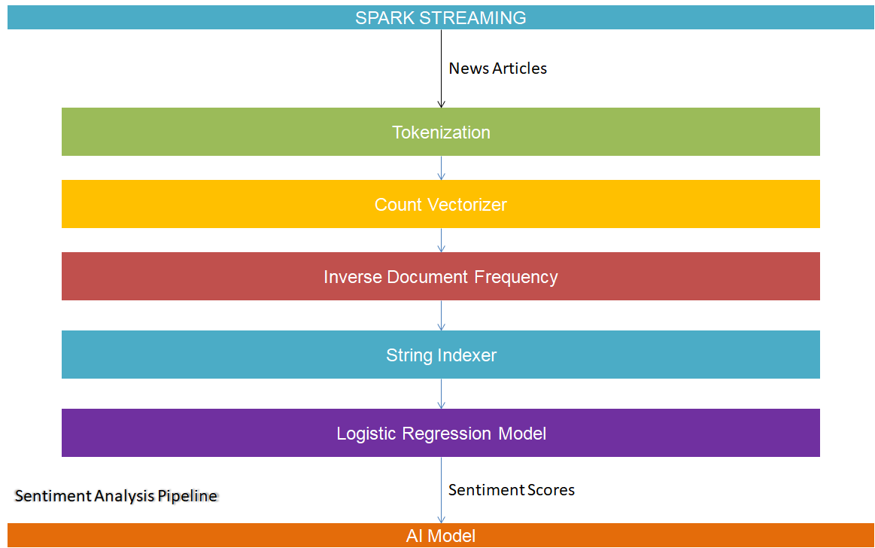

Slide 5

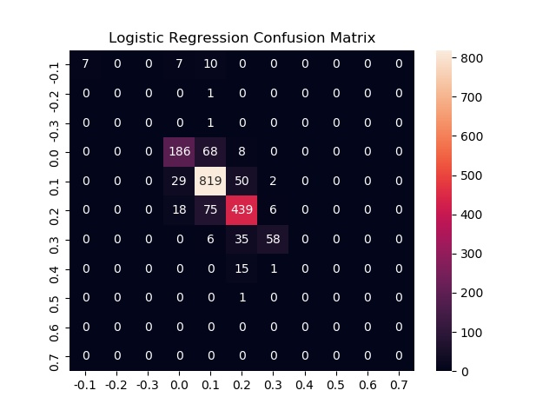




Slide 6
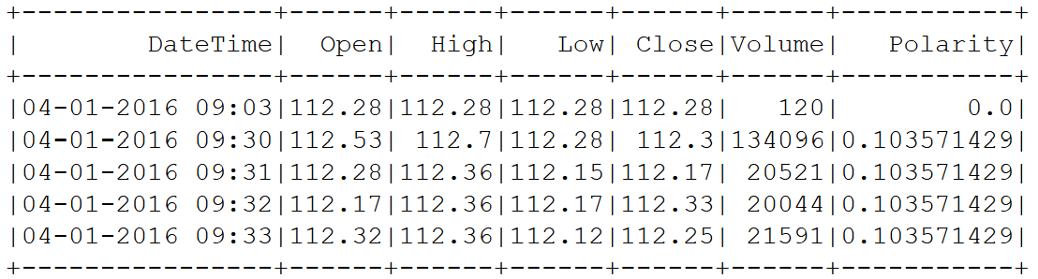
Stock Prices as Time Series
Keep only the last N values.
Use prediction algorithms that take in account the order of data points:
Rolling Window Linear Regression
Recurrent Neural Network
Notes:
Problem: predict the next value in a sequence
Order matters.
Idea: Extract valuable information from the order.

Slide 7
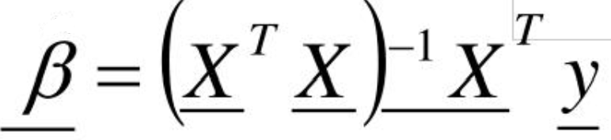
Rolling Linear Regression on Streams
Linear Regression for a base-line performance algorithm.
Deterministic
Based on matrix multiplication:
=> Perfect case for parallel computations on distributed systems
Keep only 100 recent values to train the model

Slide 8
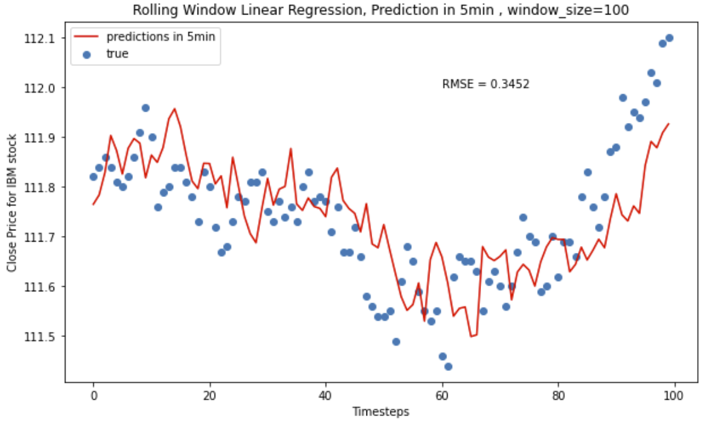
Rolling Linear Regression in Action

Slide 9
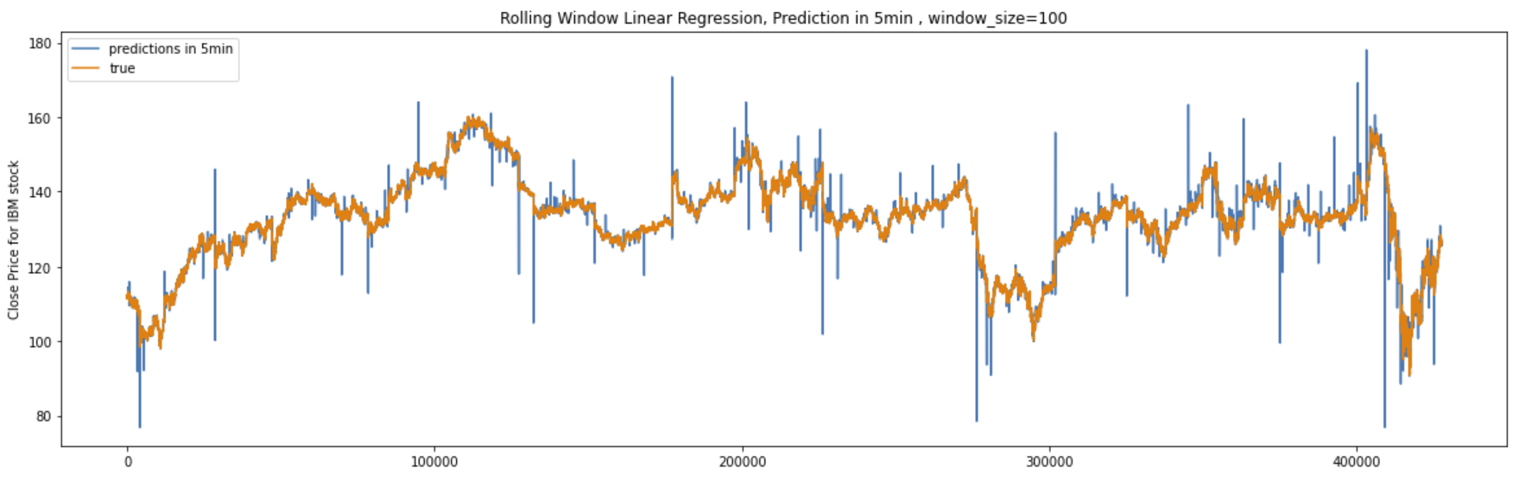
Results: Prediction vs. True
window_size = 100

Slide 10
RMSE Scores - Spark Rolling Linear Regression
RMSE scores for prediction 5, 15, and 30 minutes into the future.
 | 5 mins | 15 mins | 30 mins
Without Sentiment scores | 0.36 | 0.62 | 0.74
With Sentiment scores | 0.35 | 0.61 | 0.71

Slide 11
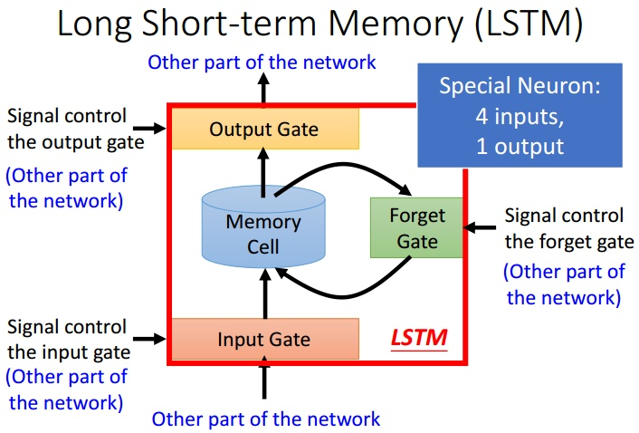
LSTM - A modified version of RNN
RNN - problems
Structures
Advantages
Deals with vanishing gradient

Slide 12
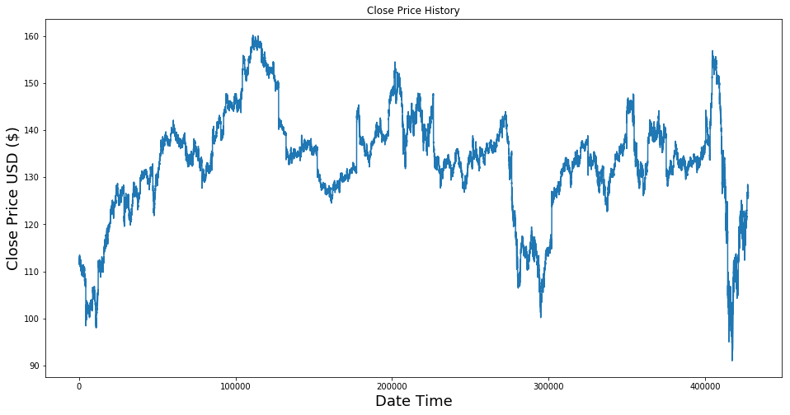
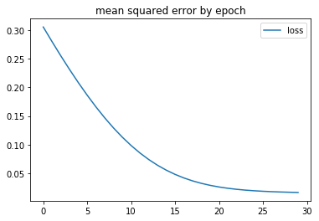
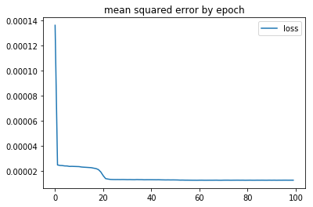
LSTM Implementation
Close price History
Batch Size
Gradient Descent.
Batch Size = Size of Training Set
Stochastic Gradient Descent.
Batch Size = 1
Mini-Batch Gradient Descent.
1 < Batch Size < Size of Training Set
More LSTM layers
Different input features
60 close price + senti scores
10 close price + senti scores
60 close price + cur open/high/low/vol + senti scores
Cur open/high/low + senti scores
Cur open/high/low/vol + senti scores( Best )

Slide 13
RMSE Scores - LSTM
RMSE analysis with 5 minutes lag, 15 minutes lag and 30 minutes lag.
 | 5 mins | 15 mins | 30 mins
Without Sentiment scores | 0.4 | 0.67 | 0.88
With Sentiment scores | 0.35 | 0.62 | 0.82

Slide 14
DEMO

Slide 15
Thank you!

