Slide 1
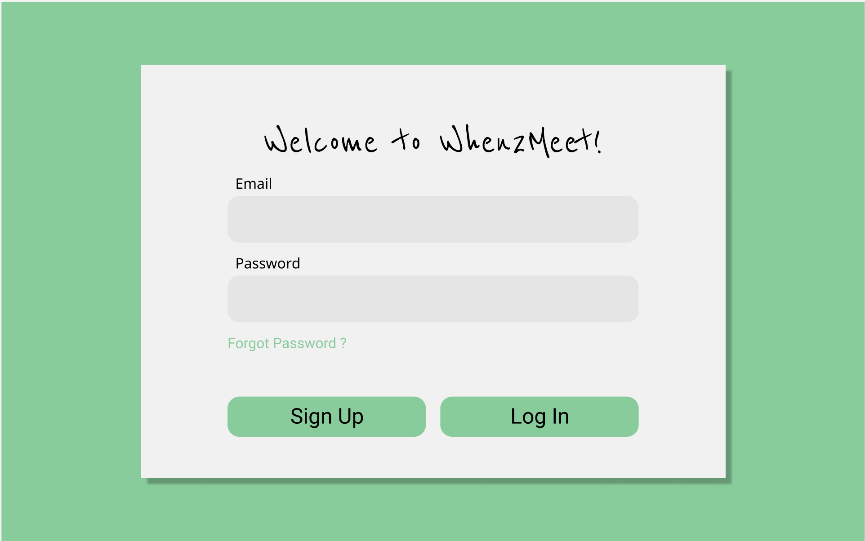
Landing Page
Login fields for existing users
Button allowing new users to sign up
Link to a “forgot password” page

Slide 2
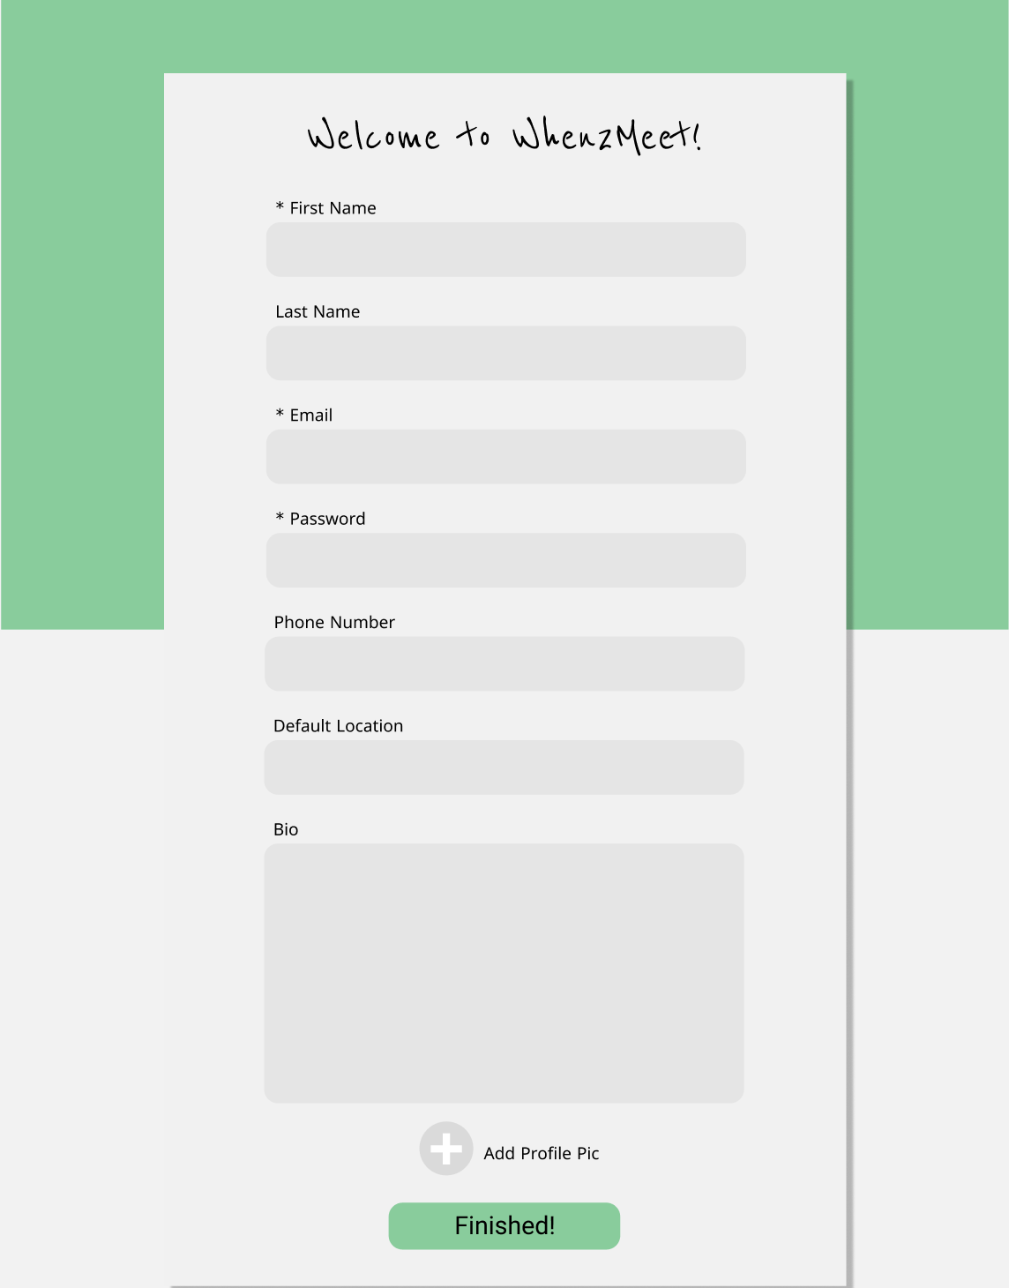
Signup Page
First name, email, and password are required fields
Last name, phone number, default location, bio, and profile picture are optional
Submit button takes you to your new profile

Slide 3
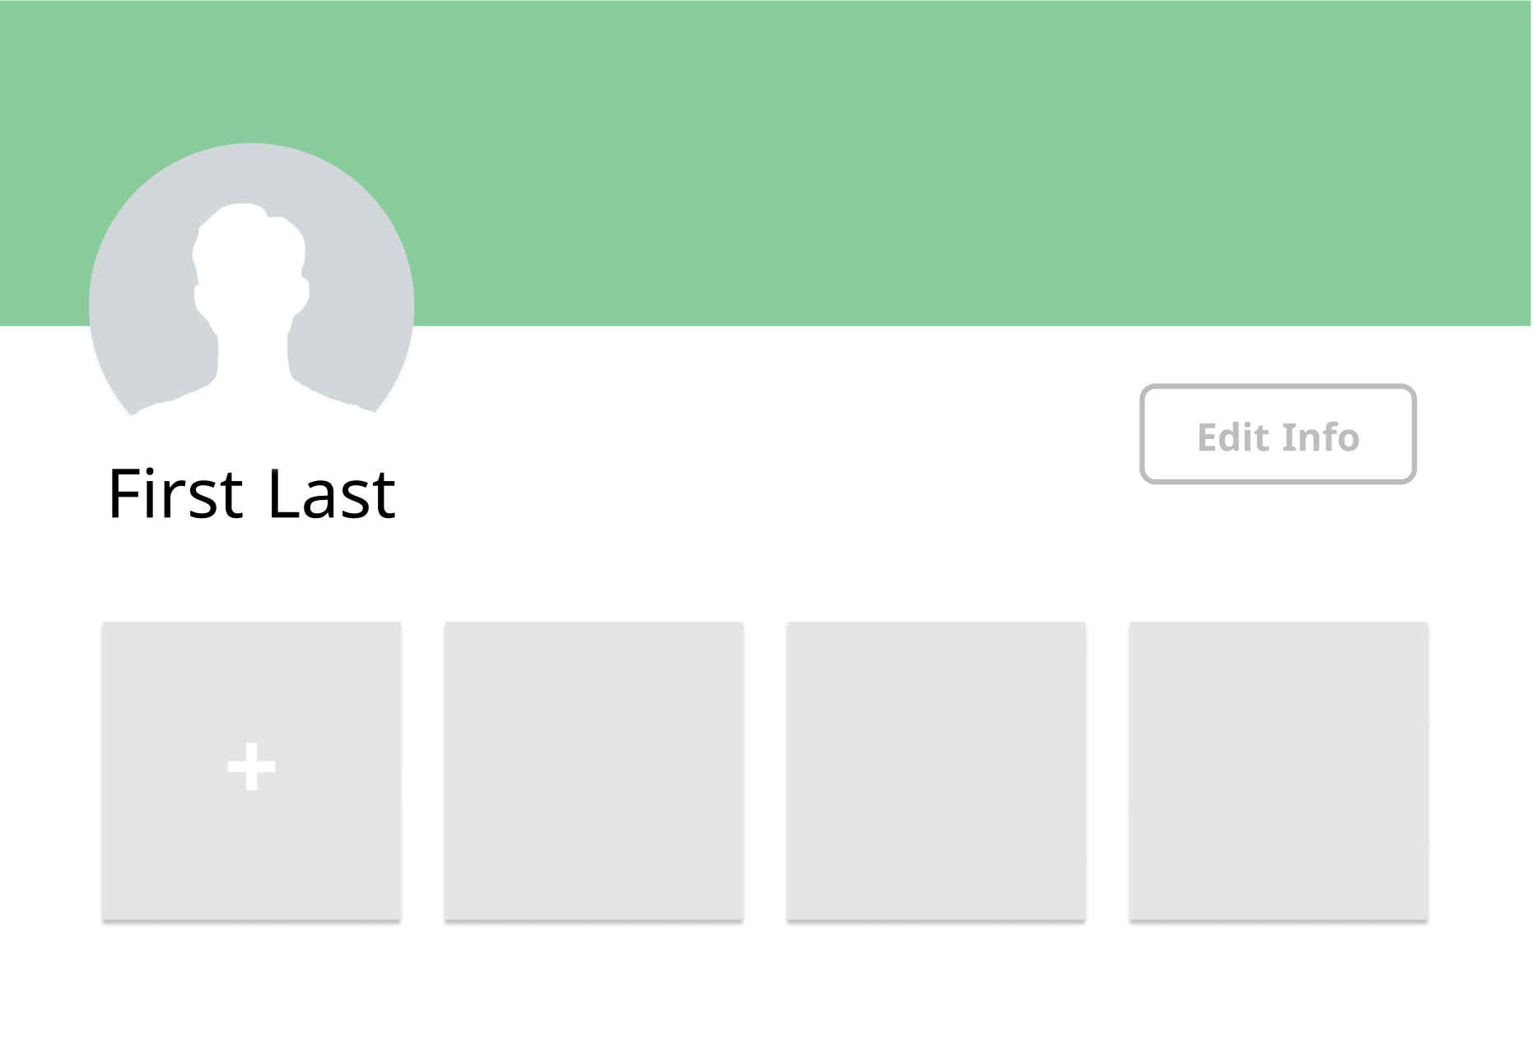
Profile Page
Profile Picture, Name, and Bio
Edit info button allows a user to change their profile info
Plus button allows you to create a new group
A user’s groups are displayed below their profile

Slide 4
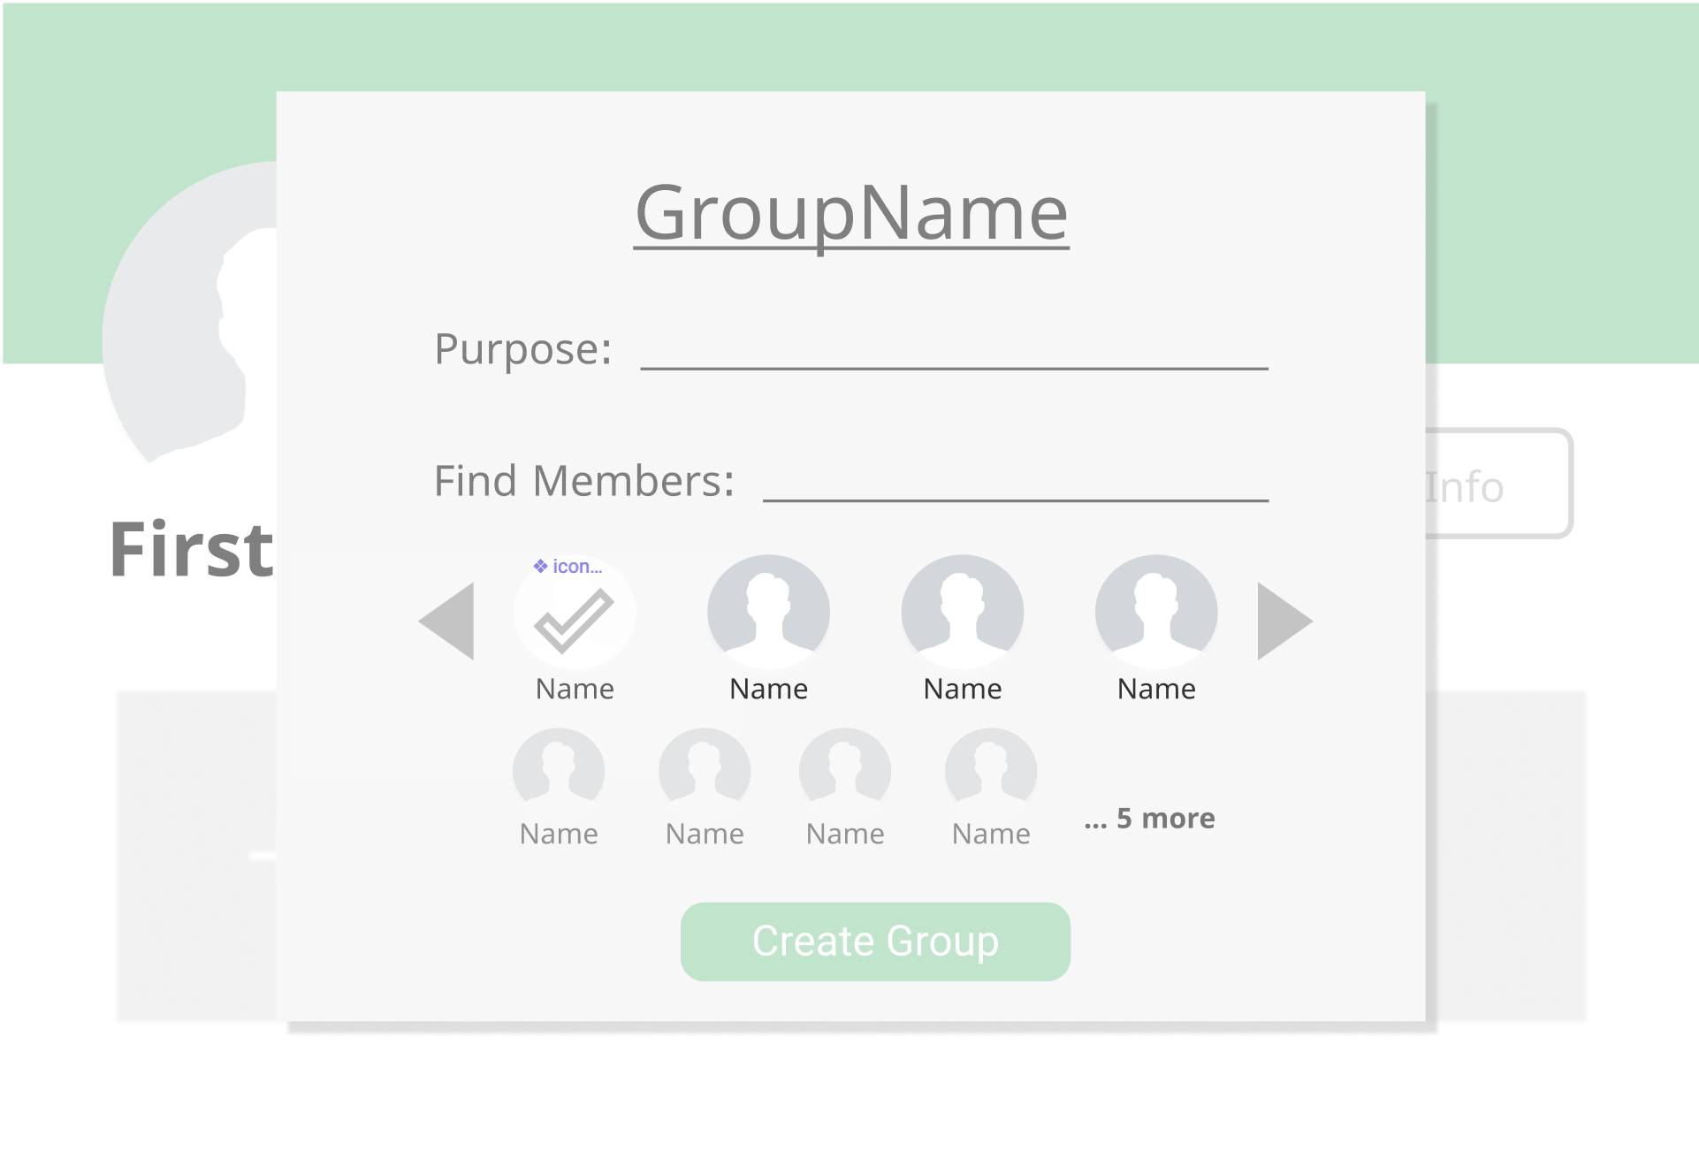
Make Group
Group Name and purpose fields
Submit button
Member Search Fields and suggestions

Slide 5
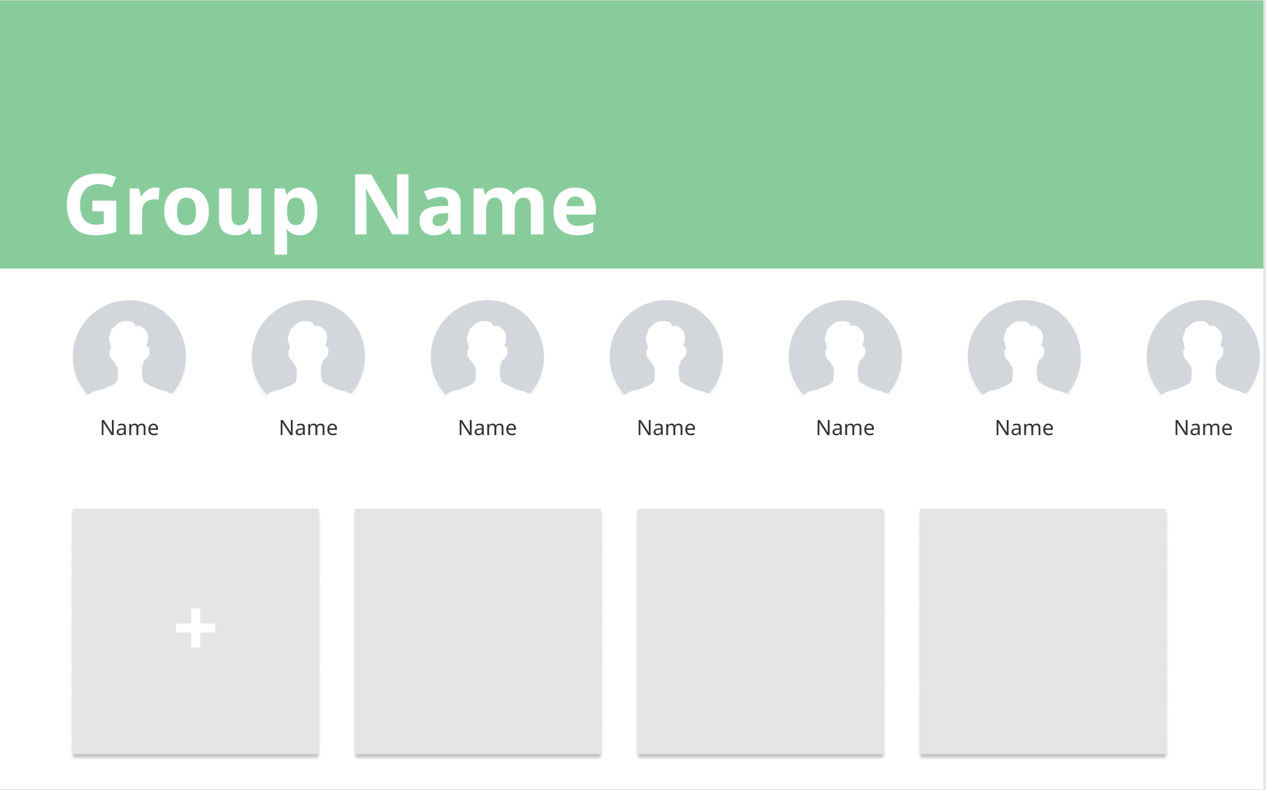
Group Profile
Group member pictures and names link to their profiles
Name of group
Event squares lead to event pop ups
Plus button creates new event

Slide 6
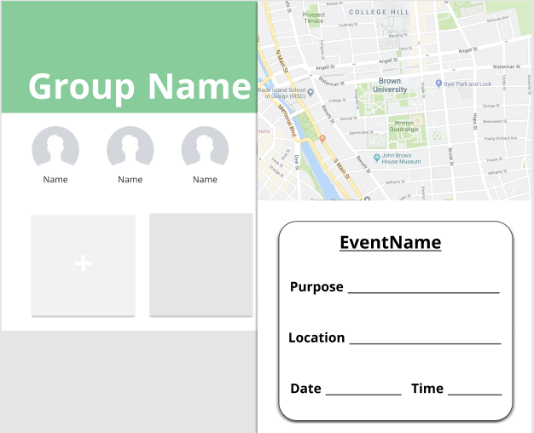
Event Creation
Google maps allows the user to see the event location
The creator must fill out these fields for the event

Slide 7
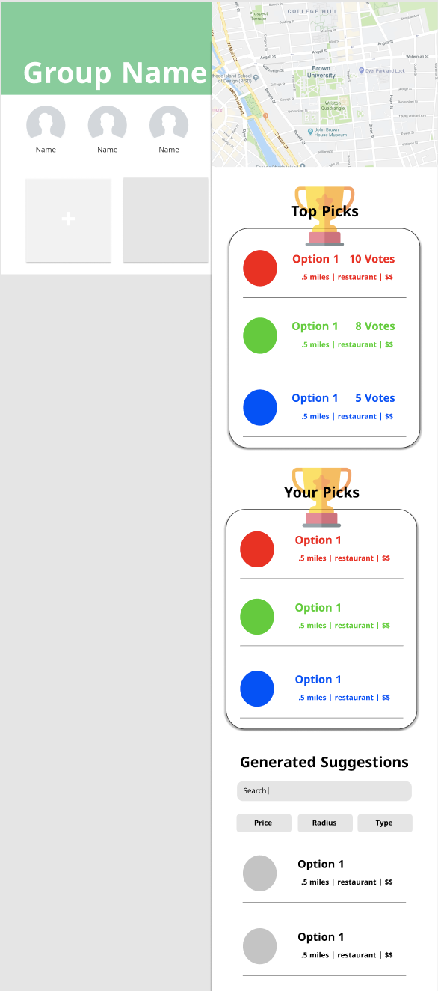
Event Pop-up
The highest ranked suggestions according to all votes
Google maps will be used to show locations and visualize suggestions for the event
A user’s selections (up to 3) for an event
Locations in the order the are suggested by our program

