Slide 1
Impact of Intermodal Equipment Status on Intermodal Equipment Rental Fees (aka Per Diem)
By Robert A. Bresley

Slide 2
Purpose:
The overall question this research needs to answer is, how can we reduce the per diem (equipment rental) charges we must pay for intermodal shipping containers? To accomplish this, we need to know in which situations, or where in the equipment usage lifecycle, we are paying the most per diem and why, so that we may focus on those areas to reduce our costs most efficiently. We need to answer the following question to highlight per diem problem situations, as each situation requires a different solution.

Slide 3
Research Question:
Does equipment that is currently placed at a customer location and is waiting to be unloaded represent a higher risk of high per diem charges than equipment that is in a different status?

Slide 4
What variables could have an impact on our question?
Status
Allocated Customer
Last Event Loc
Days on Customer Clock
Days at Location
Days on Our Clock

Slide 5
Describe what the variables mean in the dataset
Status: This is a calculated, categorical field that determines what part of the order lifecycle this equipment is currently in. For instance, a value of End Asset Usage indicates that the equipment has been returned and rental fees have stopped accumulating. A value of Released Loaded indicates that the equipment is currently loaded with product and moving towards its final destination.
Allocated Customer: This is the customer that is currently in control of the equipment. This variable is a calculated field which takes into account many aspects of the shipment including last carrier to touch the equipment, last person to report an event, and what the Event Description/Stop Type/Equipment Status combination of values was at that time.
Last Event Loc: The location where the last reported activity for this equipment happened. This is a location name known only within this system but is more specific than the simple city/state value that can be found in field Last Event City State.
Days on Customer Clock: This is a calculated field (arrival date – release date or system date if no release date is present). It represents how long the customer has been in control of a piece of equipment since that equipment was last in someone else’s control.
Days at Location: This is a calculated field (arrival date – system date if no release date is present). In this subset of data this will usually match Days on Customer Clock however if a piece of equipment has been released by the customer but not yet picked up by us, this value will be higher than Days on Customer Clock. A measure of how long a piece of equipment has stayed at the last event’s location.
Days on Our Clock: This is a calculated field (release date – system date if Status isn’t End Asset Usage) that indicates how long a piece of equipment has been sitting at a location after the customer released it to our control, without us coming to pick it up.

Slide 6
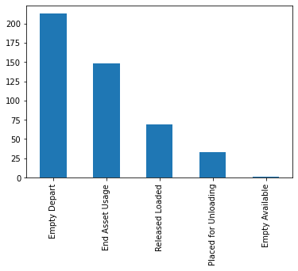
Histogram: Status

Slide 7
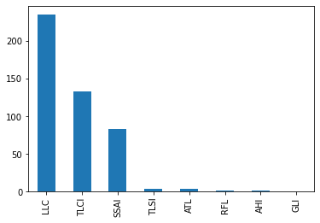
Histogram: Allocated Customer

Slide 8
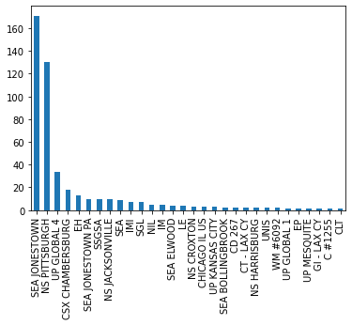
Histogram: Last Event Loc

Slide 9
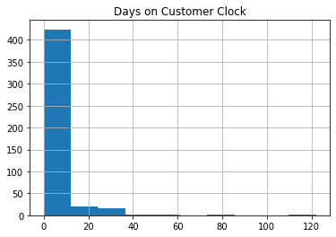
Histogram: Days on Customer Clock

Slide 10

Histogram: Days at Location

Slide 11
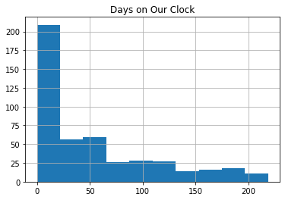
Histogram: Days on Our Clock

Slide 12
Outliers:
Status: These are calculated, categorical values and have no important outliers based on status count. However, the correlation between status and high per diem clocks is extremely important to answering our research questions.
Allocated Customer: These are categorical values and have no important outliers other than to indicate that most of our records are attributable to one of three customers.
Last Event Loc: The correlation between Last Event Loc and high per diem clocks may strongly indicate problem locations and help indicate that we might need to further research other research questions.
Days on Customer Clock: We have positive outlier values that are very large compared to most of the sample. These are the values we are looking for to answer our research question, however care will need to be taken before acting on these values, as it might be possible that the equipment has moved outside of this data’s view. Unfortunately, not all system integrations are perfect and the data we need to end the “customer’s clock” in this data set might have been sent to another system instead of this one.
Days at Location: As the values for Days at Location are so similar to Days on Customer Clock and the same outlier behaviors apply with the same reasoning and remedies.
Days on Our Clock: These positive outlier values that are very large compared to most of the sample are values which we are highly interested in as they represent either inaccurate data or pieces of equipment with high per diem charges while the equipment is under our control, and we are responsible for returning it.

Slide 13
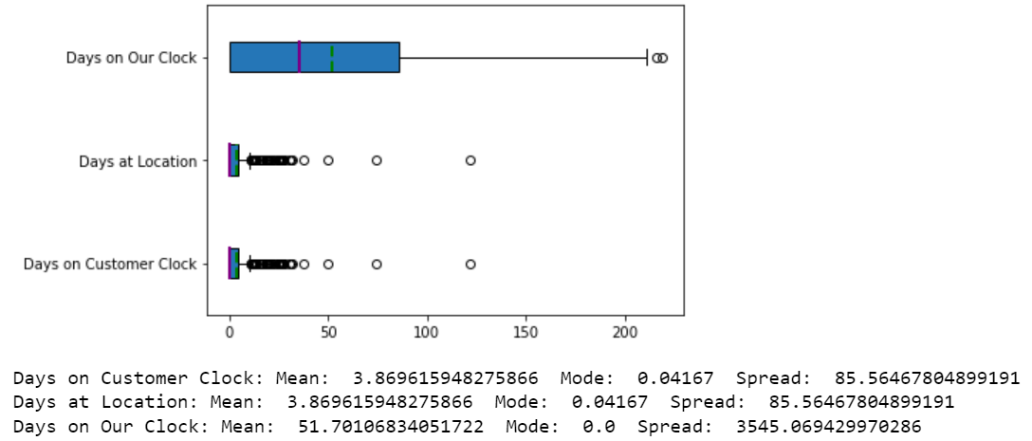
Variable Mean, Mode, and Spread

Slide 14
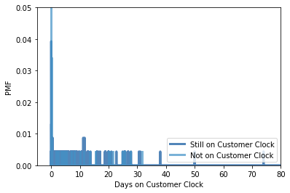
Probability Mass Function: Days on Customer Clock when equipment is still on customer clock vs when equipment is not still on customer clock
This indicates that the current possessor (the customer or us) has no dramatic impact on the Days on Customer Clock variable.

Slide 15
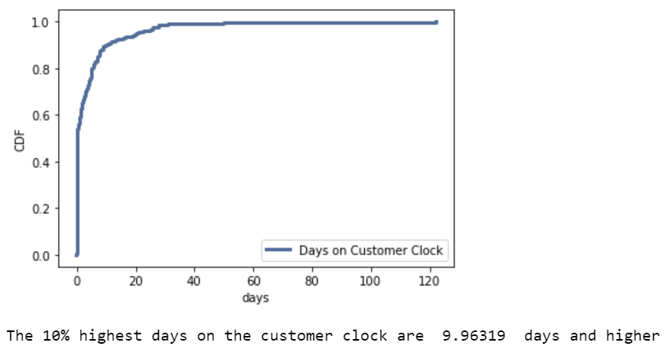
Cumulative Distribution Function: Days on Customer Clock
This indicates that our most impactful pieces of equipment are those with a Days on Customer Clock of 10 or higher. These are also the pieces of equipment with highest cost per day in per diem.

Slide 16
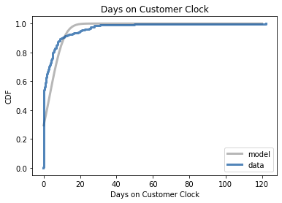
Normal Distribution Model
This model comes close to fitting our data, however it is far from perfect. Surprisingly, of the numerous models tested, this normal distribution model is the closest fit. There appears to be an inflection point around x = 10 and again around x=35 which suggests binning, breaking this into 3 models, may provide a better fit.

Slide 17
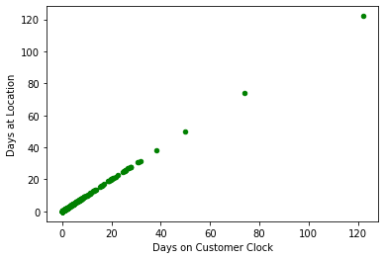
Scatterplot: Days on Customer Clock by Days at Location
While these are very strongly correlated, as visualized by the straight line, this does not necessarily indicate causation. It is possible that Days on Customer Clock is causing Days at Location, if that location is the customer location.

Slide 18
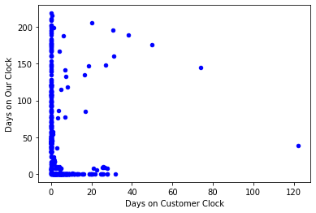
Scatterplot: Days on Customer Clock by Days on Our Clock
This graph indicates very little correlation between Days on Customer Clock and Days on Our Clock. This implies that the amount of time we are at fault for per diem is unrelated to the amount of time the customer is at fault for per diem.

Slide 19
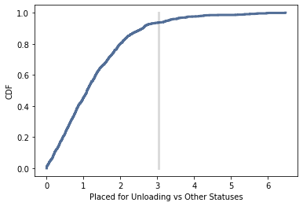
Hypothesis Test
The hypothesis that orders in status Placed for Loading have a higher number of Days on Customer Clock than others has a pvalue of: 0.063
This is on the borderline of being statistically significant

Slide 20
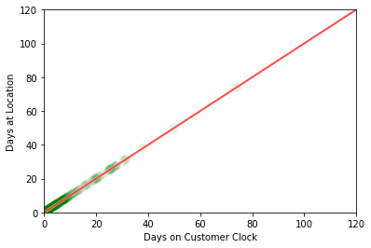
Regression Analysis: Using Days at Location to Predict Days on Customer Clock
Days at Location can be used to very closely predict the value of Days on Customer Clock. However, as stated previously, there is a danger that Days at Location is acting as a proxy for Days on Customer Clock for many of our records.

