Slide 1
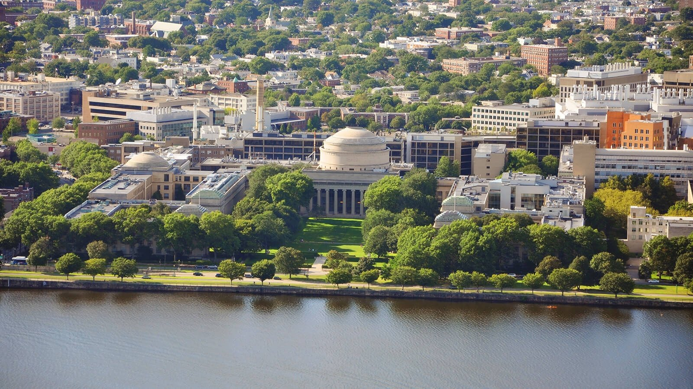

Massachusetts
Institute of Technology
CAMBRIDGE
MIT is a private research university located in Cambridge, Massachusetts. It was founded in 1861 and is considered one of the top universities in the world, renowned for it’s programs in science, technology, engineering, and mathematics. This faculty and alumni of MT have received numerous awards, including Nobel Prizes, Fields Medals, and MacArthur Fellowships.

Slide 2
Courses
Electrical Engineering and Computer Science
Mechanical Engineering
Physics
Chemistry
Biology
Economics
Management Science and Engineering
Urban Studies and Planning
Architecture
Mathematics

