Slide 1

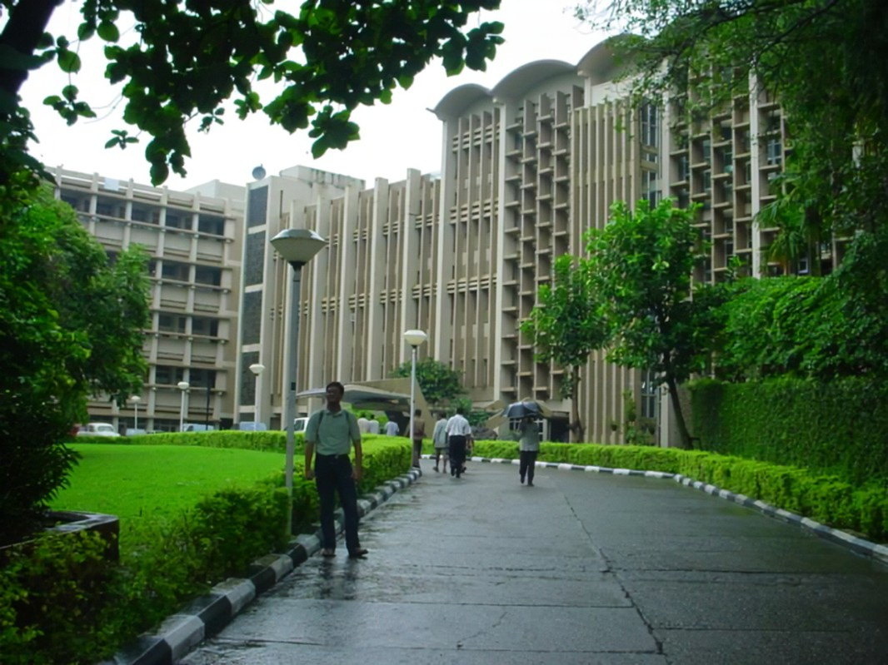
IIT BOMBAY

Slide 2
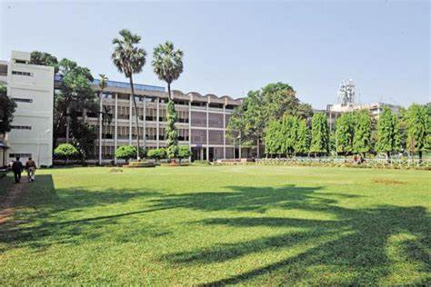
INDRODUCTION
It is located in Powai, Mumbai, Maharashtra​
Indian Institute of Technology Bombay (IIT Bombay) is considered to be one the best engineering universities in India ​
It was the top ranked university in India ​

Slide 3

COURSES
UNDERGRADUATE PROGRAMS
Bachelor of Technology in Computer Science & Engineering​
Bachelor of Technology in Aerospace Engineering​
Bachelor of Technology in Mechanical Engineering​
Bachelor of Technology in Engineering Physics​
Bachelor of Science in Chemistry​
Bachelor of Science in Mathematics​

