Slide 1

AMERICAN INTERNATIONAL UNIVERSITY- BANGLADESH
Faculty of Science and Technology
Assignment Title: Final Assignment
Assignment Number: 01 Date of Submission: 26/12/2020
Course Name: THEORY OF COMPUTATION
Section: G Course Code: CSC 3113
Semester: FALL 2020-21 [Final Term] Course Teacher:
Student’s Information
Serial: Name: ID: Program: Signature:
01. HABIB, MD. IMTIAZ 19-39389-1 BSc CSE Imtiaz
Declaration and Statement of Authorship:
I/we hold a copy of this Assignment/Case-Study, which can be produced if the original is lost/damaged.
This Assignment/Case-Study is my/our original work and no part of it has been copied from any other student’s work or
from any other source except where due acknowledgement is made.
No part of this Assignment/Case-Study has been written for me/us by any other person except where such collaboration has been authorized by the concerned teacher and is clearly acknowledged in the assignment.
I/we have not previously submitted or currently submitting this work for any other course/unit.
This work may be reproduced, communicated, compared and archived for the purpose of detecting plagiarism.
I/we give permission for a copy of my/our marked work to be retained by the Faculty for review and comparison, including review by external examiners.
I/we understand that Plagiarism is the presentation of the work, idea or creation of another person as though it is your own. It is a formofcheatingandisaveryseriousacademicoffencethatmayleadtoexpulsionfromtheUniversity. Plagiarized material can be drawn from, and presented in, written, graphic and visual form, including electronic data, and oral presentations. Plagiarism occurs when the origin of them arterial used is not appropriately cited.
I/we also understand that enabling plagiarism is the act of assisting or allowing another person to plagiarize or to copy my/our work.
Faculty Use Only
Serial: Name: ID: Marks
01. HABIB, MD. IMTIAZ 19-39389-1

Slide 2
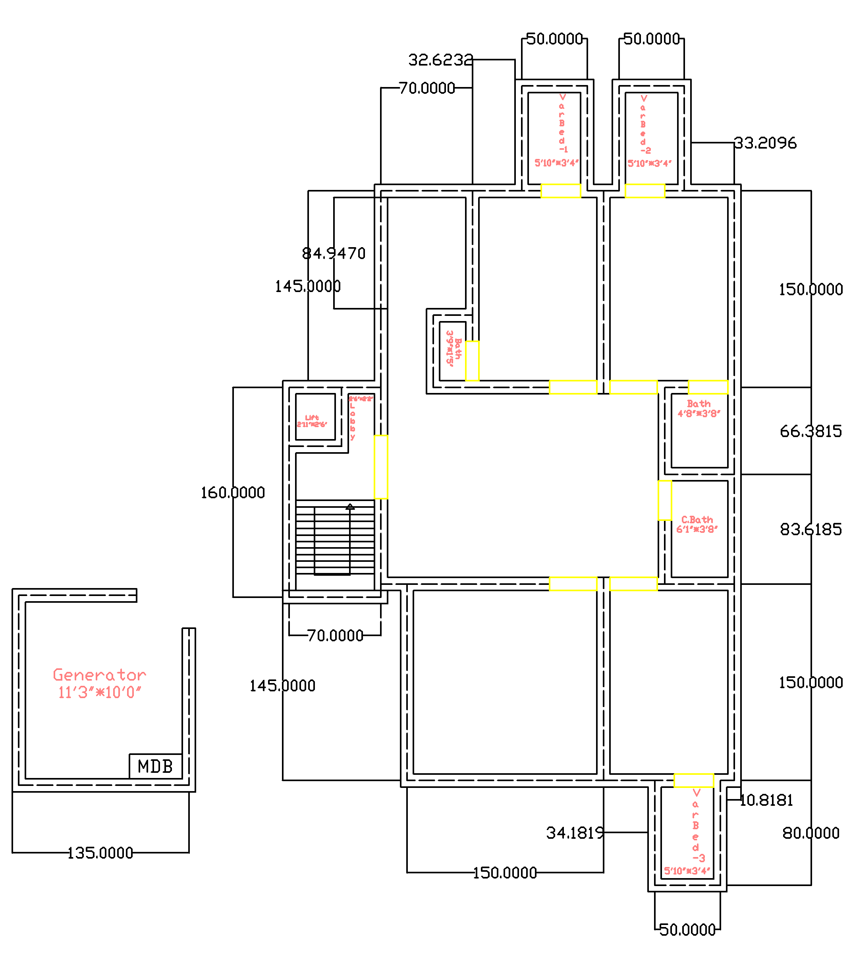
AMERICAN INTERNATIONAL UNIVERSITY-BANGLADESH
INITIAL DESIGN

Slide 3
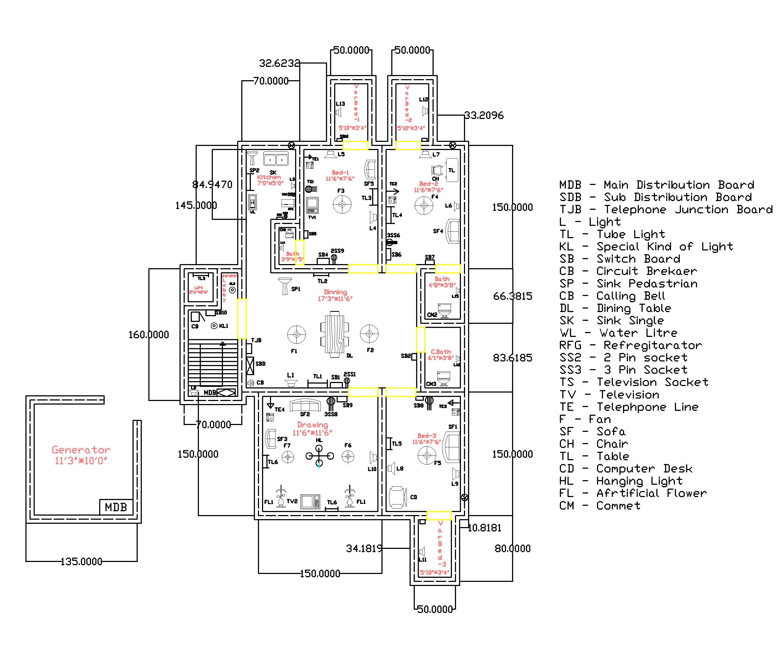
AMERICAN INTERNATIONAL UNIVERSITY-BANGLADESH
DESIGN LAYOUT WITH LOADS

Slide 4
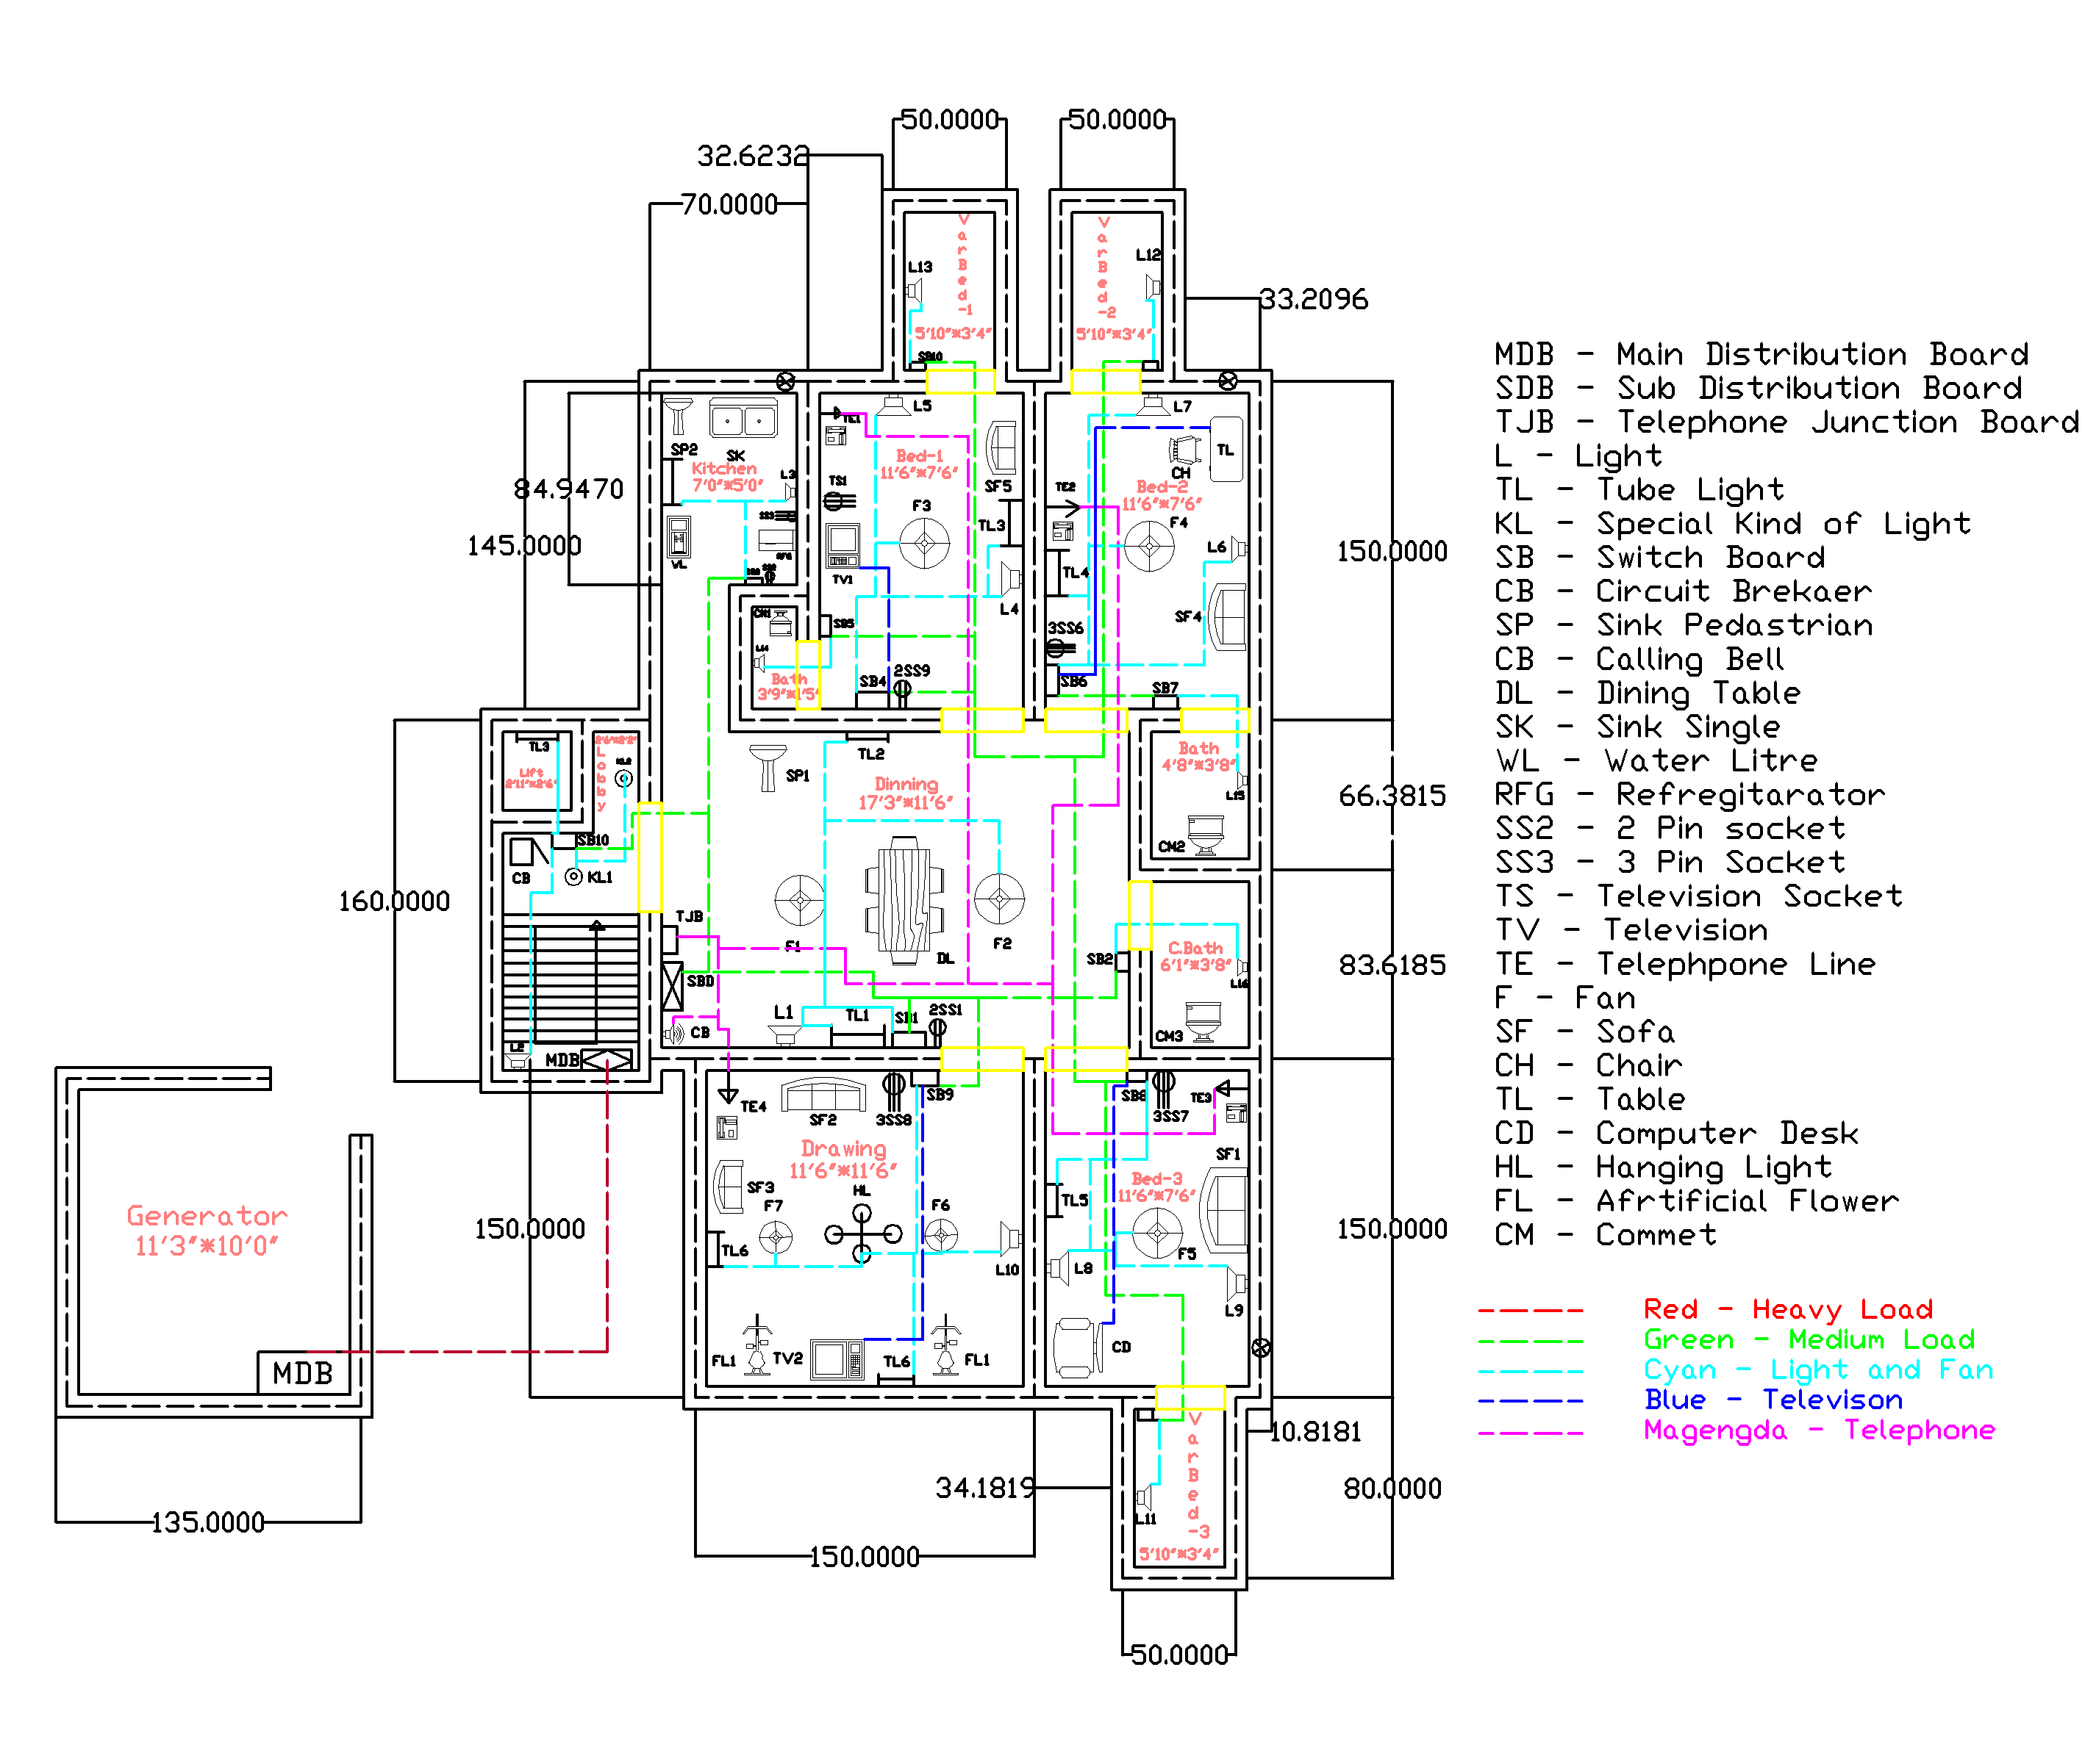
AMERICAN INTERNATIONAL UNIVERSITY-BANGLADESH
DESIGN LAYOUT WITH WIRINGS

Slide 5
AMERICAN INTERNATIONAL UNIVERSITY-BANGLADESH
LAODS CALCULATION
Light/ Bulb: 16* 30 = 480 watts
Tube Light: 9*35 = 315 watts
Special Kind of Light: 2*60 = 120 watts
Fans: 70*7 = 490 watts
Televisions: 35*2 = 70 watts
Computers: 60*2 = 120 watts
Telephones: 10* 4 = 40 watts
Refrigerator: 200 watts
Calling Bell: 8 watts
If we use Lights 10 hours a day, Fans 12 hours a
day, Televisions 3 hours a day, Computers 5
hours a day, Telephones 3 hours a day,
Refrigerator 20 hours a day, Calling bell 0,5
hours a day on average, our total cost at the end
of the month will be 300 units.
Estimated costs: 300*8= 2400 Taka.

Slide 6
THANK YOU!

