Slide 1
PRL Engineer Onboarding
Beatrix Haddock
December 2022

Slide 2
Overview
Project framing
Research docs overview
How docs sections map to our sim components
Documentation/planning challenges
Documentation/component tracking solution
Synthetic Data inputs
Notes on within sim vs. post-processing considerations
Profiling notes for scaling up
Notes on SE vs. RT responsibilities (maybe blurrier than other projects?)

Slide 3
Project Background
This is a five-year, Census-funded project. We’re focusing on part one.
They are interested in record linkage: trying to match individuals between different datasets (e.g., decennial census vs. tax records)
Our first goal is to build a population, from whom we can generate datasets, that census can then test different record linkage algorithms on.
The idea here is that with synthetic data, you can calculate true error / accuracy rates, because we know the “truth”.

Slide 4
Our task
We will build three components:
A vivarium population model of the full US
A post-processing package. It will add in details that would be expensive to run within the sim.
For example, within the simulation sims will have address_ids, and we will map those to synthetic addresses during post-processing.
Pseudo-people (sp?): a noising package. This will allow a user to pull certain “observer” outputs with a certain amount of configurable noise.
For example, a census of everyone in the US, where some rows (people) are duplicated at rate X and some names are misspelled at rate Y

Slide 5
Our task
Still focusing on this one, starting to speculate about the next two with RT
We will build three components:
A vivarium population model of the full US
A post-processing package. It will add in details that would be expensive to run within the sim.
For example, within the simulation sims will have address_ids, and we will map those to synthetic addresses during post-processing.
Pseudo-people (sp?): a noising package. This will allow a user to pull certain “observer” outputs with a certain amount of configurable noise.
For example, a census of everyone in the US, where some rows (people) are duplicated at rate X and some names are misspelled at rate Y

Slide 6
Population Synthesis Goal
Important to note: our goal is to build a population that is just complex enough such that the records we produce present an equivalently difficult linking challenge to the real data.
This means that our end-goal is not to create a faithful representation of the US population
Examples:
Perhaps(?) the percentage of people living in military housing is not important to get correct (this is a research question)
Perhaps(?) it is not necessary for the distribution of incomes within one company to be realistic – or even for the distribution of income across the US to be realistic.

Slide 7
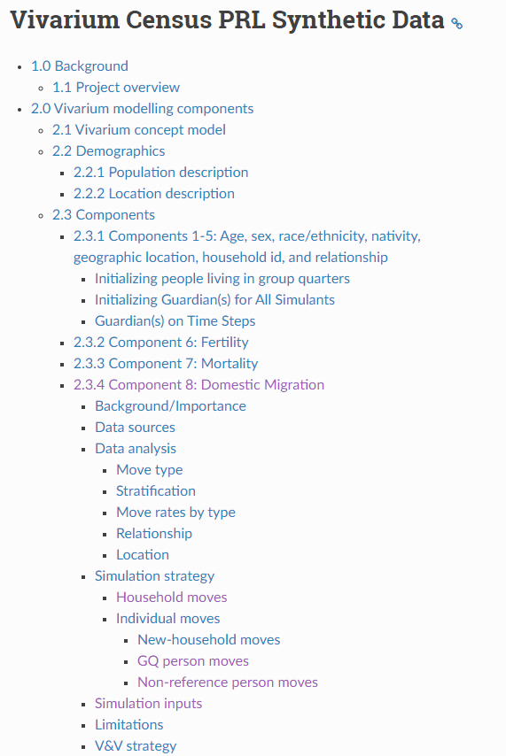
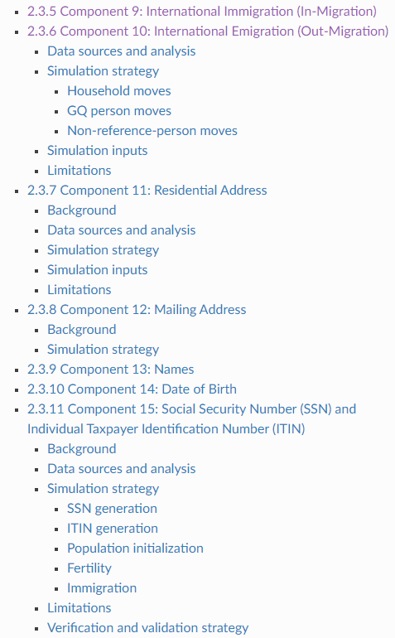
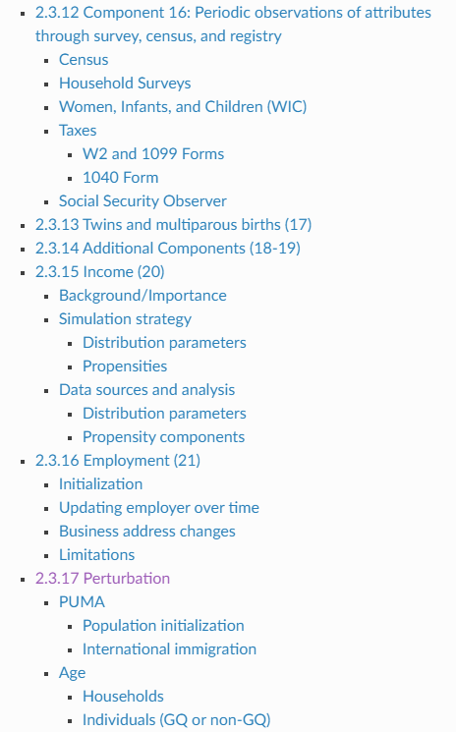
Turning to the research docs:

Slide 8
Turning to the research docs:
Basic demographic initialization

Slide 9
Turning to the research docs:
Additional basic simulant characteristics

Slide 10
Turning to the research docs:
Less basic demographic structure initialization

Slide 11
Turning to the research docs:
Fertility/Mortality (similar to typical vivarium)

Slide 12
Turning to the research docs:
Address components associated with households

Slide 13
Turning to the research docs:
Migration components

Slide 14
Turning to the research docs:
Employment components

Slide 15
Turning to the research docs:
Observer components

Slide 16
What do all of those components look like?

Slide 17
Population initialization

Slide 18
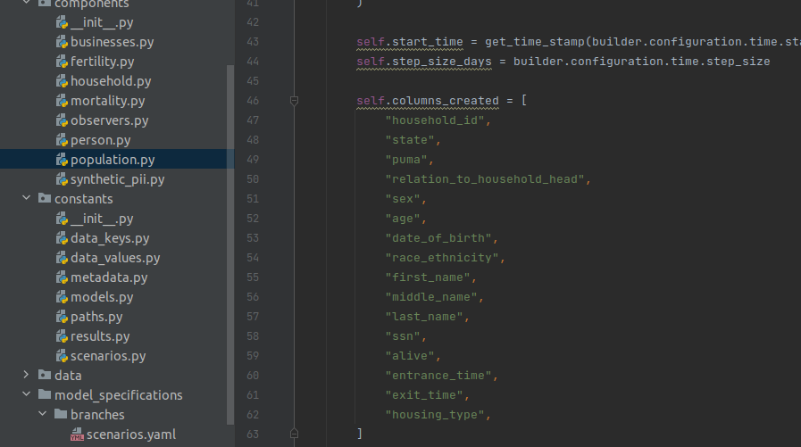
Population initialization
Managed by the population component

Slide 19
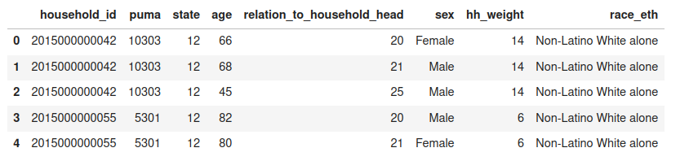
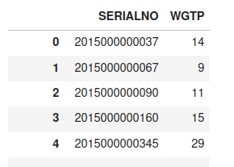
Population initialization
Notebook examining input ACS data here
Person file
Household file

Slide 20
Population initialization
We sample households from the ACS data until we hit a target number of people
We then sample from the ACS people who live in group quarters until we hit a target number of people (each GQ person is coded in ACS as being in their own household)
We perturb the PUMA and age of simulants [not yet implemented]
Then add some other characteristics not in the ACS data
(DOB, SSN, first/middle/last name, etc.)

Slide 21
Population component
Initializes population
Initializes newborns
Newborns inherit most traits from their mother, the rest are mostly randomized (sex, first name, DOB within the timstep)
Ages people

Slide 22
Fertility/Mortality

Slide 23
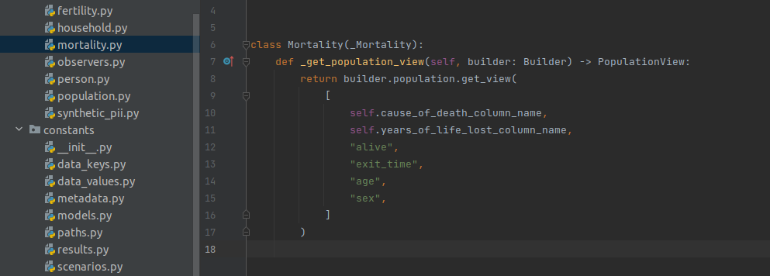
Mortality
Just like a normal vivarium model. We use 2019 (I think?) mortality rates for every year
This is the entire class:

Slide 24
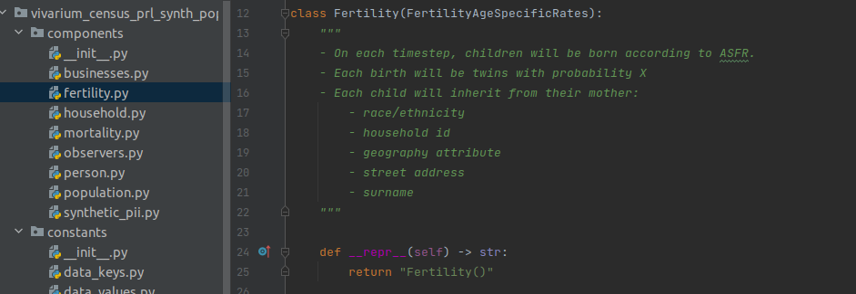
Fertility
Inherits from standard FertilityAgeSpecificRates. Mothers are chosen at a rate specified from RT to have twins. Each timestep mothers are registered. The population component then creates children for registered mothers, and manages characteristic inheritance.

Slide 25
Guardians

Slide 26
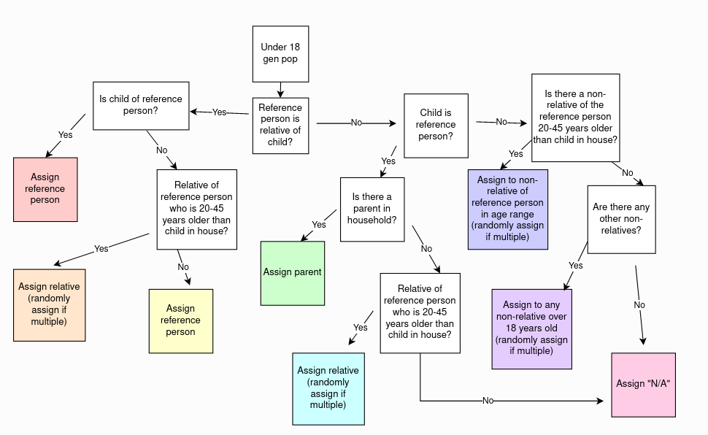
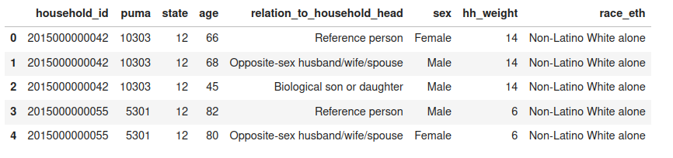
Guardians
On initialization, sims 18 and under are assigned “guardians” from among the other sims. This logic is based primarily upon the “relation to household head” attribute that simulants got from the sampled ACS data

Slide 27
Guardians
On initialization, sims 18 and under are assigned “guardians” from among the other sims. This logic is based primarily upon the “relation to household head” attribute that simulants got from the sampled ACS data
This will later be used for our tax observer, when simulants will need to claim dependents.

Slide 28
Households/addresses

Slide 29
Households/addresses
Households aren’t saved in their own datastructure; they exist implicitly by simulants in the pop table having the same “household_id”. Simulants with the same household_id will also have the same addresses/zipcodes, state, and PUMA.
The households component (which ought to be renamed to household migration; more on migration later) manages addresses

Slide 30
Households/addresses
Addresses currently exist as two columns in the state table: address and zipcode. However, we’re considering moving these out of the sim, because sampling them within the sim takes a considerable amount of time.
Additionally, we used to only have one type of address; RT has added a mailing address, so there will now be both residential and mailing addresses.
Before implementing this new address type, need to review the profiling information and decide if we prefer address_ids or actual addresses in the sim (I would recommend ids; more on this later)

Slide 31
Migration

Slide 32
Migration
Three types of migration
Within sim: an individual or household moves. Households get new addresses. Individual simulants move into other people’s households, get a new address and a new relation to head of household.
Immigration (into sim): new people and households are sampled from ACS data
Emigration (out of): sims and households chosen to move abroad. (they don’t move back into the sim)
These all need to be overhauled.
Were originally implemented one way, as designed by abie in an earlier stage. Now with more research capacity, RT realized it was necessary to fully redesign
The docs for these are quite good, though also quite complex.

Slide 33
Employers/businesses

Slide 34
Employers/businesses
We’ve used the words “businesses” and “employers” somewhat interchangeably
The businesses component manages a table of employers. The employer sizes are generated at the start of the sim, based on the population size, and follow a lognormal distribution.
There are two special employers. “unemployed” and “military”.
People of working age (18+) are randomly assigned an employer with probability proportional to employer size. People under working age are assigned “unemployed”

Slide 35
Employers/businesses
On each time step, the following are possible:
Change jobs
Business changes address
Income?
Sim is born -> becomes “unemployed”
Sim turns working age -> is randomly assigned an employer
Misc notes
We have not implemented retirement (I don’t think we plan to?)
Military is a special employer; people who are living in military group quarters (this is one of the housing types from the ACS data) are assigned “military” employer. If one of these people is randomly selected for a job change, they do not change jobs.

Slide 36
Observers

Slide 37
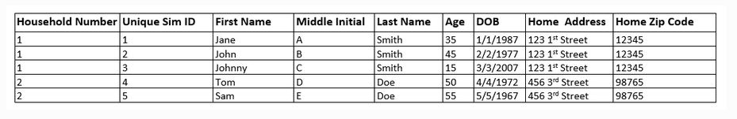
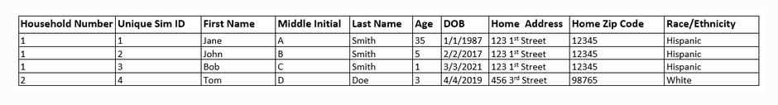
Observers
For the most part, not yet implemented
Need to know what will be configurable in the noising package (this might ?? Be in the docs now, but it’s still an open conversation Syl is working on and needs SE input on

Slide 38
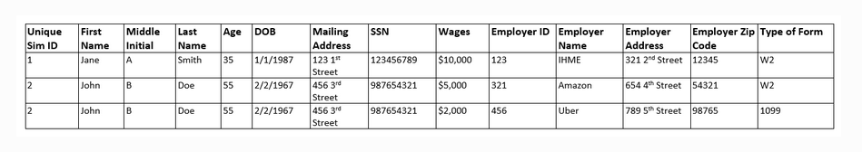
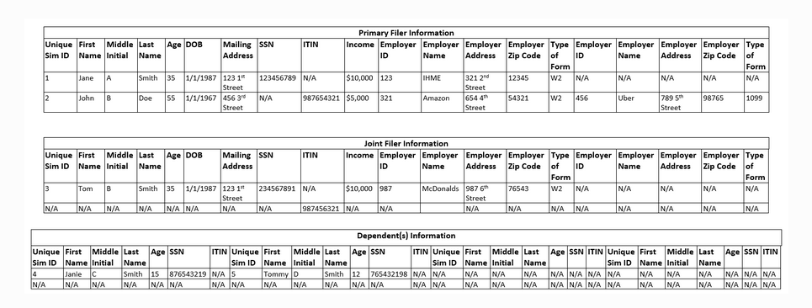
Observers

Slide 39
Documentation/planning challenges
This project started as a not-fully-formed idea, and beatrix implementing ideas abie was communicating on slack, without documenting what was implemented vs. not
It has grown into a very large project with multiple researchers. They are both building out new components and refining/rehauling ideas abie had originally come up with on the fly
This evolution means that PRL has had the somewhat unique challenge of understanding what has been:
documented and isn’t going to change,
documented and is going to change,
implemented but not documented, vs
undocumented but will become documented in the future

Slide 40
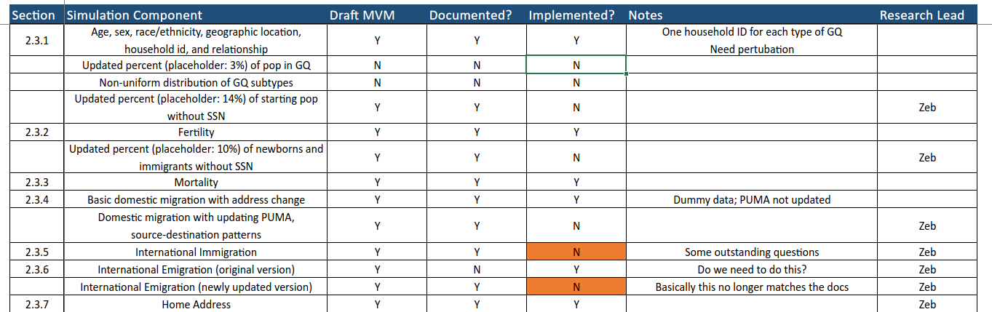
Documentation/tracking solution
Syl created a tracking doc that we are now using to understand what components have been documented vs. implemented. (If you’re ever looking for it, it’s pinned in #vivarium-census-prl)
(incomplete screenshot)

Slide 41
Documentation/tracking solution
Syl created a tracking doc that we are now using to understand what components have been documented vs. implemented. (If you’re ever looking for it, it’s pinned in #vivarium-census-prl)
The expectation is that RT will create tickets for us if they change anything that already exists in the sim, and SE will keep RT up to date (through this sheet? Also on slack and in RT/SE checkin) re: what has been implemented
(incomplete screenshot)

Slide 42
Synthetic data inputs
Abie designed and then we iterated on a component that creates synthetic data inputs:
Names (people and businesses)
Addresses
SSNs
Mostly, this package just samples subsets of real names/addresses and recombines them.
E.g., sample street number, street name, city name, zipcode
Sample first name, middle name, last name
This is one of the slowest (actually, I think the slowest) parts of the sim.

Slide 43
Synthetic data inputs re: scale up
Removing the process of sampling / synthesizing synthetic data from within the sim is likely the best place to get speedups.
With a small table of employer names, scaling up the population results in this sort of slow down:
I think this is from name and address sampling, primarily. I have other metrics for the slowdown as we increase the number of employers in the sim (and thus the number of addresses to sample)
pop size: 1_000_000
runtime: 22h40m
memory: 71515MB
pop size: 800_000
runtime: 19h33m
memory: 44738MB
pop size: 600_000
runtime: 15h22m
memory: 26947MB
pop size: 400_000,
runtime: 8h0m
memory: 14190MB
pop size: 200_000
runtime: 2h7m
memory: 10398MB
pop size: 100_000
runtime: 1h40m
memory: 10222MB
pop size: 80_000
runtime: 4h6m
memory: 9365MB
pop size: 60_000
runtime: 2h3m
memory: 9361

Slide 44
Considerations for within sim vs. post-processing
We cannot run the entire US population (350 million sims) in one thread. So we need to use multiple “shards” of the population. This poses some issues
People in separate shards can’t move into each others’ households
These issues are potentially not concerning if each shard is sufficiently large
To accomplish this manageable runtimes/memory requirements, one main tool is to move things from within the sim to post-processing
For example, within the sim, if businesses only have address_ids (an int) rather than addresses (a string that had to be sampled from 3 different datasets and concatenated) we get considerable speedup. We would then merge on actual addresses in post-processing.

Slide 45
Running the sim: mini artifact
The artifact is too large / causes local machine to OOM.
Created a mini artifact, that is generated from subsetted versions of the input data. For smaller data inputs, it also does some subsetting in the builder code.
Need to update this every time update full artifact
Recommended workflow:
Update main artifact
Merge updated artifact into test/mini-artifact branch
Update builder code as needed to subset data
Sometimes the small sample size causes weird behavior
Copies of the same family with different names throughout the sim
People with the same first and middle name (these are sampled from the same data)

Slide 46
Notes on RT vs. SE back-and-forth
Do to a few factors:
Research task is ill-defined, still. They’re working to get more clarity from the client
If they could ask for anything they wanted, RT would request something we don’t have the resources to build
A lot of the component design requires back and forth between RT and SE, where:
They tell us they want something,
We tell them how much work that request might take,
We work together to come up with a simpler solution to the need they’re meeting
This is an expected/understood part of the project at this point.
My understanding is that, because of this, the line between RT/SE (e.g., whose responsibility to design the components? Who decides what is in the sim vs. post-processing vs. noising package?) is much blurrier on this project than others.

Slide 47
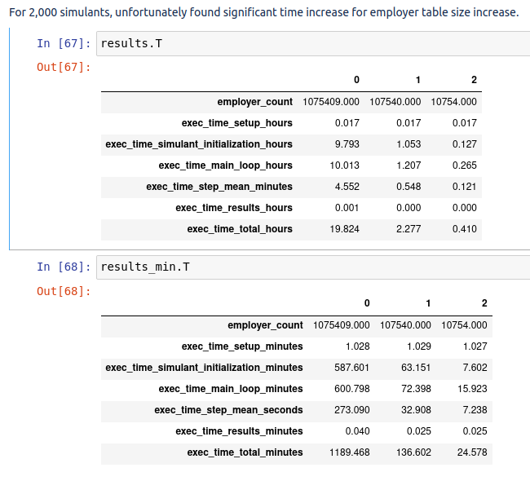
Profiling notes for various scale-ups
Smallish employers table
Scaling up pop size
Small pop size, large employers table
profiling with:
10.75 million employers
running for 10 years
address_ids instead of addresses for both households and businesses
we got:
20,000 sims:
setup: 1.566 min
init: 1.683 min
mean timestep: 8.104 seconds
main loop: 18.369 min
200,000 sims:
setup: 1.127 min
init: 4.636 min
mean timestep: ~ 1 min (30 - 60 sec)
main loop: 1.5 hours
2 million sims:
Ran out of time
20 million sims:
OOMed during initialization with 300GB
pop size: 1_000_000
runtime: 22h40m
memory: 71515MB
pop size: 800_000
runtime: 19h33m
memory: 44738MB
pop size: 600_000
runtime: 15h22m
memory: 26947MB
pop size: 400_000,
runtime: 8h0m
memory: 14190MB
pop size: 200_000
runtime: 2h7m
memory: 10398MB
pop size: 100_000
runtime: 1h40m
memory: 10222MB
pop size: 80_000
runtime: 4h6m
memory: 9365MB
pop size: 60_000
runtime: 2h3m
memory: 9361

Slide 48
Profiling notes for various scale-ups
profiling with:
10.75 million employers
running for 10 years
address_ids instead of addresses for both households and businesses
we got:
20,000 sims:
setup: 1.566 min
init: 1.683 min
mean timestep: 8.104 seconds
main loop: 18.369 min
200,000 sims:
setup: 1.127 min
init: 4.636 min
mean timestep: ~ 1 min (30 - 60 sec)
main loop: 1-2 hours (still running)
running with
10.75 million employers
2 million sims
10 years starting in april 2020
max time 10 hours
300 GB
> we ran out of time in 2023. setup was a minute, initialization took 53 min, timesteps were taking ~15 min.
running with
10.75 million employers
20 million sims
10 years starting in april 2020
max time 10 hours
300 GB
> we OOMed after setup / during initialization. i think this was probably due to name sampling.

