Slide 1
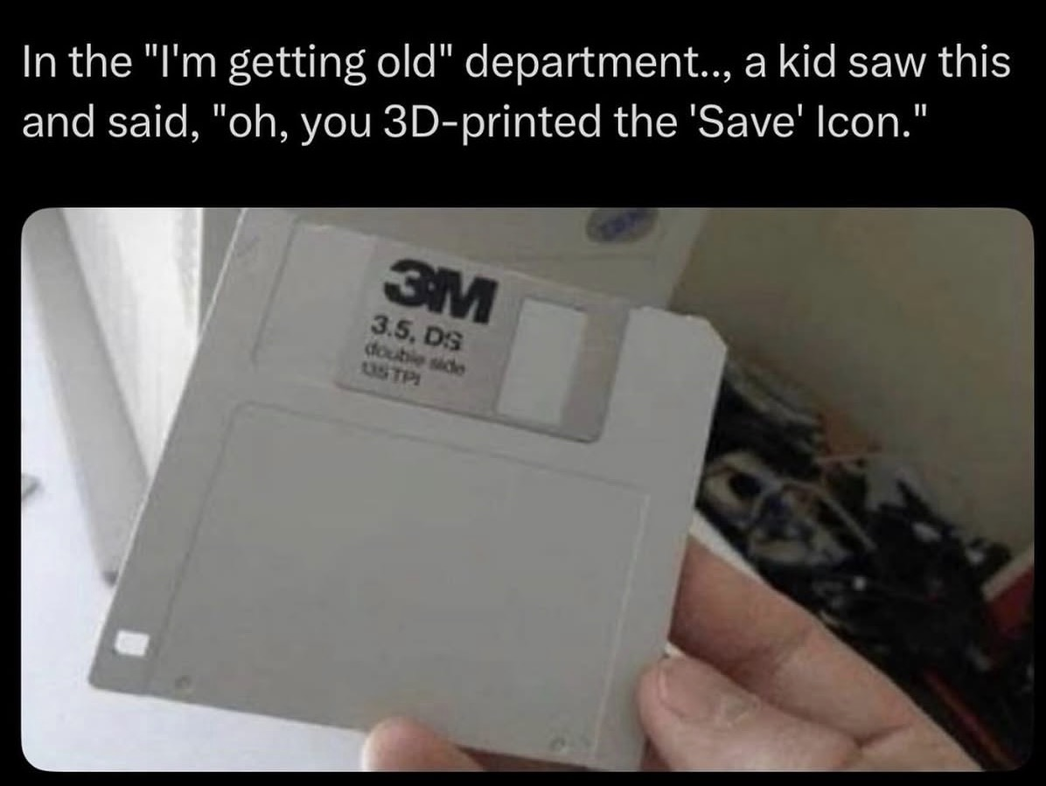
S-98 Meeting 12th May 2026

Slide 2
Agenda
Introductions
Meetings Update:
TSM
HSSC
S-164 Update

Slide 3
Meeting update - TSM
TSM meeting topics
Updates to S-98 2.6.0 completed before TSM. Updates during the meeting processed to edition 2.6.0 were then submitted to HSSC as 3.0.0 for consideration
TSM changes
S-102 / S-104 border drawing
S-102/S-104 control over interoperability
All PCs are LUA
S-124 optional extended UI
Vertical Clearance Adjustment
Cancellation updates
Others?

Slide 4

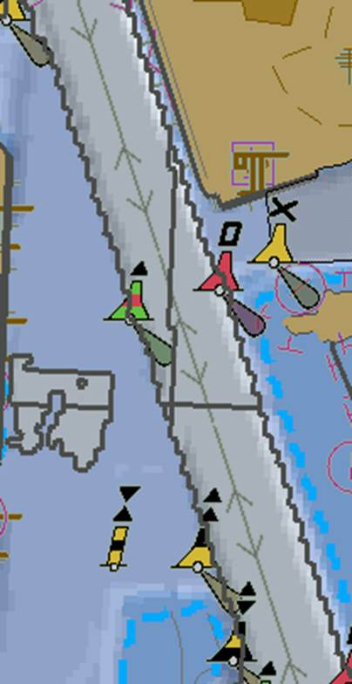
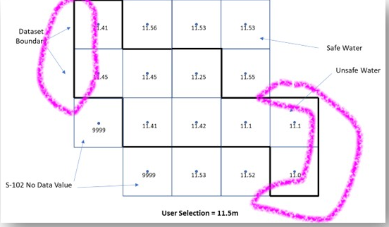
Enhanced Safety contour Issues [OSI]
In the current S-98 Appendix D, the safety contour must be drawn
Where you transition from safe to unsafe water (as defined by the values in the S-102 (+S-104 + uncertainty etc…)
At the edges of the dataset
Between NoData values and Data values.
This leads to a proliferation of safety contours.

Slide 5
Revision March 2026
11.61
11.46
11.43
11.43
9999
11.65
11.65
11.75
11.45
9999
Outside S-102 Coverage
9999
11.51
11.62
11.51
11.55
9999
9999
11.13
11.12
11.62

Slide 6
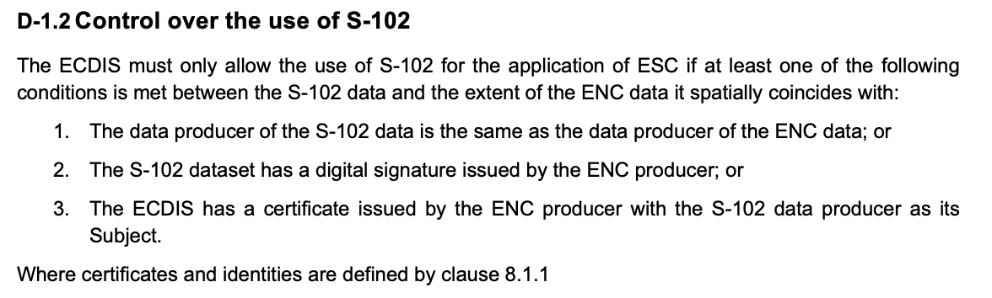

Slide 7
Changes in HSSC version 3.0.0
From ECDIS Workshop (TSM Day -1)
PC revisions
All PCs are LUA – OEMs do not have to implement XSLT for any PC
S-164 will clarify although OEMs must implement PC revisions, this does not have to be by the same method as dataset import (can be done independently)
S-124 implementation
S-124 optional extended UI optional instead of MUST requirement
Covers ONLY filtering/classification (manual and automatic) and use of Part 17 for cancellation
S-124 remains mandatory for implementation (loading, portrayal, pick report etc) and update (FC/PC)
Subsequently the requirement for dataset “self-cancellation” has been (re-)instated. This means
S-124 cancellation is implemented by Part 17 mechanisms except for self-cancellation which is S-124 specific
Revision control (reporting of in-force bulletins) is done by S-128 reconciliation
Final Adjudication of these changes to be heard at HSSC
Any further changes to be done via member state comments
Anything else from S-164/S-98 PT members?

Slide 8
S-104 issue for clarification
… received (via Primar) a Norwegian S-104 dataset which contains 2 WaterLevel instances with (nearly) identical geographic and temporal coverage. They differ in the value of "dataDynamicity". The S-104 PS allows up to 99 instances but does not define any order or priorization. Looking into S-98, there's no guidance on how to select the instance to be used for WLA. I see following alternatives:
Add a section to the Data Constraints Annex, allowing only one WaterLevel instance per S-104 dataset for ECDIS use. This would preclude many available datasets from being used in ECDIS.
Add a section to the Data Constraints Annex, allowing only WaterLevel instances of a specific "dataDynamicity" for ECDIS use. This would preclude many available datasets from being used in ECDIS.
Add a requirement that the user must be able to select an instance. This can get complicated. Should the user select from "dataDynamicity" values? As a consequence, only datasets that contain the selected "dataDynamicity" could be used for WLA at any given time, even if other datasets are available.
Add a requirement that the ECDIS must use the safest (shallowest) value of all instances available in one dataset. This is time consuming and may result in different "dataDynamicities" used for the same WLA region.
Define a priorization order for the "dataDynamicity" values and require the ECDIS to use the "best" instance according to that order.
Leave it explicitly to the ECDIS OEM to decide.
Whatever alternative is deemed appropriate, in addition to the guidance to be added, the ECDIS legend needs to be amended. (page 37, "ECDIS Legend Item": 1. WLA Method selected, 2. Attribute dataDynamicity) (b.t.w. S-111 is not used for WLA, wrong place or wrong item?)

Slide 9
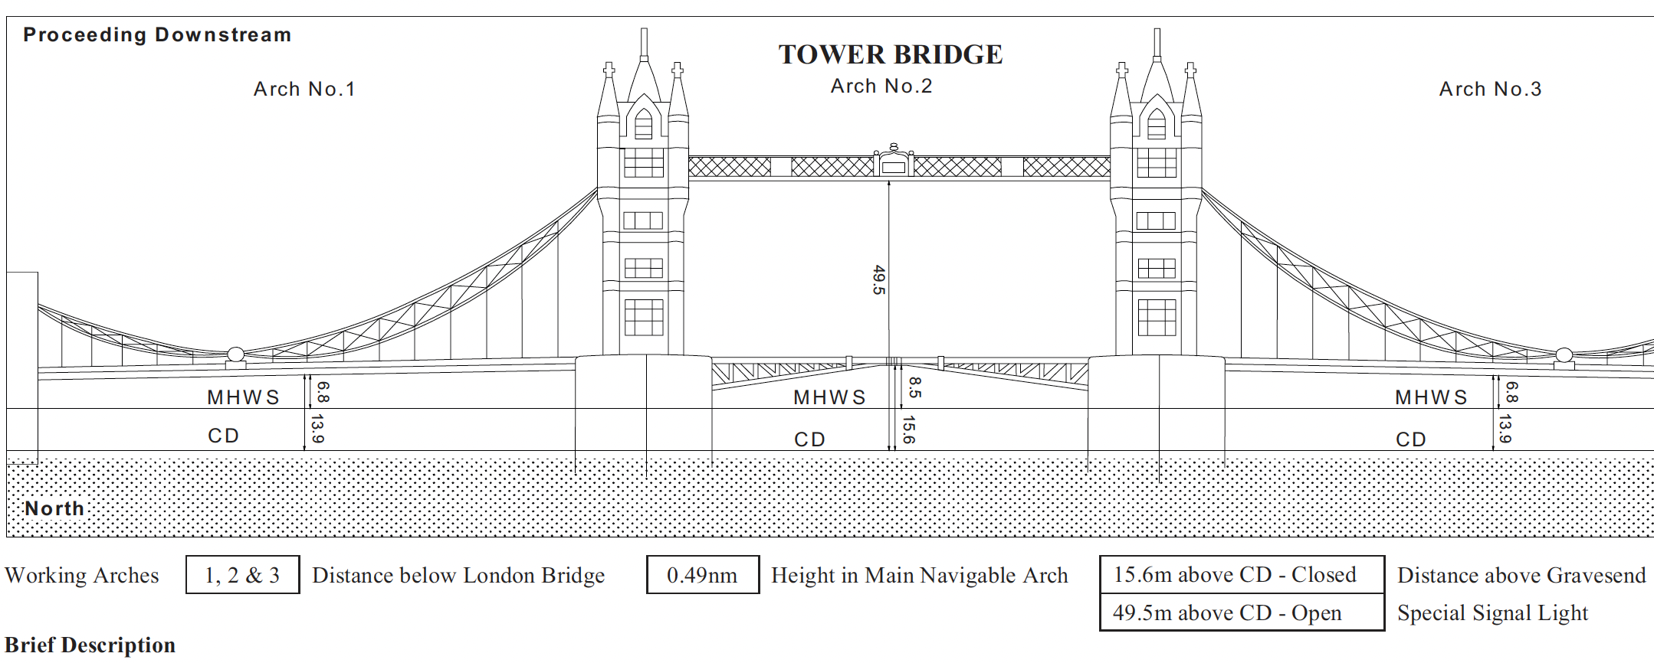

Slide 10
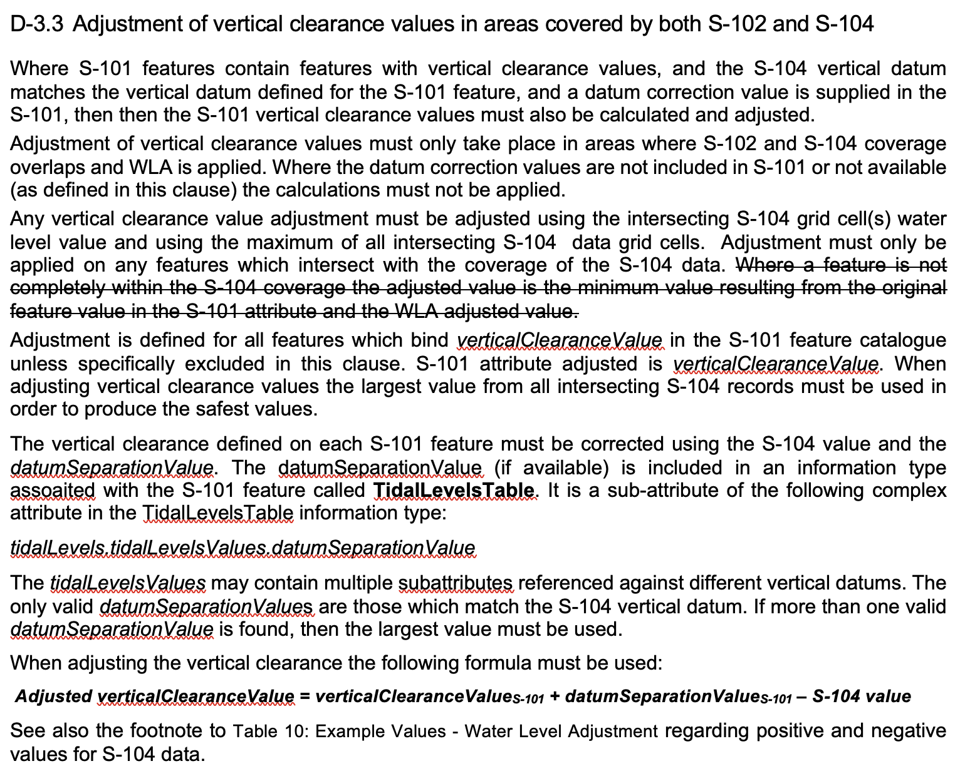
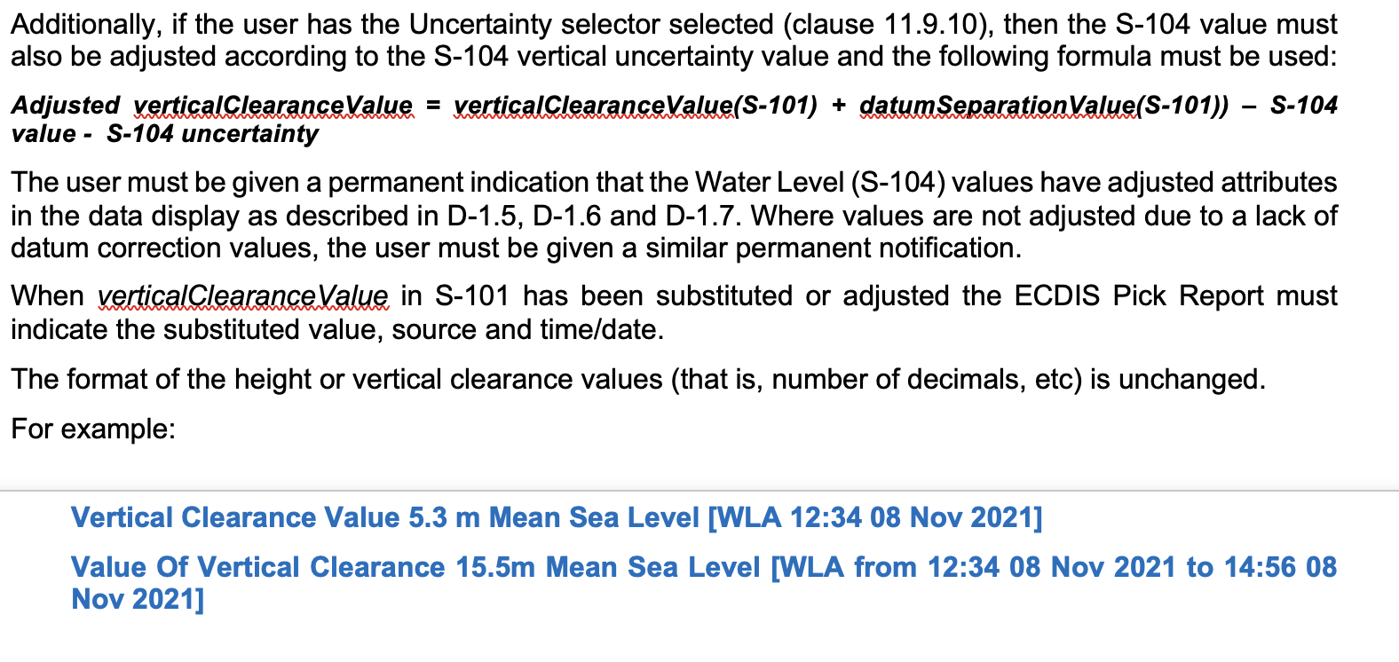

Slide 12
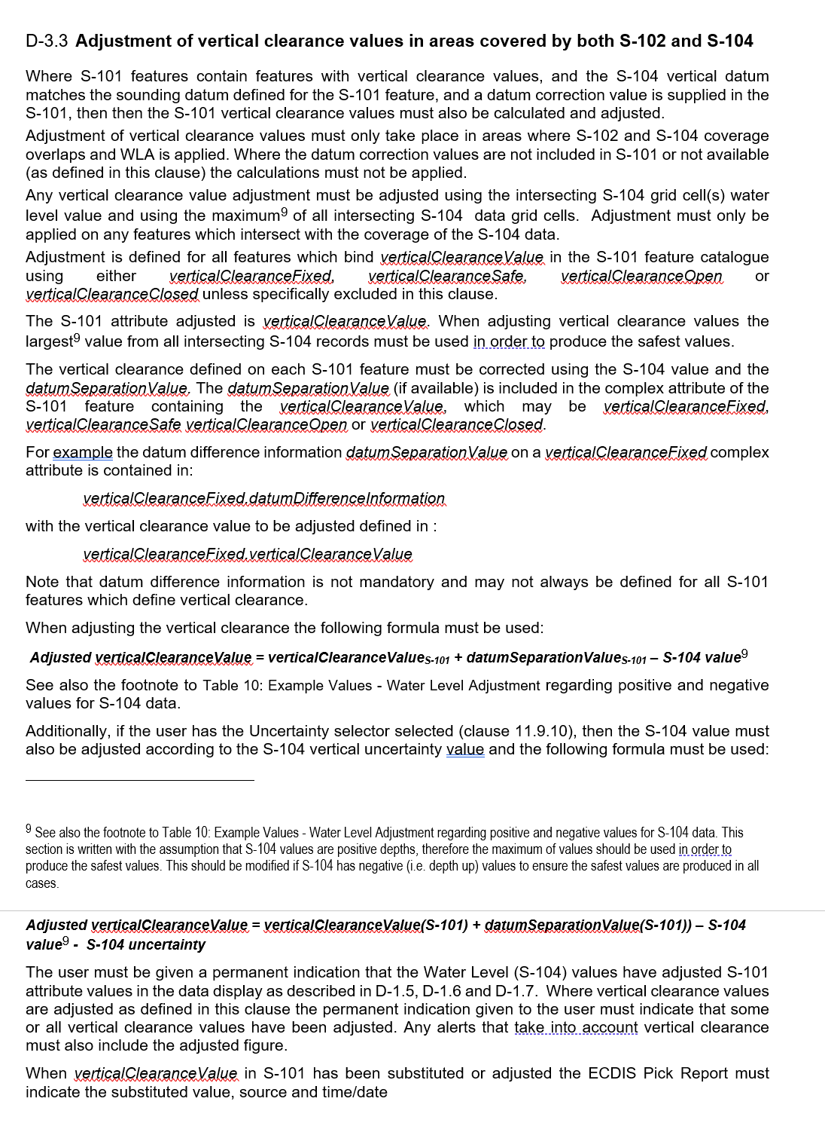

Slide 13
HSSC Update
Adjudicated comments are available in the Github repository
HSSC will consider both S-98 and S-164 for approval
Further meetings will consider refinements and any corrections necessary
S-98 Annex A (Data Constraints) will be numbered and versioned separately so it can be updated and changed as required in order to meet the requirements defined in S-98 and expressed through S-164
LOTS of updates to Annex A are required (already), mainly due to the TSM discussions, and the expectation it will continue to be updated. These will be processed once HSSC is over.
First meeting late June 2026

Slide 14
S-164 update
S-164 will continue to be updated through a process of clarification post-HSSC. It’s likely most of this PT work will be S-164 based from HSSC onwards.
Already changes and updates to be inserted, along with a general re-organisation of the test datasets reflecting the tests.
This is best done with implementers defining tests and changes for tests which reflect the requirements in S-98. Now S-98 is (hopefully) stable this should be a strictly controlled process.
The existing manual is being updated again with tests to reflect the TSM changes, and to run-through and create screenshots where they are currently deficient
Help with screenshots gratefully received from KHOA at TSM (ongoing)
IIC Exchange set builder to build renewed exchange sets for S-164. Testing over Summer 2026.
F2F Oct 2026?

