Slide 1
S-98 / S-164 Meeting
9th July 2026

Slide 2
Agenda Items
S-98
Readout from HSSC
Outstanding items
TWCWG corrections
Others?
Way forward
Data Constraints Annex updates
First candidates
S-164
Split into parts
New Exchange Sets
Gap analysis

Slide 3
HSSC Readout
S-98 3.0.0 Rev 2 endorsed
Contains S-124 edits
S-164 2.0.0 endorsed
Both can be refined, we can not change the requirements of S-98 but we can clarify their wording
S-164 can be refined within the scope of S-98. So, if there are tests which are incorrect, missing or not specific enough they can be changed and added.

Slide 4
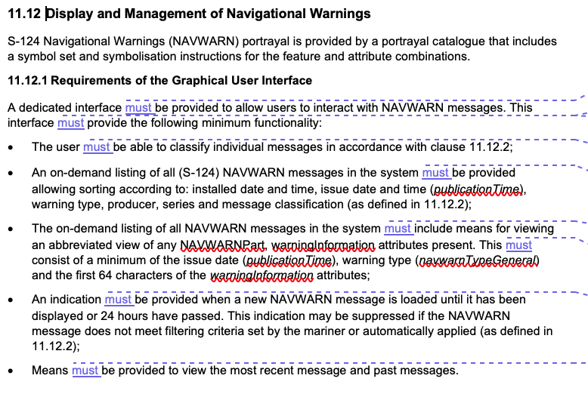
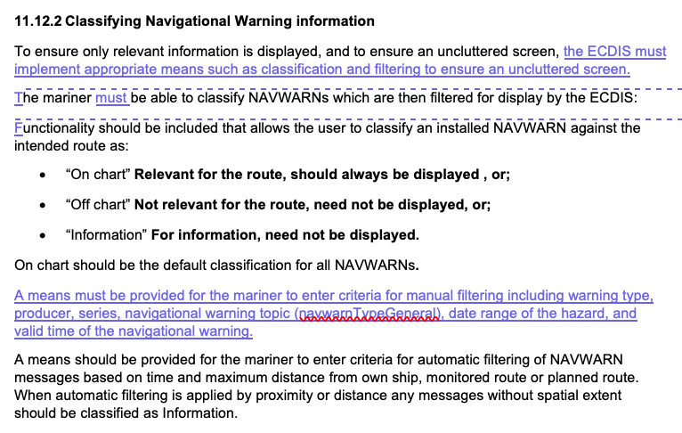
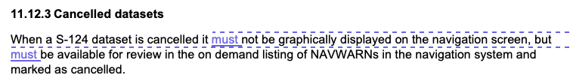
HSSC Rev2 Changes

Slide 5
interoperability
Lots of discussion at HSSC about interoperability, in particular with regard to ESC/WLA and depth substitution.
This will be raised at the upcoming interoperability workshops. Any required clarifications can be brought back to this group
Additionally, any feedback on Appendix D would be much appreciated for those interoperability workshops (December 8-10)

Slide 6
Data constraints Annex
Need to do a fuller review and decide what needs to be added into data constraints post-HSSC review.
I will prepare an initial version but would LOVE some inputs?
Some input already re: signatures and catalog.xml elements.
Next meeting bigger discussion on this topic
Please submit proposals for updates to DCA. We can change it!

Slide 7
TWCWG input for Section 13.2 (temporal display)
A discussion (raised by Canada) has highlighted a potential issue with how temporal data is selected for display in ECDIS under S‑98 Section 13.2, which currently specifies that the closest preceding value must be displayed for time‑varying data.
This results in a “past‑biased” display, where values remain fixed until the next timestamp is reached.
For S‑111 currents (e.g. hourly data), this means the display effectively reflects earlier conditions rather than a temporally balanced representation.
Canada have suggested a time‑centred approach (e.g. ±30 minutes for hourly data) would provide a more accurate and unbiased representation of the underlying time series.
The existing approach may systematically misrepresent magnitude and timing, particularly around peaks, slack water, and reversals.
S‑104 appears to apply a different (effectively conservative/shoal‑biased) logic, rather than strictly following the S‑98 “preceding value” rule.
Future environmental products (e.g. waves, winds) could inherit the same issue if aligned with the current S‑98 approach.
Is the “preceding value” rule in S‑98 intentional as a universal approach, or should S‑98 allow (or be clarified to allow) time‑centred or product‑specific temporal selection methods where more appropriate?

Slide 8
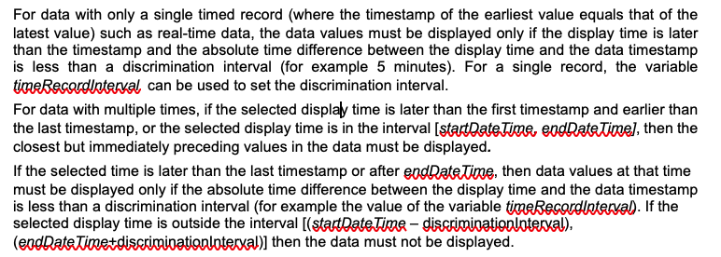
TWCWG inputs
data timestamp
startDateTime
endDateTime
<= discrimination interval
(timeRecordInterval)
System Time
System Time

Slide 9
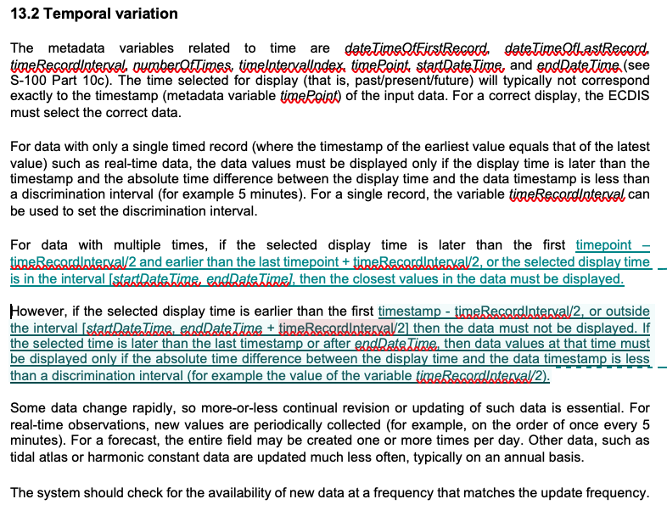
TWCWG inputs
…following up on this Canadian redline proposal for the text at Clause 13.2 in S-98…if it was acceptable and could be incorporated?
Additionally, can you confirm if S-98 Clause 13.2 applies to both S-104 & S-111 (I think it does).
startDateTime
endDateTime
x
y
min(x,y)
System Time

Slide 10
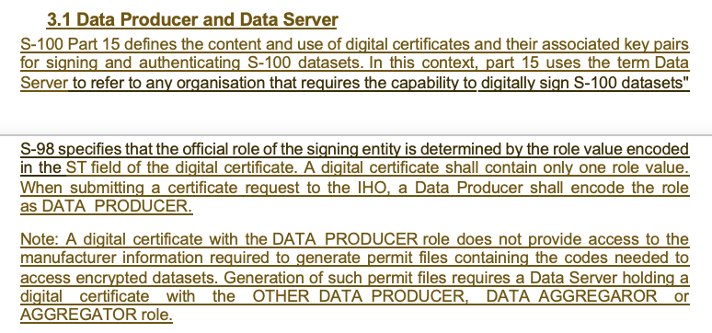
Certificates and Signing
IHO is publishing documentation for those joining the IHO data protection scheme
Data Producer guidance notes (draft) shown

Slide 11
Who is who?
SA
OEMs – get issued an M_ID/M_KEY
Don’t sign data
Data Servers, apply encryption
Need all M_ID/M_KEYs
Don’t sign data
Sign CATALOG.XML
+ make S-128
Data Server
Need certificate
OEM
Data Producer
User
Make and Sign data

Slide 12
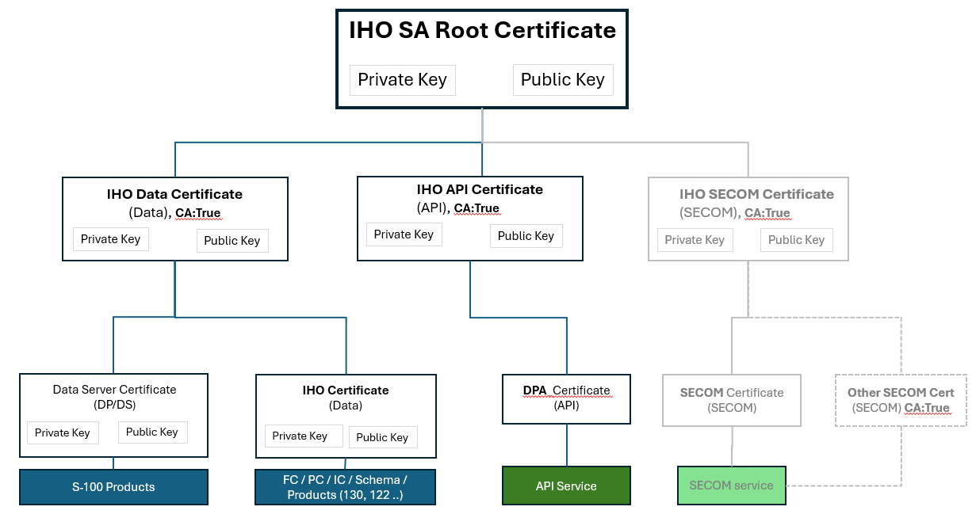
IHO Sec paper on intermediate CA arrangements

Slide 13
Anything else on S-98?
Features that extend beyond the dataset boundaries.
Better test data?
Test data for the loading algorithm
Vertical Clearance
Others?
Existing comments
According to the current approach, loading and unloading are determined based on data coverage. However, there is an additional aspect that needs to be considered—symbols such as lights that extend beyond the defined data coverage. Since these features may lie outside the coverage boundary, it becomes difficult to implement the loading/unloading logic solely based on data coverage.
As a result, it seems that a strict implementation following only the S-98 loading/unloading algorithm may not fully address this case. While it is certainly possible for manufacturers to extend the algorithm to handle such scenarios, doing so would effectively require modifying or augmenting the S-98 logic.
In this context, I was wondering whether it would be appropriate to introduce an additional concept—something like an extended or “effective” data coverage for drawing purposes. This could allow implementations to remain aligned with the S-100 Exchange Set data coverage while still properly handling features that visually extend beyond it.

Slide 14
S-164
S-164 test datasets require clarification
S-164 manual will need expansion (within scope of S-98) and changes to reflect corrections, latest additions to S-98 and clarifications of tests
We are going to split S-164 up into Parts (like S-100), probably 9 individual sections
We may go down the metanorma route for its update if the table structure can be replicated
First new exchange sets being produced now. Include complete Part 17 and Part 15 structures and new keys/certificates
New requirements in S-164 from S-98 will be created
S-124 refinements
Vertical clearance adjustment
Layer permissions (ESC/WLA)
etc…
Initial Gap analysis being performed on existing S-164 datasets
Then S-98 requirements vs S-164.

Slide 15
Re-organisation of S-164-Subgroup repo?
Currently we have Staging area but need to migrate raw datasets to exchange sets
Exchange set area could be :
List of named exchange sets; or
List of S-164 Sections, with exchange sets they require (requires duplication)
Zip + datasets or just datasets (or just zip)?

Slide 16
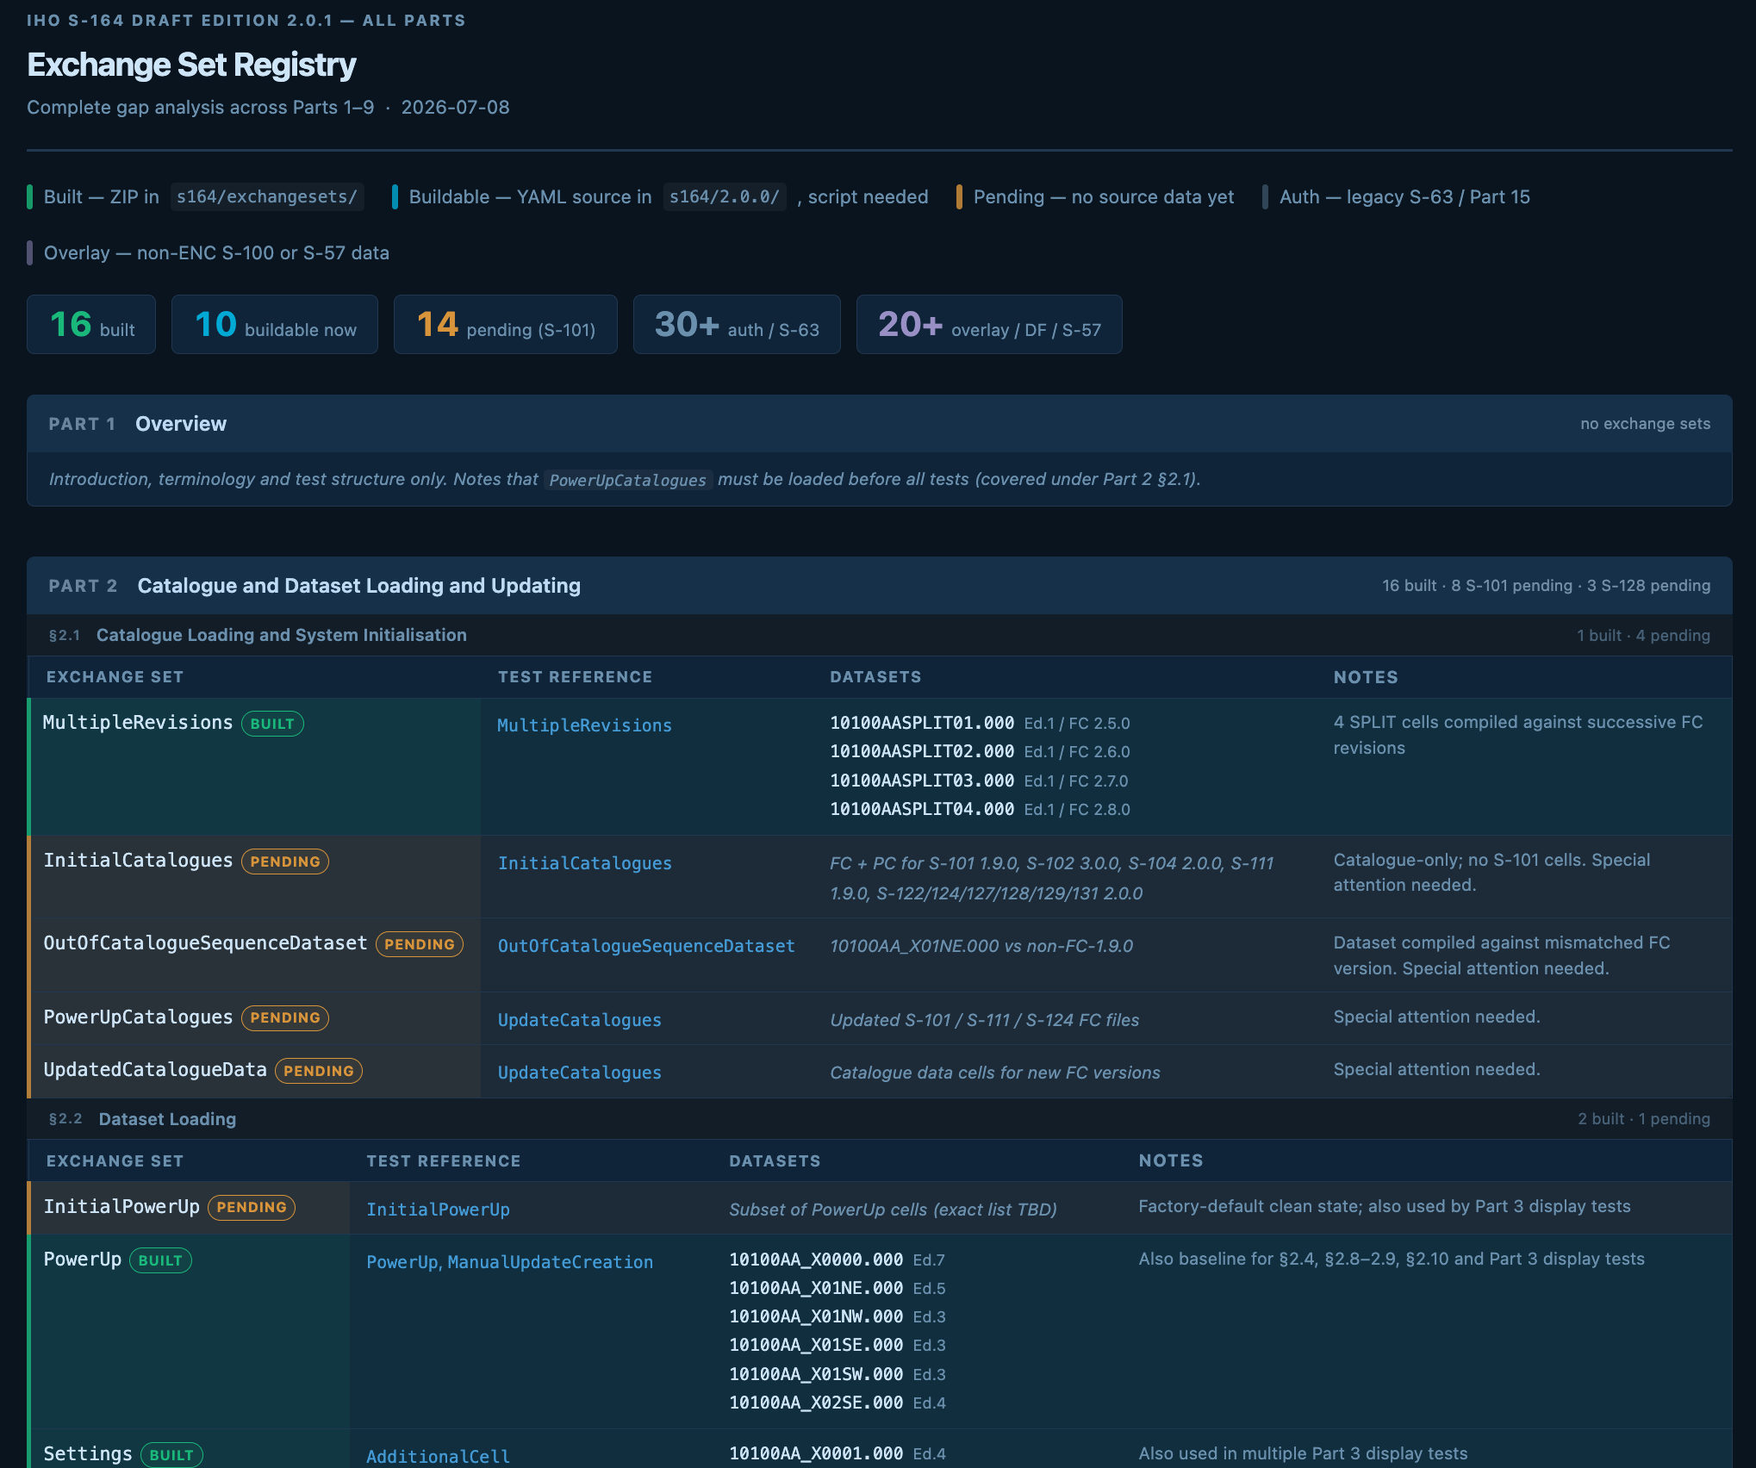
We can get the AI to summarise between the documents and the exchange sets.
Is a “dashboard-y” thing useful?

Slide 17
AOB? Q&A?
Next Meeting – mid August
Objectives
Gap Analysis
Timetable for completion of datasets
Cross-reference between S-98 and S-164
Support for implementers…
Interoperability inputs for workshop
Questions?

