Slide 1
Agenda – Let’s try to cover…
interoperabilityIdentifier encoding and mechanism
  Behaviour of interoperabilityIdentifier on ECDIS, the “Bridge Problem”
  Multiplicity of interoperabilityIdentifier, the “Multiplicity Problem”
  Likely encoding scenarios based on the product specifications we know about now
MRN Format:
  Survey of what has been proposed and what is agreed
  Good ways forward?
What will help most?
  More generic benefits for hydrographic offices…

Slide 3
S-101
ENC₁
S-101
ENC₂
association
c
Viewport
b
Bridge
pick
a
d
association

Slide 4
Interoperability Identifier is ECDIS functionality. It is a “join field” – it says which features you want to be grouped together when one of them is picked by the pick report. How does it work when you want the NW information to be returned when the user picks a component of the bridge?
S-101
ENC₁
S-101
ENC₂
S-124
e
association
c
Viewport
b
Bridge
pick
a
d
association
What happens when you do a pick report?
Which features do you get information for [a-e]?

Slide 5
S-101
ENC₁
S-101
ENC₂
Viewport
Spatial₁
pick
Spatial₂
foid=1810:238975:35
foid=1810:238975:35
What happens when you do a pick report?
Is the whole feature highlighted? Are the attributes merged (although they should be the same?)

Slide 6
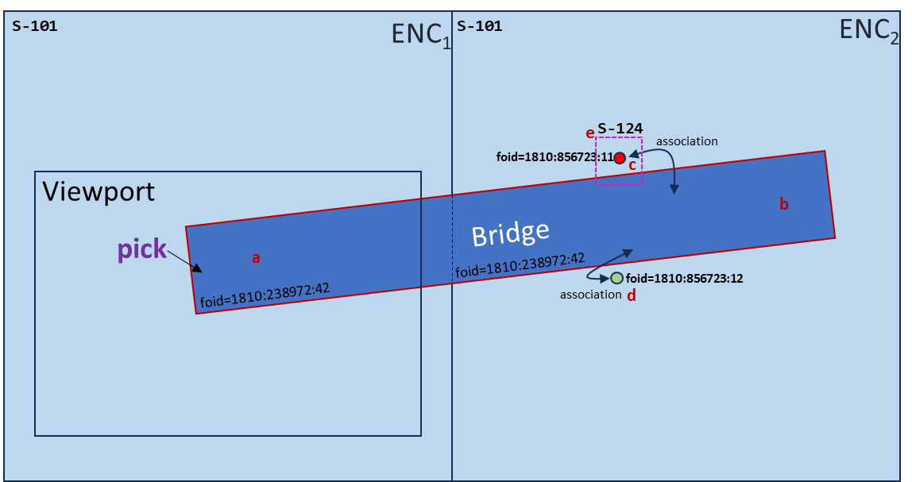
We are trying to do 2 different things:
  Identify features (interoperabilityIdentifer does this)
  Associate between features in different PS, as well as in different datasets (the same PS)
So, interoperablityIdentifier identifies “features”
featureReference.interoperabilityIdentifier contains a reference to “other” identifiers in some product specifications (not all)
The ECDIS must return (in the pick report)
  All features with identical interoperabilityIdentifiers
  Any feature which has a feature reference containing the interoperabilityIdentifier of the picked feature.
There can be multiple feature references in S-124
How can you associate between different datasets (same PS) Using common foid?

Slide 7
So: Features with common foids in the viewport should be merged together for the pick report?
S-101
ENC₁
S-101
ENC₂
association
c
Viewport
b
Bridge
pick
a
foid=1810:238972:42
foid=1810:238972:42
d
association
What happens when you do a pick report (a)?
Feature picked
Common foid
Associated with (b)
Associated with (b)

Slide 8
S-124 NavwarnPart (e):
{
featureReference.interoperabilityIdentifier =urn:mrn:iho:DK00:00365:856723:11
featureReference.interoperabilityIdentifier =urn:mrn:iho:DK00:00365:238973:42
}
S-101 AllRoundLight (c):
{
II=urn:mrn:iho:DK00:00365:238973:42
}
S-101
ENC₁
S-101
ENC₂
Pick Report must return attributes from:
Bridge at picked position
Because foid_{a} = foid_{b}
Because (b) is associated with (c)
Because (b) is associated with (d)
Because II (Bridge) = referenced II (S-124 Navwarn Part)
S-124
e
association
foid=1810:856723:11
c
Viewport
b
Bridge
pick
a
foid=1810:238972:42
foid=1810:856723:12
foid=1810:238972:42
d
association
S-101 Bridge (a) and (b):
{
II=urn:mrn:iho:DK00:00365:856723:11
}

Slide 10
Ex : Light=II1, bridge=II2, bridge.featureReference.intId=II1 and bridge(ENC1) = II2 = bridge(ENC2)
We are trying to do 2 different things:
  Identify features (II does this)
  Associate between features in different PS, and in different datasets (the same PS)
So, interoperablityIdentifier identifies “features”
featureReference.interoperabilityIdentifier contains a reference to “other” identifiers
The ECDIS returns (in the pick report)
  All features with identical interoperabilityIdentifiers
  Any feature which has a feature reference containing the interoperabilityIdentifier of the picked feature.
Can you have multiple II?
How can you associate between different datasets (same PS)?

Slide 11
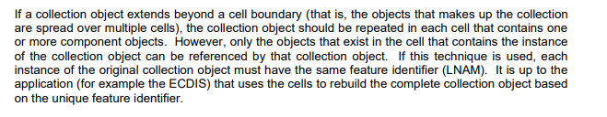

S-101
ENC₁
S-101
ENC₂
Viewport
Spatial₁
pick
Spatial₂
foid=1810:238975:35
foid=1810:238975:35

Slide 12
Ex : Light=II1, bridge=II2, bridge.featureReference.intId=II1 and bridge(ENC1) = II2 = bridge(ENC2)
We are trying to do 2 different things:
  Identify features (II does this)
  Associate between features in different PS, and in different datasets (the same PS)
So, interoperablityIdentifier identifies “features”
featureReference.interoperabilityIdentifier contains a reference to “other” identifiers
ECDIS functionality: For all features picked, also return:
  All features with identical interoperabilityIdentifier values
  Any feature, in any dataset, which has a featureReference complex attribute with a sub-attribute interoperabilityIdentifier value equal to the interoperabilityIdentifier value of the picked feature.
Can you have multiple II?
How can you associate between different datasets (same PS)?

Slide 13
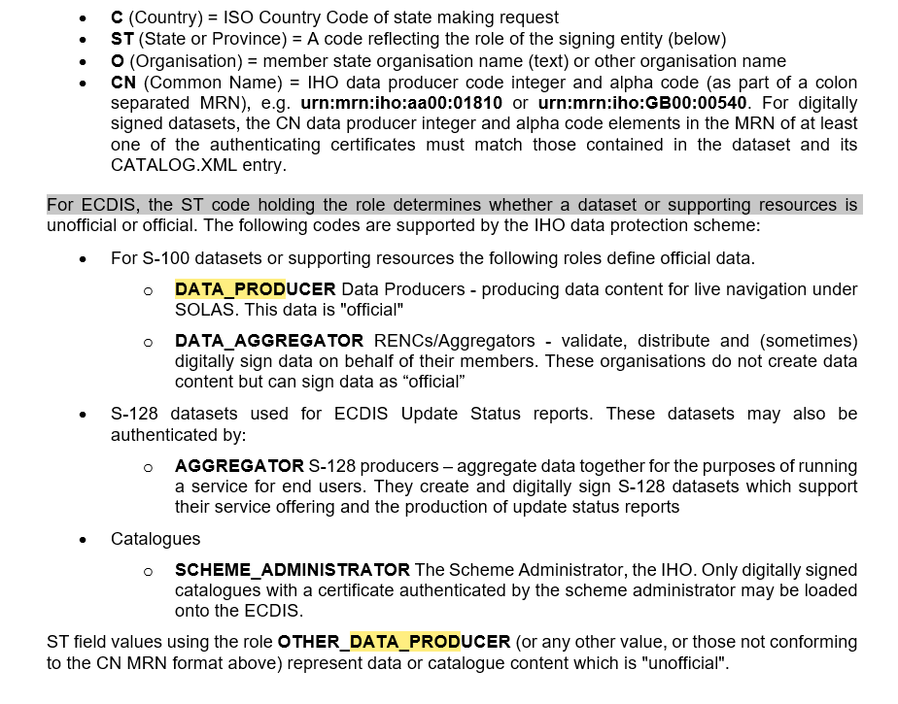
urn:mrn:iho:[CC (optional)]:[PC]:[xxxxx]
IHO
ISO3166
urn:mrn:iho:pub:
urn:mrn:iho:aggr:[org code]:[xxxxx]

Slide 14
What happens when you do a pick report?
S-101
ENC
S-122 MarineProtectedArea:
{
II=urn:mrn:iho:DK00:00365:856723:11
}
Viewport
S-122
Restricted Area
pick
Pick Report must return attributes from:
S-101 Restricted Area
S-122 Marine Protected Area
Any Information Types referred to by either the S-101 or the S-122 features
Pick Report can always return features from all layers because it’s a spatial query. When features aren’t coincident but the producer wants the information to be available, interoperabilityIdentifier can be used to join them together.
S-101 RestrictedArea:
{
II=urn:mrn:iho:DK00:00365:856723:11
}

Slide 15
S-124 NavwarnPart:
{
II=urn:mrn:iho:DK00:00365:856723:11
}
S-131 WaterwayArea:
{
II=urn:mrn:iho:DK00:00365:856723:11
}
S-101
ENC₁
S-101
ENC₂
S-131
S-124
Viewport
Bridge
pick
S-101 Bridge:
{
II=urn:mrn:iho:DK00:00365:856723:11
}

Slide 16
S-101
ENC₁
S-101
ENC₂
Viewport
Spatial₁
pick
Spatial₂
foid=1810:238975:35
foid=1810:238975:35

Slide 17
The multiplicity problem
Interoperability Identifier is ECDIS functionality. It is a “join field” – it says which features you want to be grouped together when one of them is picked by the pick report.
Either
  [1] Every feature has a value for interoperabilityIdentifier
OR
  [2] The interoperabilityIdentifier is only defined on features on which you want the pick report functionality to operate
But, if the primary use case of Interoperability Identifier is for MSI-like applications, between an ENC and another layer (e.g. S-124), then where you can’t change the underlying ENC as well, all potential “join” features in the ENC must have pre-existing interoperabilityIdentifiers as well.
So, are the interoperabilityIdentifiers actually the MRNs of the features themselves? In S-101, in S-124? In general? Or is it up to the data producer to encode in the way that makes sense to them. But we need to prepare the OEM for likely use cases.
It is likely that either S-124 or S-101 (perhaps both) will need interoperabilityIdentifier to have multiplicity > 1 but we need to model the scenarios first…

Slide 18





II are unique identifiers.
II=Goat₂
II=Sheep₃
II=Sheep₁
II=Goat₁
S-124 Sheep
II=Sheep₂

Slide 19
II represent groups of features
II=Red
II=Red
II=Blue
II=Blue
S-124 Sheep
II=Blue

Slide 20
When interoperabilityIdentifier is an actual identifier then you just list in the S-124 which features you want to join it to. If S-124 has multiplicity > 1, then you can join multiple features in pick report.
II=Goat₂
II=Sheep₃
II=Sheep₁
II=Goat₁
S-124 Sheep
II=Sheep₁,Sheep₂
II=Sheep₂

Slide 21
II=Red,Goat
II=Red,Sheep
II=Red,Sheep
II=Blue,Sheep
II=Blue,Goat
S-124 Sheep
II=Red
II=Blue,Sheep

Slide 22
II=Red,Goat
II=Red,Sheep
II=Red,Sheep
II=Blue,Sheep
II=Blue,Goat
S-124 Sheep
II=Sheep
II=Blue,Sheep

