Slide 1
S-98 Meeting 5th March 2026

Slide 2
Agenda
Introductions
S-98
Review Copy v2.6.0 Production
Timeline update
Comment Adjudication – textual / general comments
Comment Adjudication – selected topics 1
S-164 Update
AOB
Meeting Update

Slide 3
Comment Adjudication process
Hopefully we can agree many of the textual comments here
Then some more substantive comments which may require some discussion
Next week will focus on more substantive comments
Does anyone have anything from their comments they want to discuss here and now, or which they specifically would like to discuss at next week’s meeting?
TSM is an opportunity to debate some of the more complex topics. Input from these meetings will inform those sessions.

Slide 4
Comment Adjudication
Can we agree certain classes of comments (appear frequently in consolidated comments)
“MSC 530(106)” should be “MSC 530(106)/Rev.1” throughout document
“IMO Performance Standards” or “IMO Performance Standard”
Should we reference S-100 5.2.1, not 5.2.0 (or 5.2?)
Scales (MSVS and Scale values) are “1:XX 000”, not 1/XX,000 (or other)
“Alerts and Indications Catalogue(s)” not “Alert and Indication Catalogue(s)”
Bulleted lists have semicolons after each item, and a full stop at the end?
Cross-references to be corrected within document
Get rid of all double spaces
Is it “clause” or “section” (or both?)
Does WMO publish S-411,S-412 or is it IHO/WMO?

Slide 5
Comment Adjudication – Selected topics
IMO resolution MSC.191(79) cannot reference MSC.1/Circ.1609
Is 2 or 4 shades a requirement (is it done by portrayal? Is 4 shades optional?)
Positive down depths in S-104 – alteration to expression in document.
SCAMIN behaviour – requirement to provide an indication. Also, is there a need to provide a requirement to implement SCAMIN on/off?
IMS = Independent Mariner Selections – include their definition (informative)
Use of fileLocator – needs a requirement? I believe this was dropped in a previous version (also, see HTML support) [NTOU]
When are Navwarnings published? Is it the publishedDate (and, optionally publishedTime) from the dataset, or the issueDate and optional issueTime within the CATALOG.XML?
Date Formats (unclear if it’s “DD-MMM-YYY” or “DD MMM YYYY” ? Also, can ISO8601 be used (optionally instead)? Has been considered before.

Slide 6
And (maybe for next meeting)
Safety Contour drawing of ESC at dataset borders - OSI
SHOM – Using S-102/S-104 at multiple scales
Modifications to GML sections in Data Constraints Annex
S-101 topics
Vertical datum information in S-101 for adjustment
Should there be an indication when you cross CollisionRegulationLimit features.
National High Water and National Low Water Datum

Slide 7
Use of S-102 and S-104 (and overlaps)
Current Appendix D states “S-102 datasets should not overlap”, also that S-104 must not overlap. This is also specified in the Data Constraints annex (but “overlap” isn’t well defined)
Some providers would like to have spatially overlapping S-102 and S-104 so that datasets can be interoperable with ENCs within compatible scale ranges.
Proposals
Only enable ESC/WLA when the MSVS is within the S-102 (and S-104) scale range (defined in the CATALOG.XML).
If the CATALOG.XML contains overlapping scale ranges then the largest maximumDisplayScale dataset must be used and an indication given to the user.
If values are not set in the CATALOG.XML (and they would be mandated in the data constraints annex) then the OEM would require the user to specify which datasets to use in the ESC/WLA operation (as now).
(There would be no requirement on the OEM to “fill in” the display with smaller scale data (as they do with ENCs using the S-98 data selection algorithm).
Additionally S-98 needs to clarify what “overlap” means (specifically the difference between temporal and spatial overlaps)

Slide 8
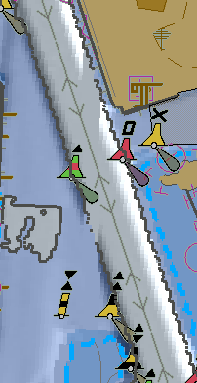
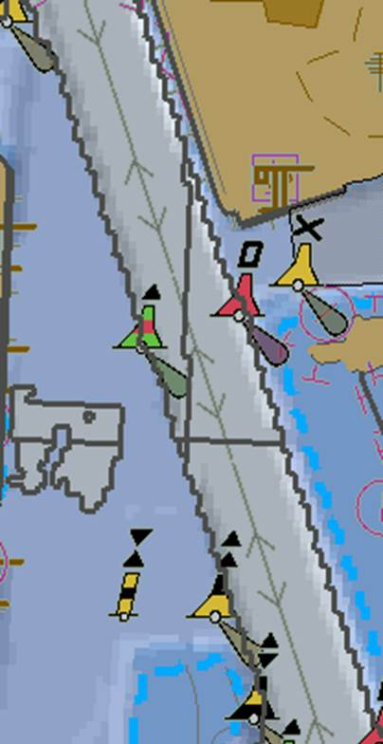
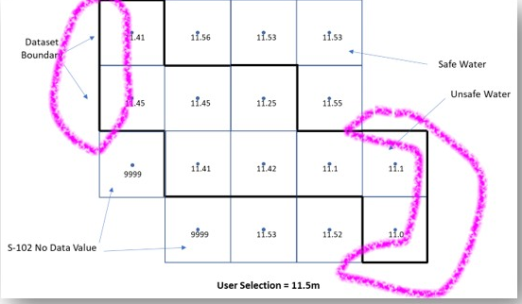
Enhanced Safety contour Issues [OSI]
In the current S-98 Appendix D, the safety contour must be drawn
Where you transition from safe to unsafe water (as defined by the values in the S-102 (+S-104 + uncertainty etc…)
At the edges of the dataset
Between NoData values and Data values.
This leads to a proliferation of safety contours.

Slide 9
Enhanced Safety contour Issues [OSI]
In the current S-98 Appendix D, the safety contour must be drawn
Where you transition from safe to unsafe water (as defined by the values in the S-102 (+S-104 + uncertainty etc…)
At the edges of the dataset
Between NoData values and Data values.
This leads to a proliferation of safety contours.

Slide 10
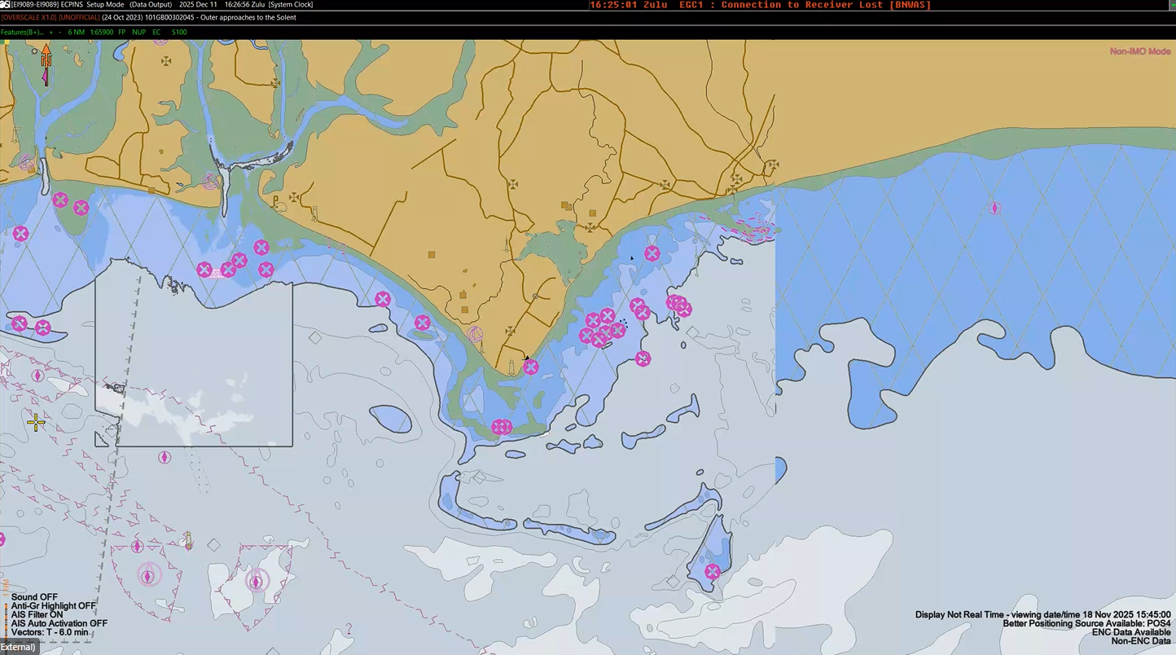

Slide 11
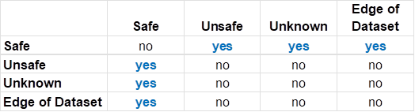
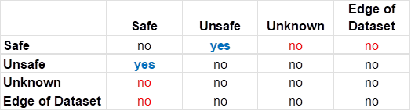

Proposal:
S.C.
Blue Border is drawn around data values only, not the dataset border.
Blue border must therefore be drawn around any region of fill values which are not on the dataset border (i.e holes in the data)
Suppression of the ENC feature(s) must only be done where there are S-102 values, not fill values.
An implementer can optionally suppress the blue border between overlapping datasets
The safety contour is not drawn between
Data and Fill Values – (noting the ECDIS will continue to produce alarms and indications for the ENC features which are exposed by the Fill values)
On the external border of the dataset – (this is consistent with how ENC currently works.)
Current:
Blue Border | Safe | Unsafe | Unknown
Unsafe | No | - | -
Unknown | No | No | -
Edge of dataset | Yes | Yes | No
Proposal:
S.C.

Slide 12
Clarifications needed
It mixes 3 different “concepts of overlap” :
spatial overlap
display scale-based overlap
temporal overlap
leading to uncertainty on whether multiple datasets covering the same area but intended for different display scale ranges and/or temporality are permissible in operational ECDIS use.
Need clarification on what overlap means, proposal :
Spatial overlap between datasets (without a temporal extent) shall be permitted only when their display-scale ranges are mutually exclusive
For any given position and display scale, at most one dataset shall be applicable.
➔ Even if the objective is to achieve “zero conflict,” a normative behaviour is required in case such a situation occurs :
If multiple datasets are applicable due to inconsistent scale metadata, the ECDIS should select the dataset with the largest maximum display scale (i.e., highest intended detail), and should provide an indication to the user.

Slide 13
Change proposal
S-98 20.3 Dataset overlaps and gaps ?
S-98 12.2 Display of non-ENC data layers ?
Equivalently.
Spatial overlap between datasets without a temporal extent shall be permitted only when their display-scale ranges are mutually exclusive.
If multiple datasets are applicable due to inconsistent scale metadata, the ECDIS should select the dataset with the largest maximum display scale (i.e., highest intended detail), and should provide an indication to the user.

Slide 15
Second Adjudication meeting topics [short]
Ambiguous wording Make clear that the settings for WLA may be changed at any time but only be applied in areas where S-101, S-102 and A-104 data is available. | Better The user must be able to select depth information adjustment by water level height. This adjustment must then be applied in areas where S-101, S-102 and S-104 data products are available.
Clarify what to display if the boundary lines for WLA areas and ESC areas are co-located Proposal: WLA area lines have precedence over ESC area lines | Add In cases that the WLA area lines and ESC lines are co-located, only the WLA Area lines must be displayed
Content and type of update status reports (possibly TSM?)

Slide 16
11.10.3 “If the (default 30 m or the selected) safety contour is not available, then the ECDIS should use the next deeper safety contour.” (also other comments)
UNOFFICIAL data. Requirement, examples? Warning on installation?
Graphical indexes need looking at
11.5.1 – what is unofficial data?
Current wording of the note implies that the ‘Value of safety contour’ in the “ECDIS legend’ only needs to display the values for both selected and displayed contour when the displayed contour is 30m (default). This isn’t the intention. Also, this is a requirement, not an informational note. | Reword to ”Note: If the Mariner has selected a contour that is not available in the ENC and the ECDIS displays a default contour, both the contour selected and the contour displayed at the selected position must be displayed quoted”

Slide 17
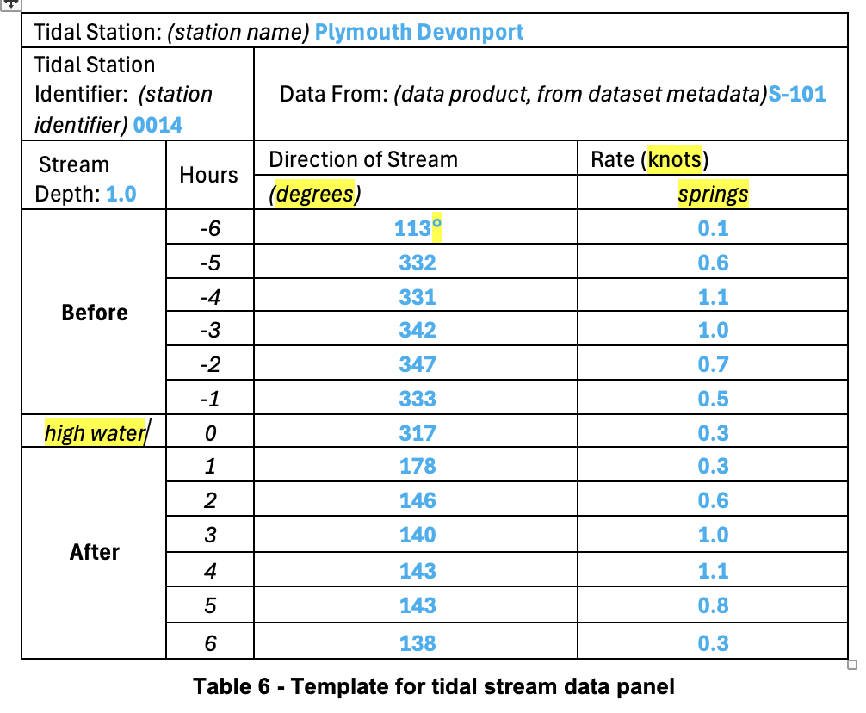
Units in rows, not column headings
Rate, not Rates
High water and springs in blue
Degree symbol
Take out knots and degrees

Slide 18
Other topics
ENDS? What is in Update Status Reports.?
The odd “should” / “shall” is still in the document
Gaps in ENC coverage (from S-52)?
S-124 stuff…
Amendments and Version/Editions in the references list.
Merging light information in pick reports. Proposal
Official / Non-official data. Need to decide how to handle.
Uncertainty calculations (clarify)
How does the ECDIS provide alerts for manual updates.?
Use of symbols vs use of PC for manual updates.

Slide 19
4.2 [DE]
The explanations for “additional layers” are a bit confusing. “Additional information is information that is not contained in the ENC, while enhanced information are layers that contain improved, detailed or higher resolution information than the ENC.” The enhanced information is also not contained in ENC. According to the section of S-100 “16a-4.2.2 Other systems” there is obviously no clear difference in content between additional or enhanced information. | Transfer from S-100?? “Generally, ENC charts form the base layer in a VTMIS and other data sources form layers of additional information or enhanced information to aid the VTMIS operator in monitoring and decision making. Examples of additional layers included radar and AIS for target tracking, …”
The first point refers to the physical chart information. The second point could accordingly refer to the “thematic chart information”. | “thematic chart information, for example traffic routeing; specified areas; cautions; etc.;”

