Slide 1
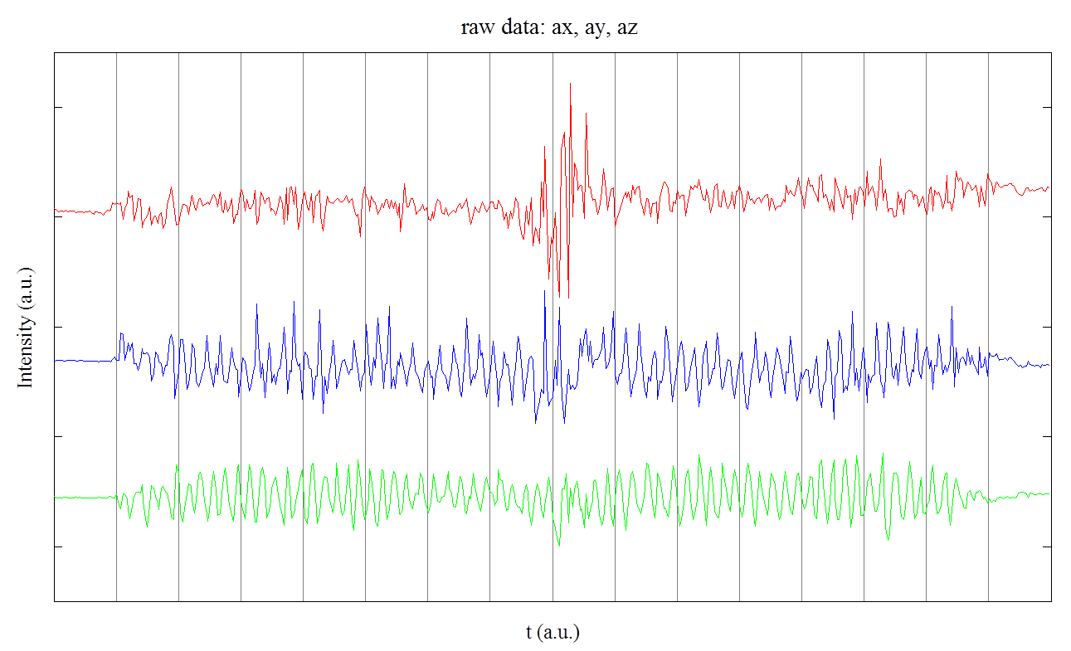
Accelerometer data acquisition and mining
In this dataset* (or probably task in general) accelerometer data is more valuable. Sometimes one component a_{x}/a_{y}/a_{z} is informative enough.
* device mounted on horse’s head.

Slide 2
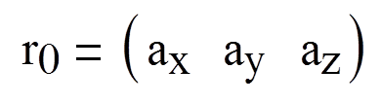
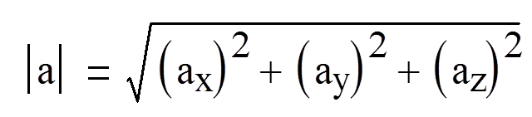
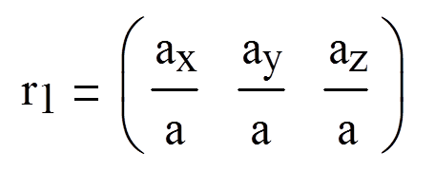
Applying various data transformation (I)
A₀ – matrix of raw accelerometer data.
Let i-th row of A₀:
Let
… and thus get vector V_{A0}. One can use
…and thus get matrix A₁

Slide 3
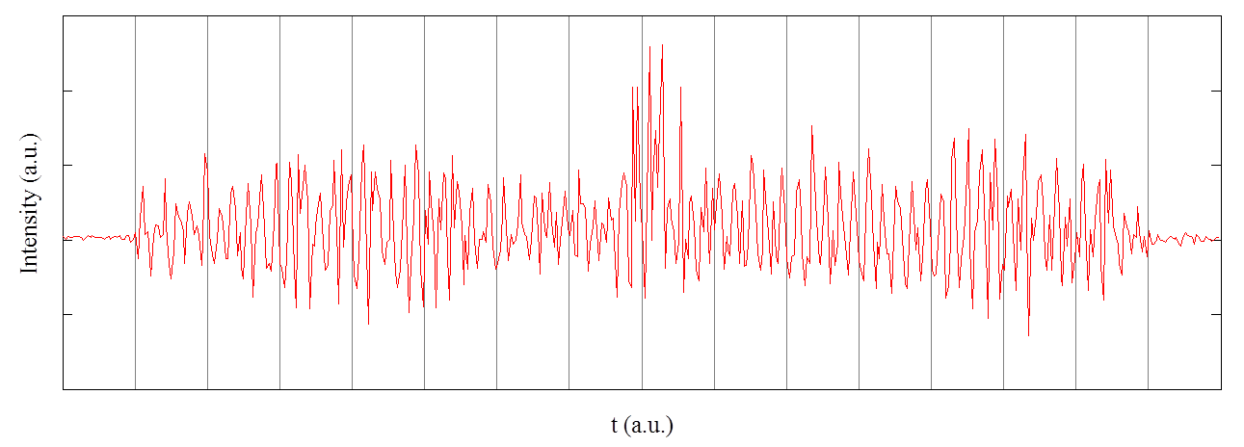
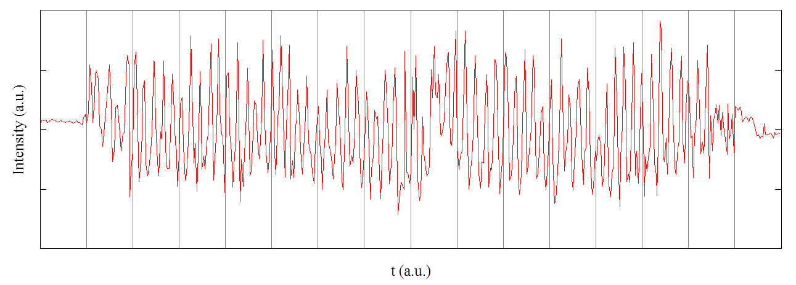
Applying various data transformation (II)
A₂ = PCA(A₁). (Principal component analysis). Observed variance: A₂ X: 65-75%, A₂ Y: 20-30%, A₂ Z: 5%
Sometimes PCA(A₀) also works well
V_{A0}
A₂ X

Slide 4
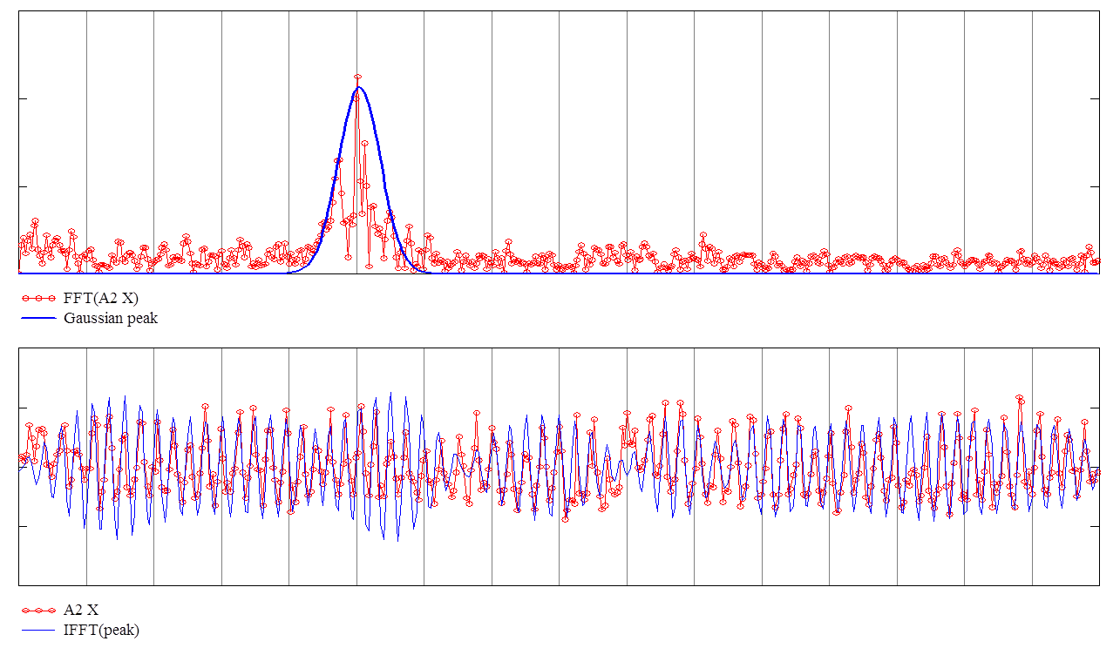
Frequency estimation / signal filtering
Fourier transform of A₂ X (crop, component with most variance)
A₂ X and inverse Fourier transform of peak above
Proven and clean periodicity with stable frequency corresponding to each leg movement. More peaks will gain better precision. Movement identification on various vectors (V_{A0}, A₂ Y, A₀ X etc) for better confidence.

Slide 5
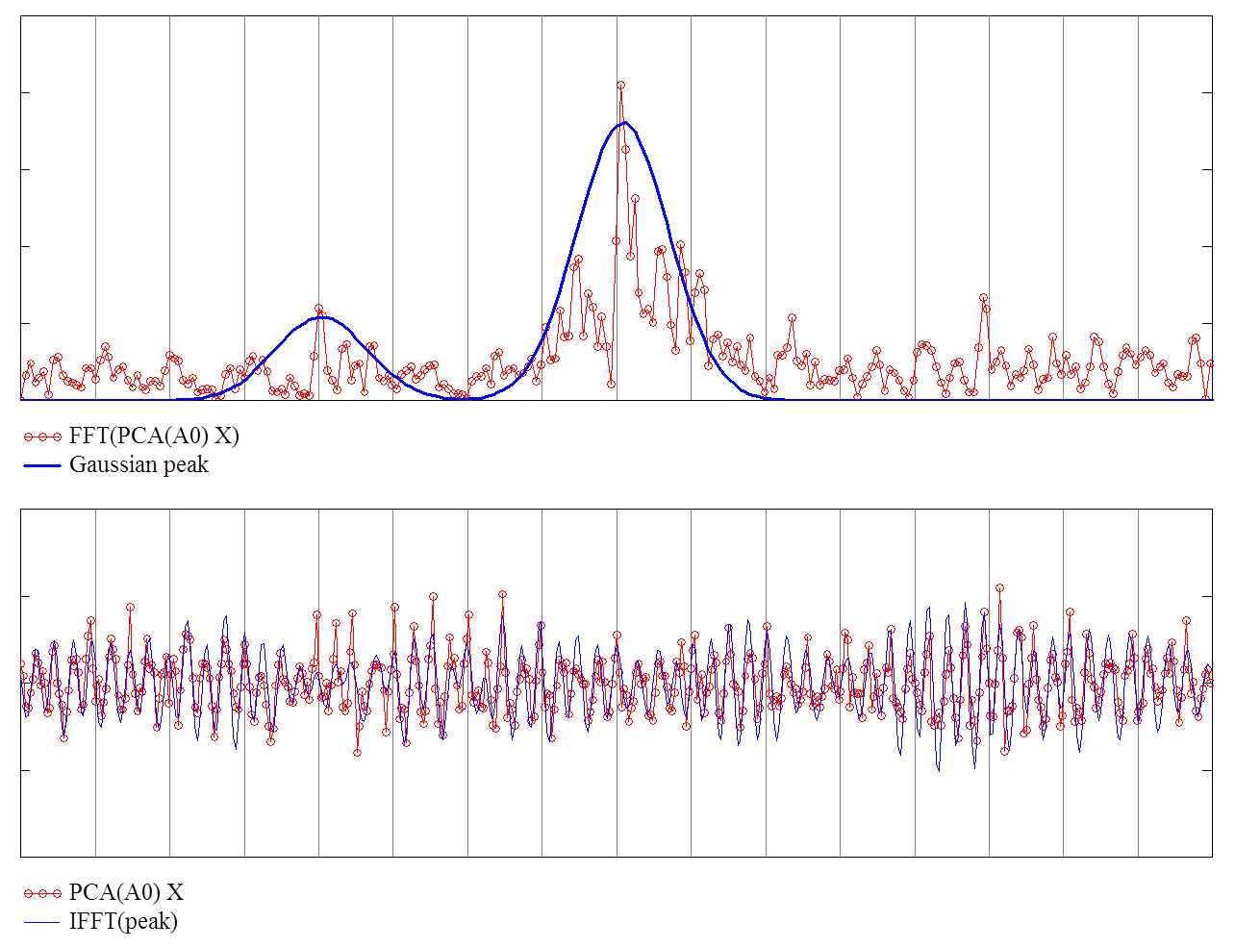
Frequency domain structure*
2v
v
* Other dataset and other movement type

