Slide 1
Granger Causality

Slide 2
Granger Causality
A statistical method to prove causality
Applied to time-series data
Based on prediction
If a signal X "Granger-causes" a signal Y, then past values of X should contain information that helps predict Y above and beyond the information contained in past values of Y alone
Formed as a hypothesis test
H0: A_{i} = 0 for all i = 0 to N
H1: A_{i} != 0 for atleast one i = 0 to N
y_{t} = N ∑ i=0 B_{i}y_{t−i} + N ∑ i=0 A_{i}x_{t−i} + E_{t}(y),
Predicted value of Y
Past value of Y
Past value of X

Slide 3
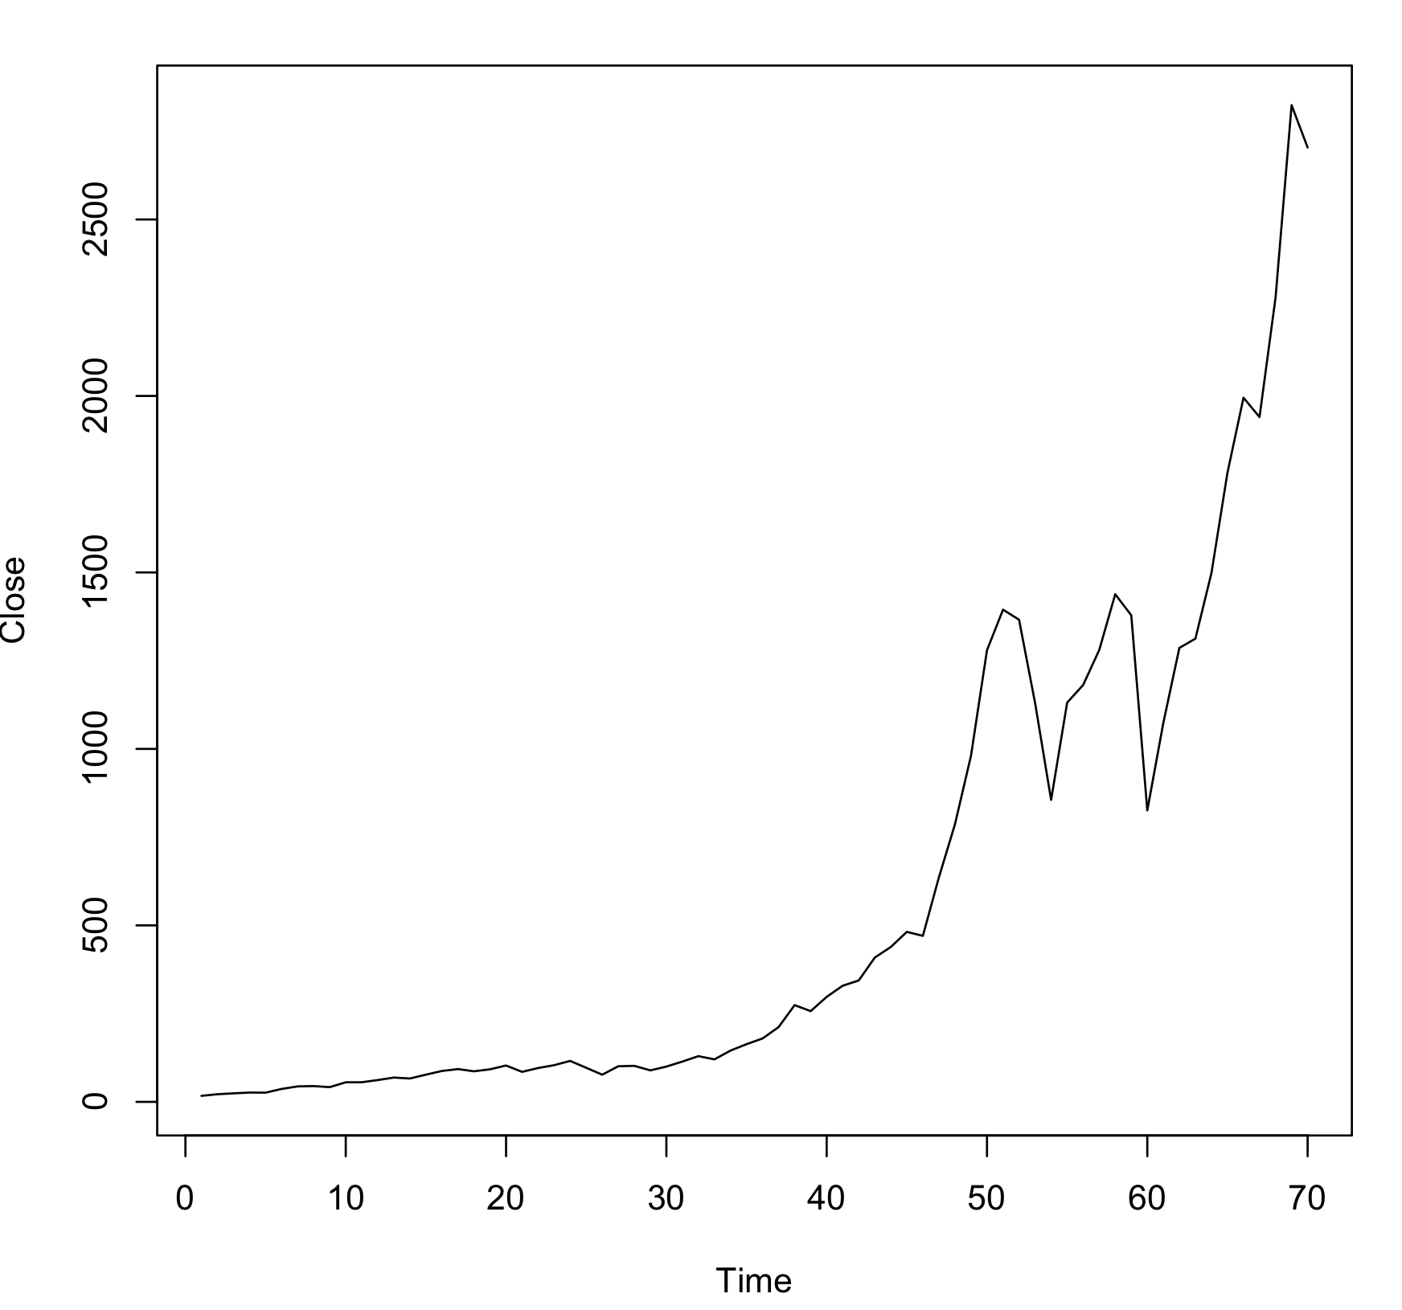
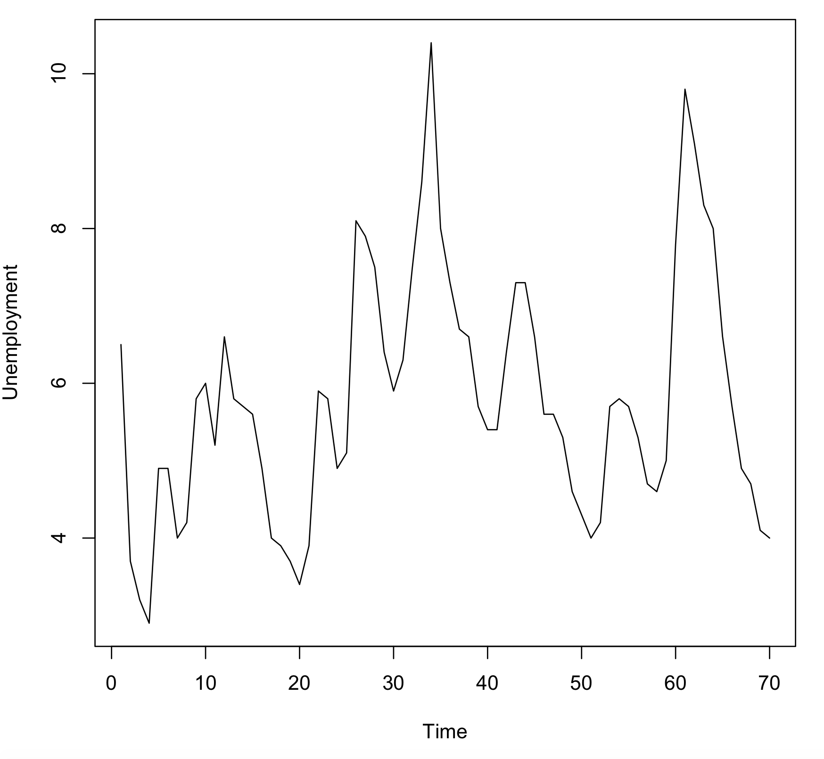
Ex) Hypothesis: S&P500 Index is a Leading Indicator of Unemployment
Data from 1950 – 2019
Modeling done in R using package lmtest

Slide 4
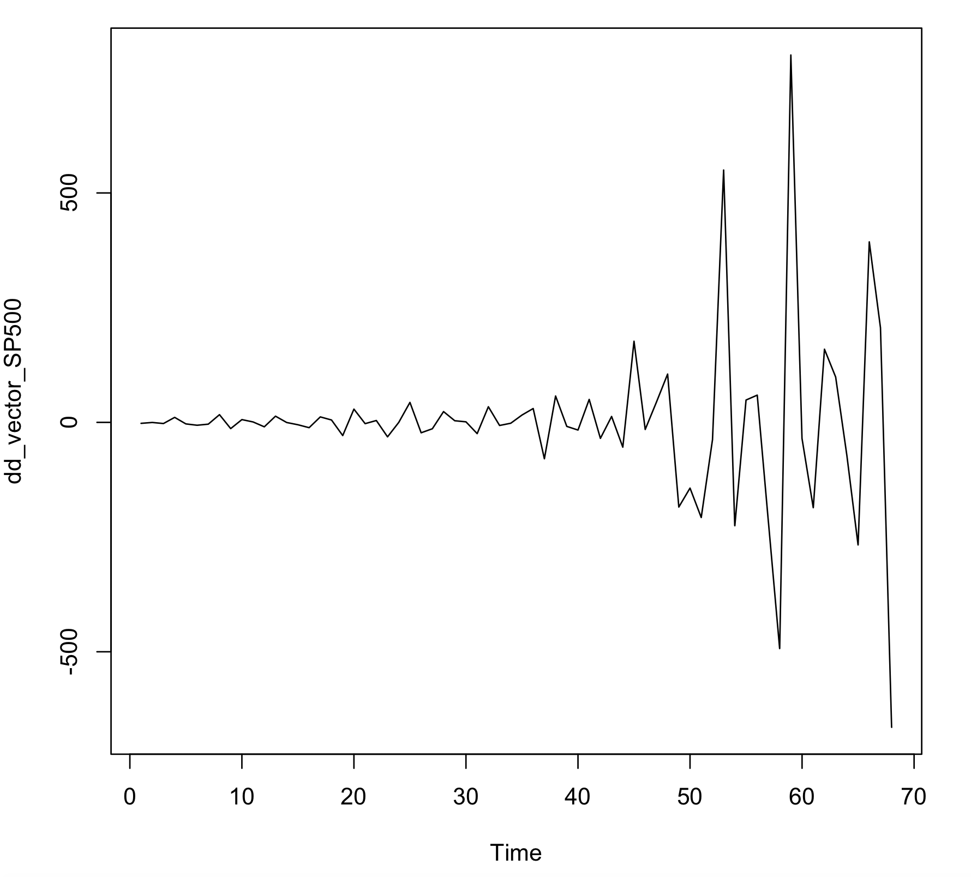
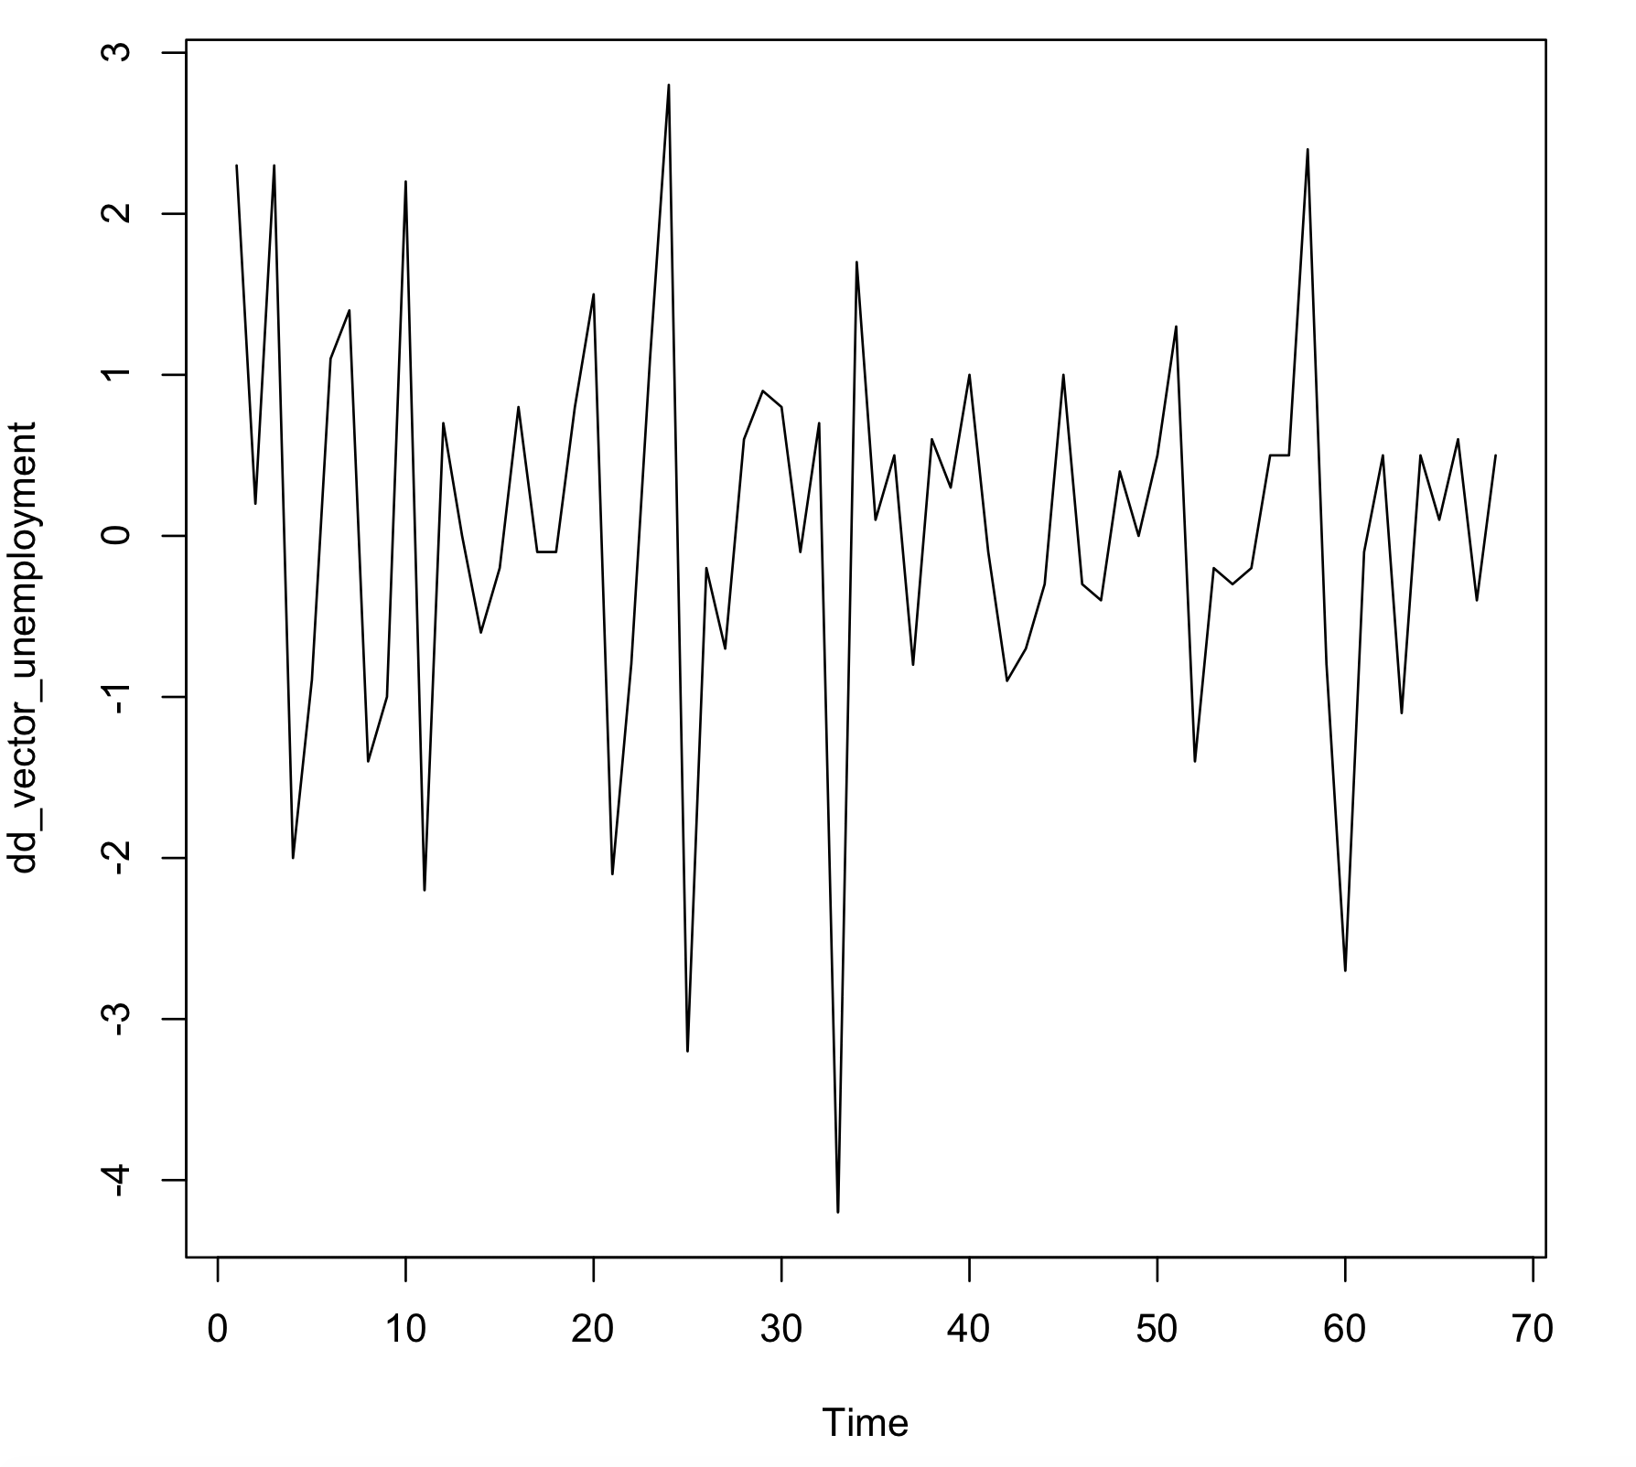
Ex) Analysis Steps
Step1) Apply differencing to make the time-series stationary (constant mean and variance)
Step2) Apply Granger causality test that S&P500 is a leading indicator of Unemployment
Sweep lags from 1-10
If p-value < .05, at the .05 significance level we reject the H0 hypothesis and accept there is a Granger causal relationship
➔ Granger causal relationship found for lag = 1

Slide 5
Ex) Analysis Steps (cont.)
Step3) Run modeling in reverse to make sure the contrary is not true (if it were true that would imply there is another exogeneous variable that is a better Granger candidate)
Granger causality test that Unemployment is a leading indicator of S&P500
Sweep lags from 1-10
If p-value < .05, at the .05 significance level we reject the H0 hypothesis and accept there is a Granger causal relationship
➔ No Granger causal relationship found

Slide 6
Appendix Materials

