Slide 1
PUG. BEM
By Ihor Dubas

Slide 2

PUG
Pug is a HTML preprocessor and template engine that was written in JavaScript for Node.js.

Slide 3



PUG Installation
Package
Command Line
To use Pug in your own JavaScript projects:
After installing the latest version of Node.js, install with:
and run with

Slide 4
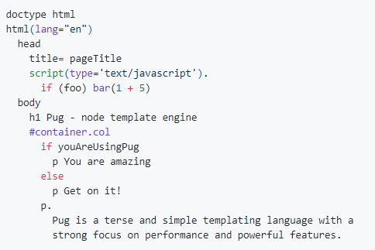
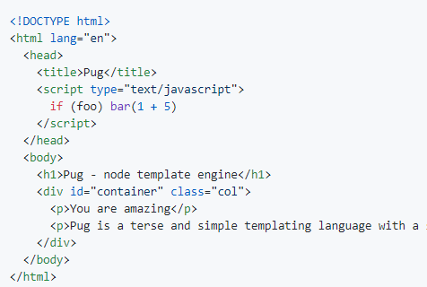
Syntax
Pug is a clean, whitespace sensitive syntax for writing HTML. Here is a simple example:
Pug transforms the above to:

Slide 5
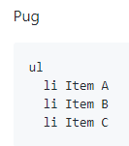
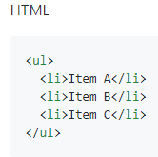
Tags
Pug does not have closing tags, instead it uses strict tabs (or indents) to determine the nesting of tags. To close the tags at the end you need to add the symbol /

Slide 6

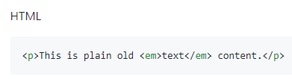
Text
You can insert elements in HTML syntax directly into Pug

Slide 7
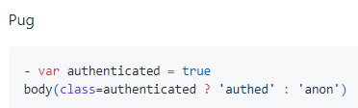
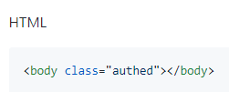
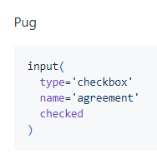
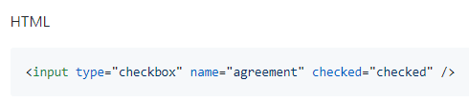
Attributes
You can embed JavaScript code in Pug, so the constructs shown below are possible.

Slide 8
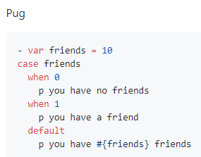
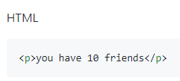
Switch Case
Pug supports a switch case, which is a more visual way to compare an expression with multiple options at once.

Slide 9
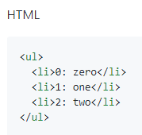
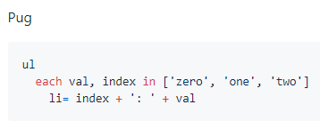
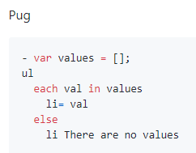
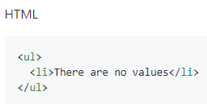
Loops

Slide 10
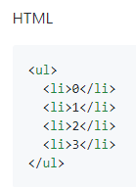
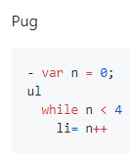
Loops

Slide 11
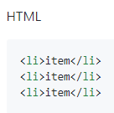
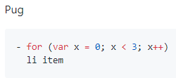
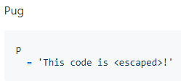

JavaScript code insertion
Pug supports inserting parts of JavaScript code into templates.
Non-buffered code begins with a -
Buffered code begins with a =

Slide 12
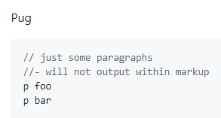
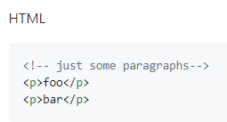
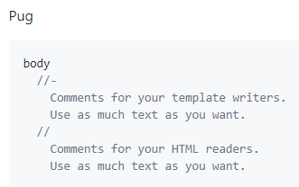
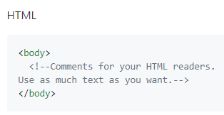
Comments
There are various comments: those that will be displayed after compilation, and those that disappear.

Slide 13
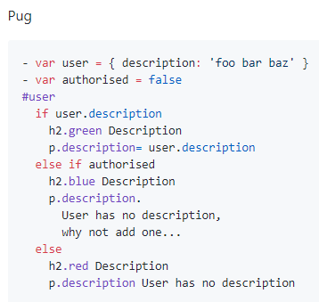
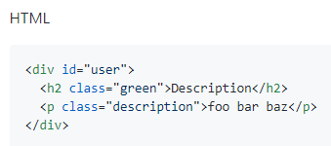
If else statements

Slide 14


Type of document

Slide 15
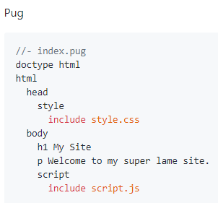
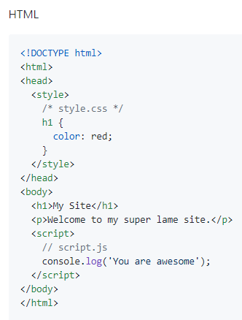
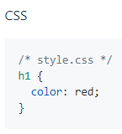
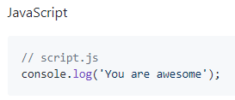
Includes
Pug has the ability to insert the contents of one file into another Pug file.

Slide 16
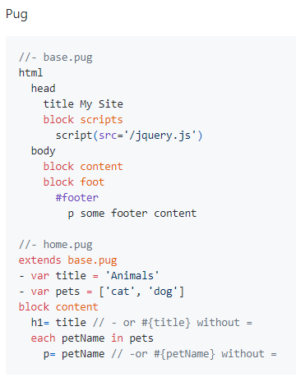
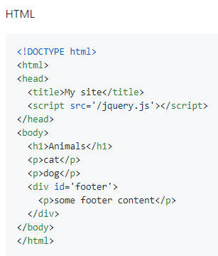
Template Inheritance
Pug supports template inheritance. Template inheritance works through the block and extend keywords. In a block template, a regular Pug block that can replace a child template. This process is recursive.

Slide 17
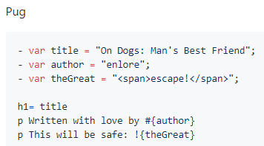
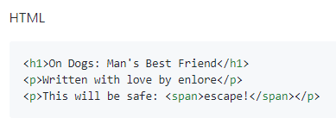
Interpolation of variables
Pug provides various ways to output variables.

Slide 18
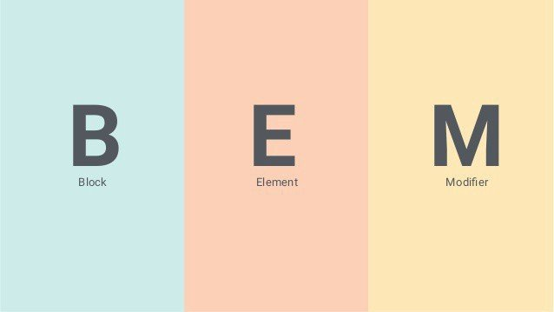
BEM
BEM (Block, Element, Modifier) - component approach to web development. It is based on the principle of dividing an interface into independent blocks. It allows you to easily and quickly develop interfaces of any complexity and reuse existing code, avoiding Copy-Paste.

Slide 19
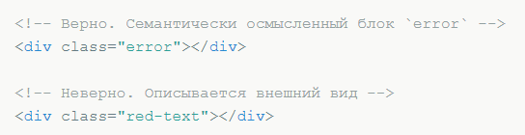
Block
Functionally independent page component that can be reused. In HTML, blocks are represented by the class attribute.
Features:
The name of the block characterizes the meaning (“what is this?” - “menu”: menu, “button”: button), and not the state (“what does it look like?” - “red”: red, “big”: big).
The block should not affect its environment, i.e., the block should not be given external geometry (in the form of indents, borders, affecting dimensions) and positioning.
In BEM CSS, it is also not recommended to use tag selectors or id.

Slide 20
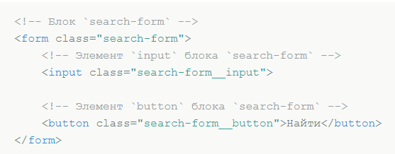
Element
A component of a unit that cannot be used in isolation from it.
Features:
The name of the element characterizes the meaning (“what is this?” - “point”: item, “text”: text), and not the state (“what does it look like?” - “red”: red, “big”: big).
The structure of the full name of the element corresponds to the scheme: block-name__ element-name. The element name is separated from the block name by two underscores (__).

Slide 21
When to create a block, when is an element?
Create block
If a piece of code can be reused and does not depend on the implementation of other components of the page.
Create item
If the code fragment cannot be used independently, without the parent entity (block).
The exception is elements whose implementation, to simplify development, requires separation into smaller parts - sub-elements. In the BEM methodology, you cannot create element elements. In this case, instead of the element, it is necessary to create a service block.

Slide 22
Modifier
An entity that determines the appearance, state, or behavior of a block or element.
Features:
The name of the modifier characterizes the appearance (“what size?”, “What theme?”, Etc. - “size”: size_s, “theme”: theme_islands), state (“how does it differ from others?” - “disabled”: disabled, “focused”: focused) and behavior (“how does it behave?”, “how does it interact with the user?” - “direction”: directions_left-top).
The name of the modifier is separated from the name of the block or element by a single underscore (_).

Slide 23
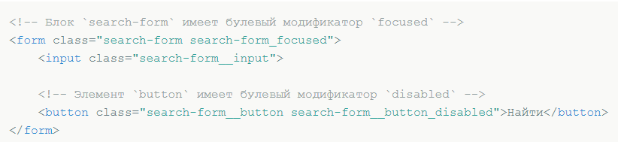
Modifier Types
Boolean
Use when only the presence or absence of a modifier is important, and its value is insignificant. For example, “disabled”: disabled. It is believed that if an entity has a Boolean modifier, its value is true.
The structure of the full name of the modifier corresponds to the scheme:
modifier_name blockname;
block_name__ element_name modifier_name.

Slide 24
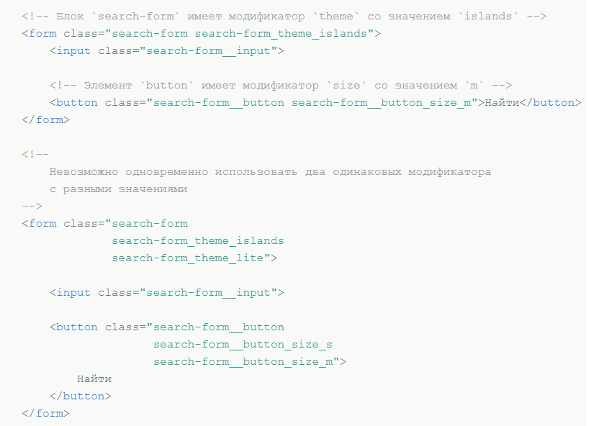
Key value
Used when the value of the modifier is important. For example, “a menu with an island theme”: menu_theme_islands.
The structure of the full name of the modifier corresponds to the scheme:
block_name modifier_name modifier_value;
block_name_item_name modifier_name modifier_value.

Slide 25
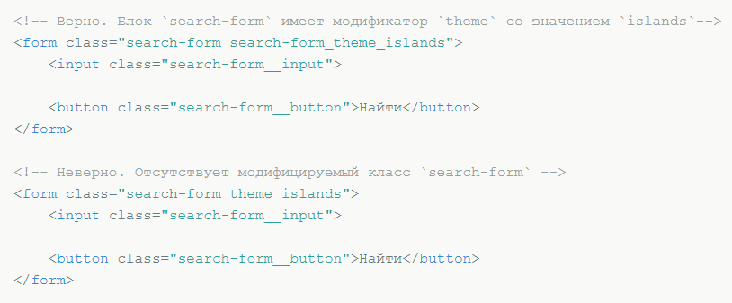
Principles of working with modifiers
Modifier cannot be used on its own
From the point of view of the BEM methodology, the modifier cannot be used in isolation from the block or element being modified. The modifier should change the appearance, behavior or state of the entity, and not replace it.

Slide 26
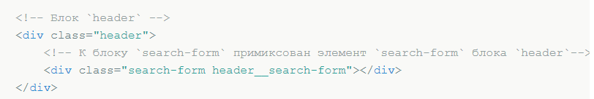
Mix
A technique that allows you to use different BEM entities on the same DOM node.
Mixes allow you to:
combine the behavior and styles of several entities without duplication of code;
create semantically new interface components based on existing ones.

Slide 27
File structure
The component approach adopted in the BEM methodology is also applied to the organization of projects in the file structure.
Features:
One block - one directory.
The names of the block and its directory are the same. For example, the header block is the directory header
The implementation of the block is divided into separate technology files. For example, header.css, header.js.
The block directory is the root for the subdirectories of its corresponding elements and modifiers.
Element directory names begin with a double underscore (__). For example, header / __ logo /.
Modifier directory names begin with a single underscore (_). For example, header / _fixed /.
Implementations of elements and modifiers are divided into separate technology files. For example, header__input.js.

Slide 28
Rules for the formation of names
Names are written in lowercase Latin letters.
A hyphen (-) is used to separate words in names.
A block name defines the namespace for its elements and modifiers.
The element name is separated from the block name by two underscores (__).
The name of the modifier is separated from the name of the block or element by a single underscore (_).
The modifier value is separated from the modifier name with one underscore (_).
The value of Boolean modifiers is not indicated in the name.

Slide 29
BEM Summary
BEM solves such issues as
How to simplify code and facilitate refactoring
How to get self-documenting code
How to start reusing code and avoiding the mutual influence of components on each other
How to place multiple entities on the same DOM node and avoid Copy-Paste

Slide 30


