Slide 1
JAVASCRIPT ECMASCRIPT2015
By Ihor Dubas

Slide 2

What is ECMAScript 2015?
ECMAScript 2015 is also known as ECMAScript 6 and ES 6.
Some people call it JavaScript 6.

Slide 3
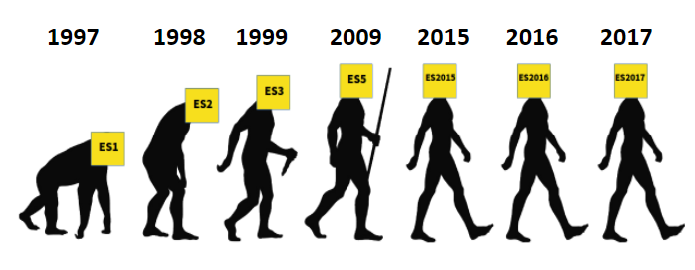

Slide 4
New features in ES6
let, const and block scope
Arrow functions
Default parameters
Spread / Rest operator
Octal and binary literals
Destructuring arrays and objects
The super keyword for objects
Template literals
for ... of vs for ... in
Map and WeakMap
Set and WeakSet
Classes in ES6
Symbol data type
Iterators
Generators
Promises

Slide 5
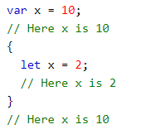
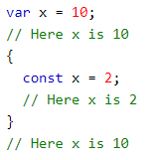
let, const and block scope
The let keyword allows you to declare variables with a limited scope - only for the block {...} in which the declaration takes place.
Another form of declaring a variable with block scope is the const keyword. It is intended to declare variables (constants) whose values are read-only.

Slide 6
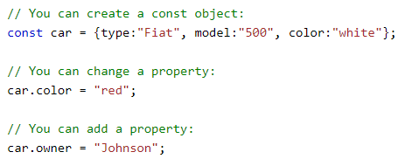
Things to remember about let/const
When it comes to hoisting let and const variables, their behavior is different from the traditional var and function behavior. Both let and const do not exist before their
The scope of let and const is the closest block.
In const, a value must be assigned simultaneously with the variable declaration.
Const does NOT define a constant value. It defines a constant reference to a value. Because of this, we cannot change constant primitive values, but we can change the properties of constant objects.

Slide 7
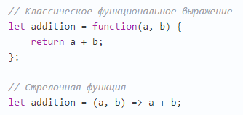
Arrow functions
Arrow functions are abbreviations of functions in ES6. An arrow function consists of a list of parameters (...) followed by the => sign and the body of the function.
Arrow functions don't just make code shorter. They are closely related to the this keyword and context binding.
The behavior of arrow functions with the this keyword is different from the behavior of regular functions with this. Each function in JavaScript defines its own this context, but inside arrow functions this value is the same as outside (arrow functions do not have their own this).

Slide 8
They are of two types:
1. Without braces: (... args) => expression - the right side of the expression: the function executes it and returns the result.
2. With curly brackets: (... args) => {body} - the brackets allow us to write multi-line instructions inside a function, but you must specify the return directive to return a value.
Also, arrow function:
Do not have arguments.
Cannot be called with new.
They also don't have super.

Slide 9
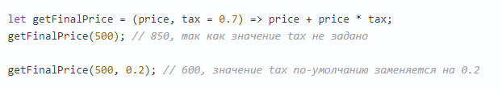
Default parameters
ES6 allows you to set default parameters when declaring a function.
Here is a simple example:

Slide 10
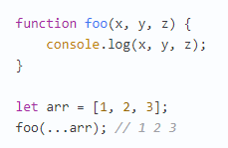
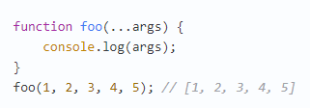
Spread / Rest operator
... the operator is called spread or rest, depending on how and where it is used.
When used in any iterable object, this operator “splits” it into individual elements:
Another common use of the operator ... is to combine a set of values into a single array. In this case, the operator works as "rest"

Slide 11
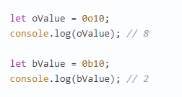
Octal and binary literals
ES6 introduces new support for octal and binary literals.
Adding 0o or 0O to the beginning of the number converts it to an octal number system (similarly, 0b or 0B converts it to a binary number system). Let's look at the following code:

Slide 12
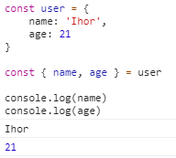
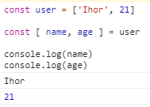
Destructuring arrays and objects
Destructuring helps to avoid using auxiliary variables when interacting with objects and arrays.

Slide 13
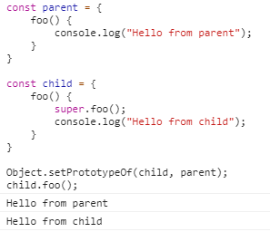
The super keyword for objects
ES6 allows you to use the super method in (classless) objects with prototypes.
Here is a simple example:

Slide 14

Template literals
ES6 provides an easier way to insert the value of a variable or the result of an expression (called "interpolation"), which is calculated automatically.

Slide 15
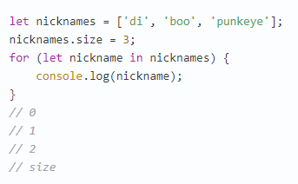
for...in
for ... in is used to loop through all enumerable properties of an object.

Slide 16
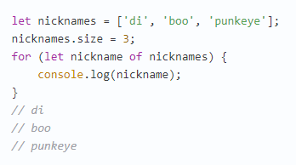
for...of
for ... of is used to iterate over iterable objects, for example, arrays.

Slide 17
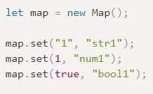
Map
In fact, we use "Map" in JavaScript all the time. Each object can be represented as a special case of Map.
Map is a key / value collection, just like Object. But the main difference is that Map allows you to use keys of any type.
Methods and properties:
new Map () - creates a collection.
map.set (key, value) - writes the value value by the key key.
map.get (key) - returns the value by key or undefined if the key key is missing.
map.has (key) - returns true if the key key is present in the collection, otherwise false.
map.delete (key) - deletes an element by the key key.
map.clear () - clears the collection of all elements.
map.size - returns the current number of elements.

Slide 18
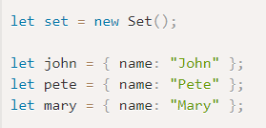

Set
The Set object is a special type of collection: a “set” of values ​​(without keys), where each value can appear only once.
His main methods are:
new Set (iterable) - creates a Set, and if an iterable object (usually an array) was provided as an argument, then copies its values ​​to the new Set.
set.add (value) - adds a value (if it already exists, it does nothing), returns the same set object.
set.delete (value) - deletes a value, returns true if value was in the set at the time of the call, otherwise false.
set.has (value) - returns true if the value is present in the set, otherwise false.
set.clear () - removes all available values.
set.size - returns the number of elements in the set.

Slide 19
WeakMap and WeakSet
WeakSet is a special kind of Set that does not prevent the garbage collector from deleting its elements. Same thing - WeakMap for Map.
That is, if a certain object is present only in WeakSet / WeakMap - it is deleted from memory.
This is necessary for those situations where the main place for storing and using objects is somewhere else in the code, but here we want to store “auxiliary” data for them, existing only while the object is alive.

Slide 20
Classes in ES6
ES6 introduced a new syntax for classes. It is worth noting here that the ES6 class is not a new object-oriented inheritance model. This is just syntactic sugar for prototype inheritance in JavaScript.
A class in ES6 is just a new syntax for working with prototypes and constructor functions that we are used to using in ES5.

Slide 21
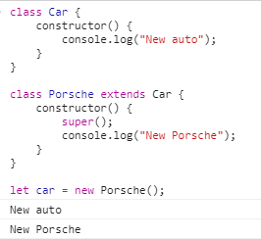
Extends and super in classes
In ES6, the extends keyword allows a descendant class to inherit from its parent class. It is important to note that the constructor of the descendant class must call super ().
Also, in the child class, you can call the method of the parent class using super.ParentMethod name ().

Slide 22

Type symbol
Symbol is a unique and immutable data type introduced in ES6. Symbol's goal is to create a unique identifier that cannot be accessed. You cannot use new with Symbol (...).

Slide 23
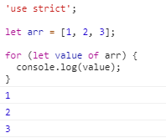
Iterator
An iterator is an object designed to iterate over another object.
Iterable or, in other words, "iterated" objects are those whose contents can be looped through.
For example, the object being searched is an array. But not only him. There are many objects in the browser that are not arrays, but whose contents can be enumerated (for example, a list of DOM nodes).
To loop through such objects, a new loop syntax has been added: for..of.

Slide 24
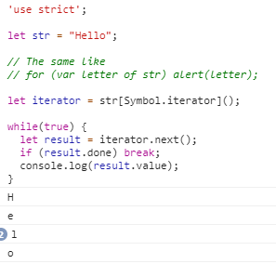
Built-in iterators
JavaScript built-in iterators can also be obtained explicitly, without for..of, by a direct call to Symbol.iterator.
For example, this code gets an iterator for a string and calls it completely “manually”:

Slide 25
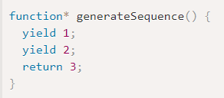
Generators
Generators are created using function-generators function * f (...) {...}.
Inside generators and only inside them is there a yield statement.
The external code and generator exchange intermediate results through next / yield calls.
In modern JavaScript, generators are rarely used. But sometimes they prove useful, because the ability of a function to communicate with the calling code at run time is completely unique. And, of course, to create iterable objects.

Slide 26
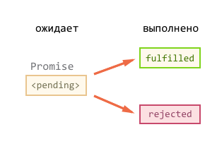
Promises
Promise is a special object that stores its state, the current result (if any) and callbacks.
When creating new Promise ((resolve, reject) => ...), the argument function is automatically launched, which should call resolve (result) on successful execution and reject (error) on error.
The resolve / reject argument (only the first, the rest are ignored) is passed to the handlers at this promise.
Handlers are assigned by calling .then / catch.
To transfer the result from one processor to another, using chaining.

Slide 27


